Slide 1
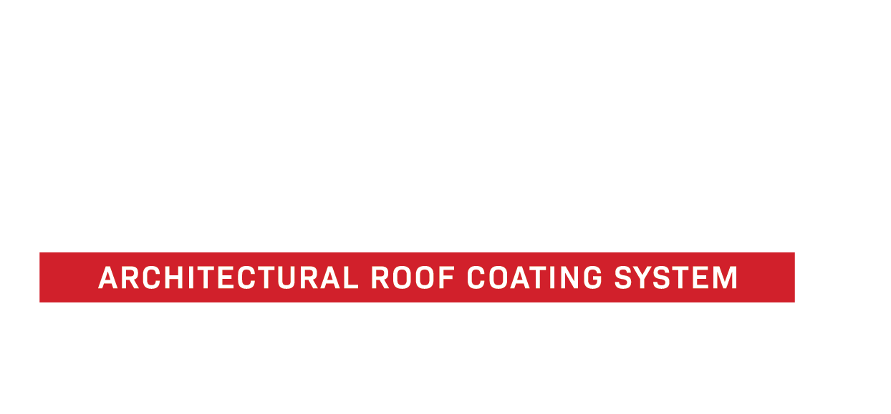
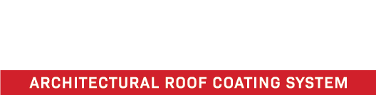
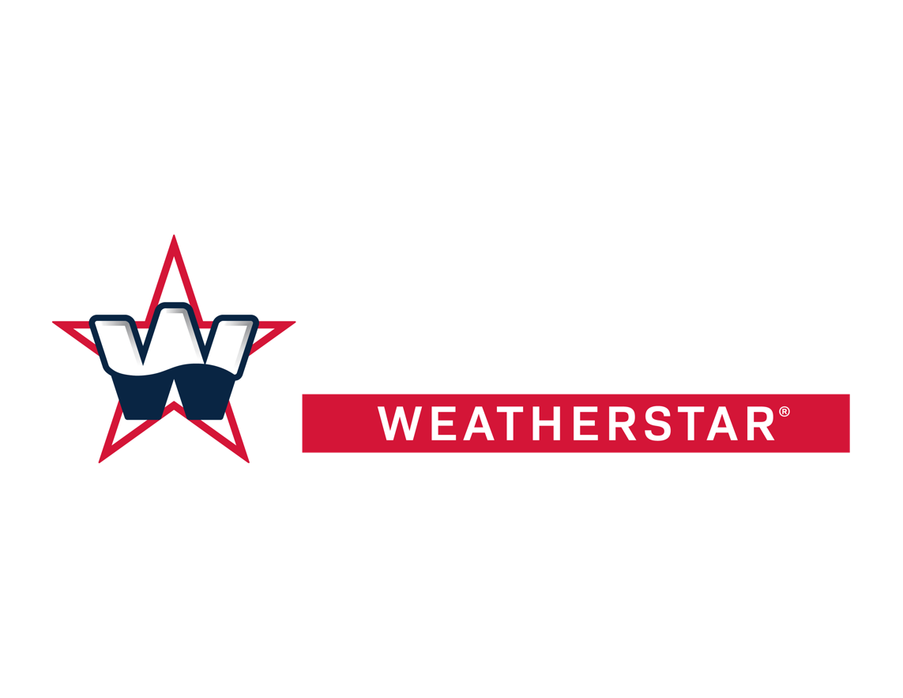
THE ARCHITECTURAL ROOF RESTORATION SOLUTIONS
FLUID-APPLIED ROOF RESTORATION
www.americanweatherstar.com | 800-771-6643

Slide 2
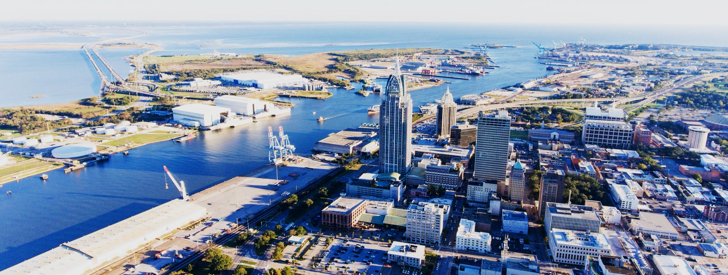
ABOUT AMERICAN WEATHERSTAR
Founded in 2004, American WeatherStar is an established leader in the commercial roofing industry. Based in Mobile, Alabama, we are a full-line supplier of high-quality, energy-efficient, fluid-applied roof restoration systems and products for both flat and metal roofs.
www.americanweatherstar.com
02

Slide 3
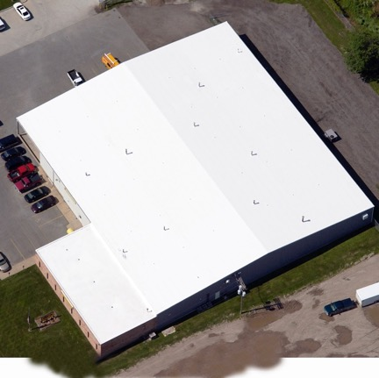
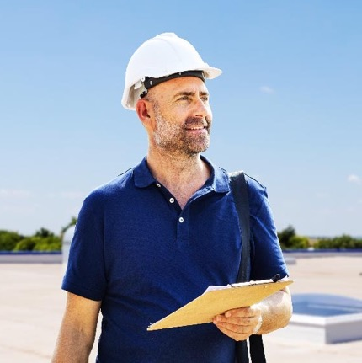
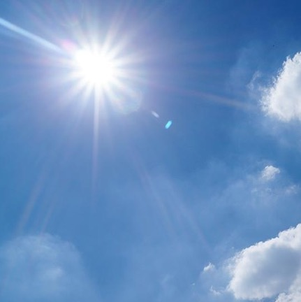
AMERICAN WEATHERSTAR BY THE NUMBERS
500+
475+
85%
More than 500 million square feet of commercial and industrial roofs restored throughout the United States.
A nationwide network of more than 475 approved and platinum level approved commercial roofing contractors.
Our energy-efficient, fluid-applied roof restoration systems reflect up to 85% of the sun’s harmful ultraviolet (UV) rays.
03

Slide 4
WHAT ARE THE MOST COMMON PROBLEMS FOUND IN COMMERCIAL AND INDUSTRIAL METAL ROOFS?
04

Slide 5
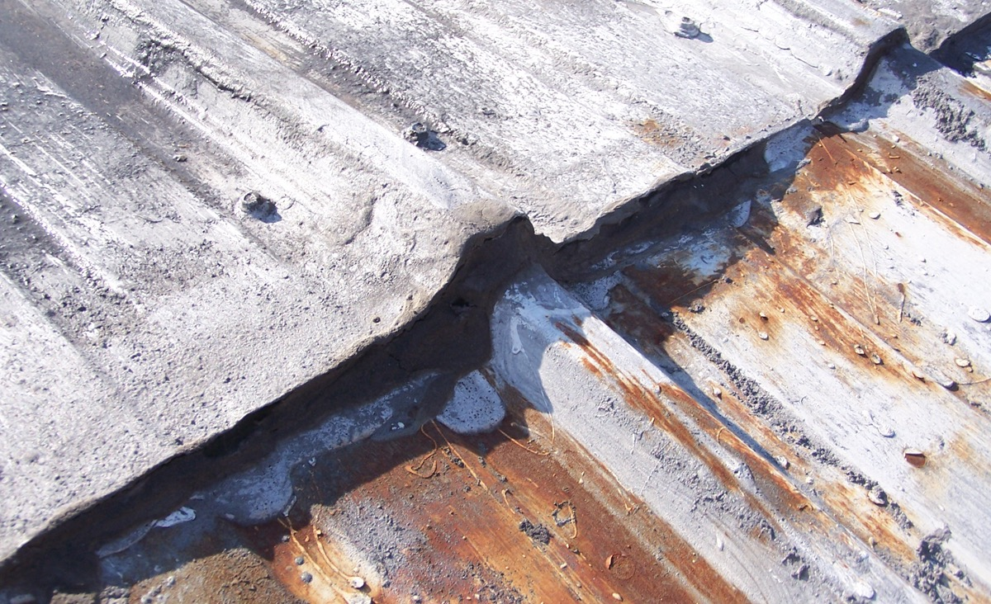
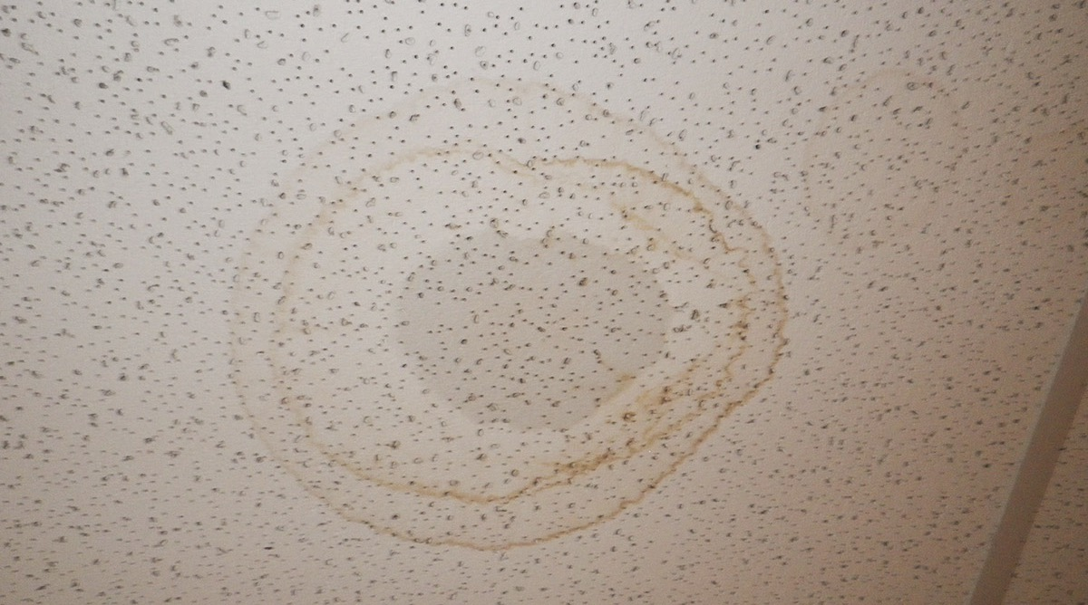
ROOF LEAKS
Roof leaks are a major problem for any type of roof surface—even metal. While most roof leaks are easy to identify, some can materialize in other ways such as mold spots, strong odors, stains/discoloration on walls and ceilings, and of course, puddling water.
It is possible for leaks to be limited to one specific area of your roof, but chances are you have multiple leaks throughout your building. In any case, water entering your building is a big problem and steps should be taken immediately to minimize interior damage.
05

Slide 6
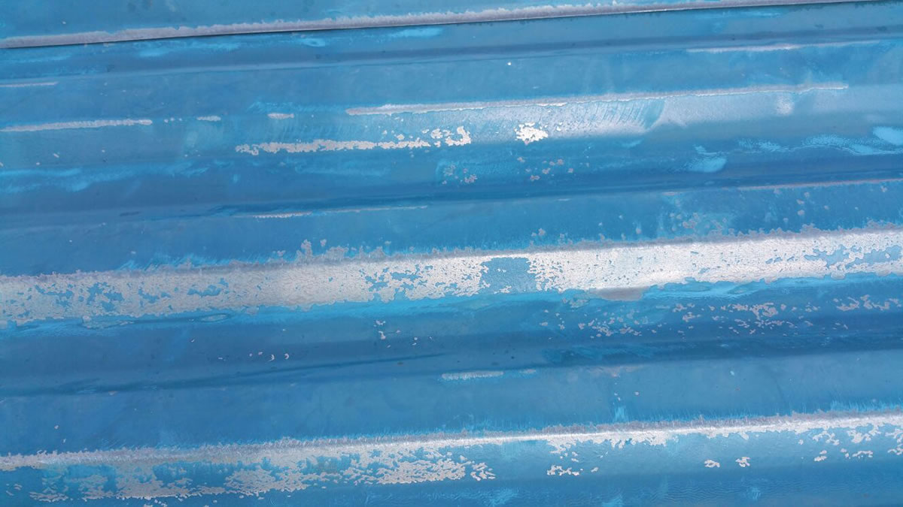
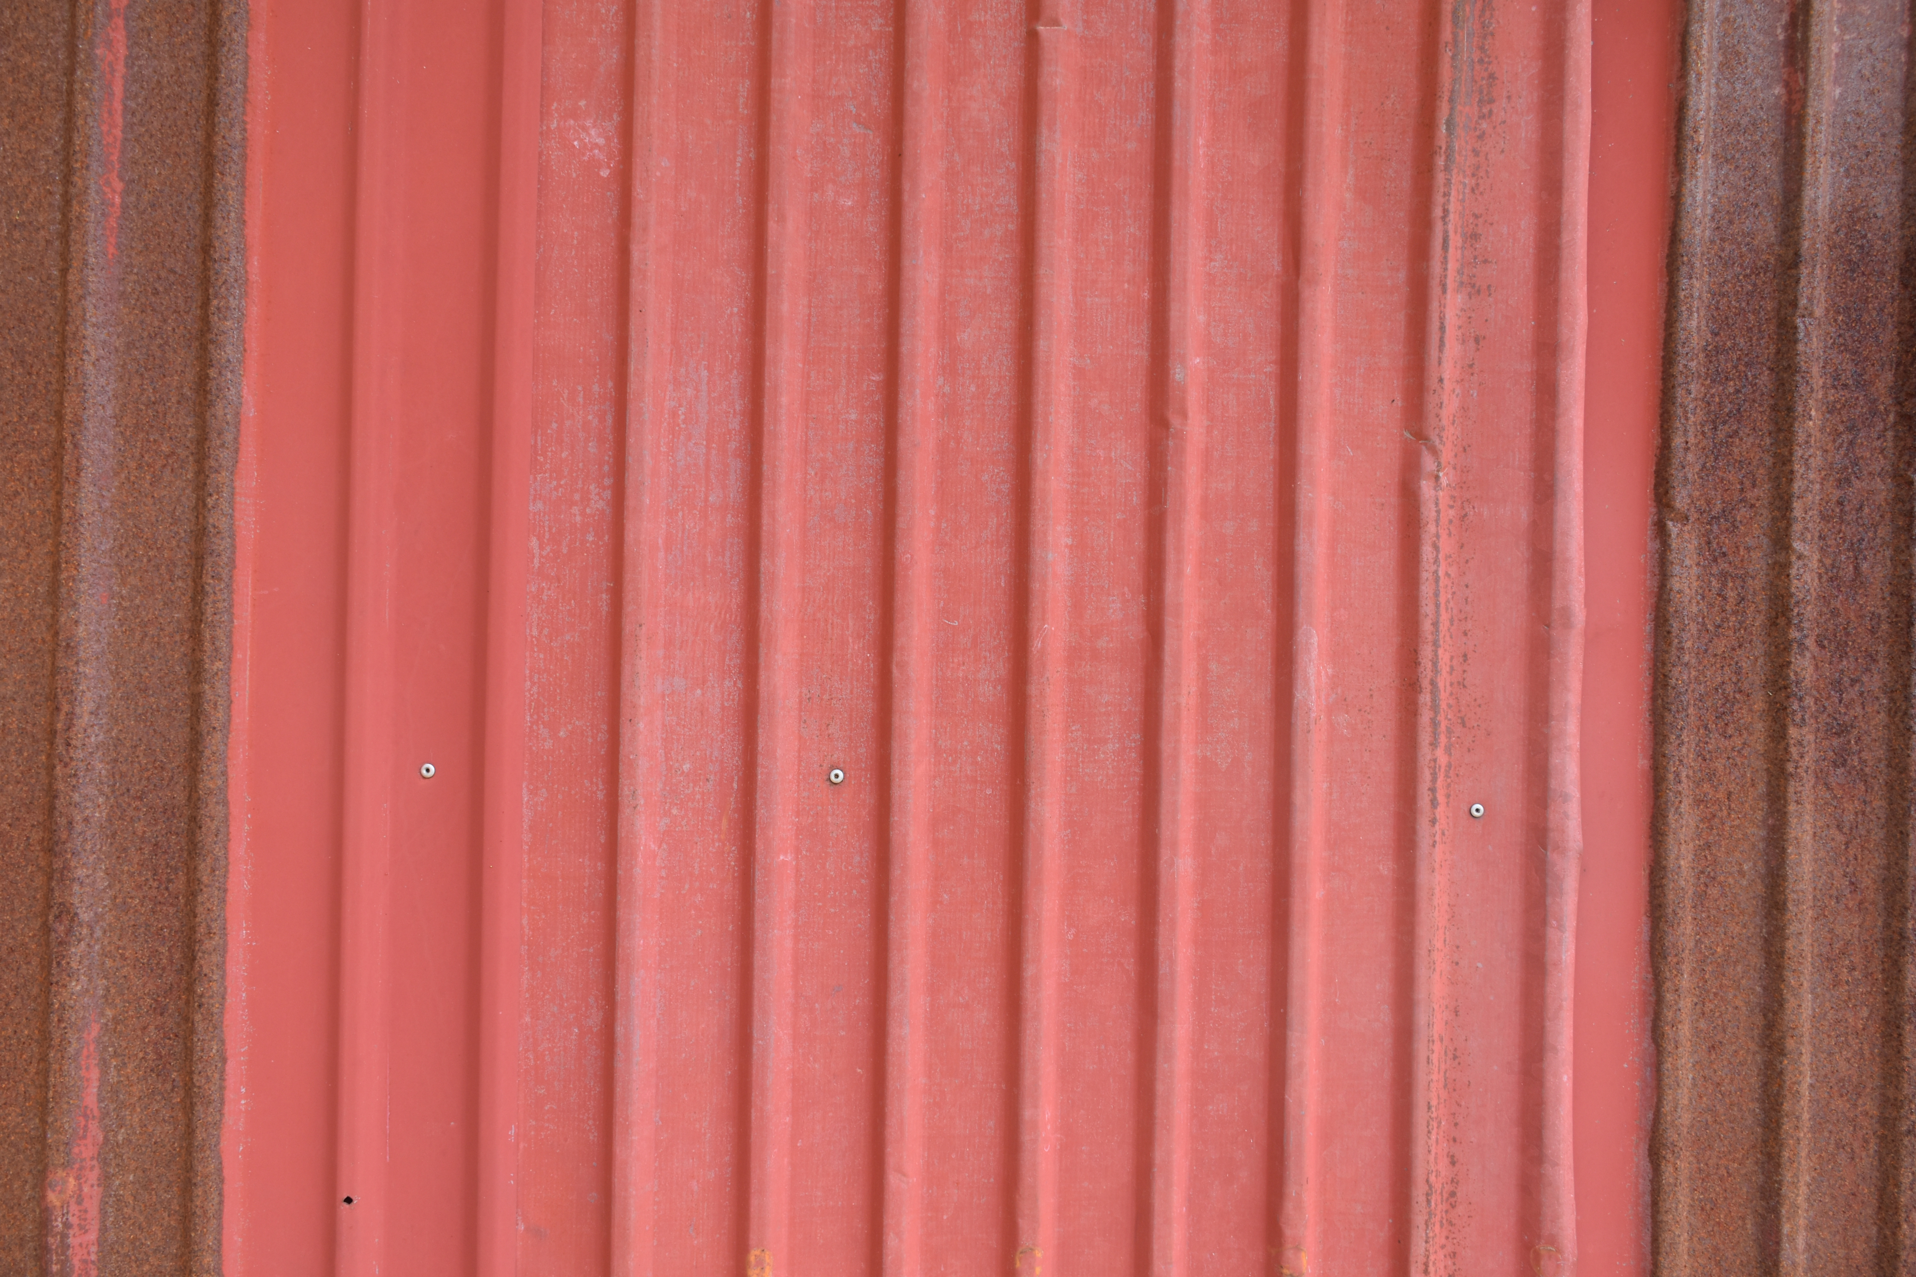
FADING & CHALKING
A metal roof will begin to fade and chalk overtime. Chemicals in the paint break down from excessive sun exposure. UV rays are a major contributing factor, other factors include moisture, salty air, chemicals and pollution in the air.
06

Slide 7
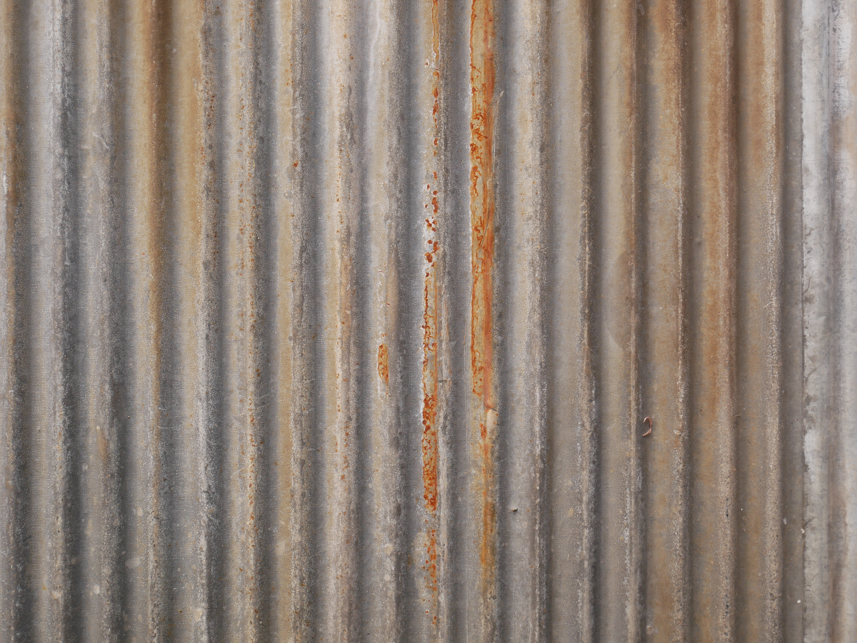
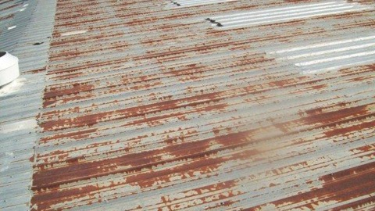
MILD RUST
Rust and corrosion are very common in aging metal roofs. Most metal roofing systems are made of galvanized metal or coated to prevent rust from occurring, but high winds, heavy rain, and the heat generated by direct sunlight can eventually wear the roof's protection away.
Once the onset of rust occurs, corrective action is recommended to restore and protect the roof from further degradation.
07

Slide 8
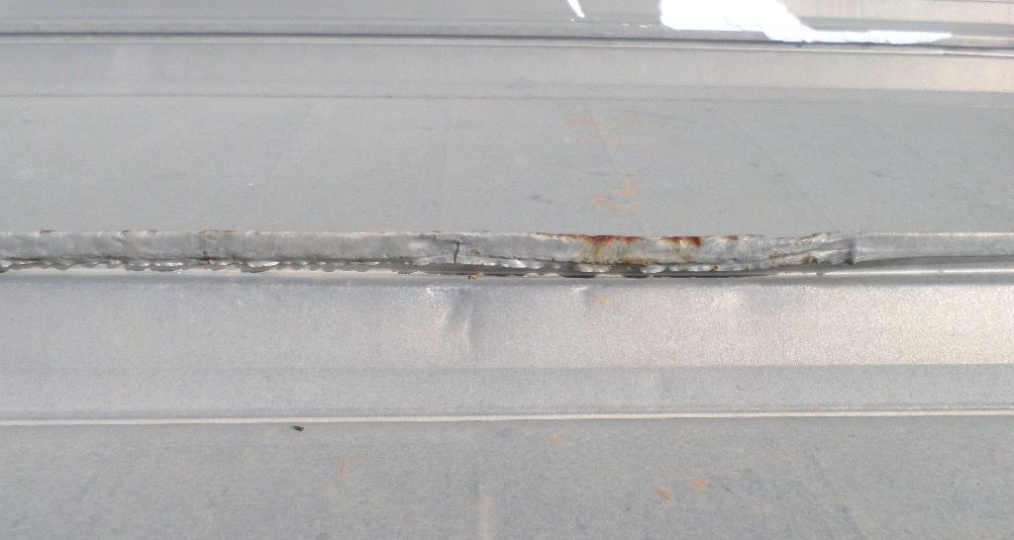
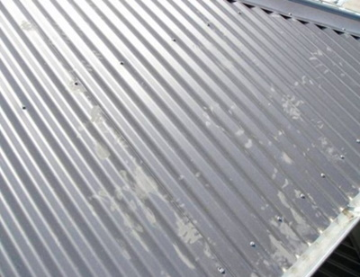
SURFACE ABRASIONS
Just like any other type of commercial roofing substrate, metal roofs are susceptible to various types of damage. The most common types of physical damage include the following: storm damage, damage caused by foot traffic, punctures, denting, scratches, premature discoloration, etc.
08

Slide 9
WHAT OPTIONS DO YOU HAVE WHEN IT COMES TO YOUR COMMERCIAL OR INDUSTRIAL METAL ROOF?
9

Slide 10
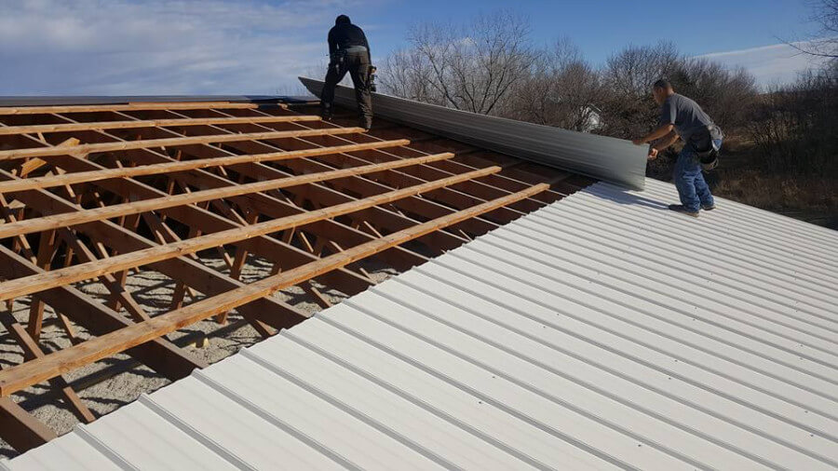
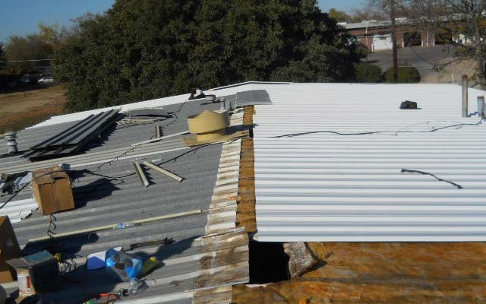
ROOF REPLACEMENT
In some cases, a full roof replacement may be the only option for a building owner, but there are a number of factors to consider before committing to such a costly and extensive endeavor. For this reason, we recommend consulting an American WeatherStar approved contractor to explore all of your options.
10

Slide 11
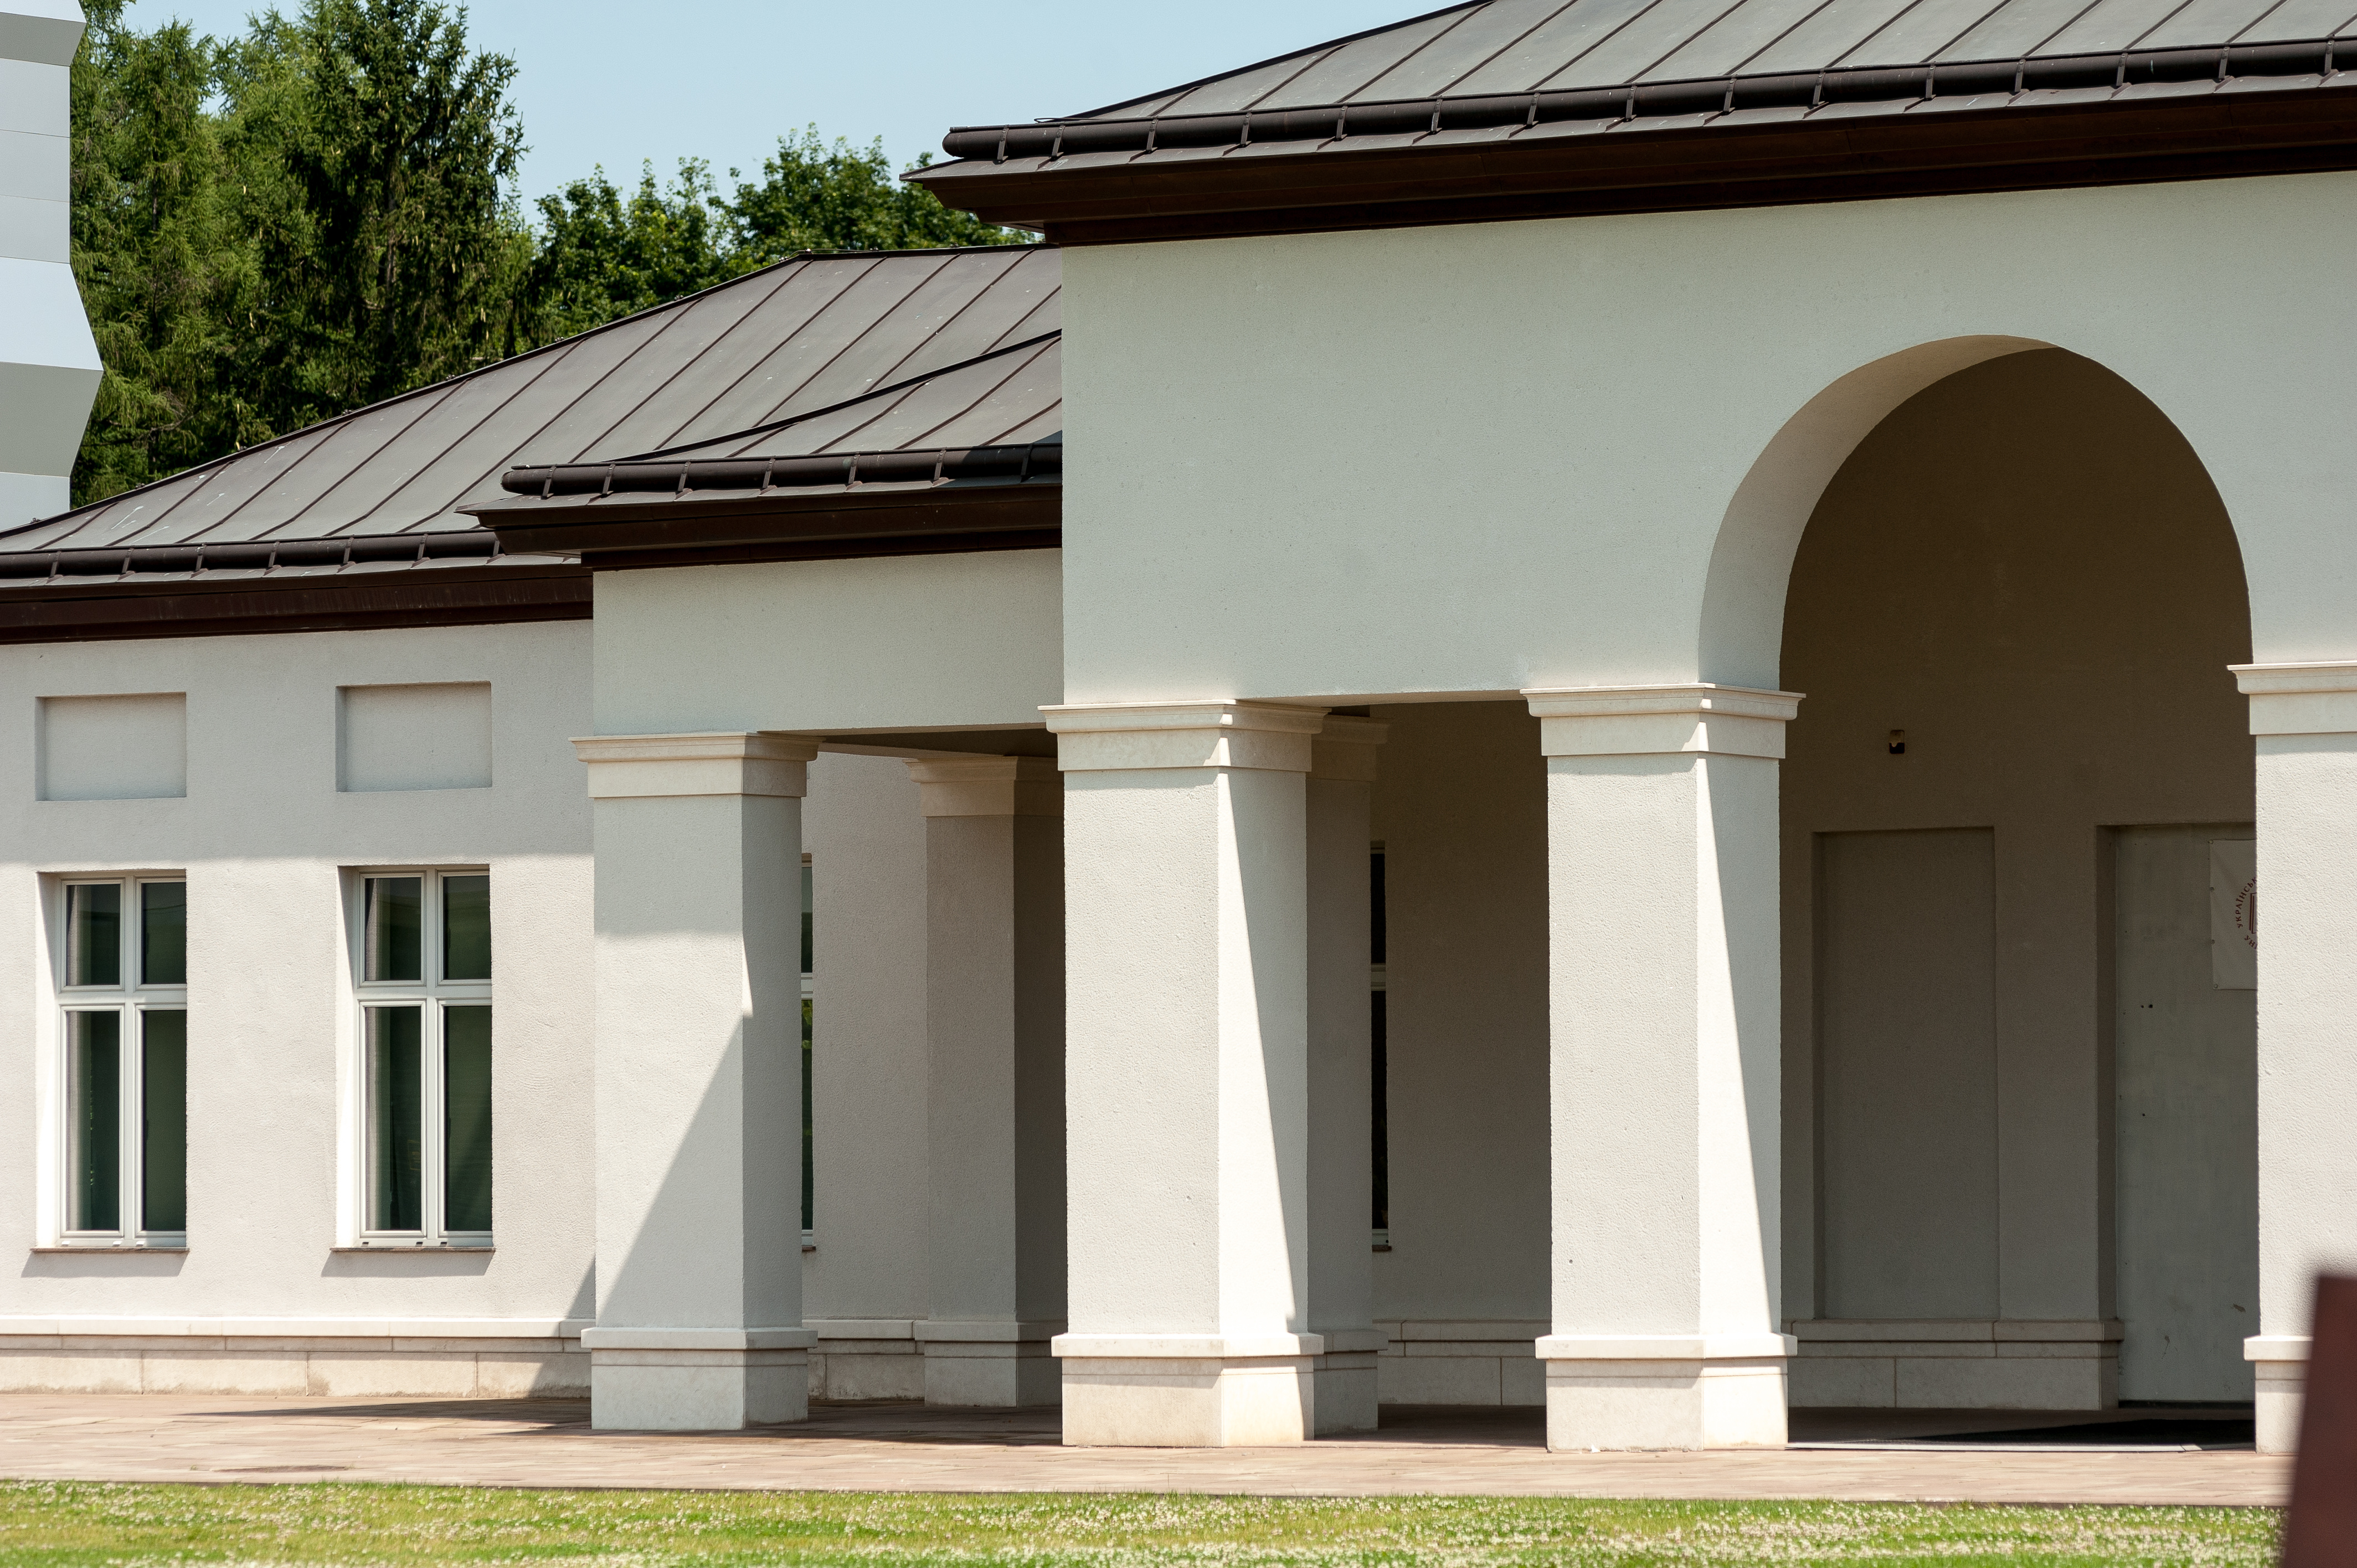
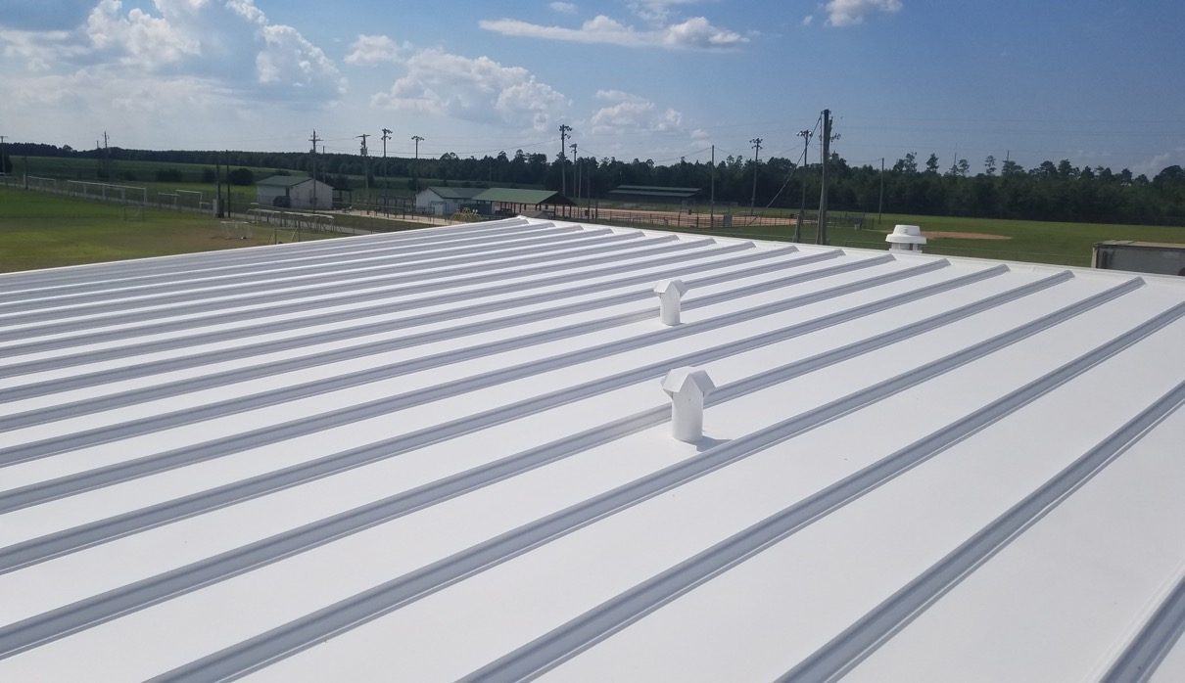
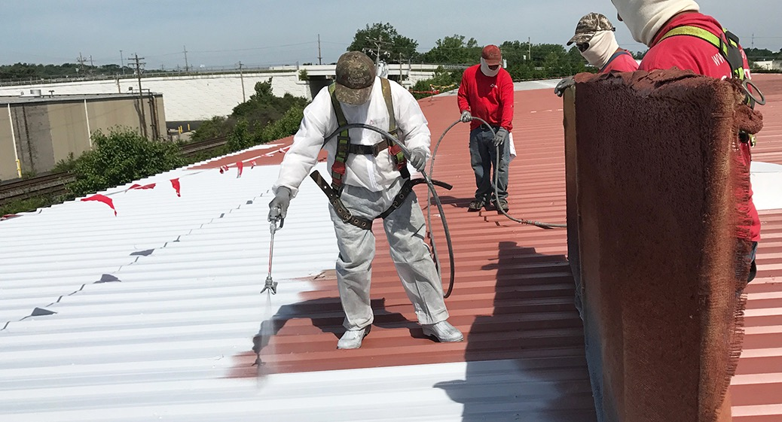
ROOF RESTORATION
For building owners and facility mangers experiencing problems with their metal roofs, fluid-applied roof restoration is a more sustainable and cost-effective alternative to roof replacement. These systems not only stop leaks, they increase energy savings, reduce internal building temperatures, and prolong roof life.
11

Slide 12


REPLACEMENT VS. RESTORATION
Not every metal roof is a candidate to receive a roof restoration system. Depending on the state of the existing roof system, a full roof replacement may be necessary. However, many roof systems can be restored at nearly half the cost of a full replacement. There are other factors to consider as well:
ROOF REPLACEMENT
ROOF RESTORATION
More expensive
High labor costs
High material costs/volume
More intrusive to business
Less sustainable
Long-term job duration
Less expensive (1/2 the cost)
Low labor costs
Low material costs/volume
Less intrusive to business
More sustainable
Short-term job duration
12
12

Slide 13
ARCHITECTURAL ROOF RESTORATION SOLUTIONS
13

Slide 14
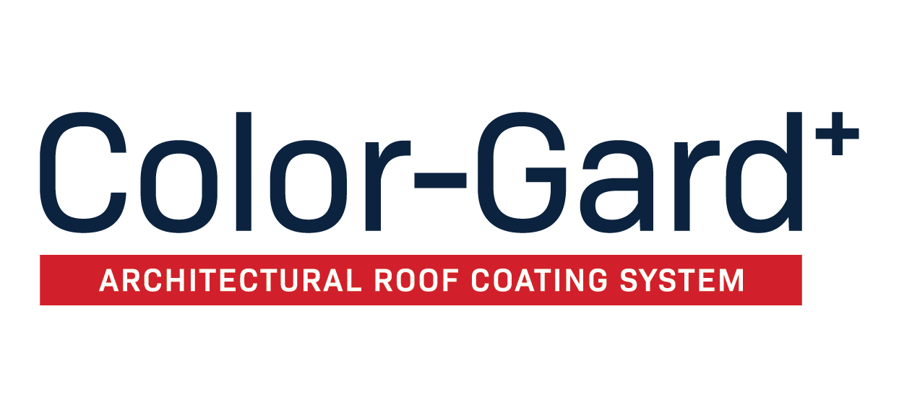
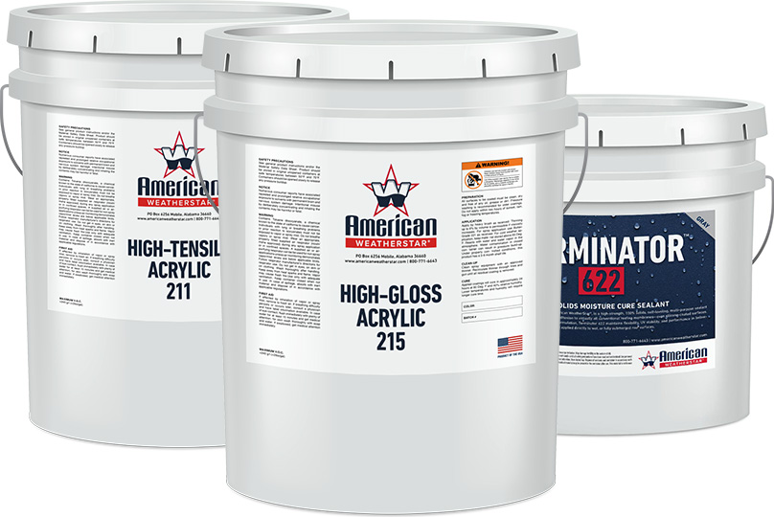
The Color-Gard system is an architectural color + waterproofing roof restoration system. This highly-advanced coating system provides commercial metal roof surfaces with a beautiful, low-build, architectural finish and contributes unsurpassed reflectivity, weatherability, abrasion-resistance, colorfastness, and resistance to dirt pick-up.
14

Slide 15
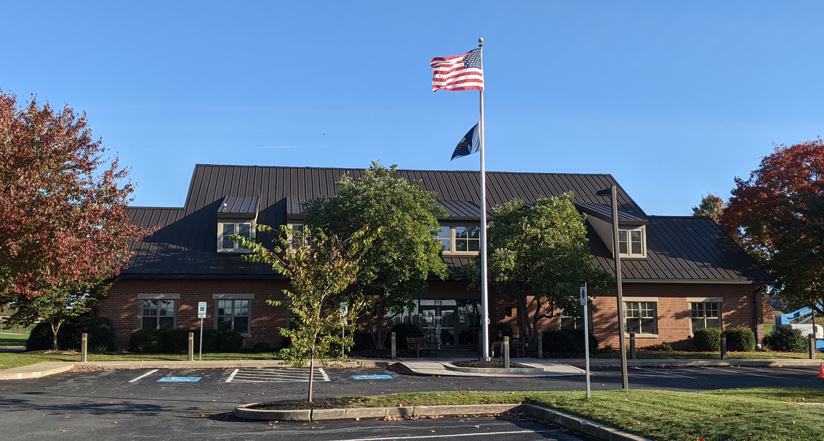
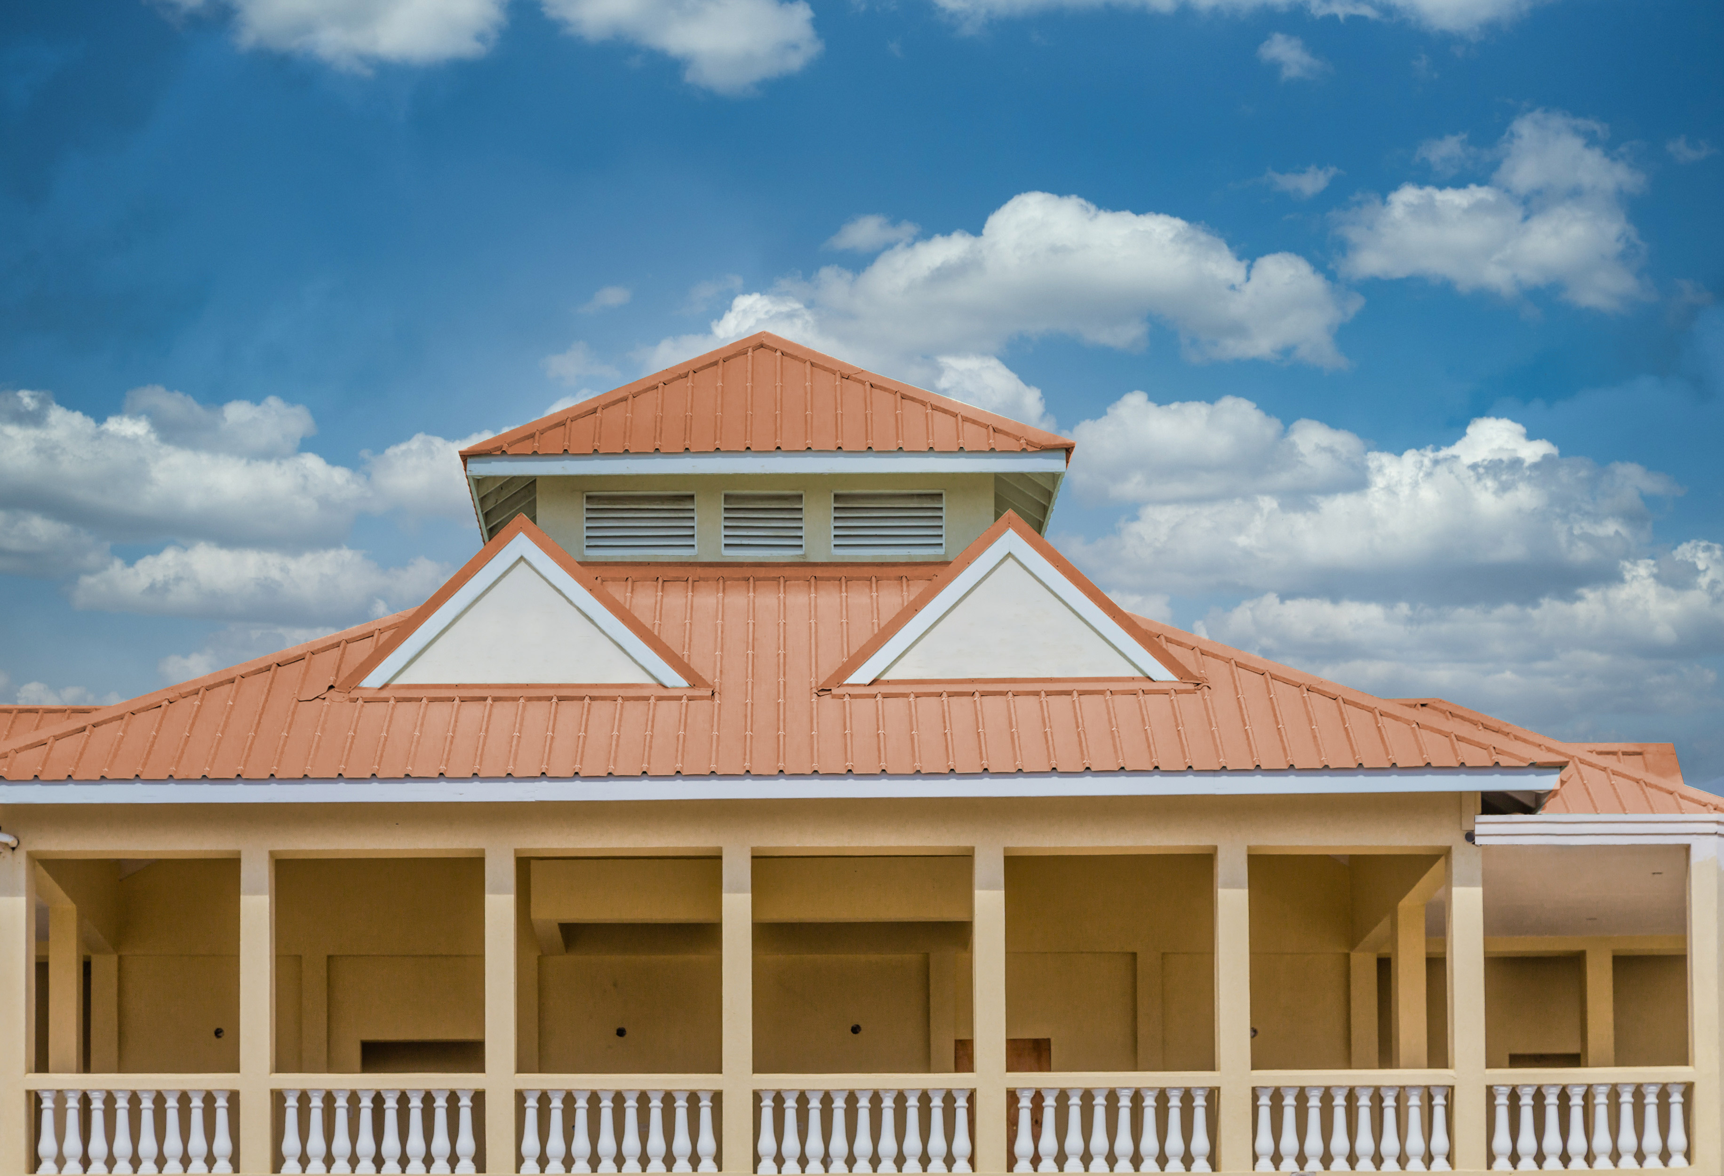
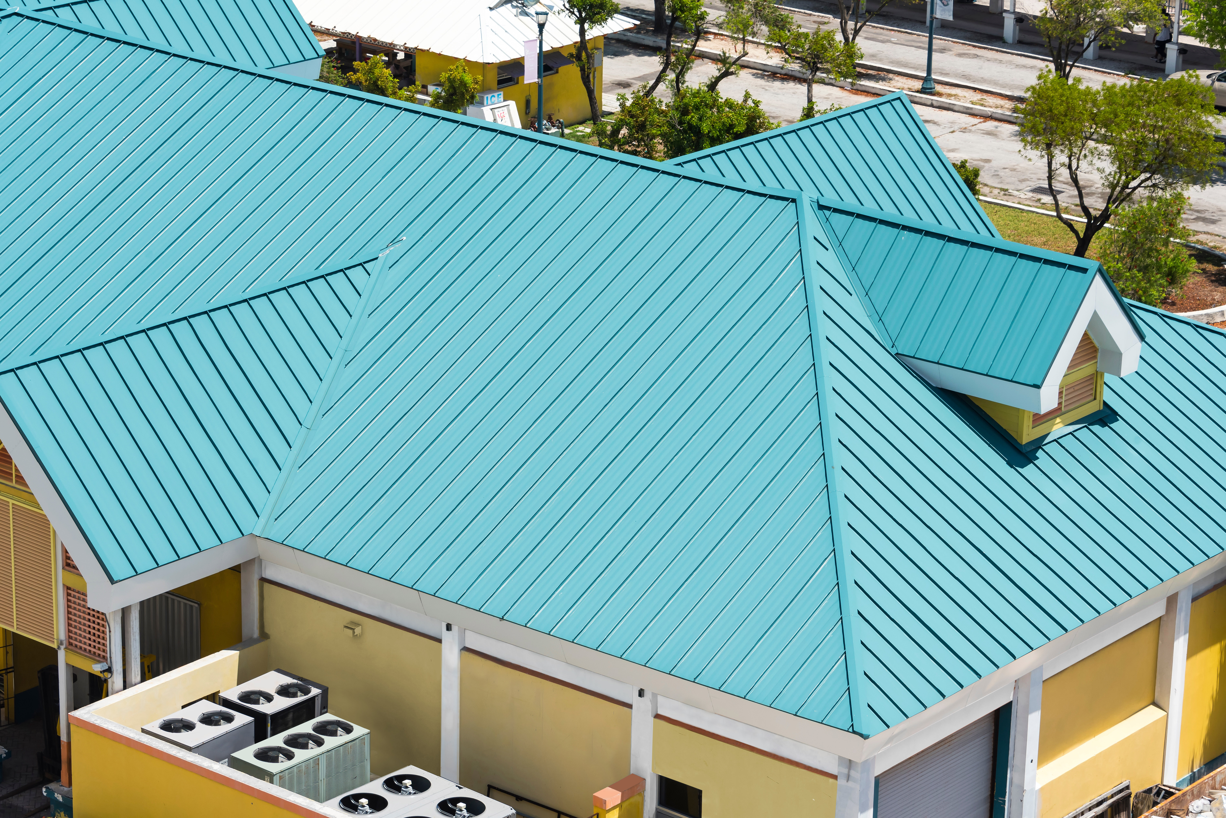
SYSTEM BENEFITS
Stops leaks and vastly improves roof performance
Provides a beautiful, long-lasting, architectural finish
Substantially reduces maintenance
Extends service life by restoring the existing metal roof surface
Superior elongation, tensile strength, and color-retention
Color-Gard+ cures to form a seamless, watertight membrane
Eliminates the onset of rust and corrosion
Long-term warranty options available for Color-Gard+
Minimal interruption to business
10-year color-fade warranty
15

Slide 16
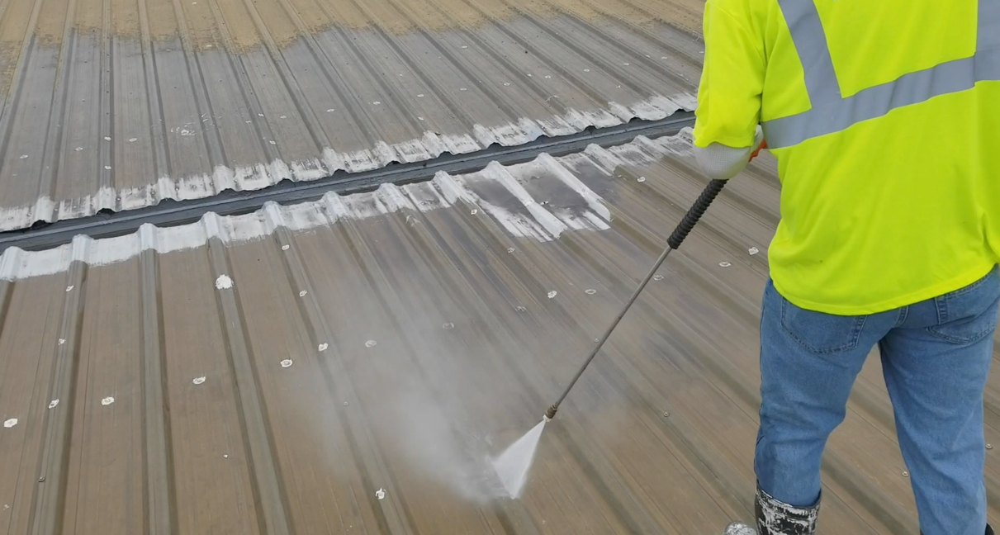
APPLICATION PROCESS
STEP 1: PREP & PRIME
First, the roof surface is thoroughly pressure washed to ensure all dirt and debris are removed. Any problem areas found during surface preparation are addressed before any coating products are applied.
In some cases, a primer application of Red Oxide Rust Primer 912 may be necessary.
16

Slide 17
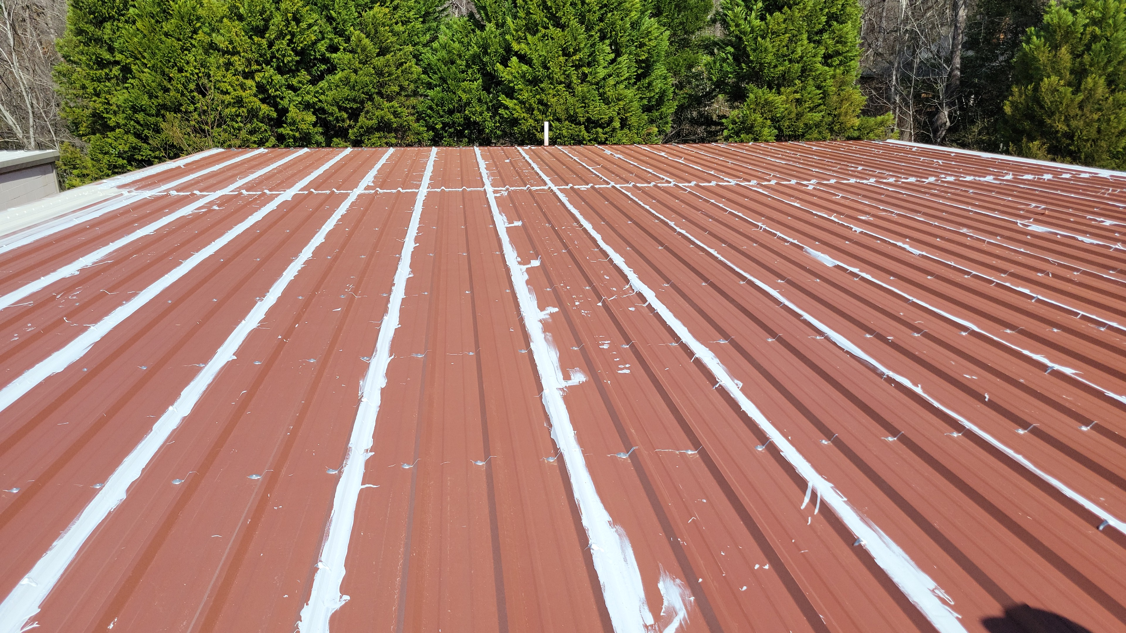
APPLICATION PROCESS
STEP 2: WATERPROOFING
All seams and flashing details are coated with Terminator 622 a thick “rubber-like” mastic to help withstand the expansion and contraction of the roof structure.
17

Slide 18
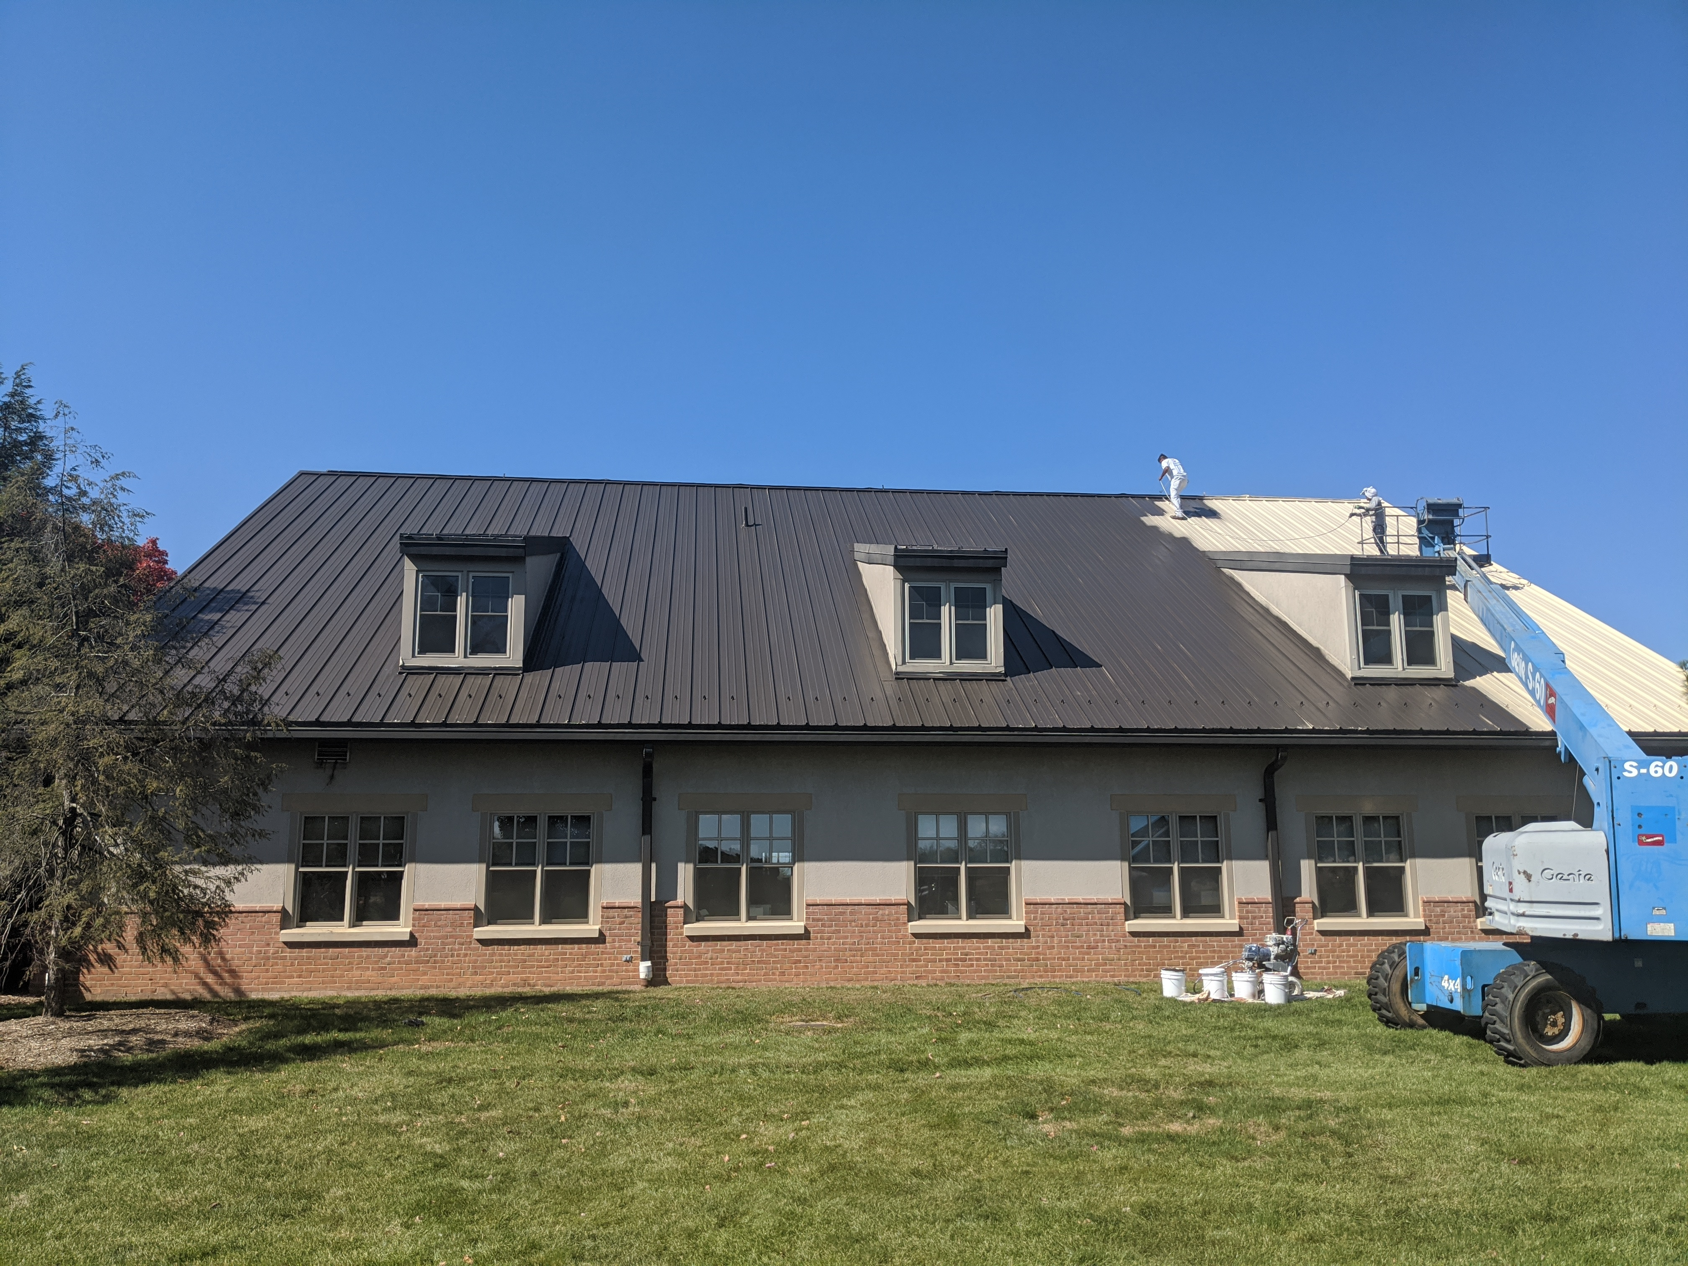
APPLICATION PROCESS
STEP 3: BASE COAT APPLICATION
A base coat of High-Tensile Acrylic 211 provides excellent color retention and delivers maximum adhesion to metal roof substrates.
18

Slide 19

APPLICATION PROCESS
STEP 4: TOP COAT APPLICATION
A top coat of High-Gloss Acrylic 215 provides a low-build, flexible, and aesthetic finish with superior weatherability, abrasion resistance, and colorfastness.
19

Slide 20
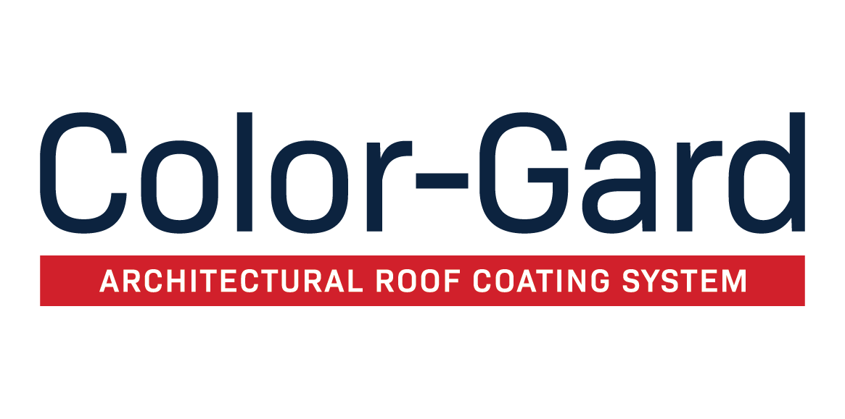
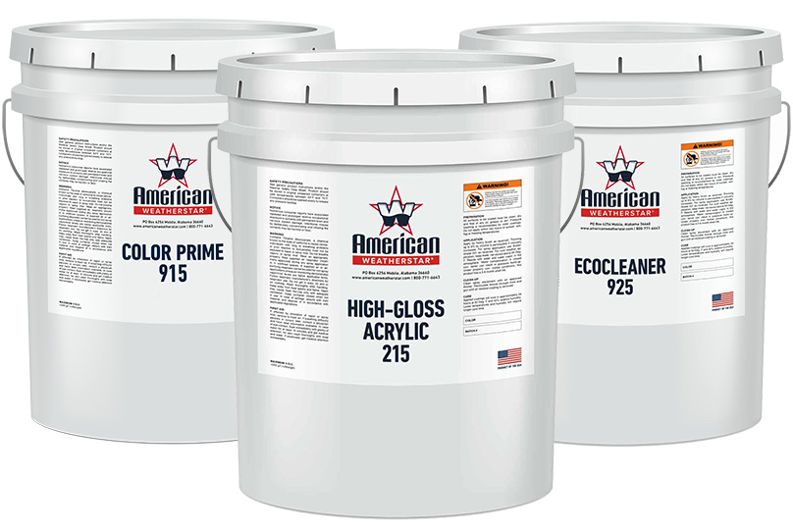
The Color-Gard system is an architectural color roof restoration system. This highly-advanced coating system provides commercial metal roof surfaces with a beautiful, low-build, architectural finish and contributes unsurpassed reflectivity, weatherability, abrasion-resistance, colorfastness, and resistance to dirt pick-up.
20

Slide 21
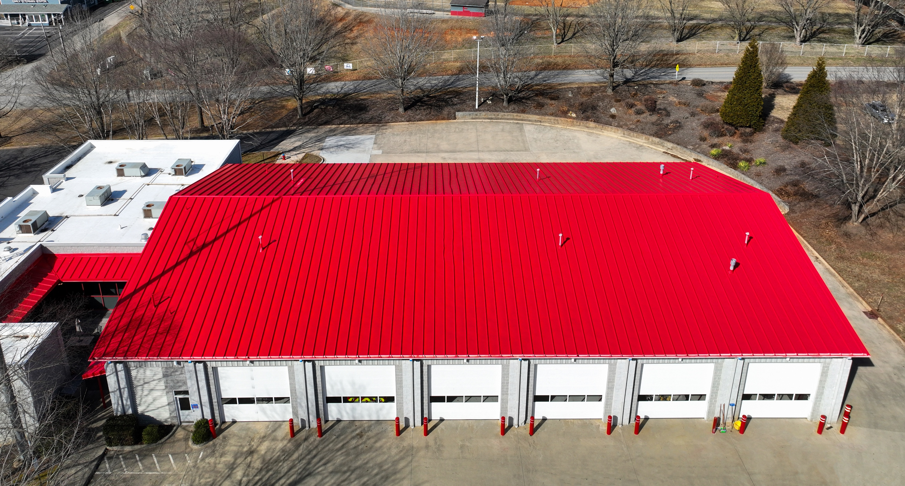
SYSTEM BENEFITS
Vastly improves roof performance
Provides beautiful, long-lasting, architectural finish
Substantially reduces moisture
Extends service life by restoring the existing metal roof surface
Superior elongation tensile strength, and color retention
Eliminates the onset of rust and corrosion
Minimal interruption to business
10-year color-fade warranty
21

Slide 22
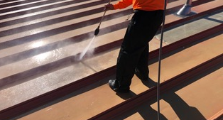
APPLICATION PROCESS
STEP 1: SURFACE PREPARATION
First, the roof surface is thoroughly pressure washed to ensure all dirt and debris are removed. Any problem areas found during surface preparation are addressed before any coating products are applied.
22

Slide 23
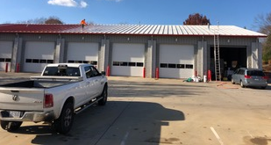
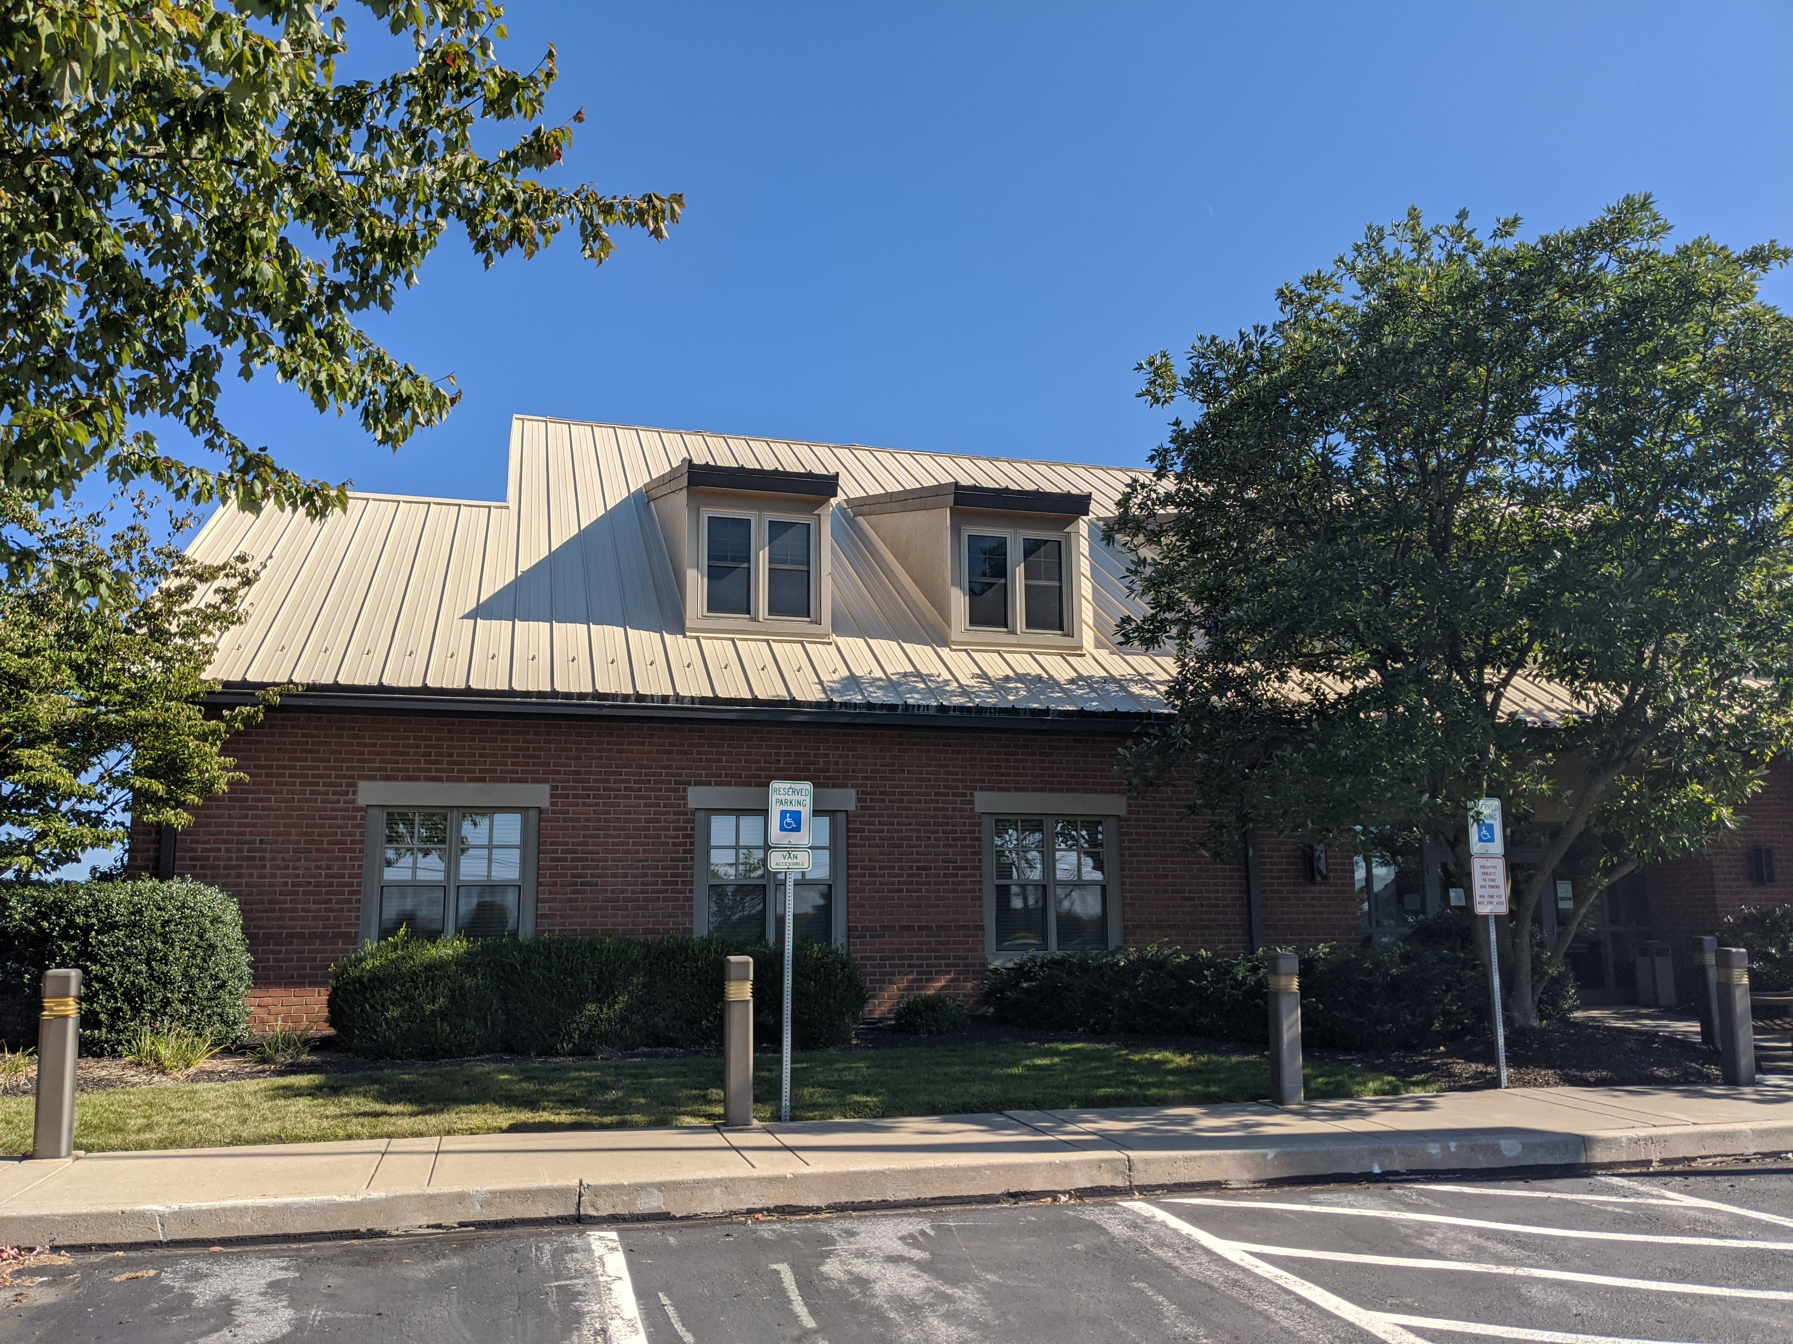
APPLICATION PROCESS
STEP 2: PRIMER
Color Prime 915 provides an optimal surface for the subsequent coating applications. In some cases, a primer application of Red Oxide Rust Primer 912 may be necessary.
23

Slide 24
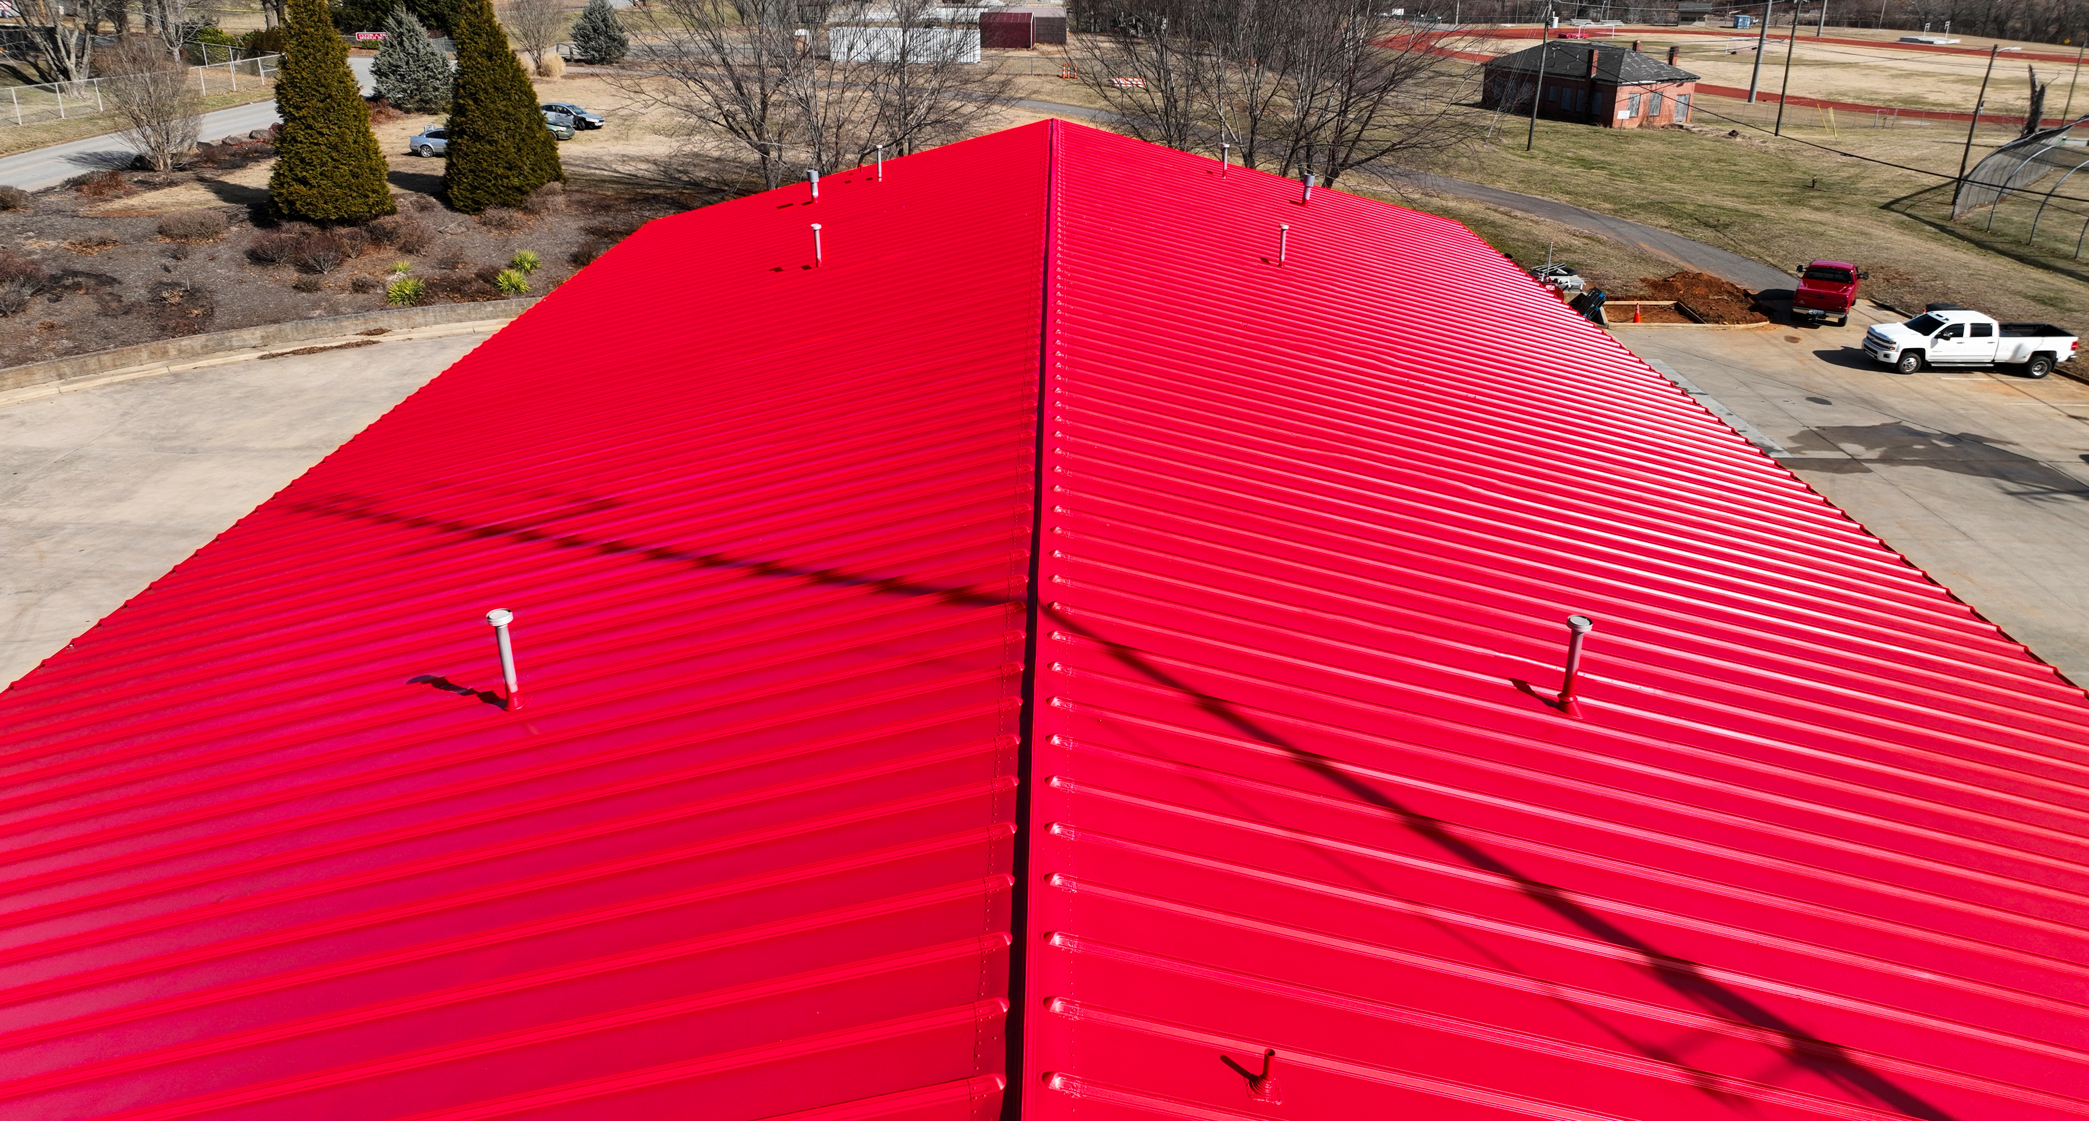
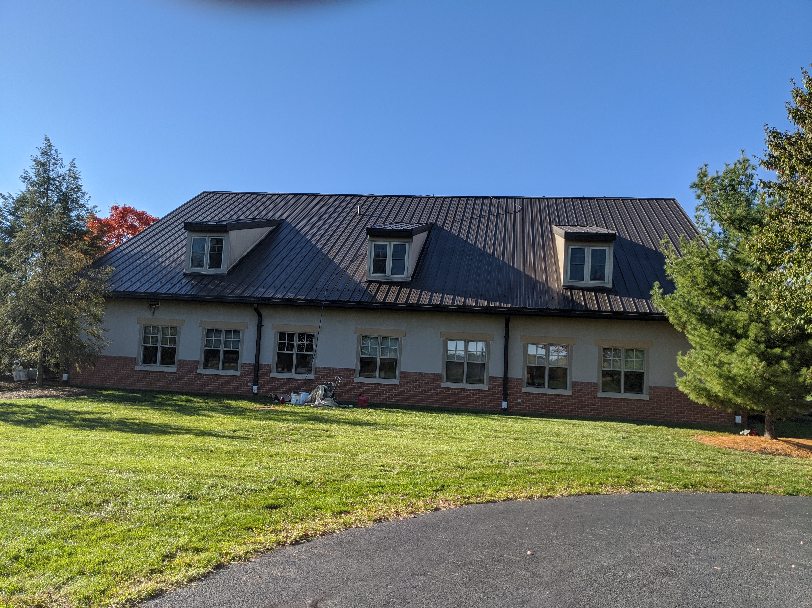
APPLICATION PROCESS
STEP 3: BASE COAT APPLICATION
To ensure uniform dry mil thickness, a base coat of High-Gloss Acrylic 215 (custom color) is applied to the roof surface.
24

Slide 25

APPLICATION PROCESS
STEP 4: TOP COAT APPLICATION
A top coat of High-Gloss Acrylic 215 provides a low-build, flexible, and aesthetic finish with superior weatherability, abrasion resistance, and colorfastness.
25

Slide 26
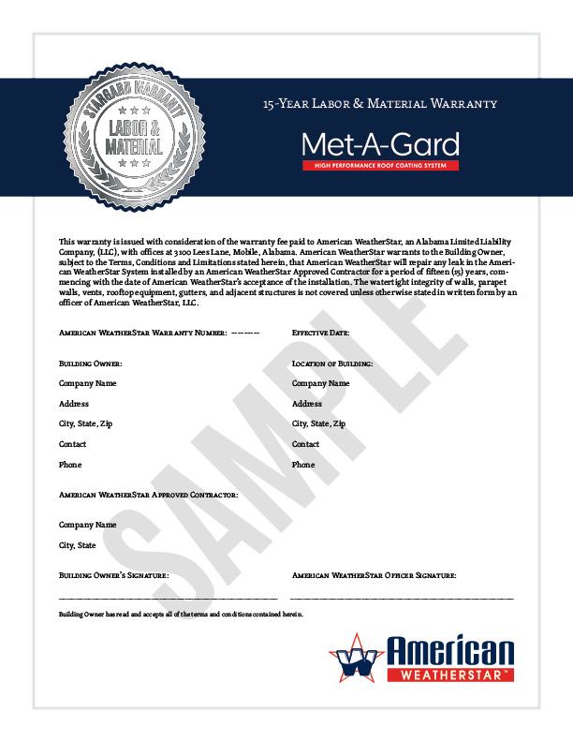
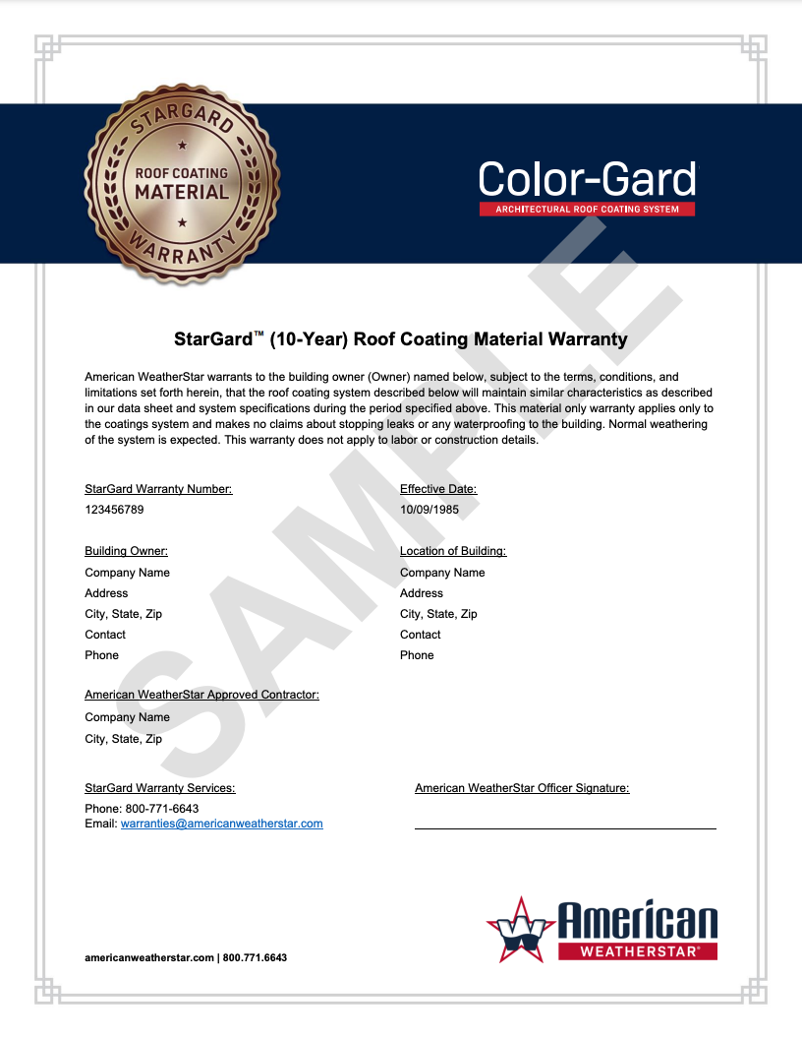
SUSTAINABLE
WARRANTY OPTIONS
American WeatherStar offers a NDL System Material warranty for most of its roof restoration systems when installed by an American WeatherStar approved contractor. Contact your American WeatherStar approved contractor to discuss your options.
10-year color-fade warranty
10, 15 or 20-year warranty options
Renewable, transferable, and extendable
CLICK HERE TO LEARN MORE
26

Slide 27
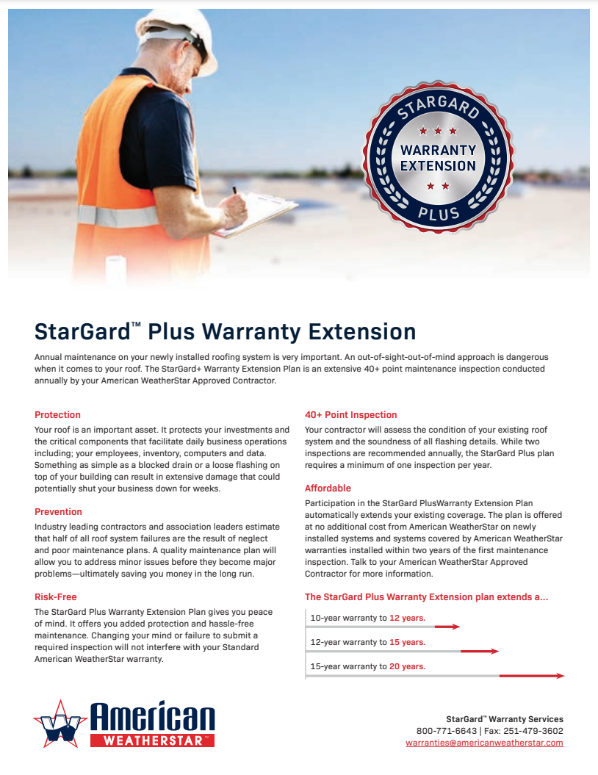
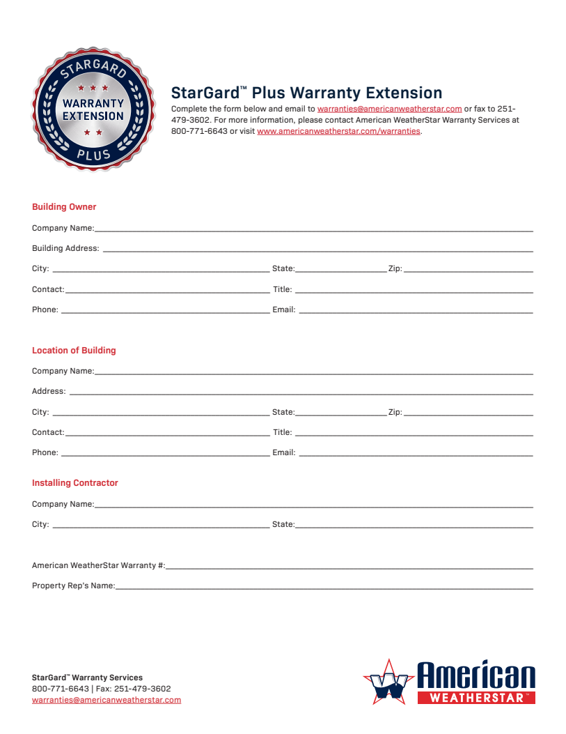
STARGARD+ WARRANTY
EXTENSION PLAN
Annual maintenance on your newly installed roofing system is very important. An out-of-sight-out-of-mind approach is dangerous when it comes to your roof. The StarGard+ Warranty Extension Plan is an extensive 40+ point maintenance inspection conducted annually by your American WeatherStar approved contractor.
40+ point inspection
Risk-free and affordable
Added protection and prevention
CLICK HERE TO LEARN MORE
27

Slide 28
HELPFUL LINKS
INFORMATIONAL LINKS
Color-Gard+ Quick Spec
Color-Gard Quick Spec
10-Year Limited Color Fade Warranty
StarGard Warranty Program
StarGard+ Warranty Extension Plan
PRODUCT DATA SHEETS
EcoCleaner 925
Red Oxide Rust Prime 912
Color Prime 915
Terminator 622
High-Tensile Acrylic 211
High-Gloss Acrylic 215
APPLICATION GUIDELINES
Color-Gard+
Color-Gard
www.americanweatherstar.com | info@americanweatherstar.com | Toll Free: 800-771-6643

