Slide 1
THE PREFERRED ROOF RESTORATION SOLUTION FOR AREAS REGULATED BY STRICT ENVIRONMENTAL STANDARDS.
FLUID-APPLIED ROOF RESTORATION
www.americanweatherstar.com | 800-771-6643

Slide 2
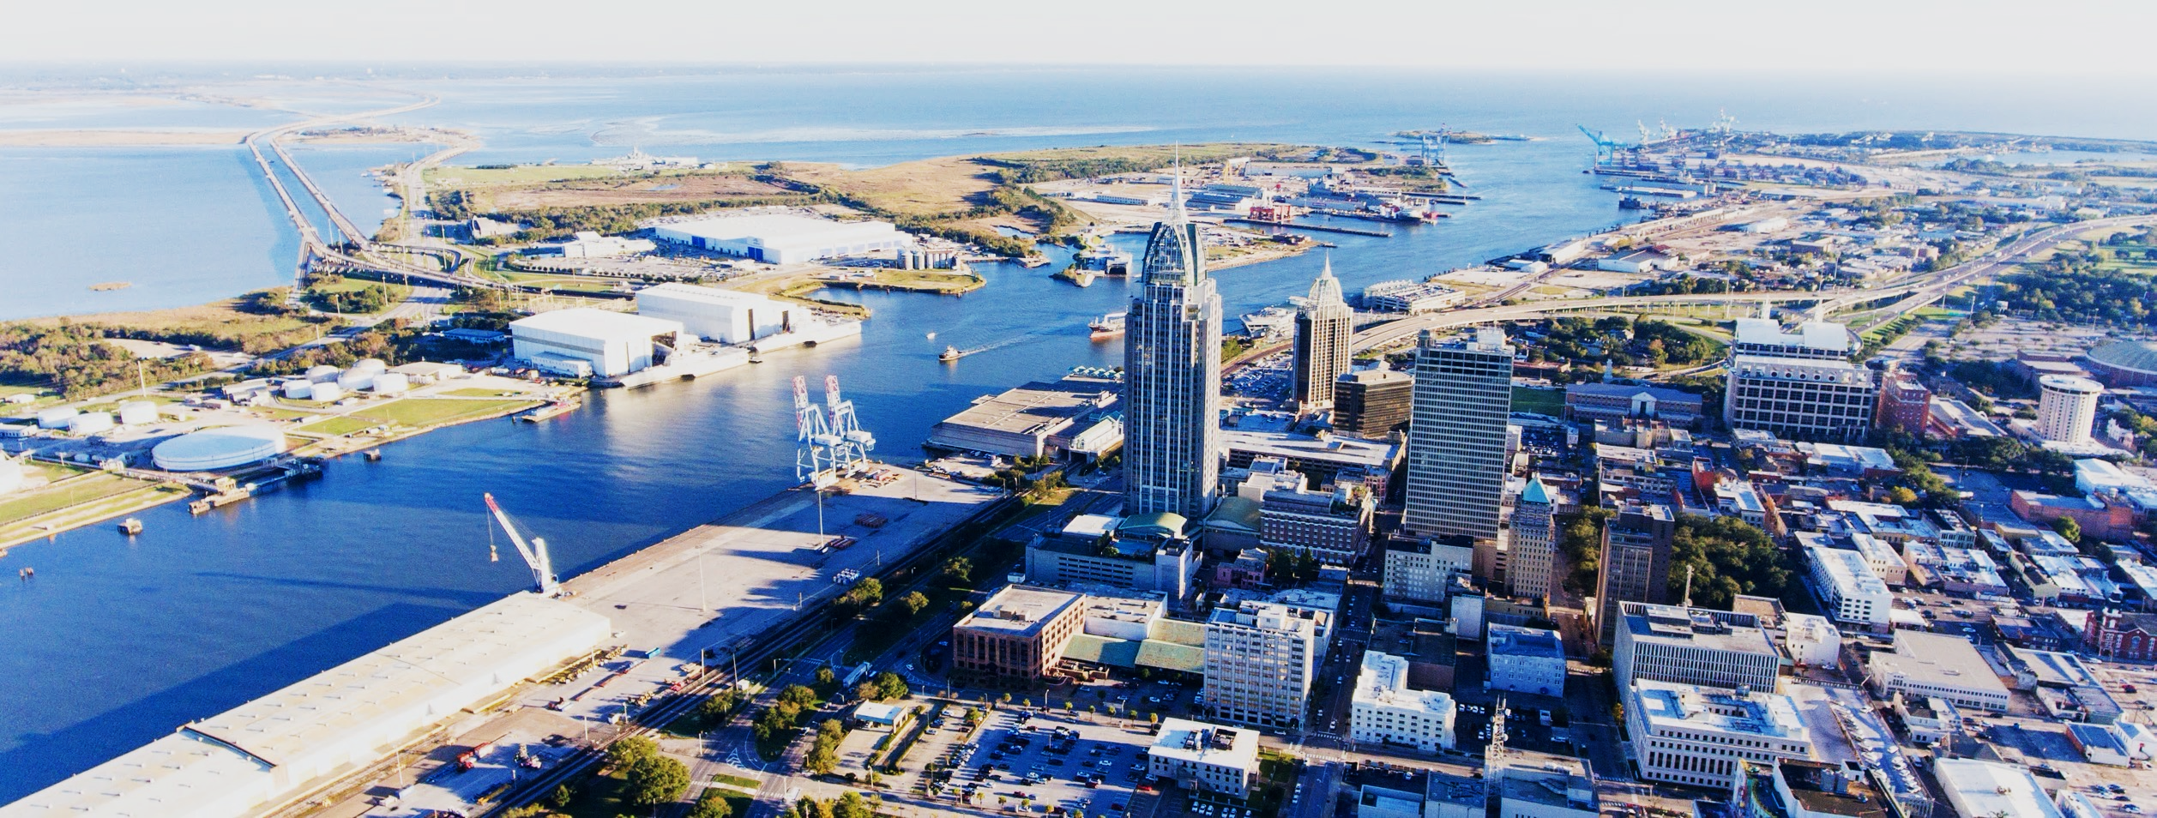
ABOUT AMERICAN WEATHERSTAR
Founded in 2004, American WeatherStar is an established leader in the commercial roofing industry. Based in Mobile, Alabama, we are a full-line supplier of high-quality, energy-efficient, fluid-applied roof restoration systems and products for flat and metal roofs.
www.americanweatherstar.com
02

Slide 3
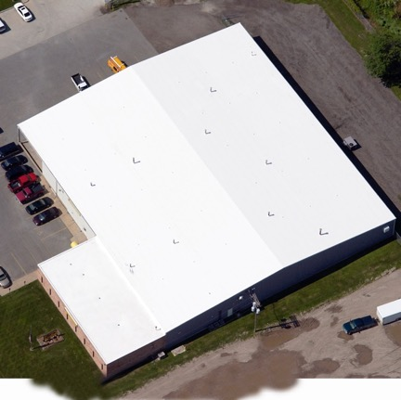
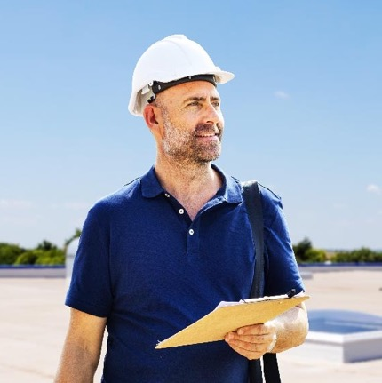
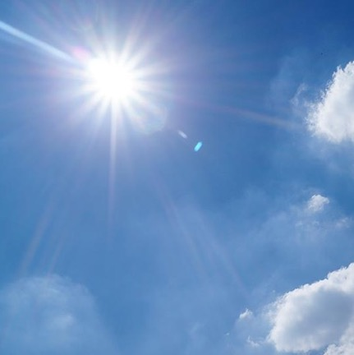
AMERICAN WEATHERSTAR BY THE NUMBERS
500+
475+
85%
More than 500 million square feet of commercial and industrial roofs restored throughout the United States.
A nationwide network of more than 475 approved and platinum level approved commercial roofing contractors.
Our energy-efficient, fluid-applied roof restoration systems reflect up to 85% of the sun’s harmful ultraviolet (UV) rays.
03

Slide 4
WHAT ARE THE MOST COMMON PROBLEMS FOUND IN COMMERCIAL AND INDUSTRIAL ROOFS?
04

Slide 5
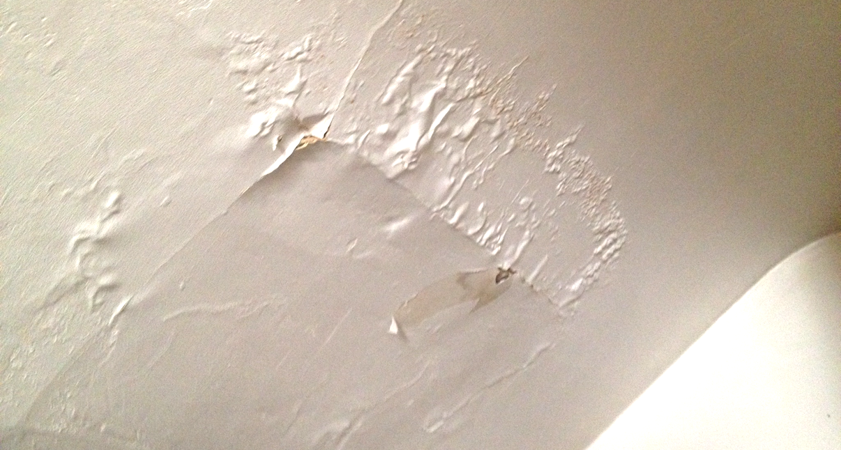
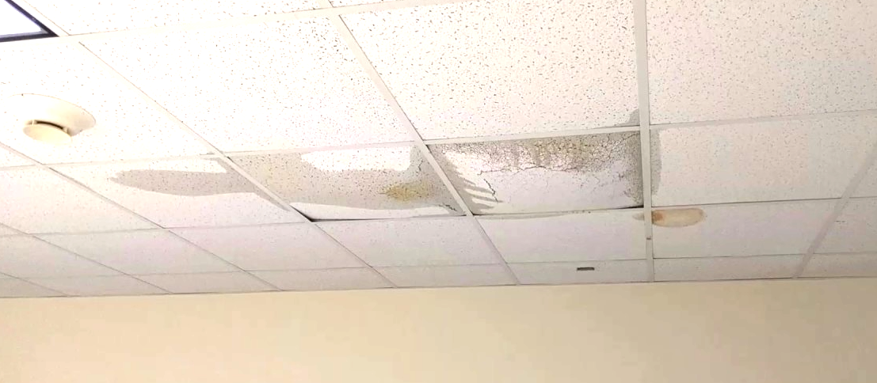
ROOF LEAKS
Roof leaks are a problem for any type of commercial/industrial roof surface and can occur for any number of reasons. While most roof leaks are easy to spot, some can materialize in other ways such as: mold spots, strong odors, stains/discoloration on walls and ceilings, and of course, puddling water.
It is possible for leaks to be limited to one specific area of your roof, but chances are you have multiple leaks throughout your building. In any case, water entering your building is a big problem and steps should be taken immediately to minimize interior damage.
Once the severity of the damage is known, an American WeatherStar approved contractor can help you in determining the appropriate, long-term solution to prevent future leaks.
05

Slide 6
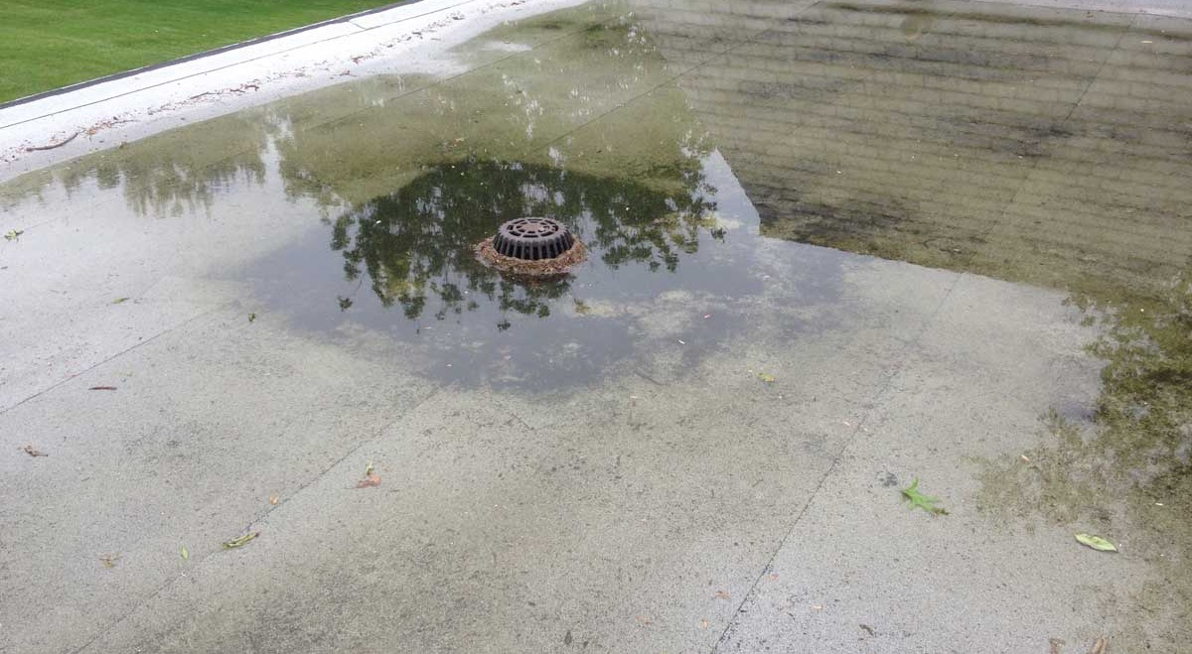
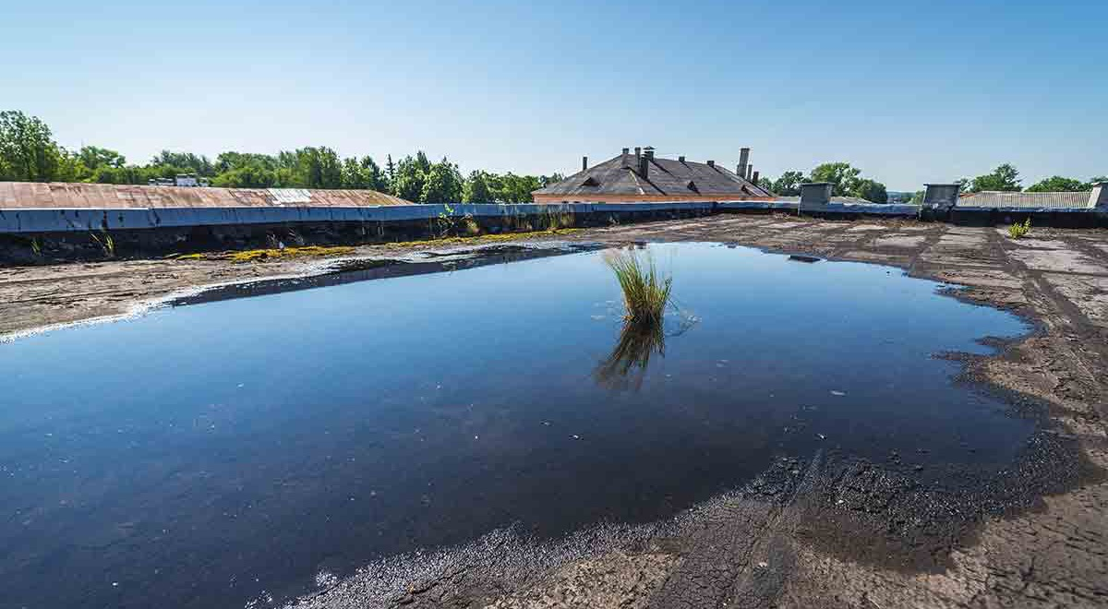
PONDING WATER
Ponding water, also known as standing water, occurs when there is poor or no drainage on the roof surface. This formation of water typically develops when drains, gutters, downspouts, and other vulnerable roof components are not regularly cleaned or properly maintained.
Naturally, ponding water can lead to roof leaks, but it can also lead to other, equally serious issues. The accumulation of ponding water adds a lot of extra weight to the roof surface, which can potentially compromise the structural integrity of your building.
If not addressed in a timely manner, ponding water can become a very costly problem for a building owner or property manager.
06

Slide 7
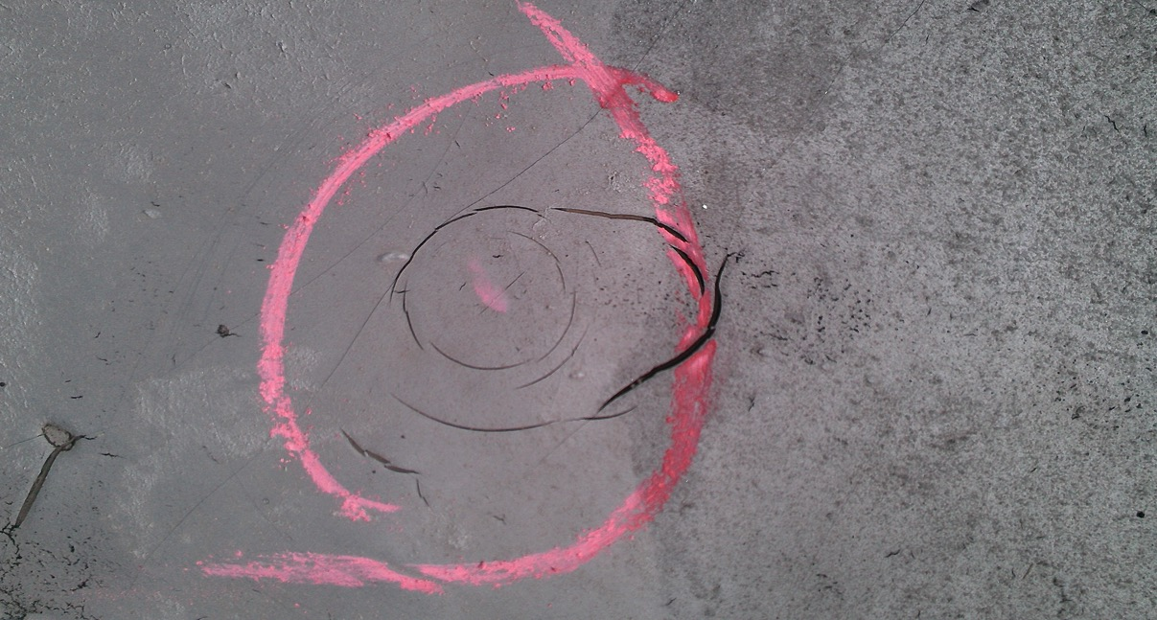
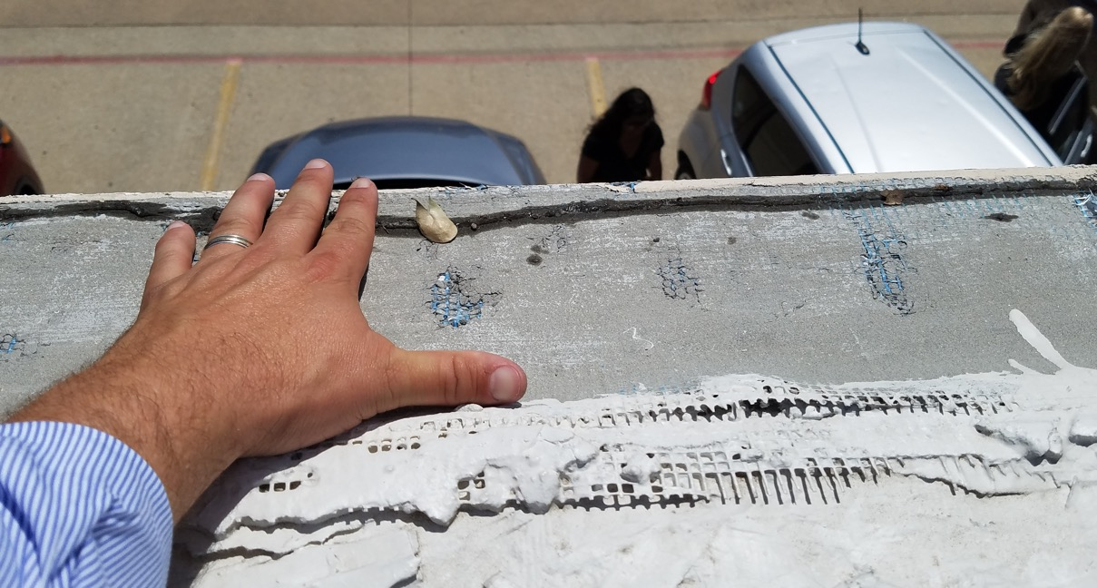
STORM DAMAGE
Hailstorms and high winds can wreak havoc on any commercial or industrial roof. In some cases, the damage caused by a storm can be easily repaired with minimal expense on behalf of the building owner. In other cases, the damage sustained during a storm can result in total loss.
Even minor storms have the potential to damage commercial roof surfaces allowing for moisture intrusion and separation of the membrane from the underlying substrate. If addressed early, building owners and managers can avoid a costly, more-extensive repair project later on.
If you believe your commercial or industrial building has sustained storm damage, contact your American WeatherStar approved contractor today for a free roof inspection.
07

Slide 8
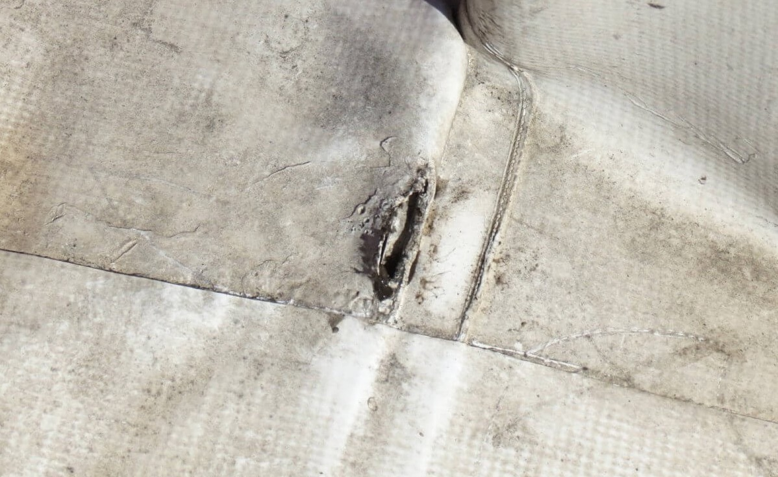
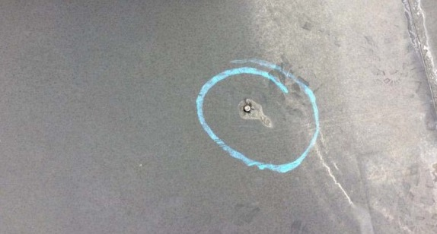
MECHANICAL DAMAGE
Mechanical damage is a broad term used to describe damage associated with equipment present on a roof in conjunction with human error. This type of damage is typically caused by: pedestrian traffic, tools and equipment, HVAC units, communication equipment, improperly discarded hardware, etc.
Just like any other type of damage, mechanical damage can lead to much bigger problems if not addressed promptly. While it may not be practical to accompany everyone that goes up on your roof, a little guidance and education can go a long way towards avoiding any mishaps.
Though you may not have reason to believe that your roof has been subject to mechanical damage, we strongly recommend building owners get their roofs inspected regularly, and follow a scheduled maintenance program.
08

Slide 9
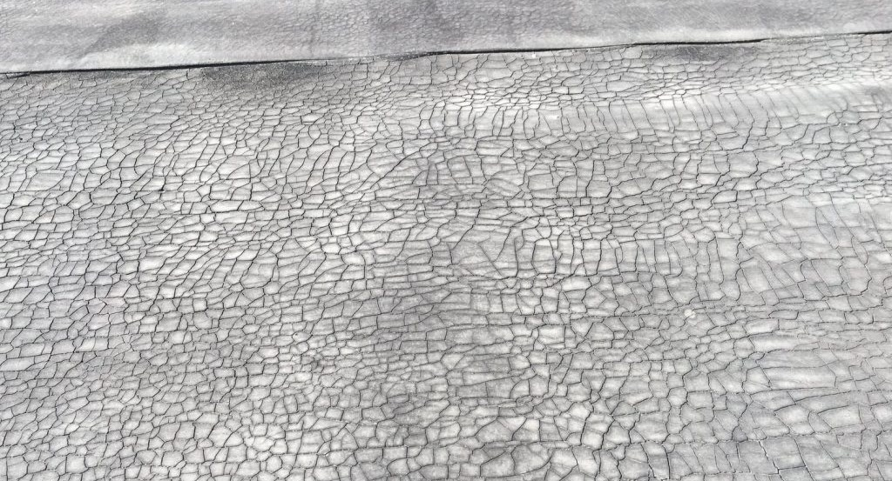
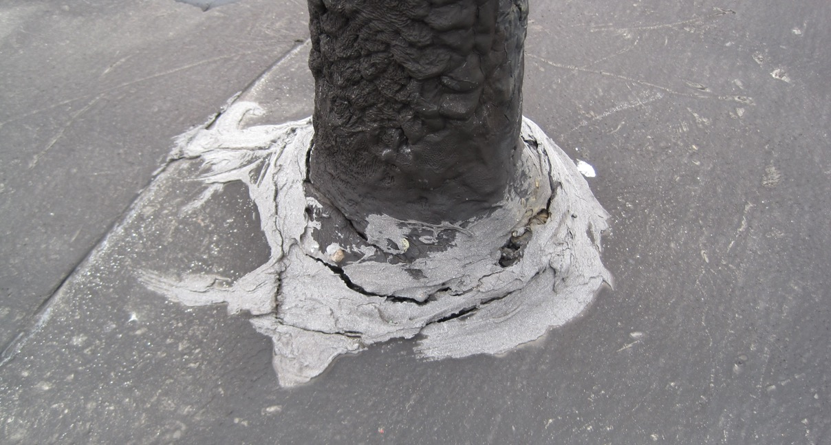
AGED MEMBRANE
Most commercial roofing systems last between 15 and 20 years; that can vary depending on a few different factors. Regular maintenance and repair can help extend the service life of your roof, but eventually, all roofs need to be fully replaced.
Many roof replacements (tear-offs) are totally unnecessary. Many building owners don’t know that fluid-applied roof restoration systems are a perfectly suitable solution to extend the life of their roof, not to mention roof restoration cost half as much as a full replacement.
Not sure if a fluid-applied roof restoration system is right for your commercial/industrial building? Contact American WeatherStar today to schedule your free roof inspection.
09

Slide 10
WHAT OPTIONS DO YOU HAVE WHEN IT COMES TO YOUR COMMERCIAL OR INDUSTRIAL ROOF?
10

Slide 11
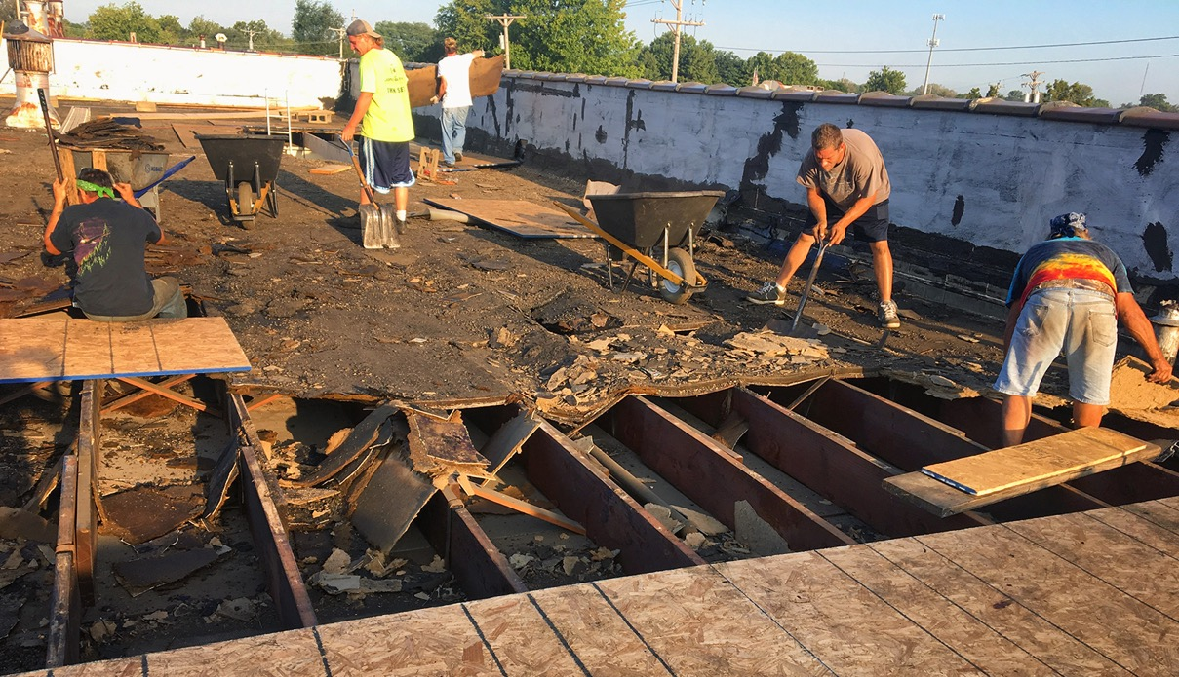
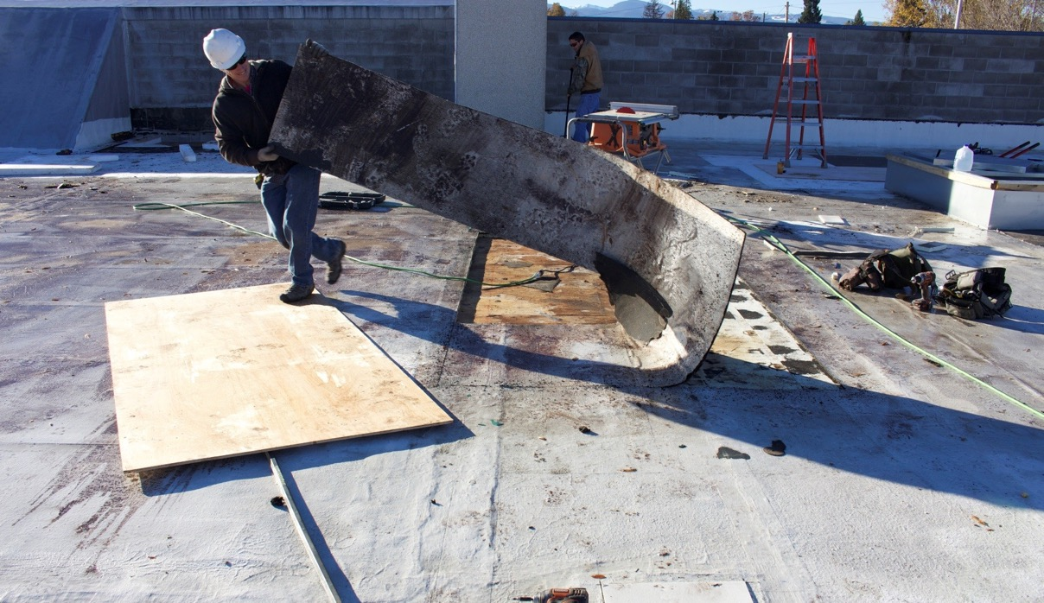
ROOF REPLACEMENT
In some cases, a full roof replacement may be the only option for a building owner. There are a number of factors to consider before committing to such a costly and extensive endeavor. For this reason, we highly recommend that you consult an American WeatherStar approved contractor to explore all of your options.
11

Slide 12
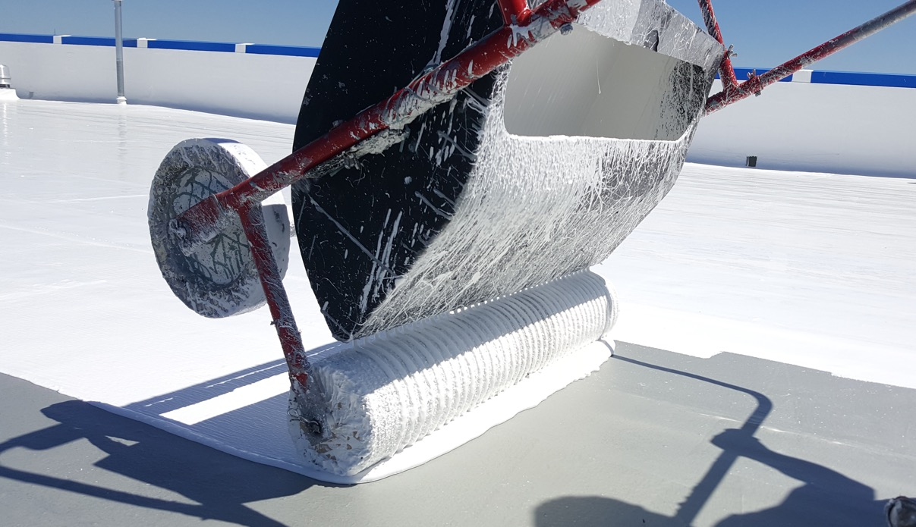
ROOF RESTORATION
For building owners and facility mangers experiencing problems with their roofs, fluid-applied roof restoration is a more sustainable and cost-effective alternative to roof replacement. These restoration systems not only stop leaks, but they also increase energy savings, reduce internal building temperatures, and prolong roof life.
12

Slide 13
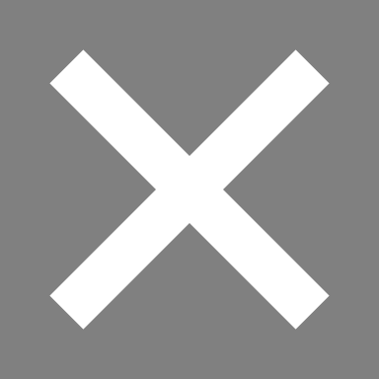
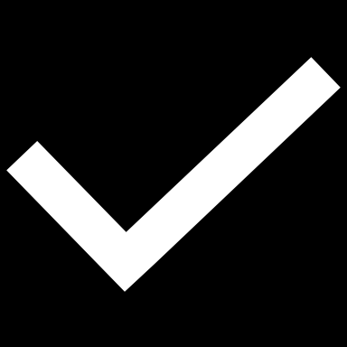
REPLACEMENT VS. RESTORATION
Again, not all commercial and industrial roofs are candidates to receive a roof restoration system. Depending on the state of the existing roof system, a full roof replacement might be necessary. However, many roof systems can be restored at nearly half the cost of a full replacement. There are other factors to consider as well:
ROOF REPLACEMENT
ROOF RESTORATION
More expensive
High labor costs
High material costs/volume
More intrusive to business
Less sustainable
Long-term job duration
Less expensive (1/2 the cost)
Low labor costs
Low material costs/volume
Less intrusive to business
More sustainable
Short-term job duration
13
13

Slide 14
THE ULTIMATE SOLUTION IN ROOF RESTORATION EXCLUSIVELY FROM AMERICAN WEATHERSTAR
14

Slide 15
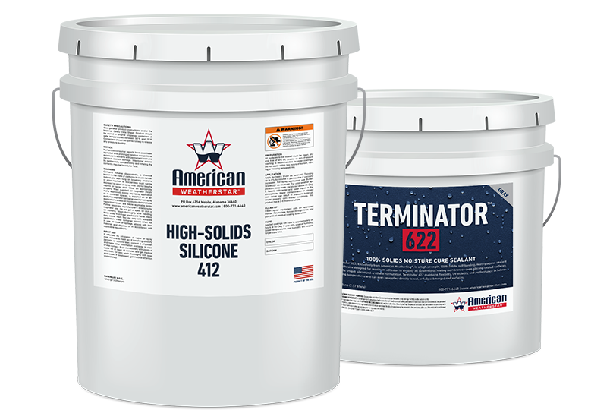
The Ure-A-Sil system is proven to restore and protect flat roof surfaces. Combining a urethane base coat and a silicone top coat provides the ultimate level of strength, durability, reflectivity, and UV resistance. Companies of all sizes have used the Ure-A-Sil system to stop leaks, increase energy savings, cool their buildings, and improve their bottom lines.
15

Slide 16
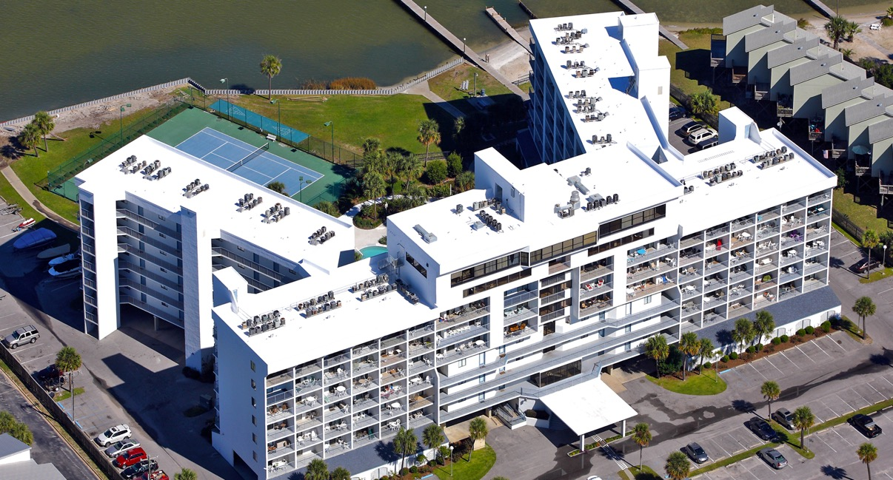
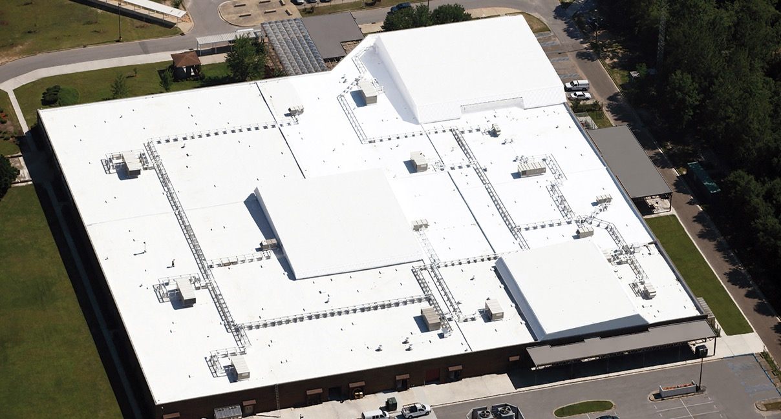
SYSTEM BENEFITS
Stop leaks and vastly improves performance
Costs significantly less than a total roof replacement
Substantially reduces maintenance and energy costs
Extends service life by restoring the existing roof membrane
Industry-leading UV stability, reflectivity, and durability
High-solids content, Low VOC, and environmentally safe
Long-term warranty options available
Provides minimal interruption to business
16

Slide 17
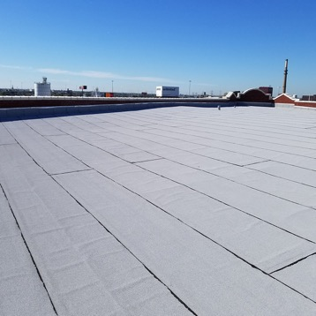
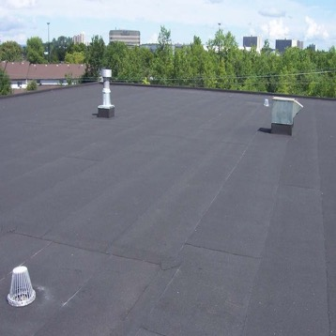
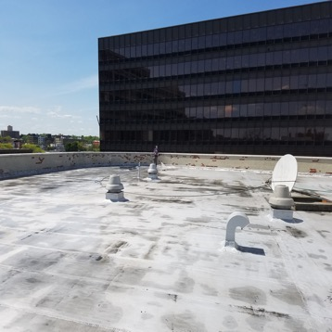
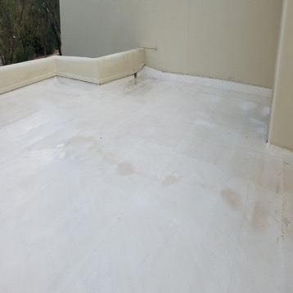
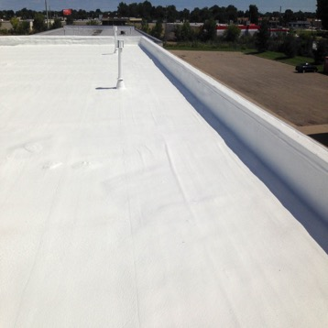
SUITABLE ROOF SURFACES
MODIFIED BITUMEN
EPDM
SMOOTH BUILT-UP
SINGLE-PLY
SPRAY FOAM
17

Slide 18
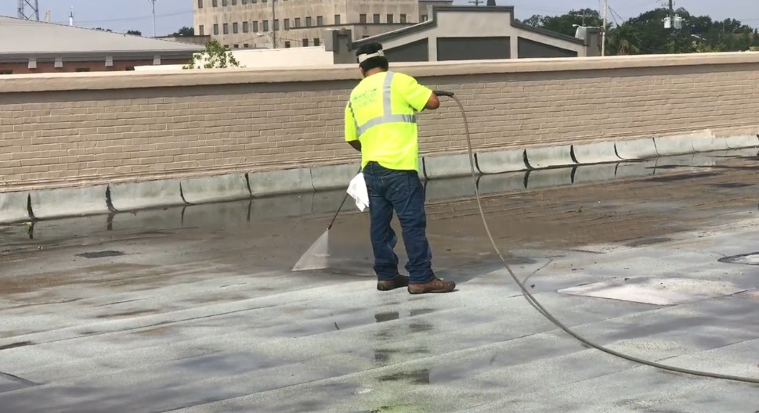
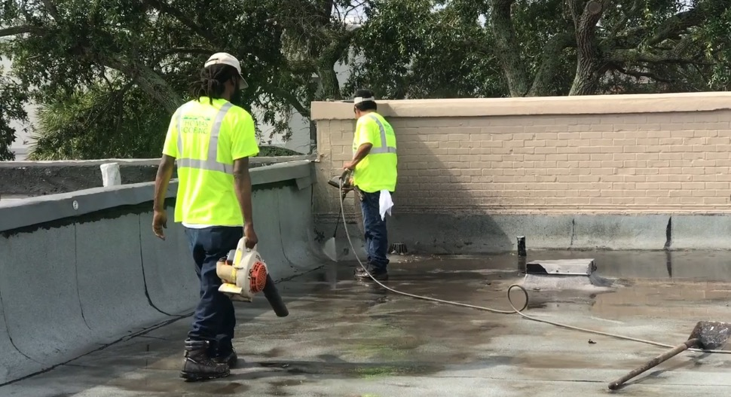
APPLICATION PROCESS
STEP 1: SURFACE PREPARATION
First, the roof surface is thoroughly pressure washed to ensure all dirt and debris are removed. Any problem areas found during surface preparation are addressed before any coating products are applied.
18

Slide 19
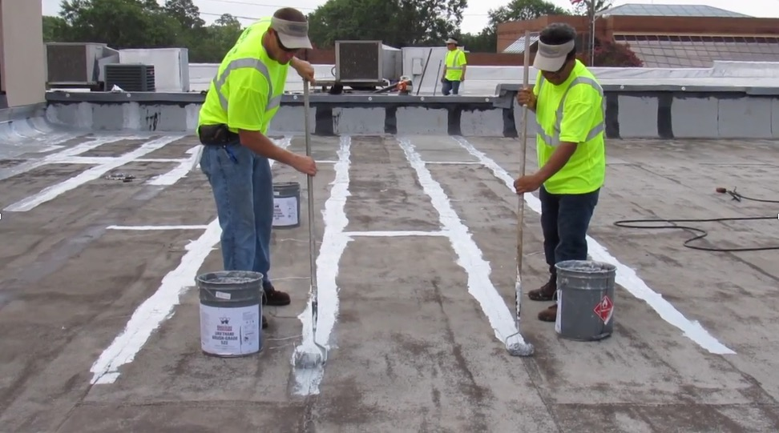
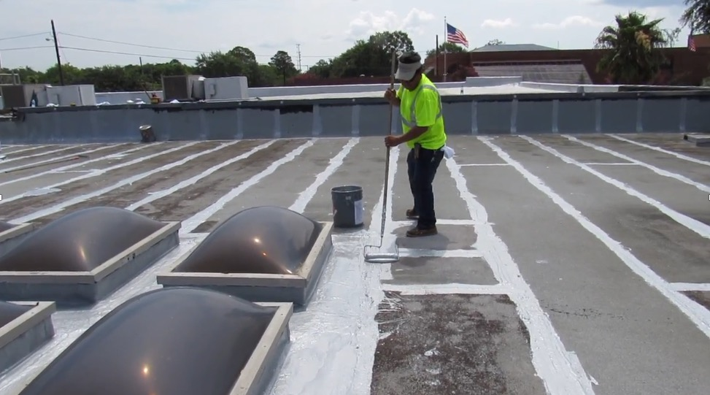
APPLICATION PROCESS
STEP 2: PREPARATION FOR COATINGS
Next, seams and flashing details are coated with a thick “rubber-like” mastic to help withstand the expansion and contraction of the roof structure.
19

Slide 20
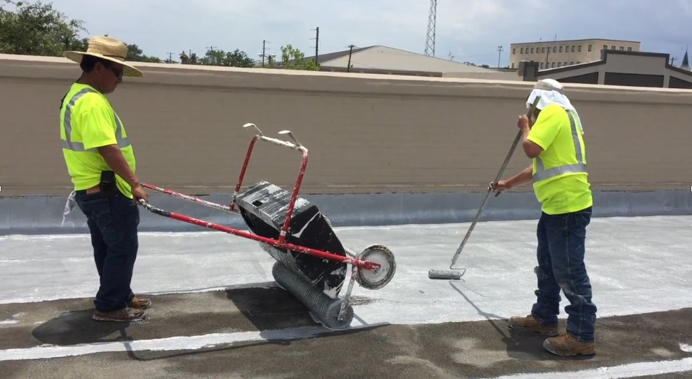
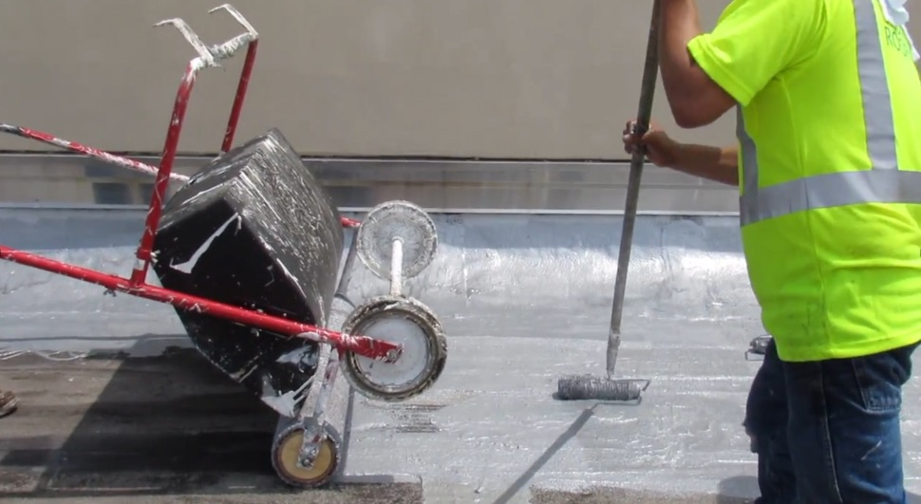
APPLICATION PROCESS
STEP 3: BASE COAT APPLICATION
Once all details have been addressed, a base coat of High-Solids 412 is then applied to the roof. This layer will provide the system with a durable, flexible, waterproof membrane capable of withstanding the natural expansion and contraction (thermal cycling) of the roof structure.
20

Slide 21
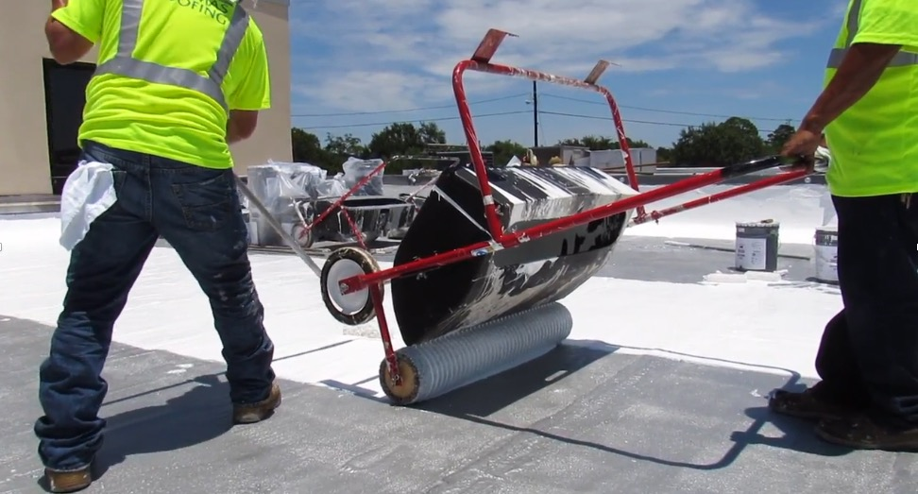
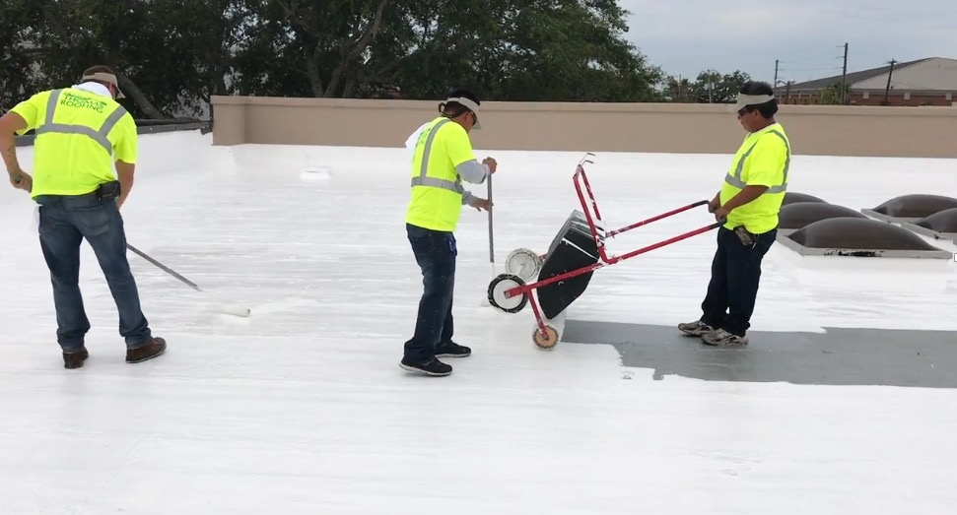
APPLICATION PROCESS
STEP 4: TOP COAT APPLICATION
Once the base coat fully cures, a top coat of High-Solids Silicone 412 is then applied to form a seamless, watertight, membrane that provides industry-leading UV protection, reflectivity, and resistance to ponding water.
21

Slide 22
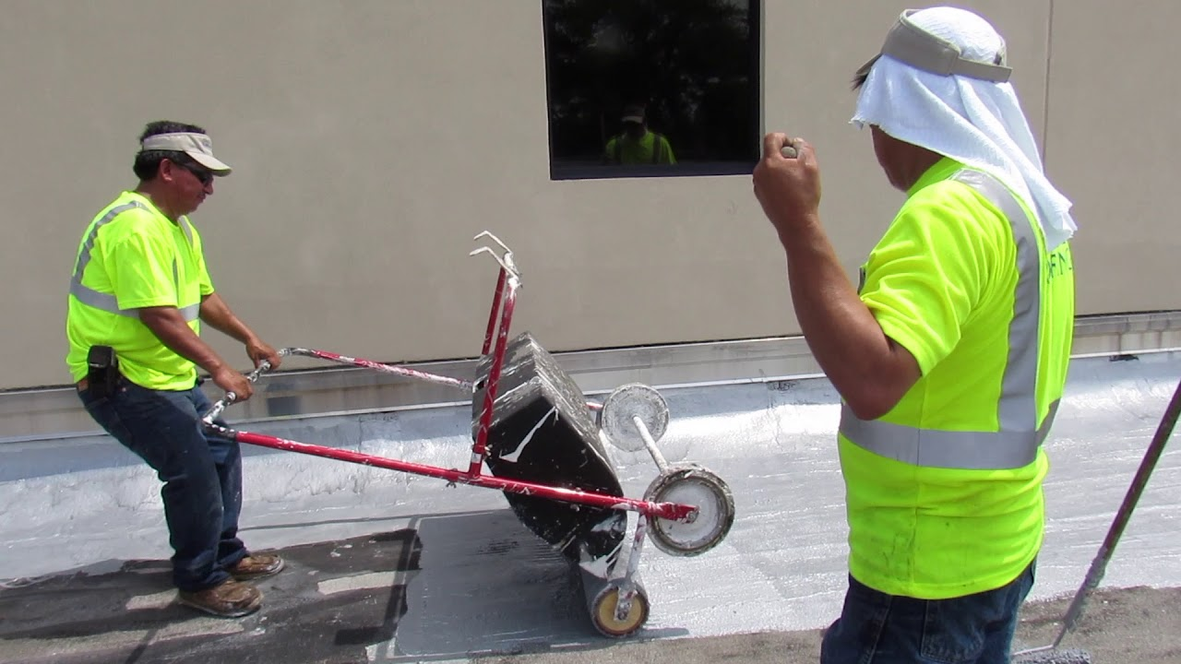
SYSTEM VIEW VIDEO
22

Slide 23
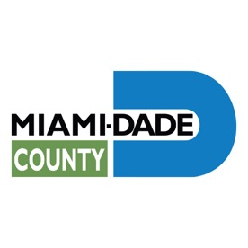
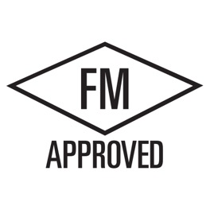
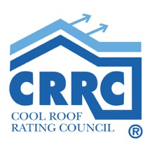
SYSTEM AND PRODUCT APPROVALS
23

Slide 24
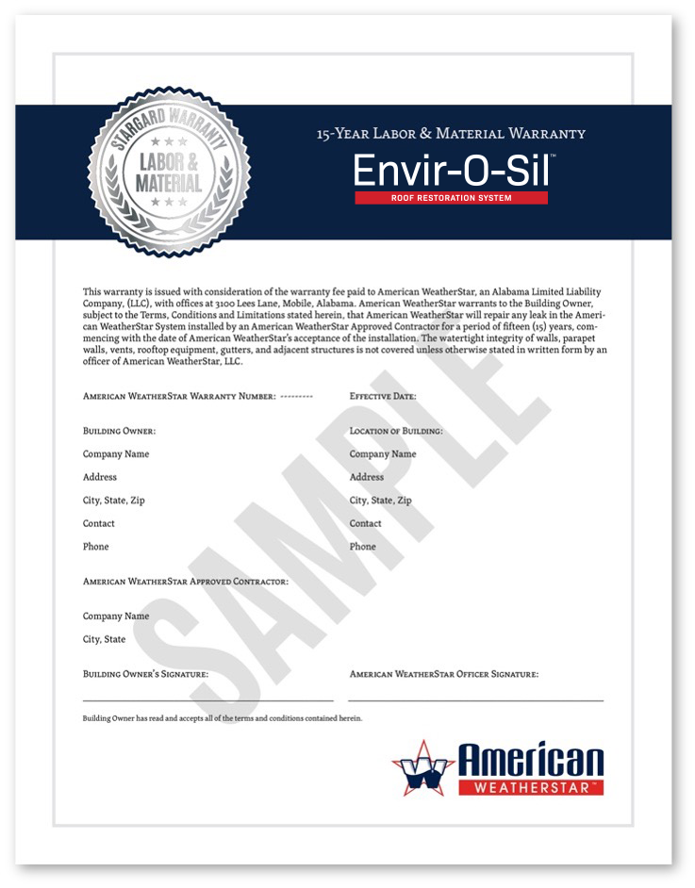
SUSTAINABLE
WARRANTY OPTIONS
American WeatherStar offers a NDL System Material warranty for most of its roof restoration systems when installed by an American WeatherStar approved contractor. Contact your American WeatherStar approved contractor to discuss your options.
10- 15, and 20-year warranty options
Renewable, transferable, and extendable
CLICK HERE TO LEARN MORE
24

Slide 25
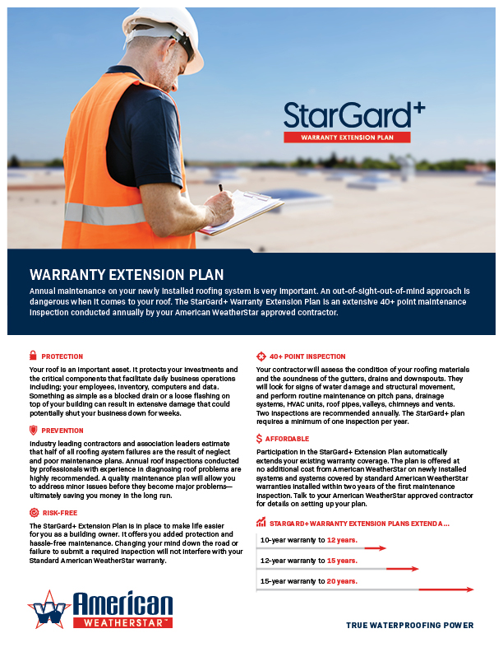
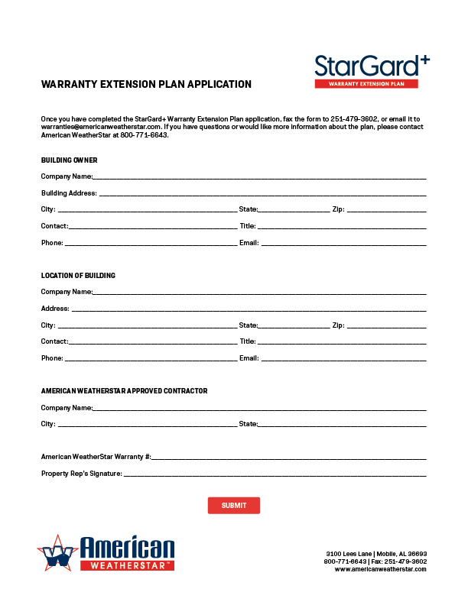
STARGARD+ WARRANTY
EXTENSION PLAN
Annual maintenance on your newly installed roofing system is very important. An out-of-sight-out-of-mind approach is dangerous when it comes to your roof. The StarGard+ Warranty Extension Plan is an extensive 40+ point maintenance inspection conducted annually by your American WeatherStar approved contractor.
40+ point inspection
Risk-free and affordable
Added protection and prevention
CLICK HERE TO LEARN MORE
25

Slide 26
HELPFUL LINKS
INFORMATIONAL LINKS
Envir-O-Sil Quick Spec
StarGard Warranty Program
StarGard+ Warranty Extension Plan
PRODUCT DATA SHEETS
High Solids Silicone 412
Terminator 622
APPLICATION GUIDELINES
Modified Bitumen
EPDM
Single-Ply
Built-Up
Spray Polyurethane Foam
PRODUCT WEBPAGES
High Solids Silicone 412
Terminator 622
www.americanweatherstar.com | info@weatherstar.net | Toll Free: 800-771-6643

