Slide 1
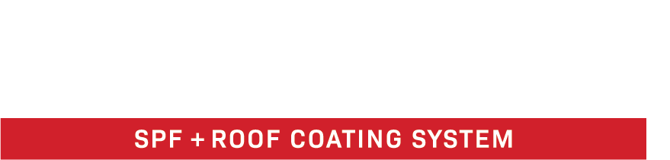
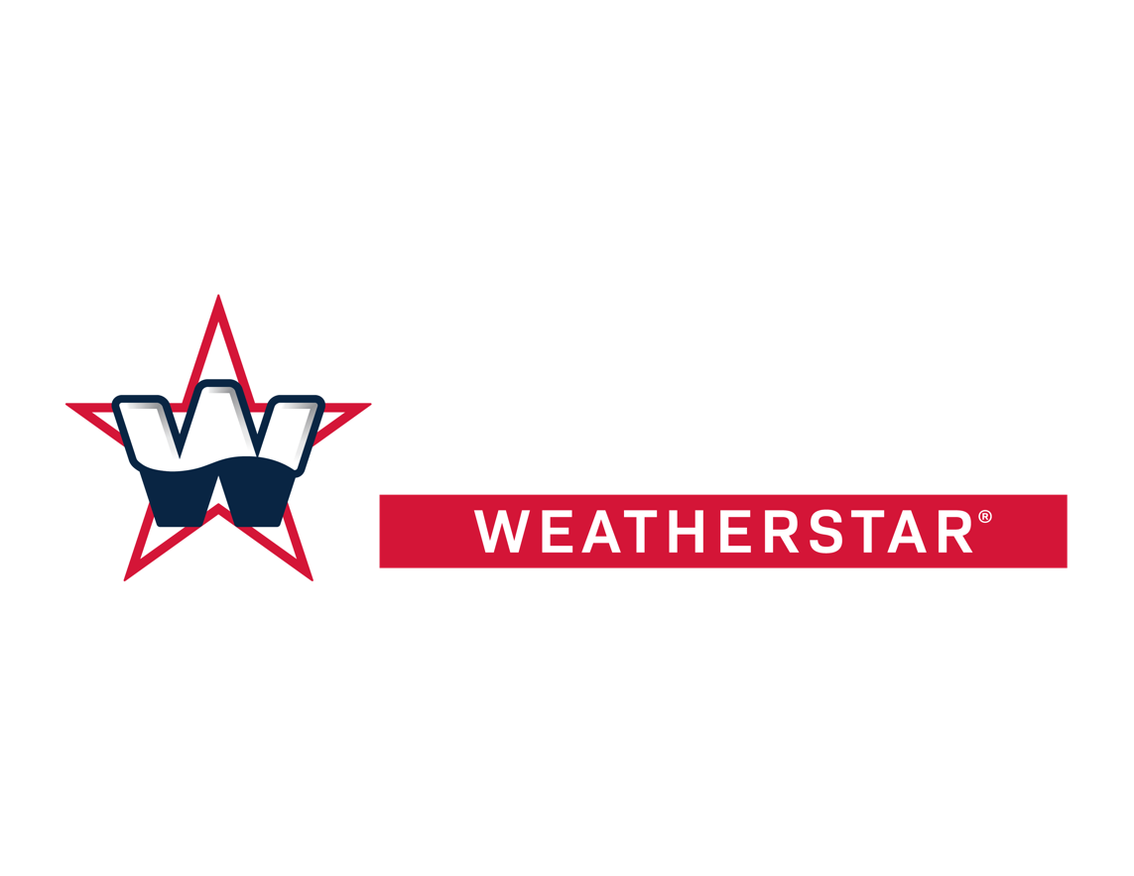
THE PREFERRED SPRAY POLYURETHANE FOAM (SPF) + COATING SOLUTION FOR COMMERCIAL & INDUSTRIAL ROOFS
FLUID-APPLIED ROOF RESTORATION
www.americanweatherstar.com | 800-771-6643

Slide 2
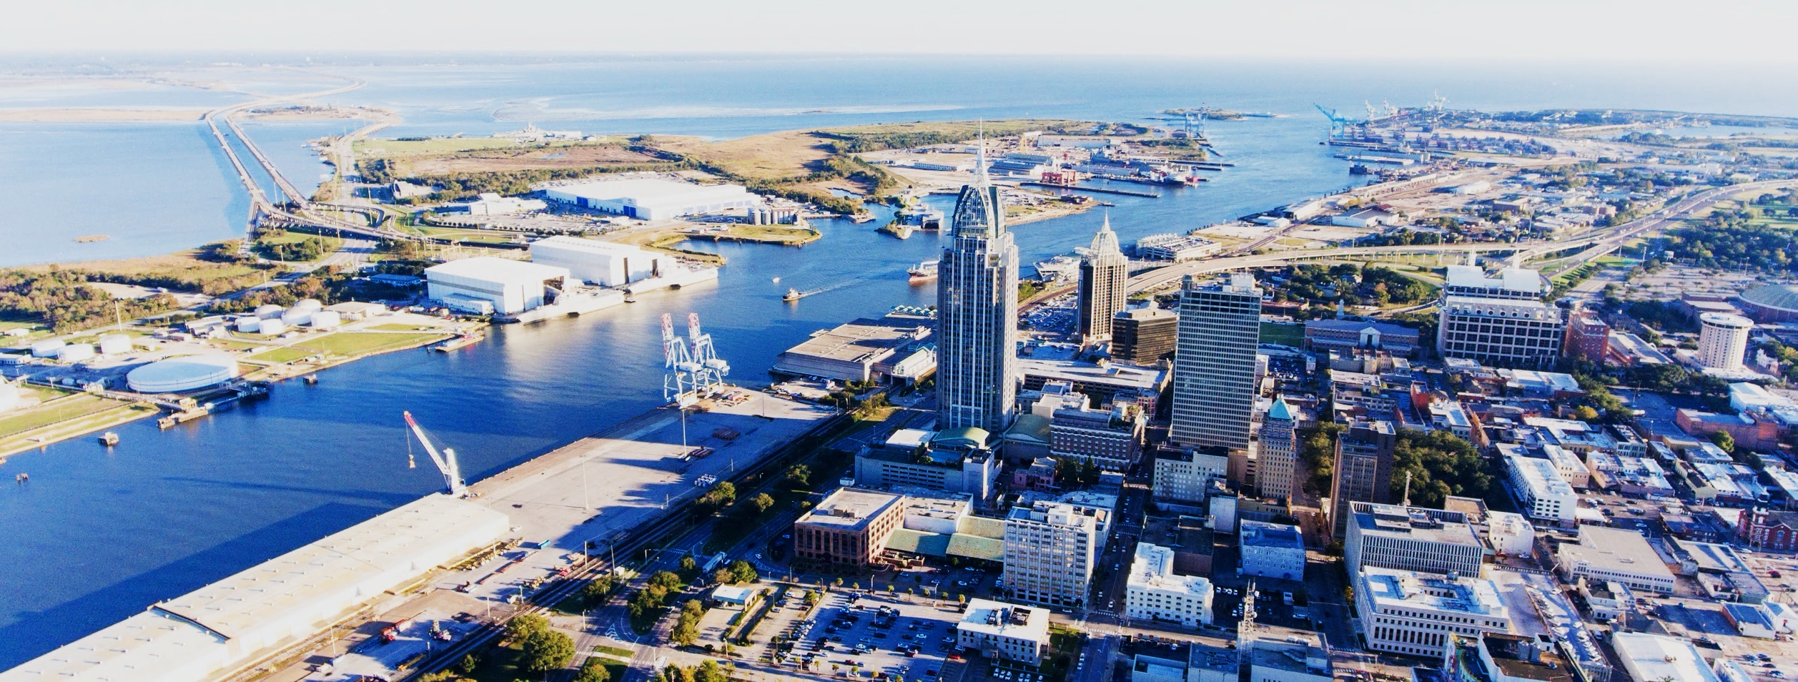
ABOUT AMERICAN WEATHERSTAR
Founded in 2004, American WeatherStar is an established leader in the commercial roofing industry. Based in Mobile, Alabama, we are a full-line supplier of high-quality, energy-efficient, fluid-applied roof restoration systems and products for flat and metal roofs.
www.americanweatherstar.com
02

Slide 3
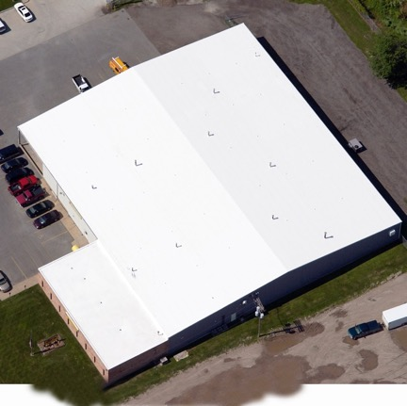

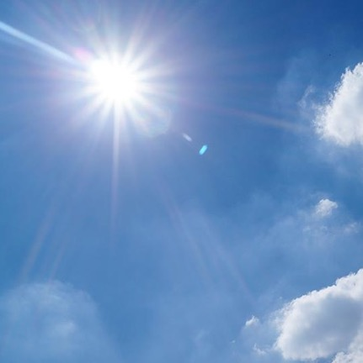
AMERICAN WEATHERSTAR BY THE NUMBERS
500+
475+
85%
More than 500 million square feet of commercial and industrial roofs restored throughout the United States.
A nationwide network of more than 475 approved and platinum level approved commercial roofing contractors.
Our energy-efficient, fluid-applied roof restoration systems reflect up to 85% of the sun’s harmful ultraviolet (UV) rays.
03

Slide 4
WHAT ARE THE MOST COMMON PROBLEMS FOUND IN COMMERCIAL AND INDUSTRIAL ROOFS?
04

Slide 5
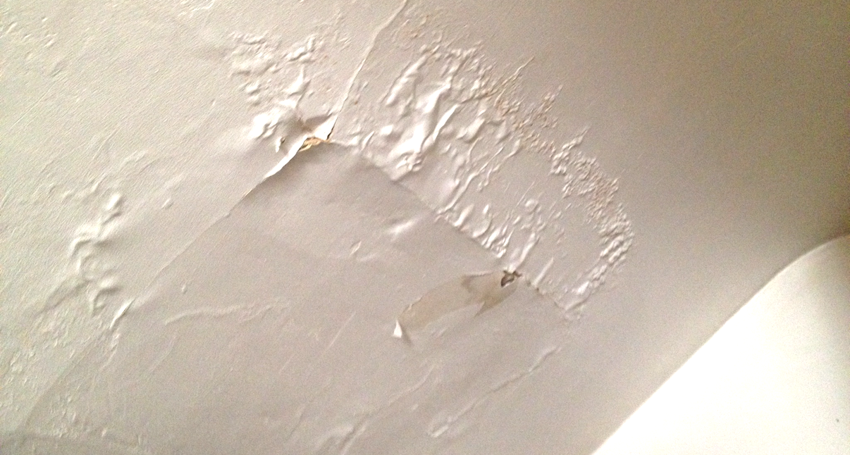
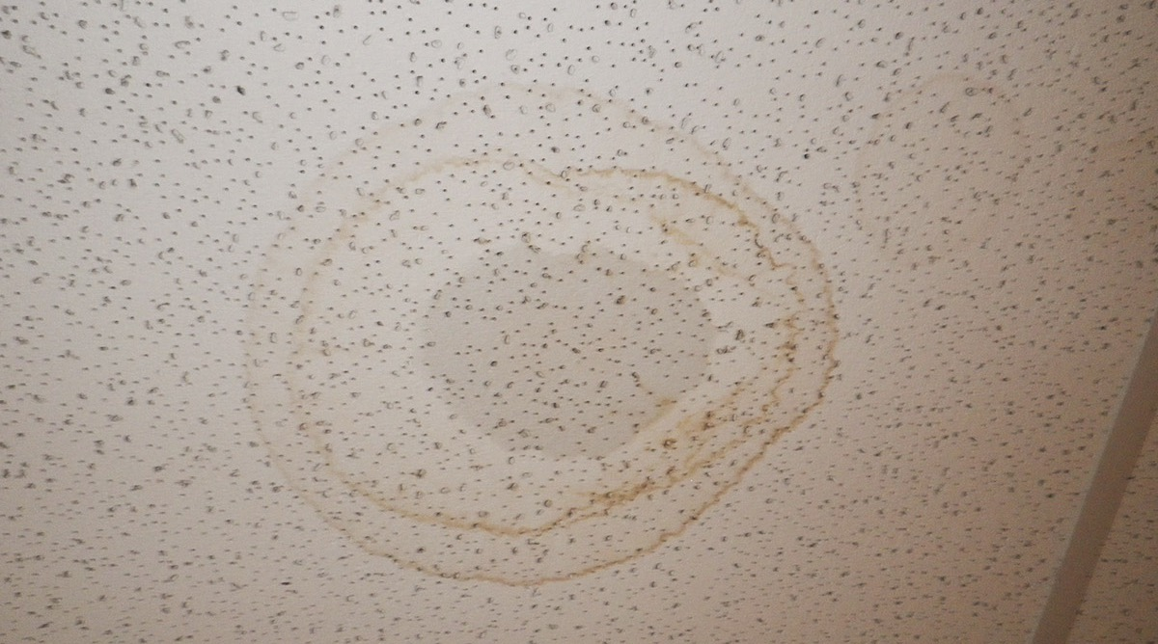
ROOF LEAKS
Roof leaks are a major problem for any type of roof surface—even metal. While most roof leaks are easy to identify, some can materialize in other ways such as mold spots, strong odors, stains/discoloration on walls and ceilings, and of course, puddling water.
It is possible for leaks to be limited to one specific area of your roof, but chances are you have multiple leaks throughout your building. In any case, water entering your building is a big problem and steps should be taken immediately to minimize interior damage.
Once the severity of the damage is known, an American WeatherStar approved contractor can help you in determining the appropriate, long-term solution to prevent future leaks.
05

Slide 6
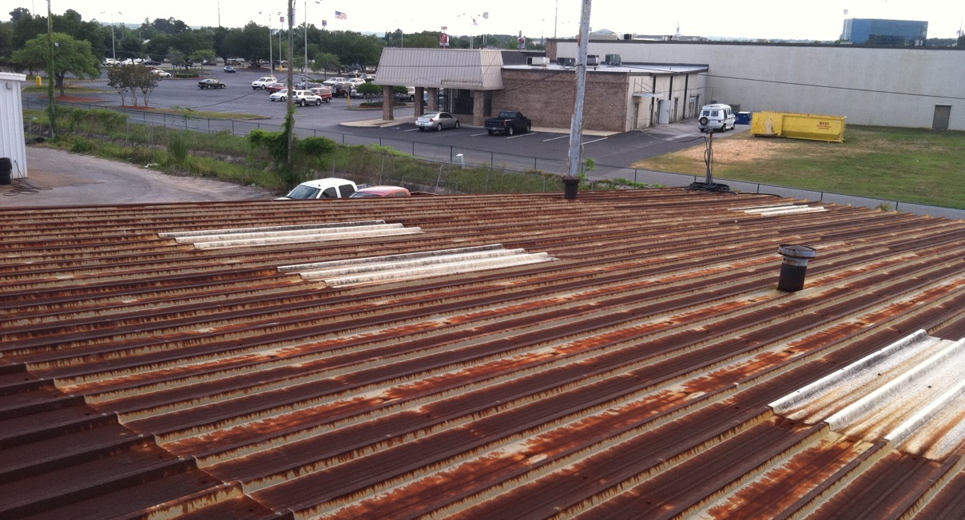
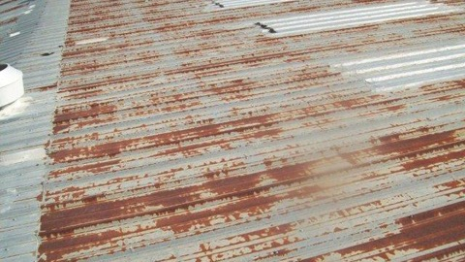
RUST & CORROSION
Rust and corrosion are very common in aging metal roofs. Most metal roofing systems are made of galvanized metal or coated to prevent rust from occurring, but high winds, heavy rain, and the heat generated by direct sunlight can eventually wear the roof's protection away.
Once the onset of rust occurs, corrective action is recommended to restore and protect the roof from further degradation.
06

Slide 7
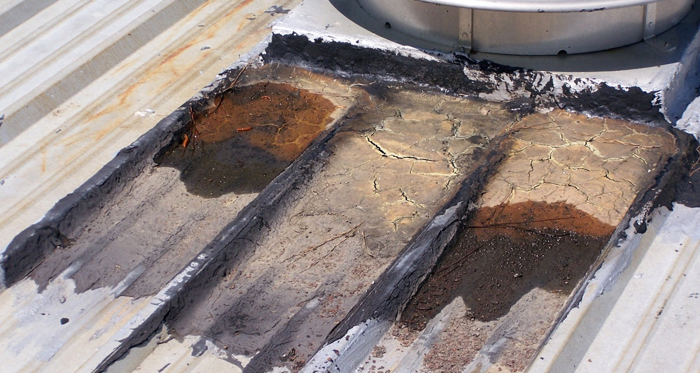
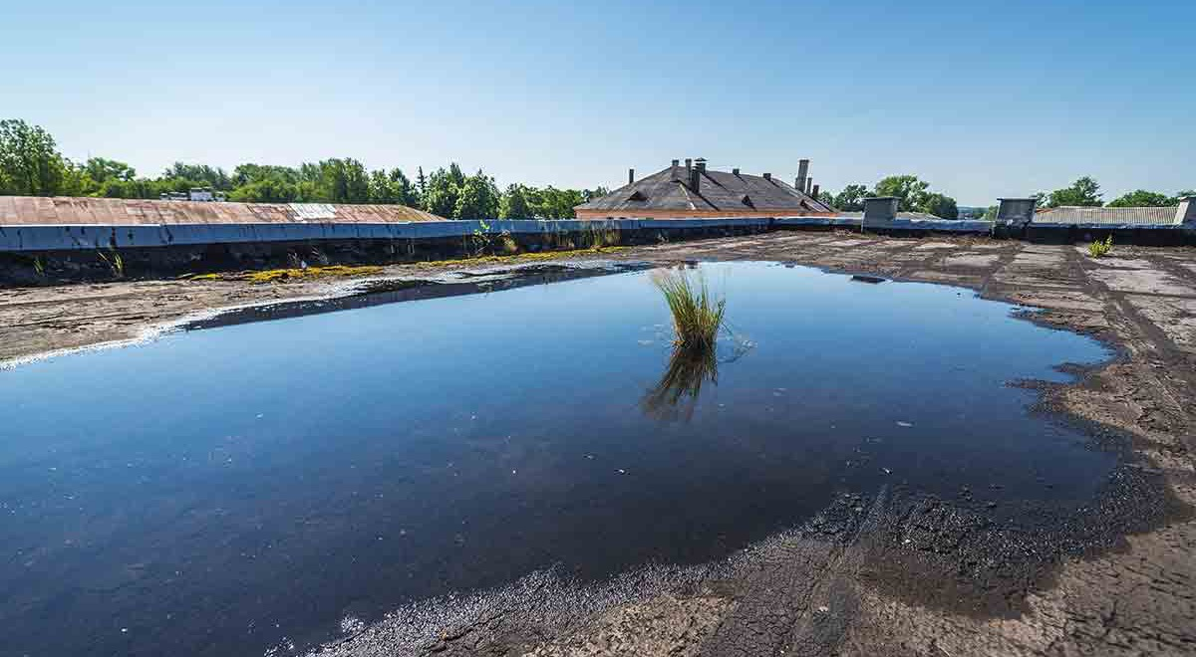
PONDING WATER
Ponding water occurs when there is poor or no drainage on the roof surface. This formation of water typically develops when drains, gutters, downspouts, and other components are not regularly cleaned or maintained.
Naturally, ponding water can lead to roof leaks, but it can also lead to other serious problems. Ponding water adds extra weight to the roof surface, which can potentially compromise the structural integrity of your building. If not addressed in a timely manner, ponding water can become a very costly problem for a building owner or property manager.
If not addressed in a timely manner, ponding water can become a very costly problem for a building owner or property manager.
07

Slide 8
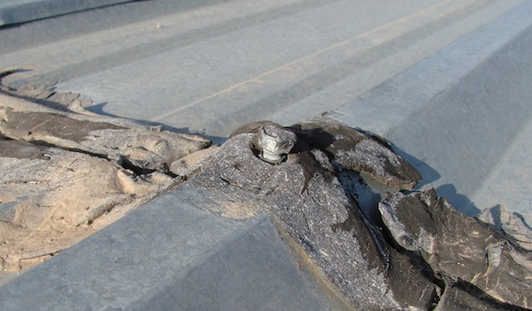
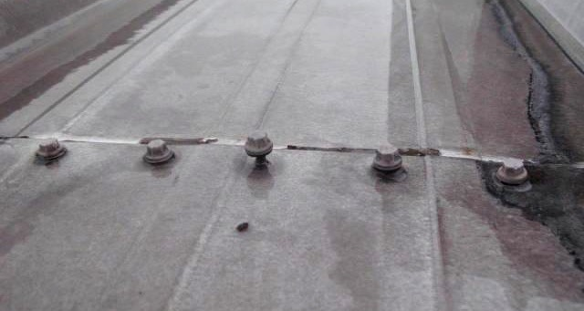
LOOSE FASTENERS
In general, metal roofs systems are among the strongest and most durable roofing materials available on the market, but that does not mean they are impervious to physical wear and tear.
One of the most common issues with metal roof systems are loose, or failing, fasteners. These can not only lead to roof leaks, but they can also lead to an assortment of other roof-related maintenance issues.
08

Slide 9
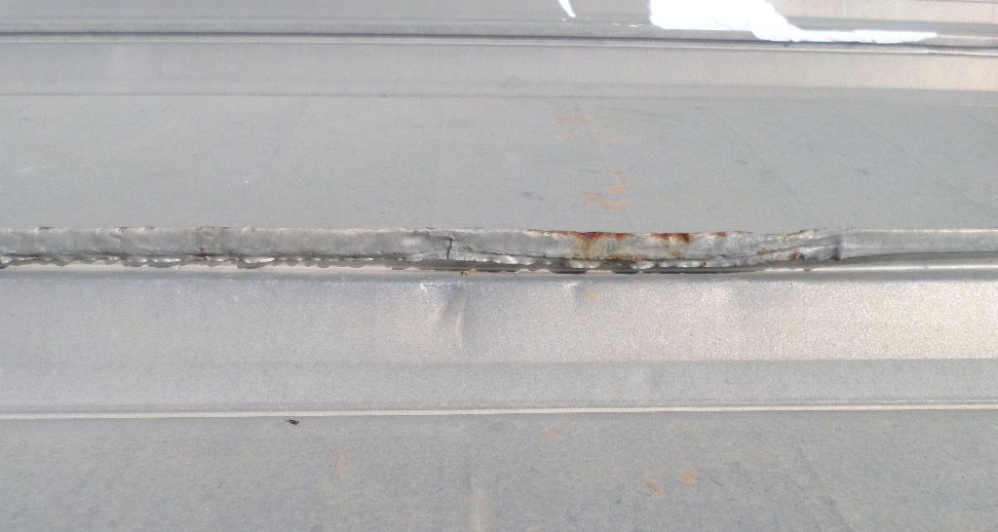
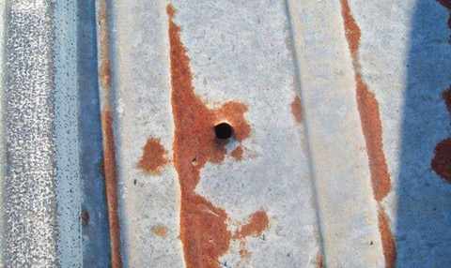
PHYSICAL DAMAGE
Just like any other type of commercial roofing substrate, metal roofs are susceptible to various types of damage. The most common types of physical damage include the following: storm damage, damage caused by foot traffic, punctures, denting, scratches, premature discoloration, etc.
09

Slide 10
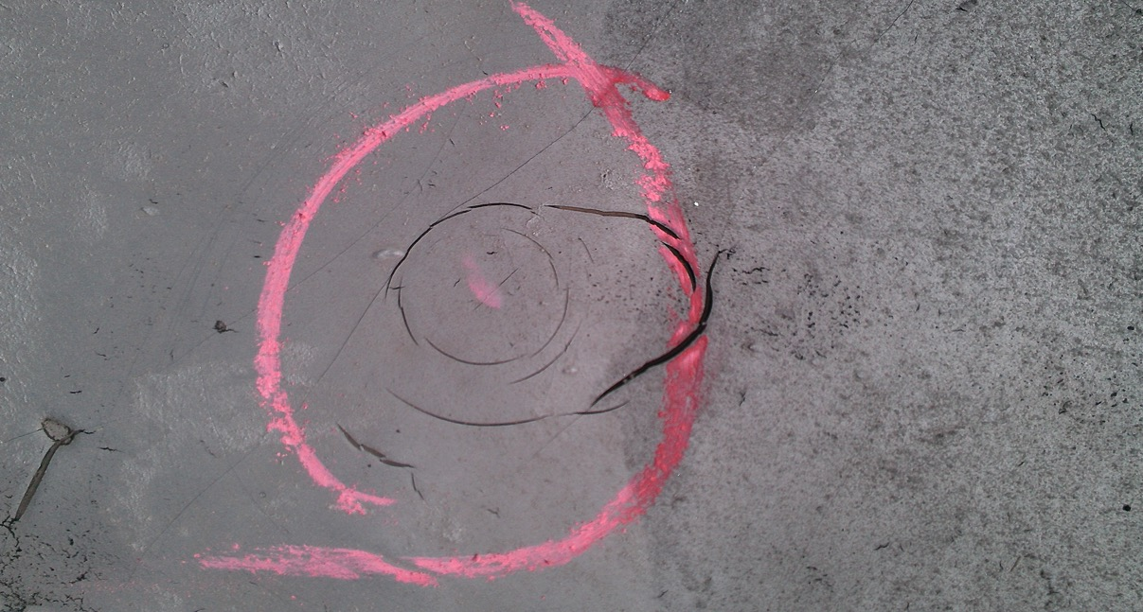
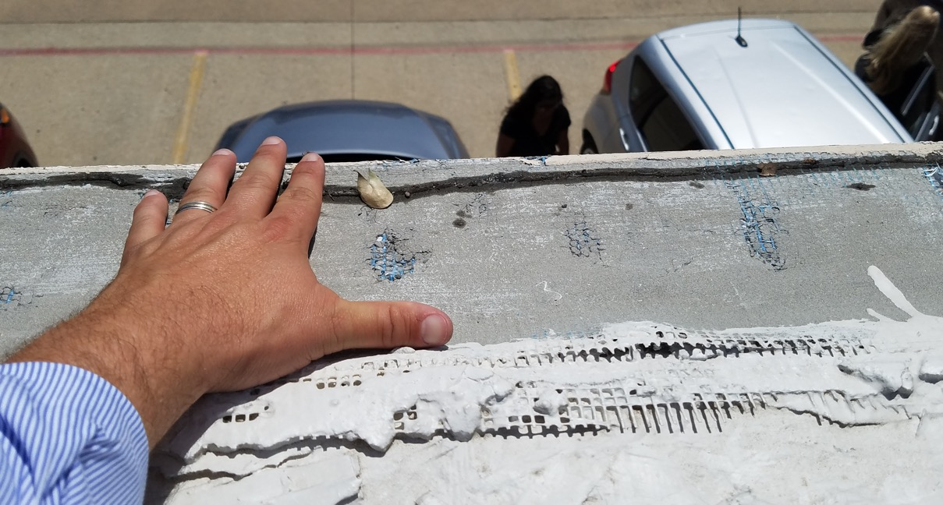
STORM DAMAGE
Hailstorms and high winds can wreak havoc on any commercial or industrial roof. In some cases, the damage caused by a storm can be easily repaired with minimal expense on behalf of the building owner. In other cases, the damage sustained during a storm can result in total loss.
Even minor storms have the potential to damage commercial roof surfaces allowing for moisture intrusion and separation of the membrane from the underlying substrate. If addressed early, building owners and managers can avoid a costly, more-extensive repair project later on.
If you believe your commercial or industrial building has sustained storm damage, contact your American WeatherStar approved contractor today for a free roof inspection.
10

Slide 11
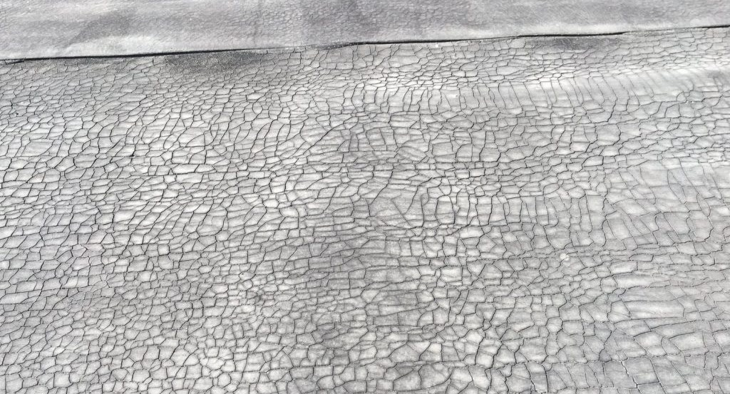
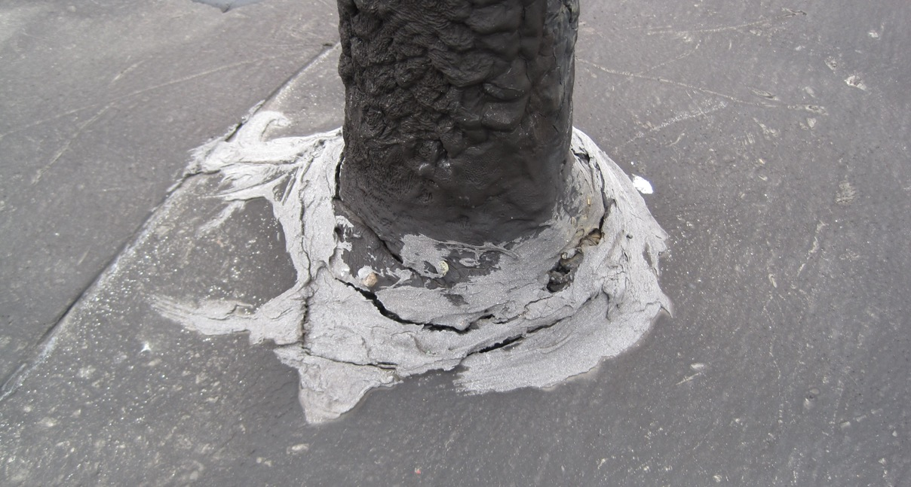
AGED MEMBRANE
Most commercial roofing systems last between 15 and 20 years; that can vary depending on a number of different factors. Regular maintenance and repair can help extend the service life of your roof, but eventually, all roofs need to be fully replaced.
That being said, some roof replacements (tear-offs) are totally unnecessary. Many building owners don’t know that fluid-applied roof restoration systems are a perfectly suitable solution to extend the life of their roof, not to mention roof restoration cost half as much as a full replacement.
Not sure if a fluid-applied roof restoration system is right for your commercial/industrial building? Contact American WeatherStar today to schedule your free roof inspection.
11

Slide 12
WHAT OPTIONS DO YOU HAVE WHEN IT COMES TO YOUR COMMERCIAL OR INDUSTRIAL ROOF?
12

Slide 13
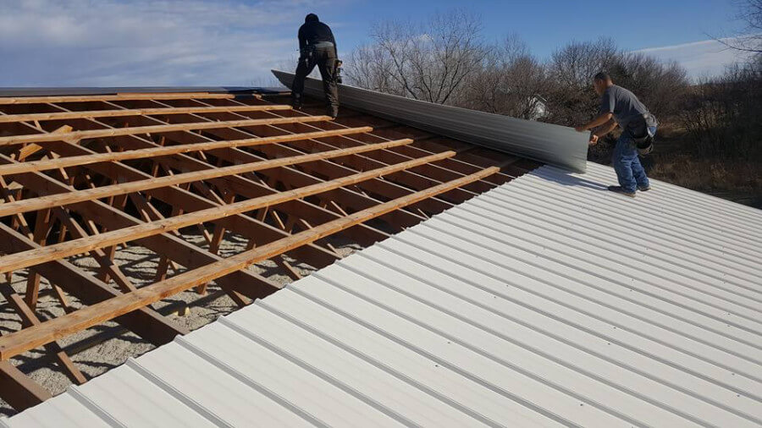
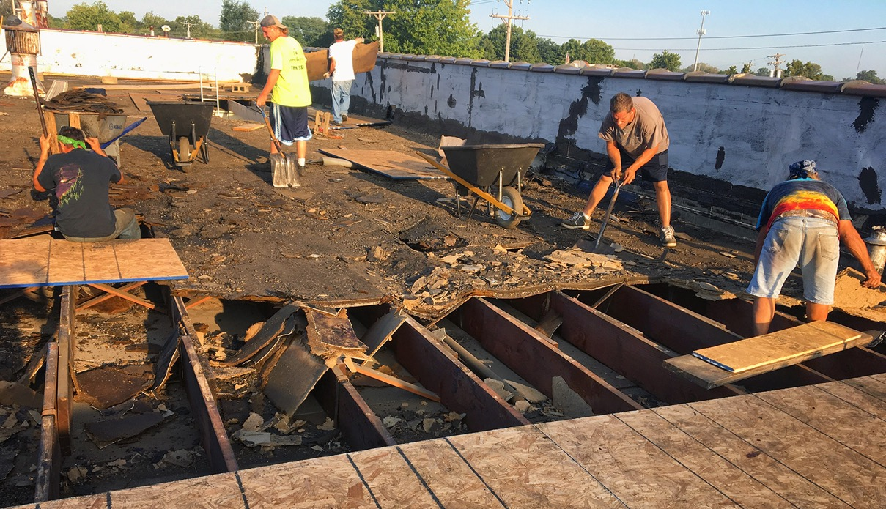
ROOF REPLACEMENT
In some cases, a full roof replacement may be the only option for a building owner, but there are a number of factors to consider before committing to such a costly and extensive endeavor. For this reason, we recommend consulting an American WeatherStar approved contractor to explore all of your options.
13

Slide 14
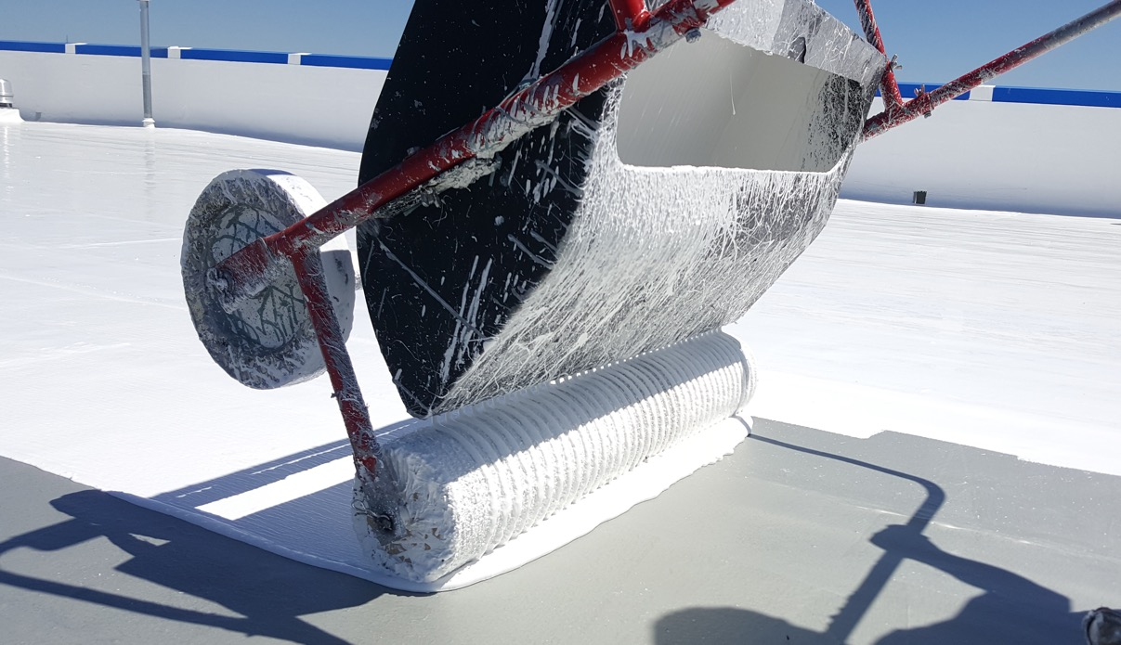
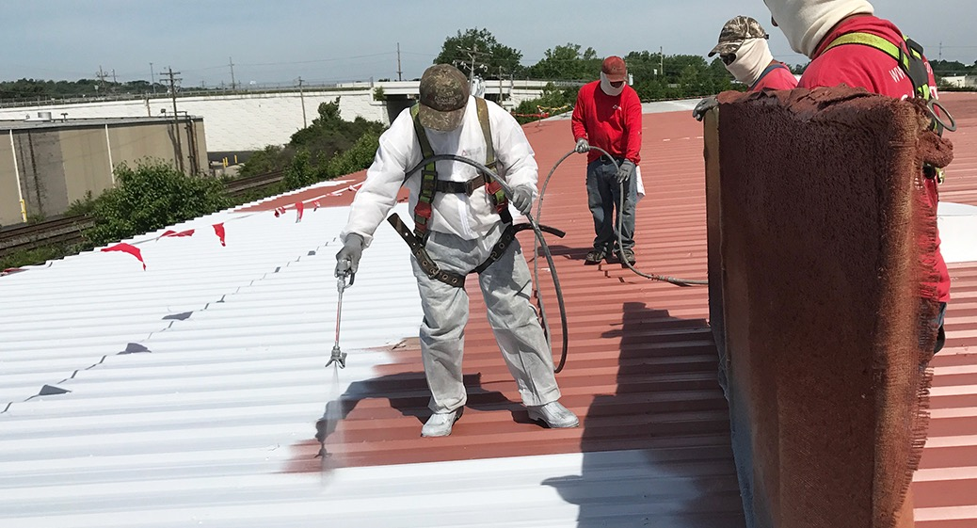
ROOF RESTORATION
For building owners and facility mangers experiencing problems with their roofs, fluid-applied roof restoration is a more sustainable and cost-effective alternative to roof replacement. These systems not only stop leaks, they increase energy savings, reduce internal building temperatures, and prolong roof life.
14

Slide 15
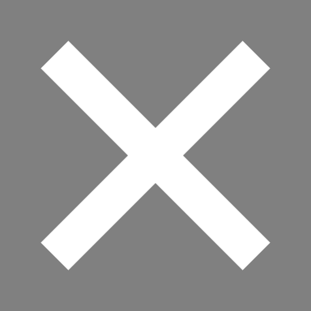
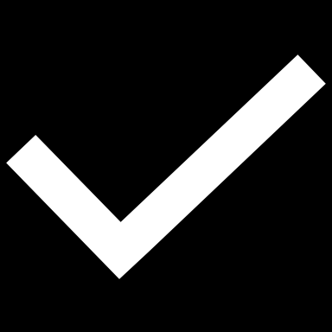
REPLACEMENT VS. RESTORATION
Not every metal roof is a candidate to receive a roof restoration system. Depending on the state of the existing roof system, a full roof replacement may be necessary. However, many roof systems can be restored at nearly half the cost of a full replacement. There are other factors to consider as well:
ROOF REPLACEMENT
ROOF RESTORATION
More expensive
High labor costs
High material costs/volume
More intrusive to business
Less sustainable
Long-term job duration
Low labor costs
Low material costs/volume
Less intrusive to business
More sustainable
Short-term job duration
15
15

Slide 16
THE ULTIMATE SPRAY FOAM ROOFING SOLUTION
EXCLUSIVELY FROM AMERICAN WEATHERSTAR
16

Slide 17
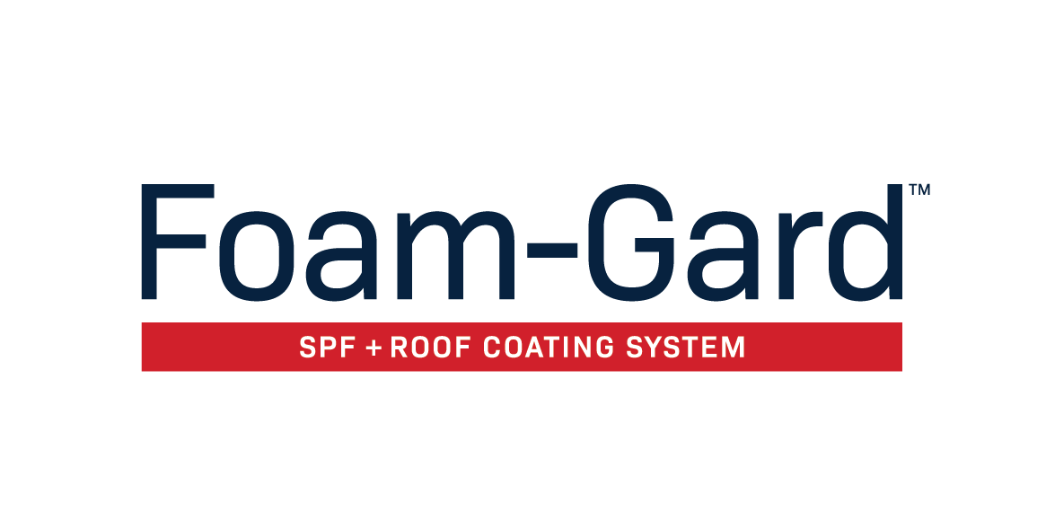
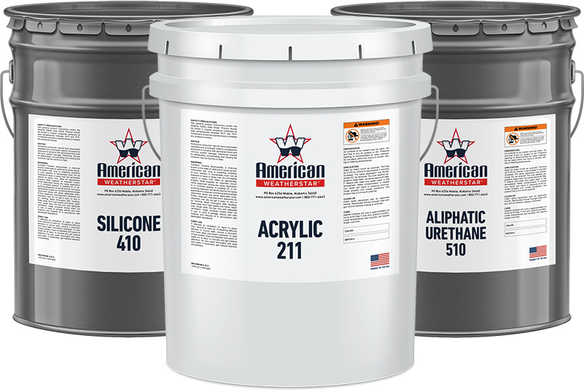
The Foam-Gard System is the preferred spray polyurethane foam (SPF) solution to safeguard commercial and industrial roof surfaces. With its unsurpassed insulative qualities, the Foam-Gard System provides a long-lasting, energy-efficient, and durable air barrier for a variety of roof types including metal, modified bitumen, built-up roofs, & single-ply, and concrete.
17

Slide 18
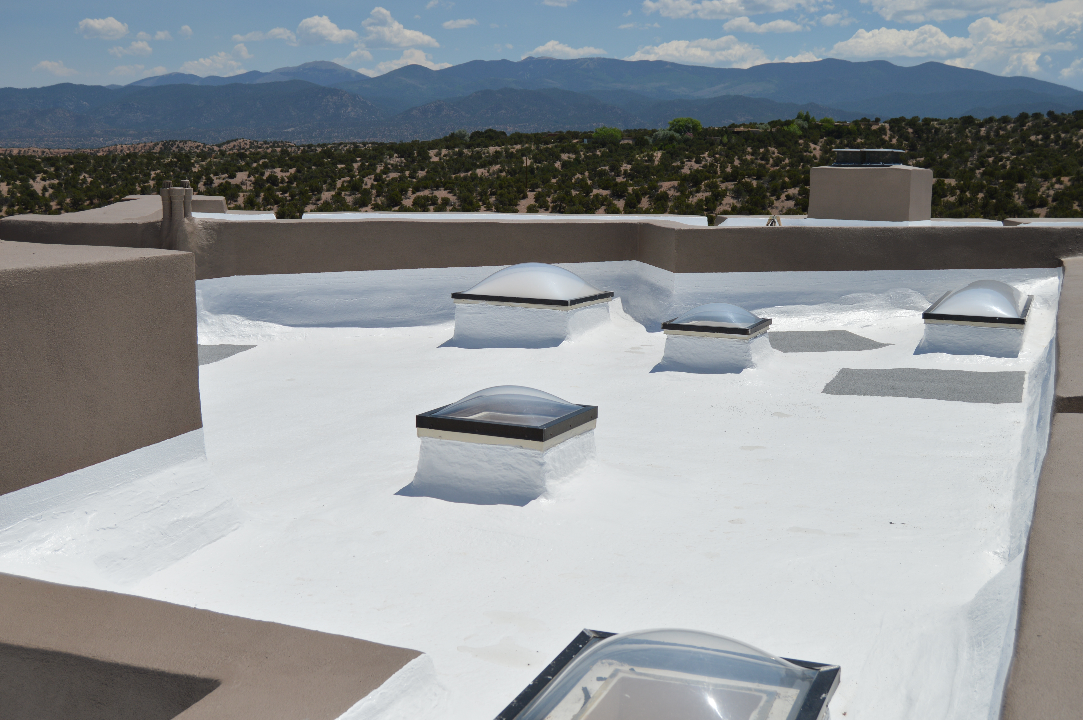
SYSTEM BENEFITS
Stops leaks and vastly improves performance
Provides the highest R-value of any roofing material on the market
Substantially reduces maintenance and energy costs
Extends service life by restoring the existing roof membrane
Industry-leading UV stability, reflectivity, and durability
Cures to form a seamless, watertight membrane
Long-term StarGard Warranty plans available
Provides minimal interruption to business
18

Slide 19
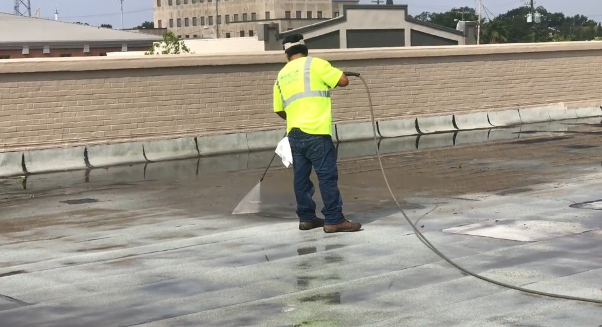
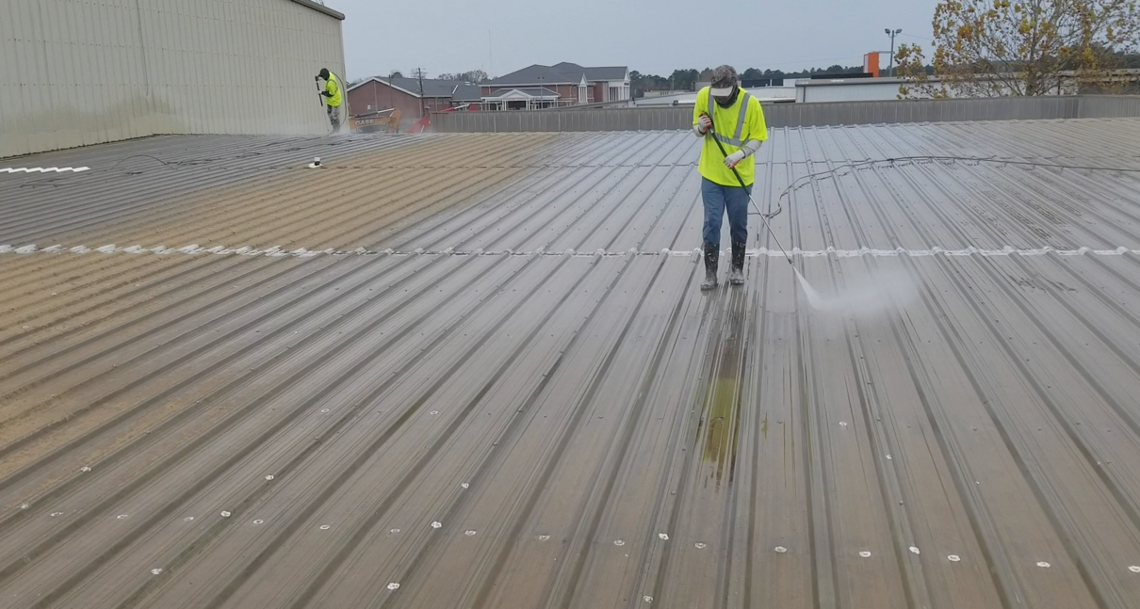
APPLICATION PROCESS
STEP 1: SURFACE PREPARATION
First, the roof surface is thoroughly pressure washed to ensure all dirt and debris are removed. Any problem areas found during surface preparation are addressed before any coating products are applied.
19

Slide 20
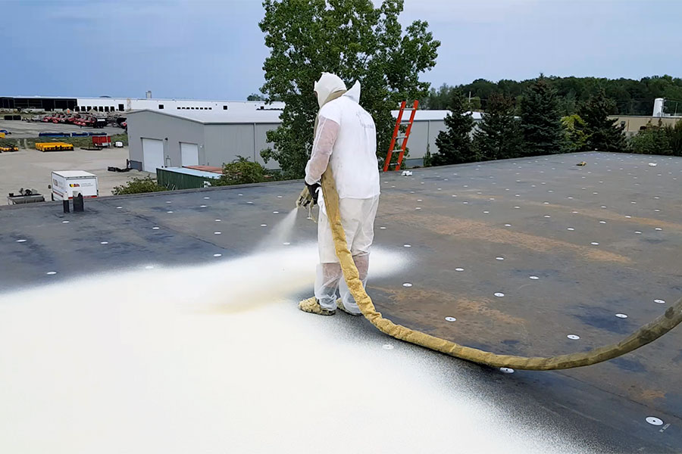
APPLICATION PROCESS
STEP 2: SPRAY POLYURETHANE FOAM
An application of spray polyurethane foam (SPF) provides and incredibly strong, yet lightweight insulation barrier with unsurpassed-value.
20

Slide 21
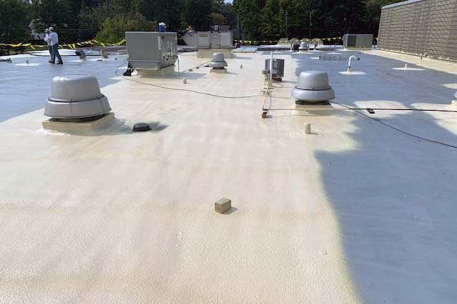
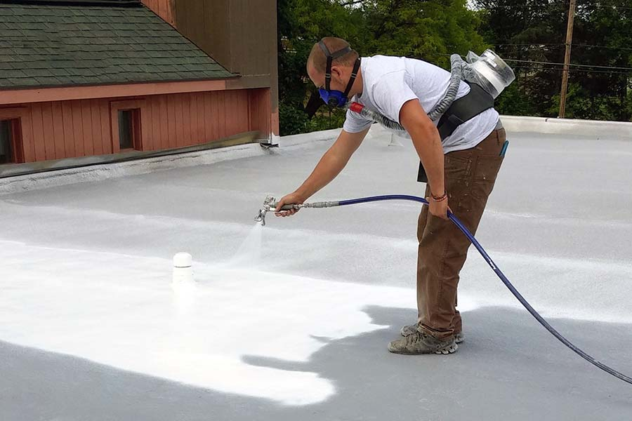
APPLICATION PROCESS
STEP 3: ELASTOMERIC ROOF COATINGS
To protect the SPDF foundation, multiple coats of elastomeric roof coating are then applied providing UV protection, reflectivity, and supplemental waterproofing.
21

Slide 22
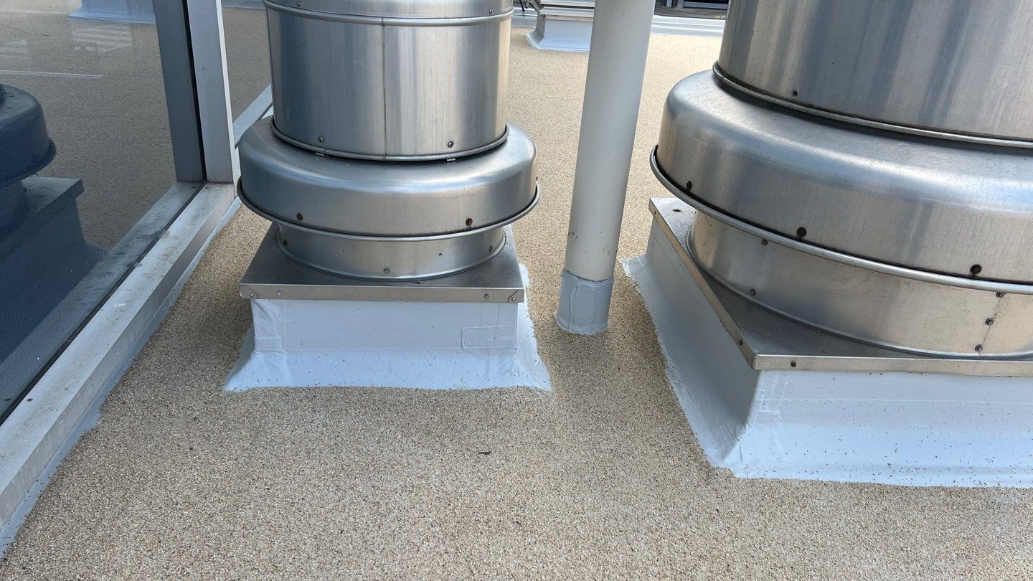
APPLICATION PROCESS
STEP 4: ROOFING GRANULES
Roofing granules are then broadcast directly into the elastomeric top coat to increase weather-resistance and durability.
22

Slide 23
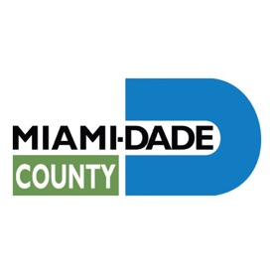
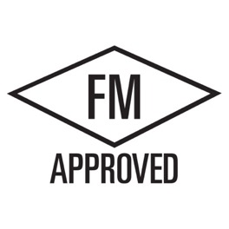
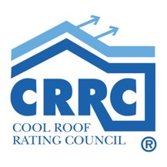
SYSTEM AND PRODUCT APPROVALS
23

Slide 24
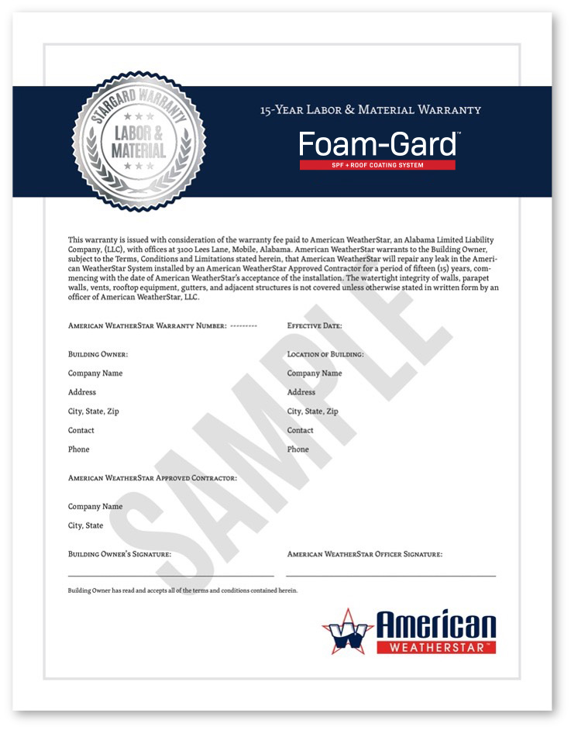
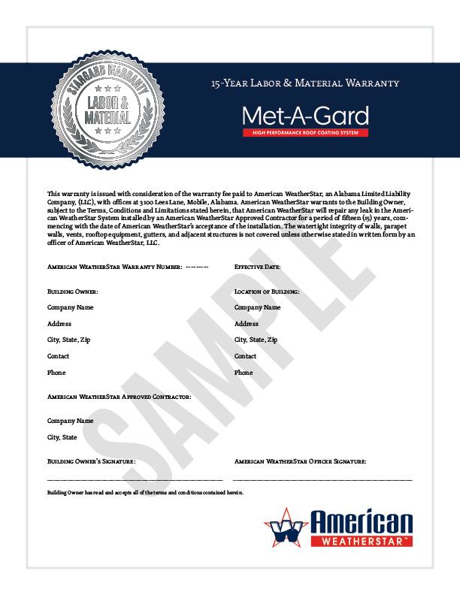
SUSTAINABLE
WARRANTY OPTIONS
American WeatherStar offers a NDL System Material warranty for most of its roof restoration systems when installed by an American WeatherStar approved contractor. Contact your American WeatherStar approved contractor to discuss your options.
10, 12, 15, and 20-year warranty options
Renewable, transferable, and extendable
CLICK HERE TO LEARN MORE
24

Slide 25
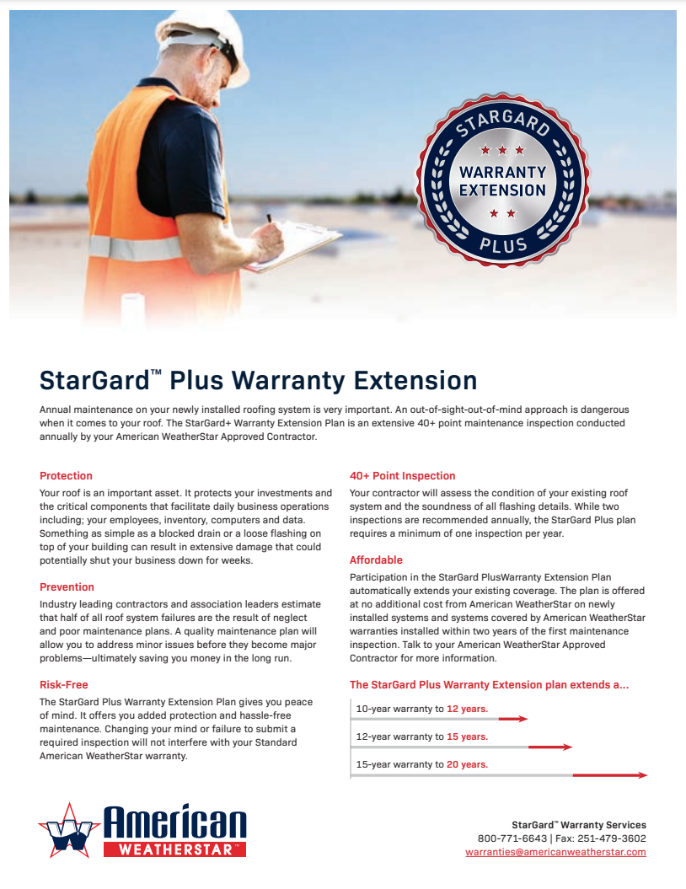
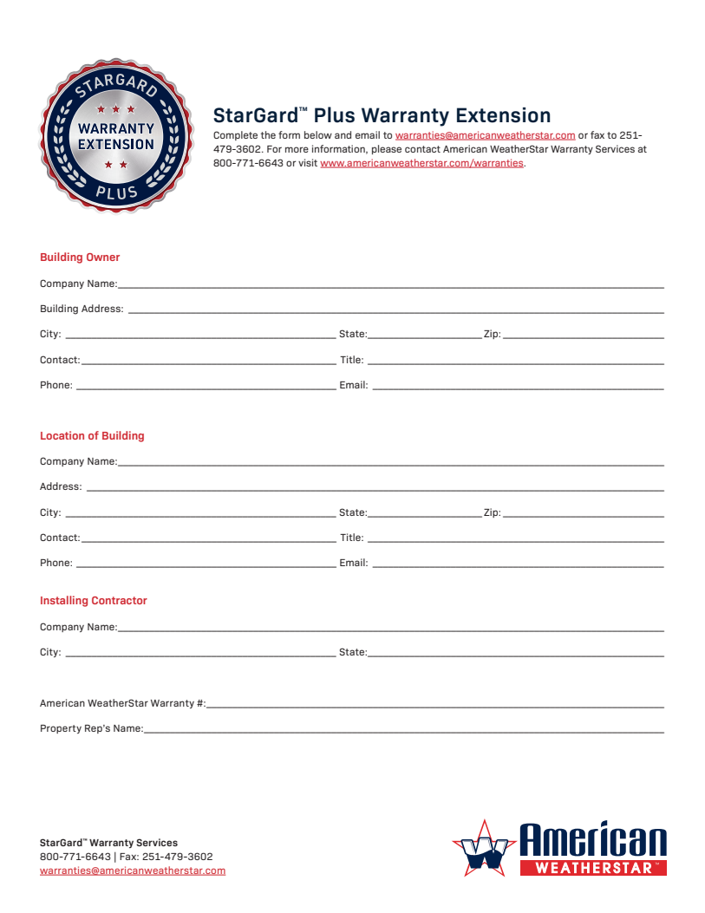
STARGARD+ WARRANTY
EXTENSION PLAN
Annual maintenance on your newly installed roofing system is very important. An out-of-sight-out-of-mind approach is dangerous when it comes to your roof. The StarGard+ Warranty Extension Plan is an extensive 40+ point maintenance inspection conducted annually by your American WeatherStar approved contractor.
40+ point inspection
Risk-free and affordable
Added protection and prevention
CLICK HERE TO LEARN MORE
25

Slide 26
CUSTOMER TESTIMONIALS
We are very impressed with the Met-A-Gard+ system we had put on our metal roof. We had leaks and other concerns such as heat reduction and waterproofing the roof. The contractor came in a very timely manner and handled the job perfectly. It has been two years and we have had neither issues nor a reason to get up on the roof. The system did exactly what the website advertised it would do.
John Hanney
Refuge Temple Ministries.
Lake Charles, LA
The number one problem with my metal roof has always been weather conditions. They’re constantly changing, and my roof expands and moves nonstop. This makes my roof leak and causes disruption in the company. The Met-A-Gard system is the first solution I have been able to find which moves with the roof. The installing contractor made all of the difference in the world! If I needed any repairs or additional help, they were right on top of it. I no longer have leaks in my roof, and I am very pleased with this system.
Joe Brackett
Power Equipment Co.
Memphis, TN
We had several leaks in our roof. American WeatherStar referred us to an approved contractor, and they did a phenomenal job. They installed the Met-A-Gard system and were done in no time with a job well completed. I noticed the energy levels already decreasing in the building and have not had any issues with leaking since. They did a great job! I have already recommended to a colleague of mine who is having similar issues with his metal roof.
Timothy Armentor
Armentor
Youngsville, LA
26

Slide 27
HELPFUL LINKS
INFORMATIONAL LINKS
Foam-Gard Quick Spec
StarGard Warranty Program
StarGard+ Warranty Extension Plan
PRODUCT DATA SHEETS
Acrylic 211
High-Tensile Acrylic 211
Silicone 410
Aliphatic Urethane 510
APPLICATION GUIDELINES
Foam-Gard
www.americanweatherstar.com | info@americanweatherstar.com | Toll Free: 800-771-6643

