Slide 1


LUNCH & LEARN
Approved Contractor Program

Slide 2
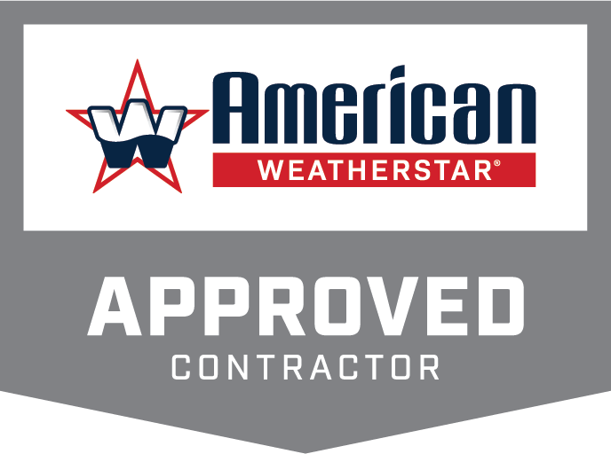
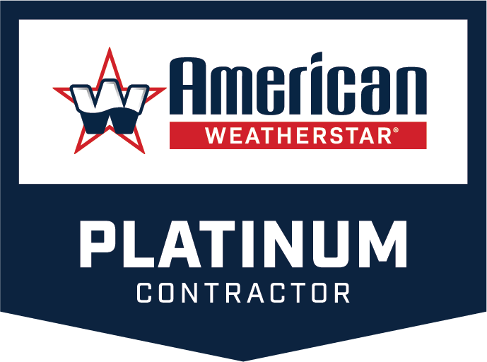
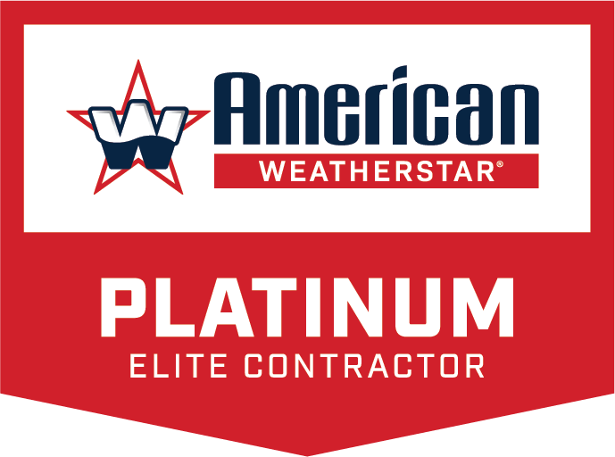


Slide 3
Presentation Outline
Requirements
Benefits
Moving up in the Program
Sales & Marketing Tools
Training & Education
Technical Resources
Certified Applicator Program
  Requirements
  Benefits

Slide 4
Requirements

Slide 5
Requirements
Approved Contractor
Licensed/Insured
Commercial roofing experience
No coating MFG certifications
Platinum Contractor
Licensed/Insured
Commercial roofing experience
Substantial coatings experience
Approved by major coating industry manufacturers
Platinum Elite Contractor
Licensed/Insured
Commercial Roofing Experience
Substantial coatings experience
Approved by major coating industry manufacturers
Certified applicator on staff
Continue to meet AWS quality standards

Slide 6
Benefits

Slide 7
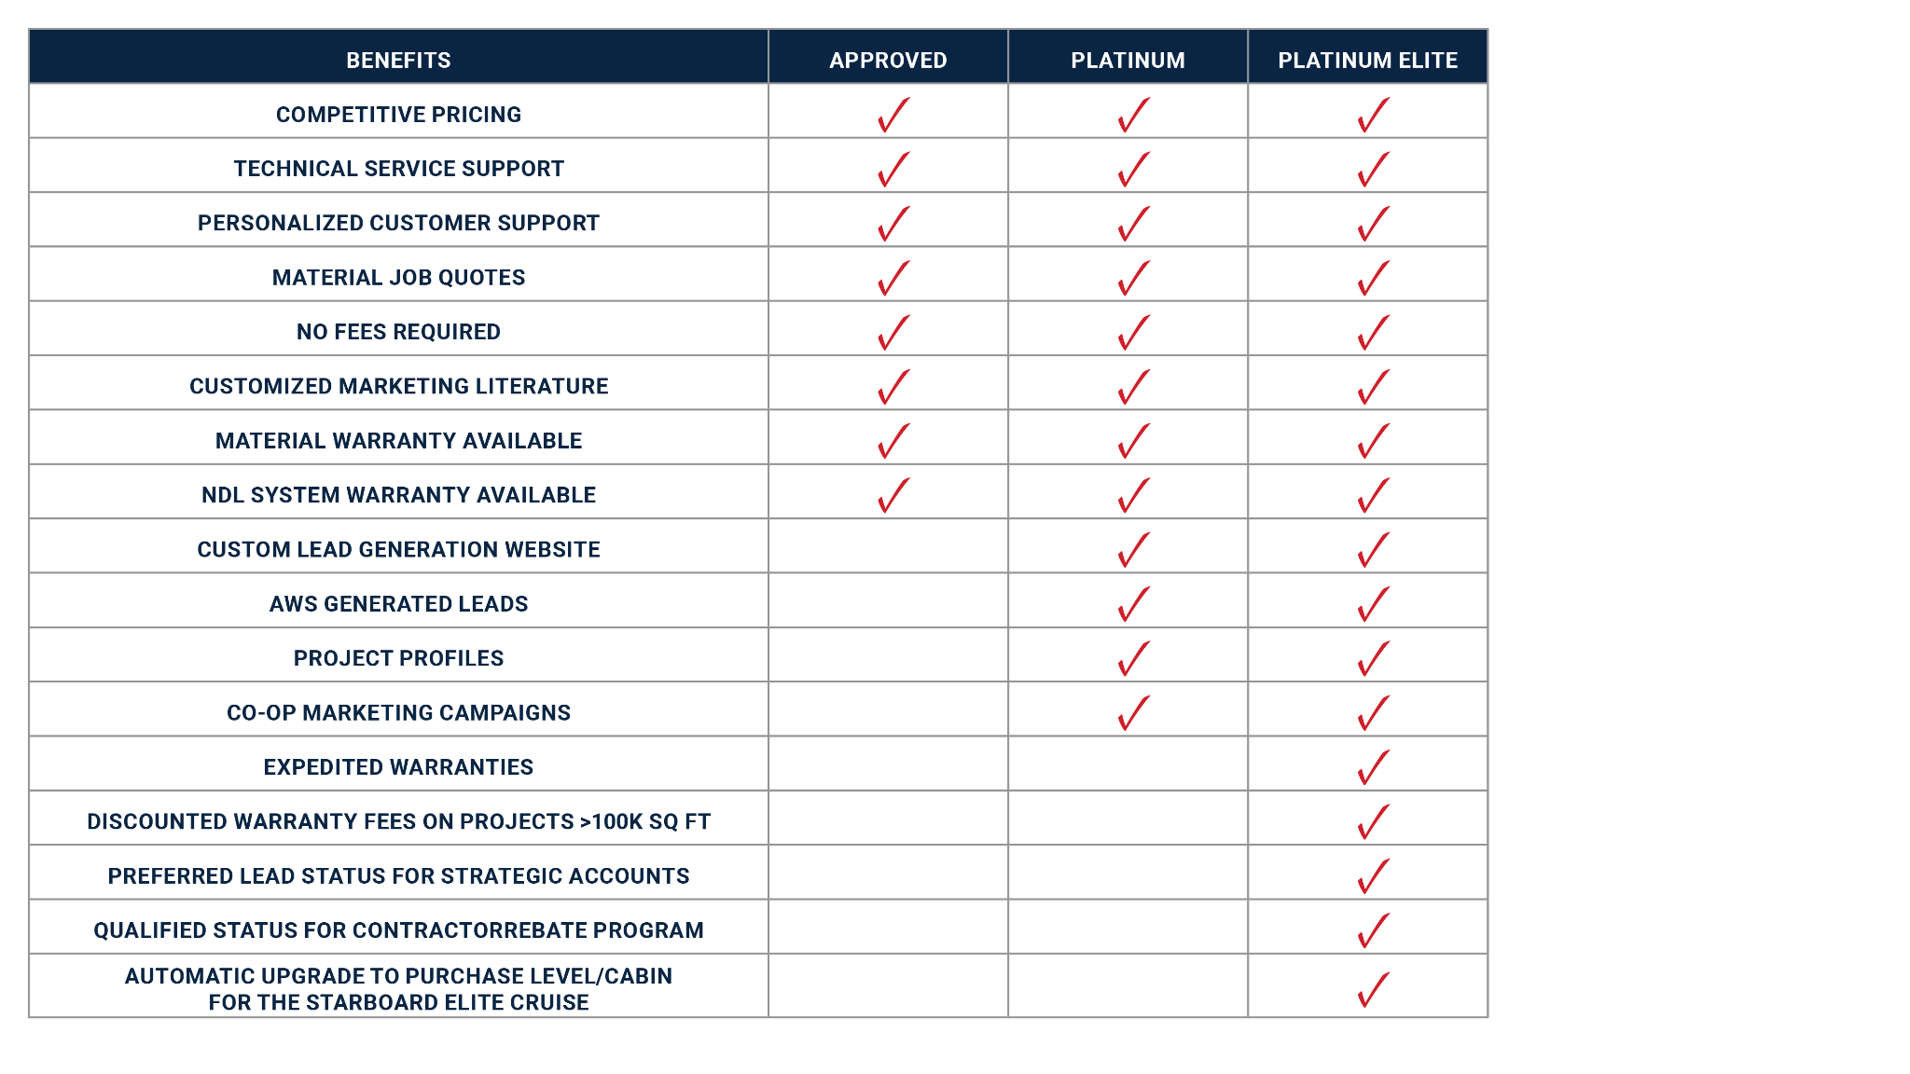
Benefits

Slide 8
Moving Up

Slide 9
Moving Up
Moving up to Platinum
3 American WeatherStar jobs installed:
  Minimum 5,000 sq ft each
  Minimum 1 metal & 1 flat
Inspected by AWS at AWS’ expense
Passing grade of 8 on a 10 point scale
Moving up to Platinum Elite
Minimum one crew member become an
AWS Certified Applicator
Meets AWS quality standards
  100K sq ft per year installed & inspected
  Scores a min of 8 out of 10 on inspections

Slide 10
Sales & Marketing

Slide 11
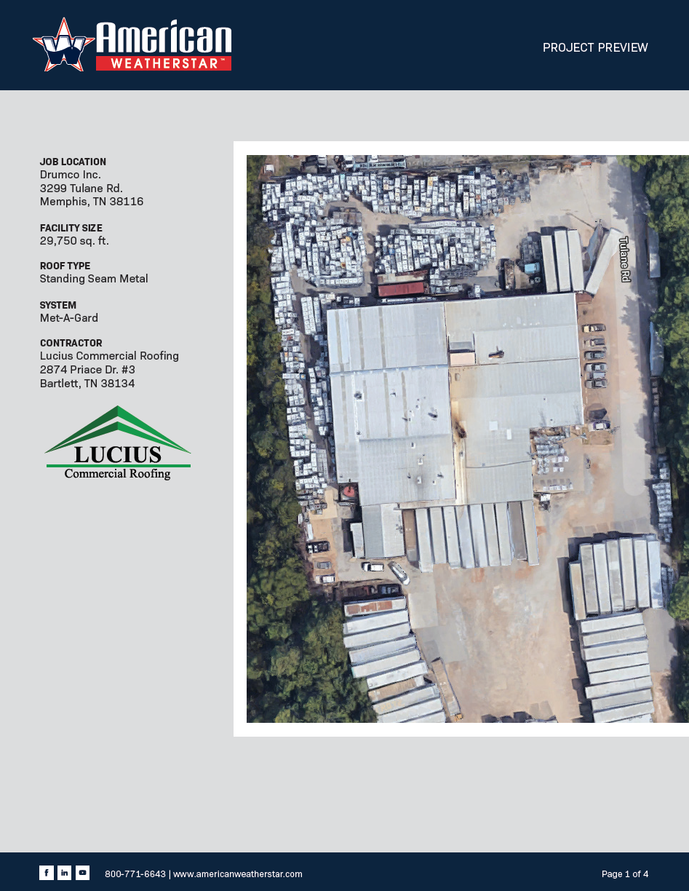
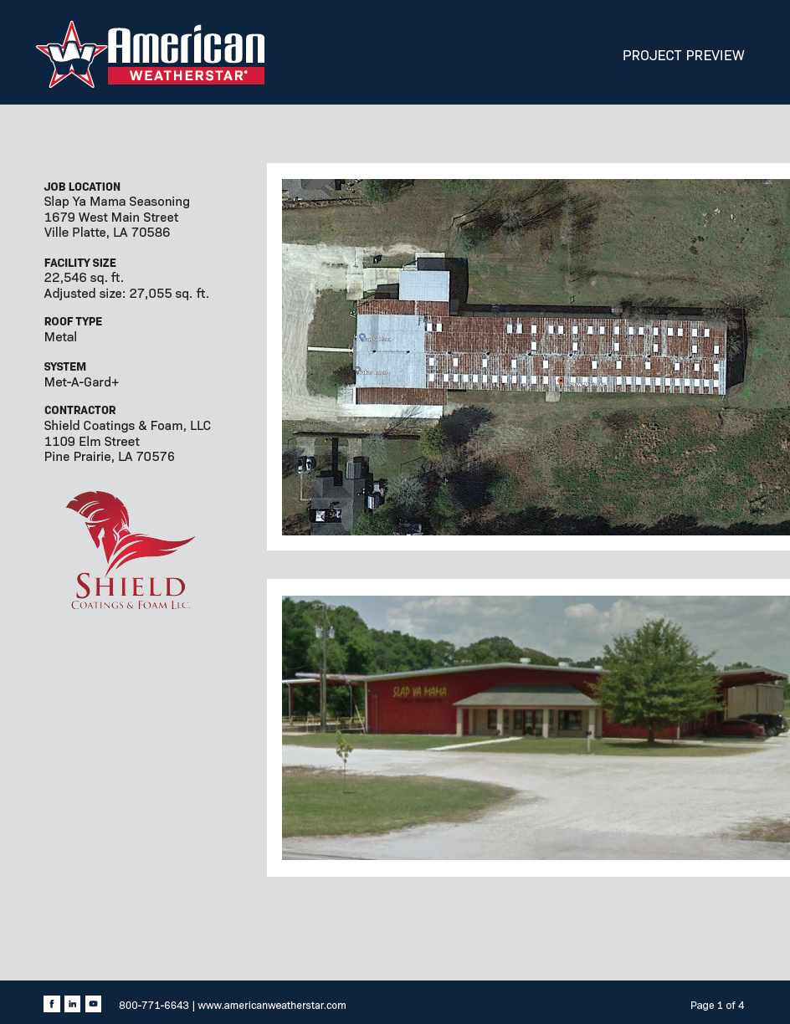
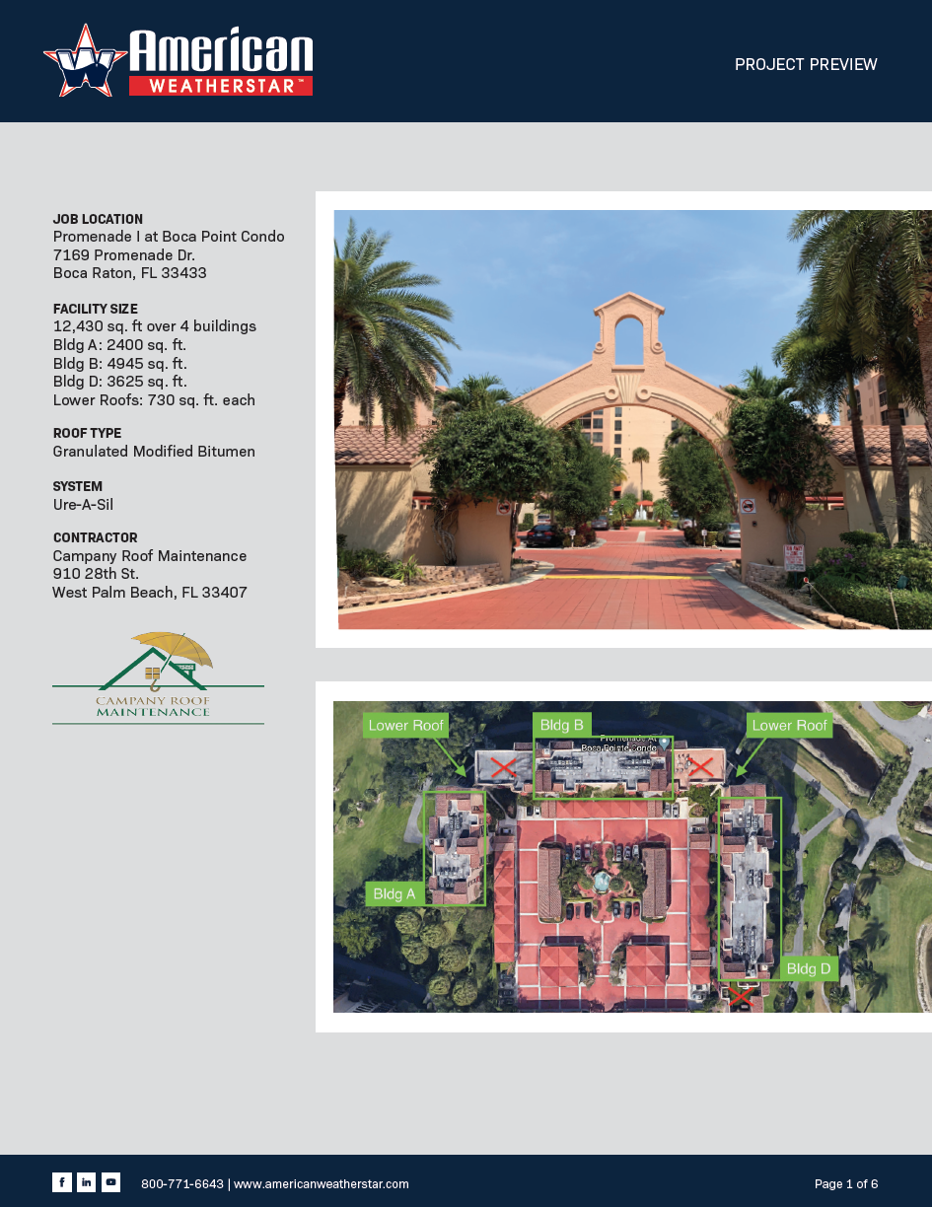
Sales &
Marketing
Tools
Project Previews
Project Previews

Slide 12
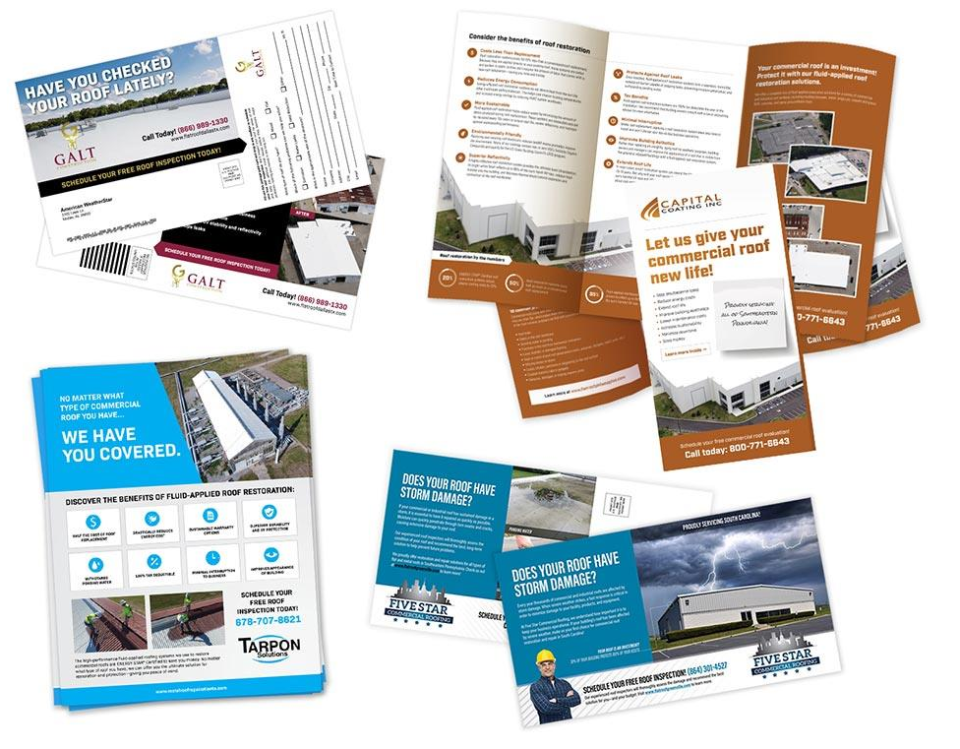
Sales &
Marketing
Tools
Custom Marketing Pieces
Marketing Tools

Slide 13
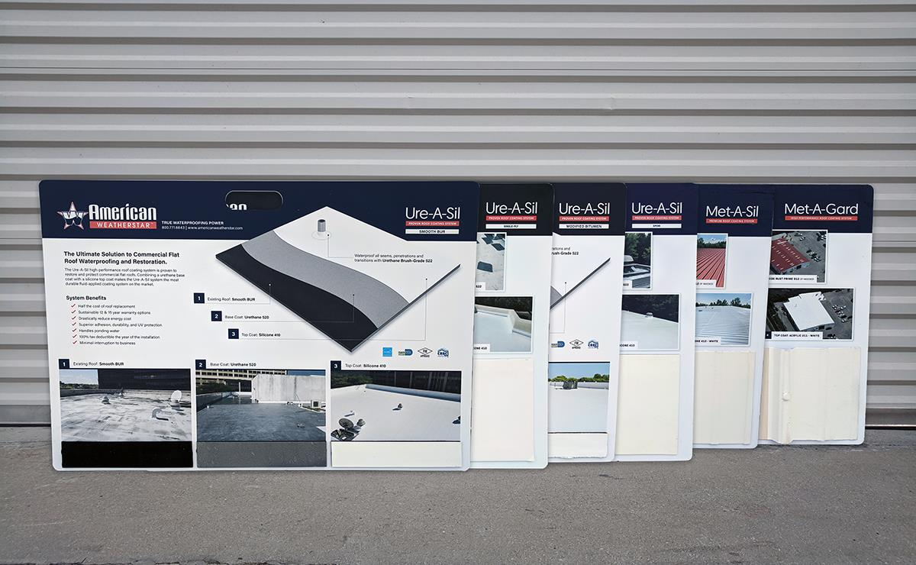
Sales &
Marketing
Tools
System Boards
with Samples
System Boards

Slide 14
Training & Education

Slide 15

Training & Education
Introductions to fluid-applied systems & products
Traditional in-class multimedia presentations
Hands-on demos with roof coatings & equipment
Networking opportunities with industry pros
Insights into sales & lead generations techniques
Q&A sessions Platinum Elite Contractors
2-day & 1-day training courses available

Slide 16

Training & Education
FAST Training Classes

Slide 17
Technical Resources

Slide 18
Technical Resources
Product Data Sheets
Application Guidelines
Detail Drawings
Project Support Documents
Quick Specs
Roof Surface Cross Reference Charts
Mastic Coverage Rates
Safety Data Sheets
Warranties
Docs & Downloads

Slide 19


Slide 20
Certified Applicator Program
Requirements
Employed by an AWS Approved Contractor
Completed Application
Experience on a minimum of 2 AWS coatings projects
Attend a FAST course
Pass online QC test
Benefits
Build professional value in you and your team with recognition from an industry leader
Certified Applicator Certificate
SWAG

Slide 21
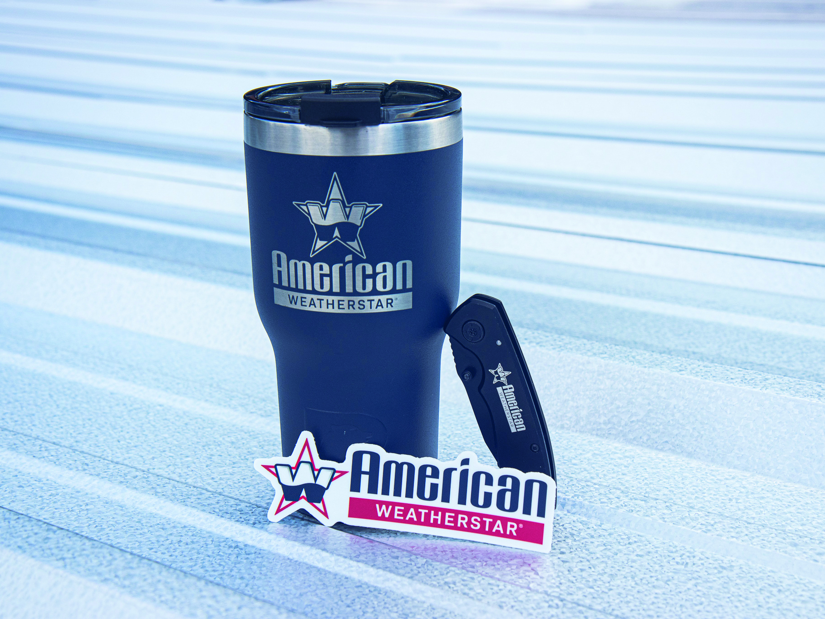
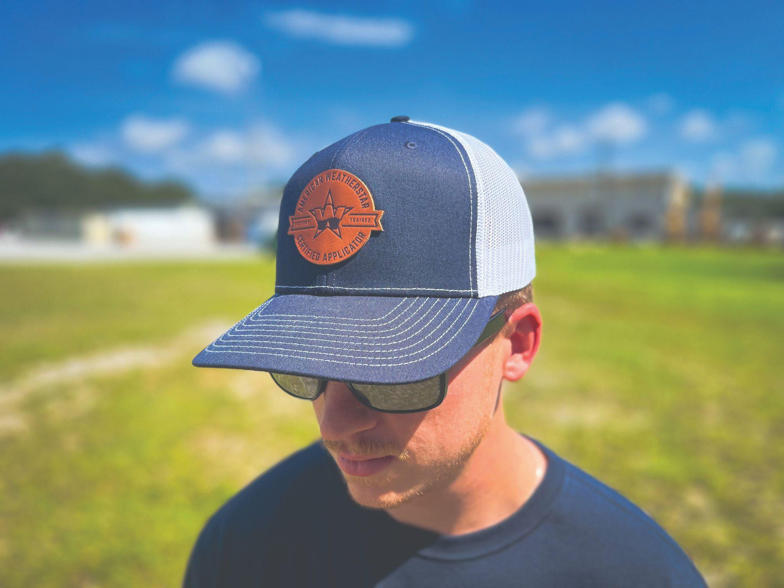
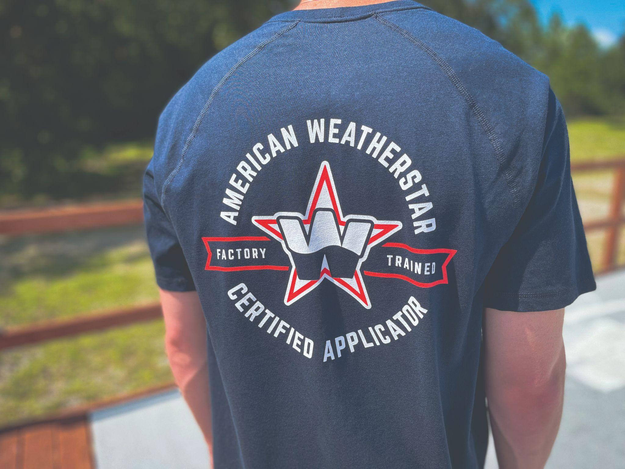
Certified Applicator Program – SWAG

Slide 22

For more information, visit our website: www.americanweatherstar.com

