Slide 1
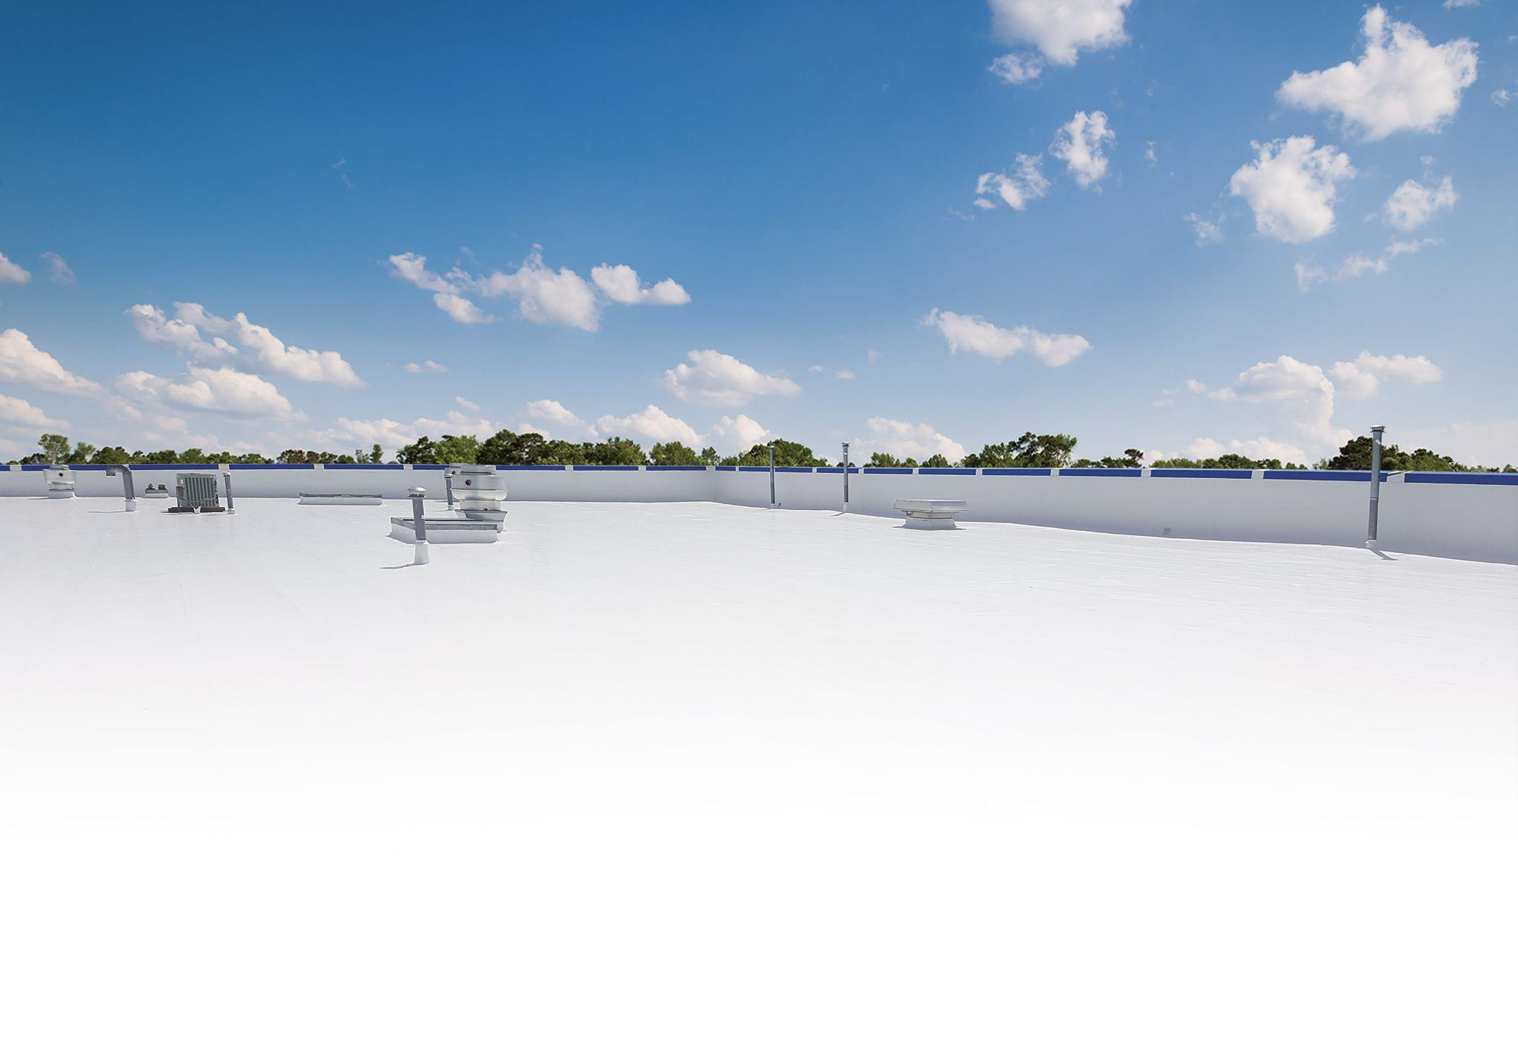

LUNCH & LEARN
Flat Roof Restoration

Slide 2

Lunch & Learn Outline
System Basics
Estimating Job Costs
Marketing Tools
Warranty Program

Slide 3
System Basics

Slide 4
Flat Roof Restoration – System Basics
Suitable Substrates?
Which AWS products compose this system?
What are my payment options?
What types of warranties are available for this system?
When is this system the best option?
When is it not the best option?

Slide 5
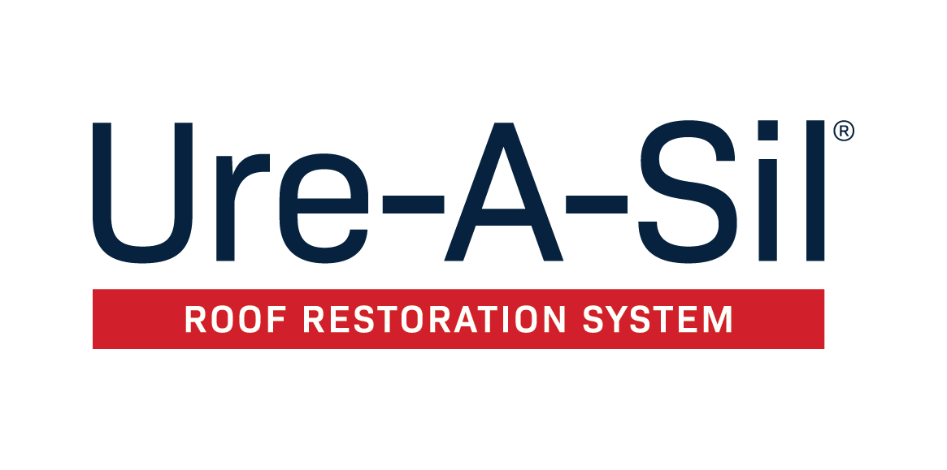
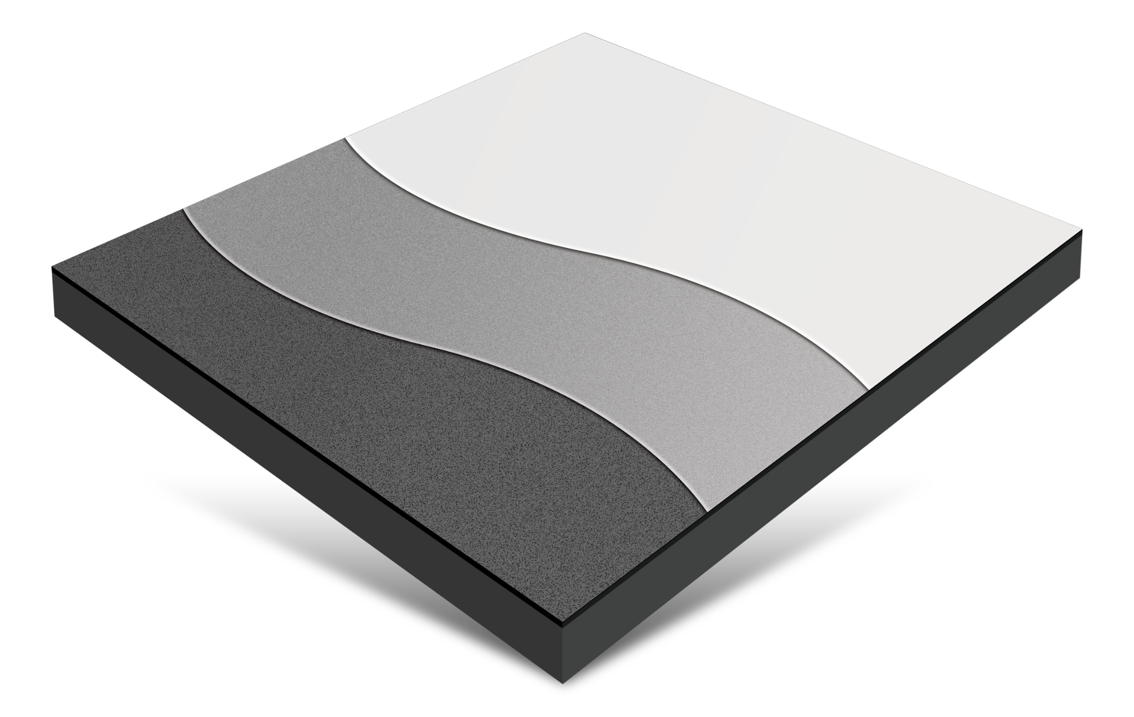

Suitable Substrates?
Modbit, Smooth BUR, Single-ply, concrete, SPF
Which products compose this system?
Waterproofing: Urethane Brush-Grade 522
Base Coat: Aromatic Urethane 520
Top Coat: Silicone 410 or 412
What are my equipment options?
Hydraulic Spray Rig
Super Spreader
What type of warranties are available?
12, 15, and 20 year
When is this system the best option?
Cool Weather
Low Slope
More than 10-year warranty required
Areas with high probability of rain
When is it not the best option?
Xylene based materials cause an odor in the are
(make sure AC units are not pulling in fresh air)
Existing Substrat
Top Coat
Silicone 410 or
High Solids Silicone 412
Base Coat
Urethane 520
Waterproofing
Urethane Brush-Grade 522
Ure-A-Sil Overview

Slide 6

Suitable Substrates?
Modbit, Smooth BUR, Single-ply, SPF
Which products compose this system?
Primers: Fabric Bond 930
Waterproofing: Terminator 622, Silicone Brush Grade 422
Base Coat: High Solids Silicone 412
Top Coat: High Solids Silicone 412
What are my equipment options?
Graco 933
Super Spreader with Rooftop Equipment’s Profile Rollers
What type of warranties are available?
10, 15, and 20 year
When is this system the best option?
When VOCs or fuels are an issue
When is it not the best option?
When system or high traffic is an issue
Adhesion qualities and durability do not
match the Ure-A-Sil system
Existing Substrat
Top Coat
High Solids Silicone 412
Base Coat
High Solids Silicone 412
Waterproofing
Silicone Brush-Grade 422
or Terminator 622
Envir-O-Sil Overview

Slide 7
Estimating Job Costs

Slide 8
Estimating Job Costs – Flat Roof Restoration
System/Chemistry being installed
Application Method
Time of Year/Weather Conditions
Prep required in advance of coating
Logistics (distance from contractors location)
Key Factors for Determining Job Timeline
Size of Project
Slope
Roof Substrate
Roof Access (Is a lift required?)
Staging Material
Roof Layout (Are there multiple sections?)

Slide 9
Estimating Job Costs
Ure-A-Sil (12-Year System)
Roof Type ……………………………………………………………………………….. EPDM w/Seam every 10’
Roof Size ……………………………………………………………………. 25,000 Square Feet (250’ x 100’)
Waste Factor …………………………………………………………………………………………………………………. 5%
Total Area (including waste) …………………………………………………………. 26,250 Square Feet
Seams …………………………………………………………………………………………………… 2,750 Linear Feet
(6) Drains ……………………………………………………………………………………………………….. 2’ Diameter
(12) Pipe Vents .…………………………………………………………………………………………….. 2’ Diameter
(2) HVAC Units ……………………………………………………………………………………………. 24’ Diameter

Slide 10
Ure-A-Sil (12-Year System)
APPLICATION STEP | PRODUCT | COVERAGE RATE-REQUIRED DFT | QUANTITY REQUIRED | APPROX MATERIAL COST
PRESSURE WASH | EcoCleaner 925 | 150 square feet per gallon | 50 gallon (dilute 4:1) | $0.11 per sq ft
PRIMER | - | - | - | -
WATERPROOFING | - | - | - | -
SEAMS - SIDES & END LAPS | Urethane Brush-Grade 522 | 100 linear feet per gallon | 30 gallons | $0.07 per sq ft
PERIMETER OF ROOF | Urethane Brush-Grade 522 | 100 linear feet per gallon | 10 gallons | $0.02 per sq ft
PENETRATIONS | Urethane Brush-Grade 522 | 35 linear feet per gallon | 2 gallons | $0.01 per sq ft
BASE COAT APPLICATION | Aromatic Urethane 520 | 1 gallon per square feet | 265 gallons | $0.54 per sq ft
TOP COAT APPLICATION | Silicone 410 | 1.5 gallon per square feet | 395 gallons | $0.77 per sq ft
 |  |  |  | Total Cost: $1.52

Slide 11
Ure-A-Sil (12-Year System)
(based on a 4 man experienced crew)
APPLICATION STEP | ESTIMATED TIME TO COMPLETE
PRESSURE WASHING | 2 days
PRIMER APPLICATION | -
WATERPROOFING | 2 days
BASE COAT APPLICATION | 3 days
TOP COAT APPLICATION | 3 days
TOTAL TIME INVESTED | 10 working days

Slide 12
Marketing Tools

Slide 13
Marketing Tools - Overview
Website landing pages
Testimonials
System boards
Dry samples
System view videos
System brochures
Quick specs
Case studies
System branded warranties
StarGard+ program
Project Previews
Rooftop contact sign

Slide 14
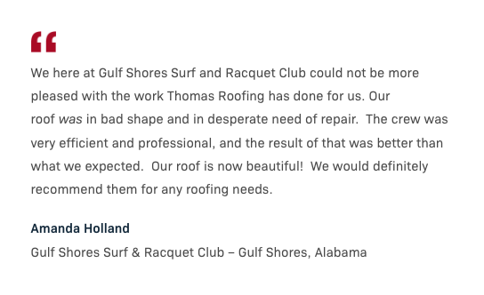
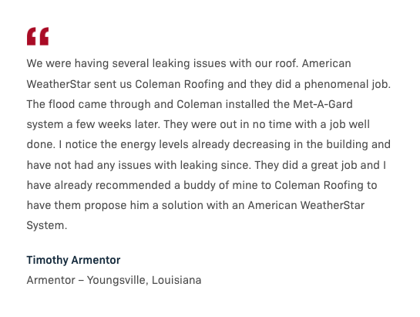
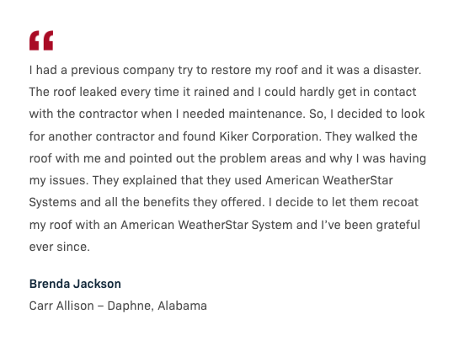
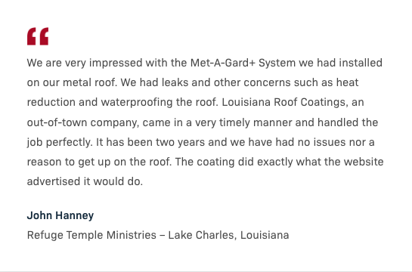
Sales &
Marketing
Tools
Testimonials
Testimonials

Slide 15
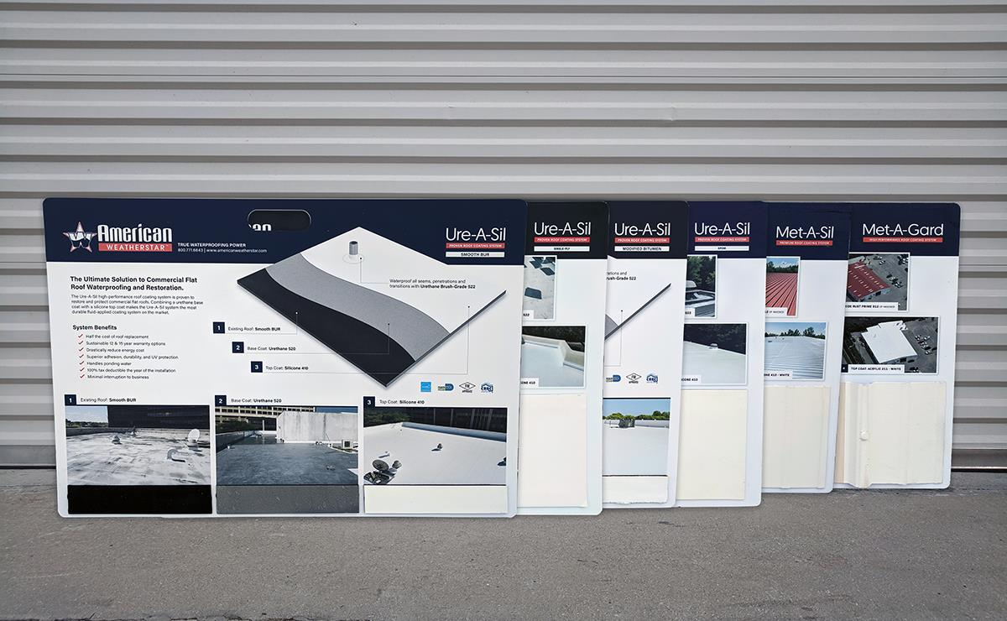
Sales &
Marketing
Tools
System Boards
System Boards

Slide 16
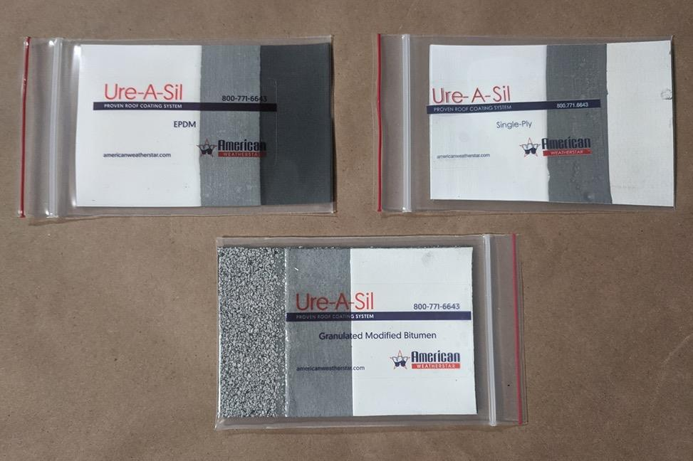
Sales &
Marketing
Tools
Dry Samples

Slide 17
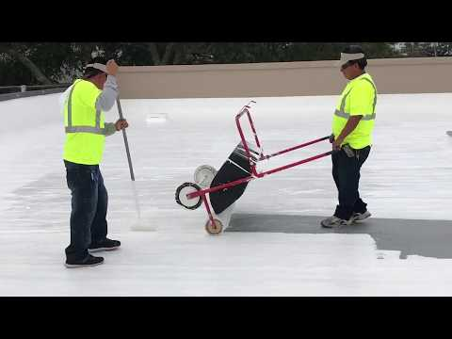
Sales &
Marketing
Tools
Informational Videos

Slide 18
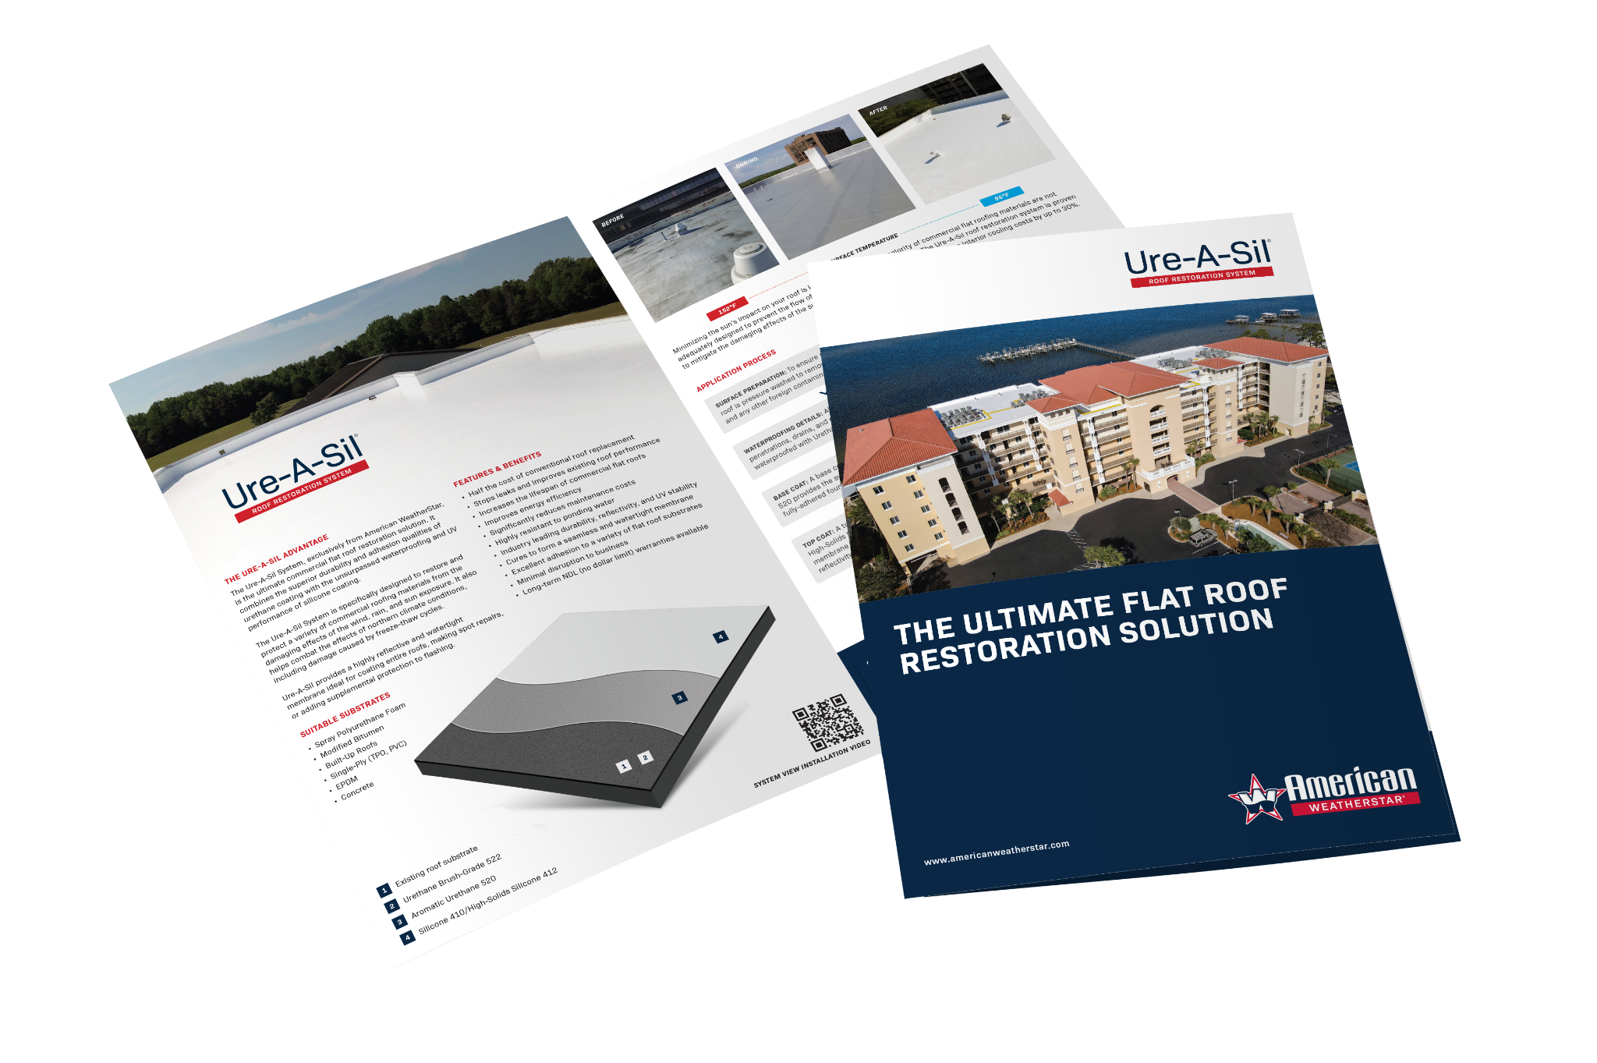
Sales &
Marketing
Tools
System Brochures
System Brochures

Slide 19
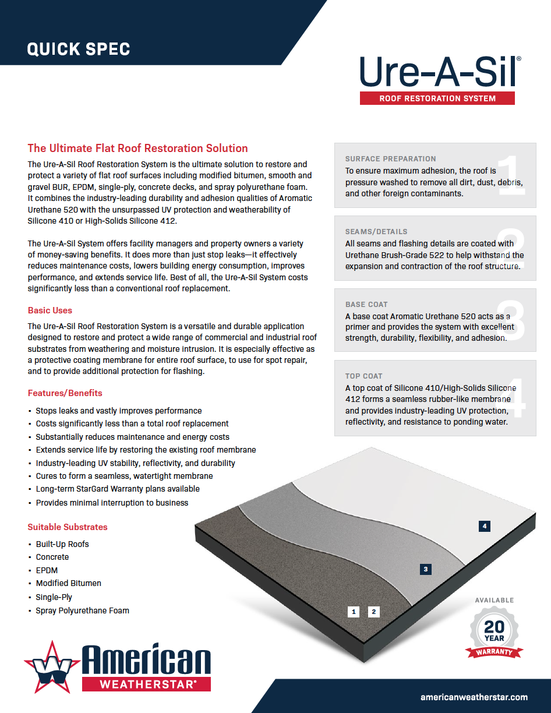
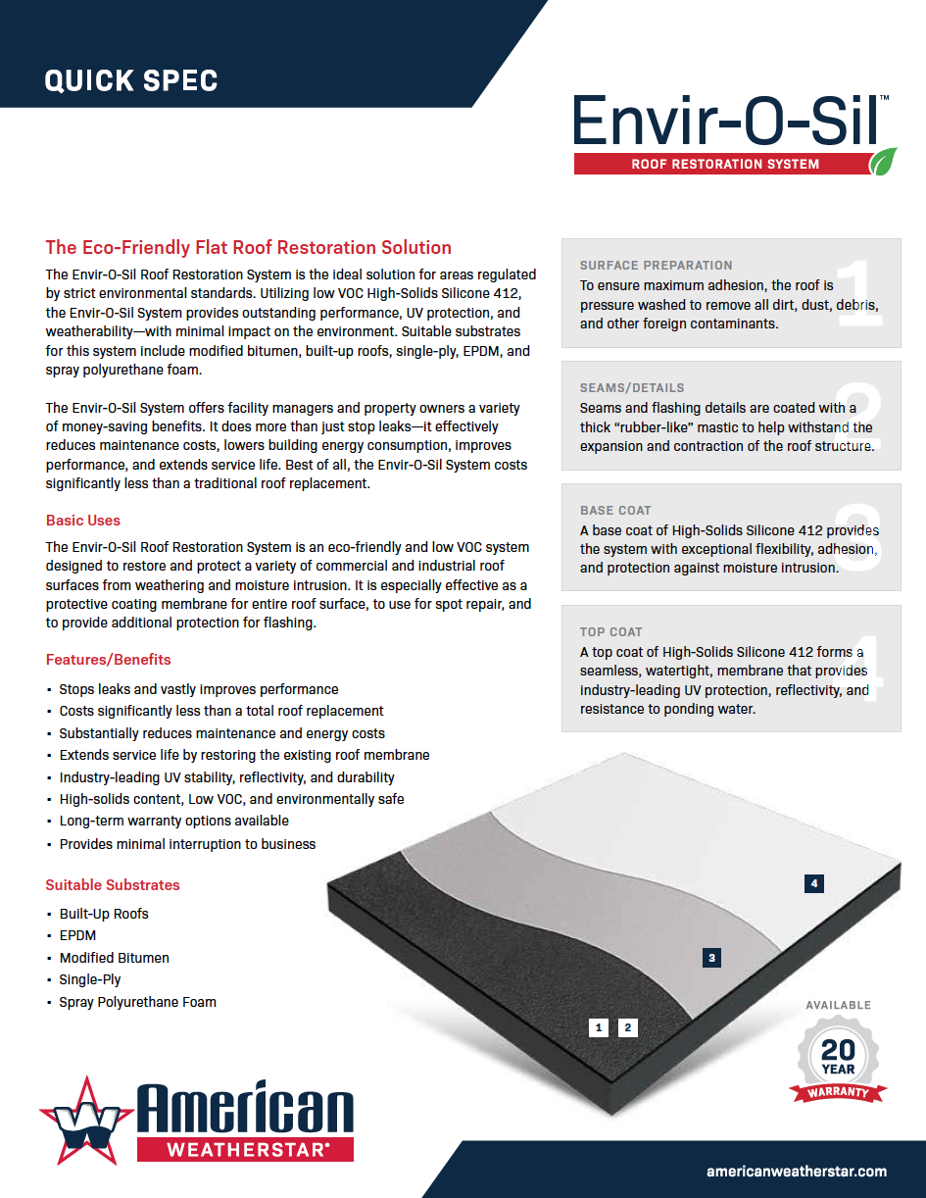
Sales &
Marketing
Tools
Quick Specs
Quick Specs

Slide 20
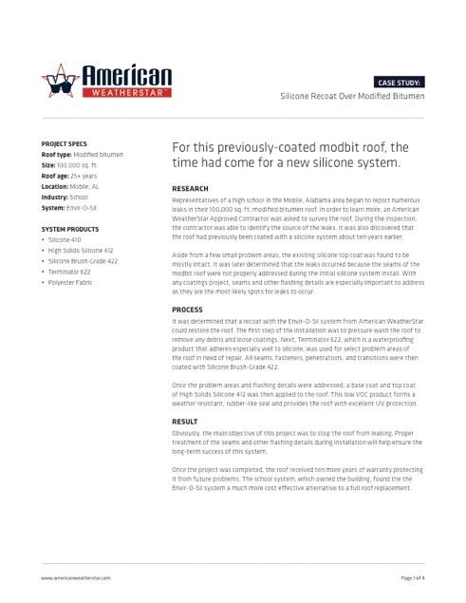
Sales &
Marketing
Tools
Case Studies
Case Studies

Slide 21
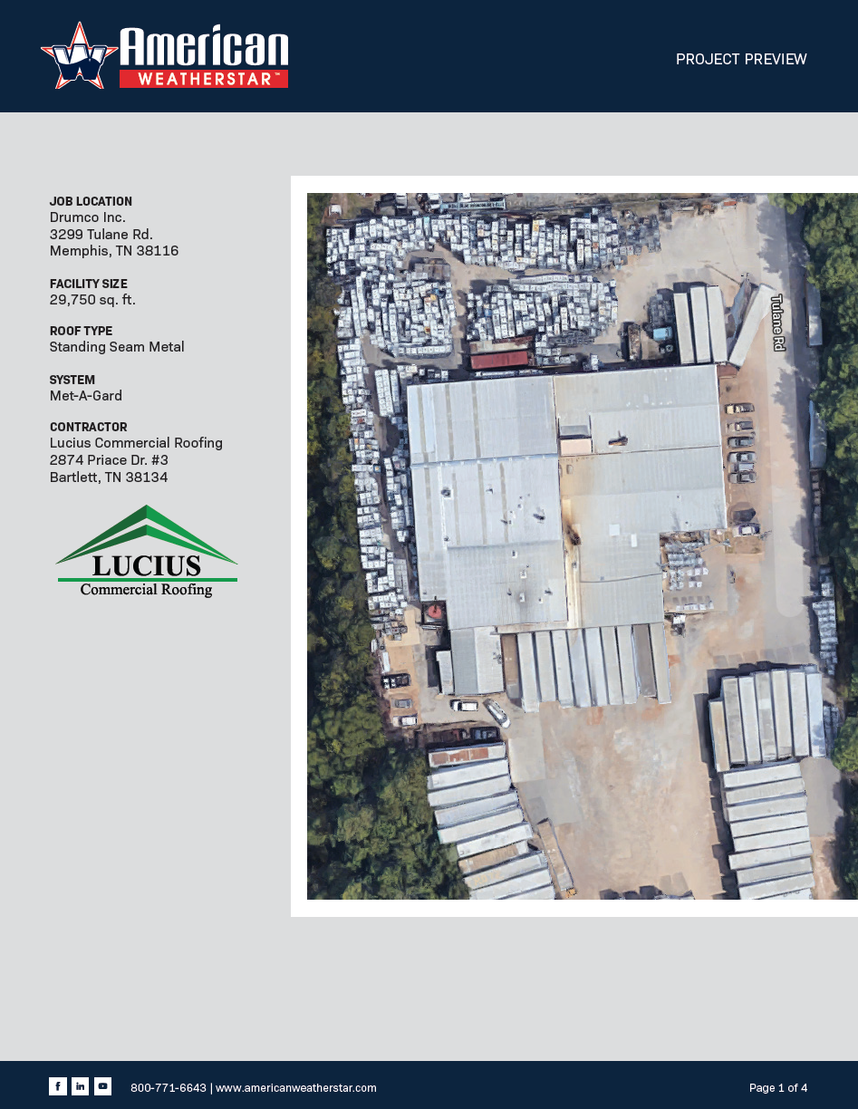
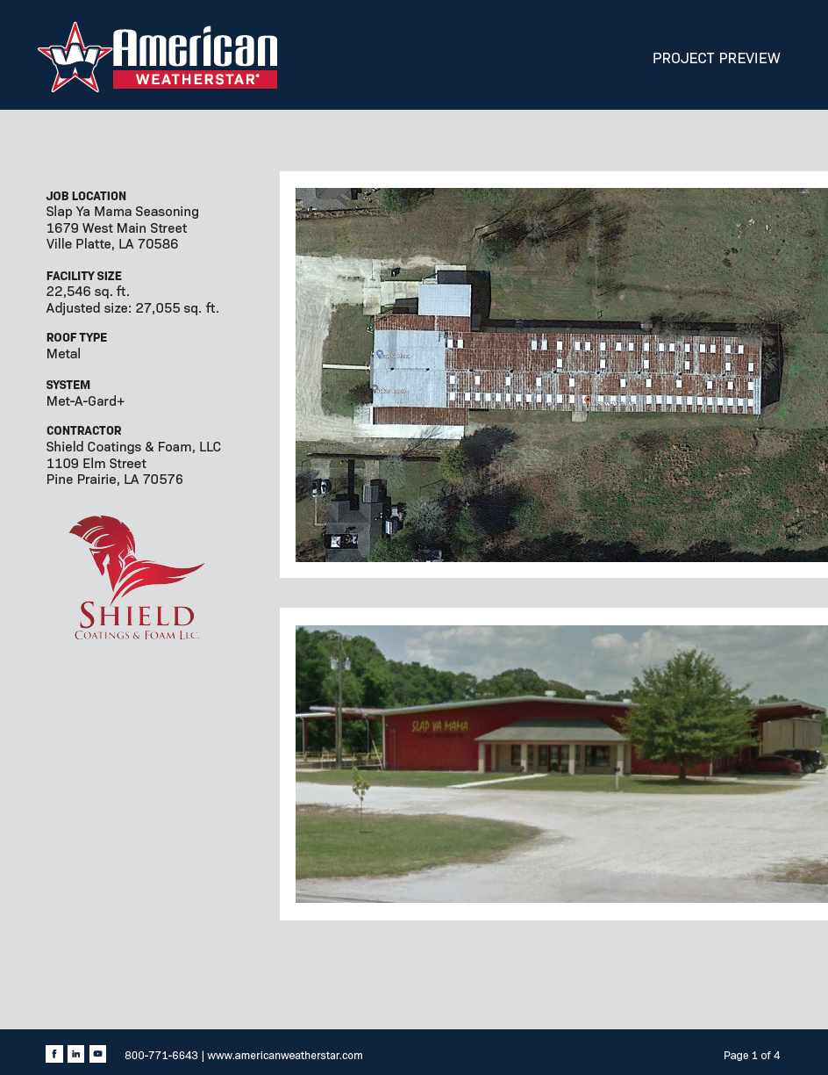
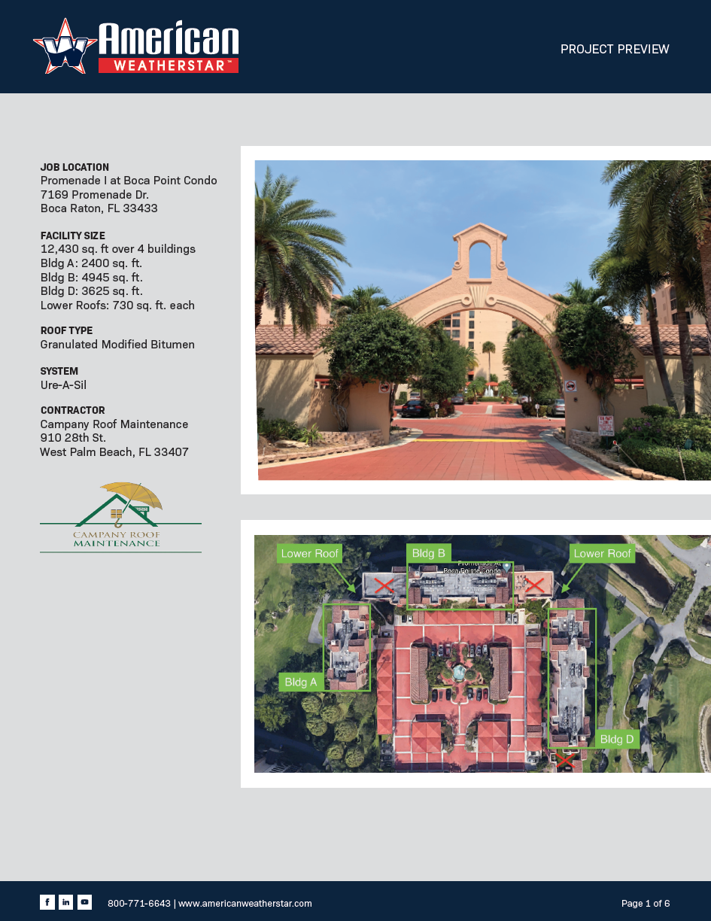
Sales &
Marketing
Tools
Project Previews
Project Previews

Slide 22
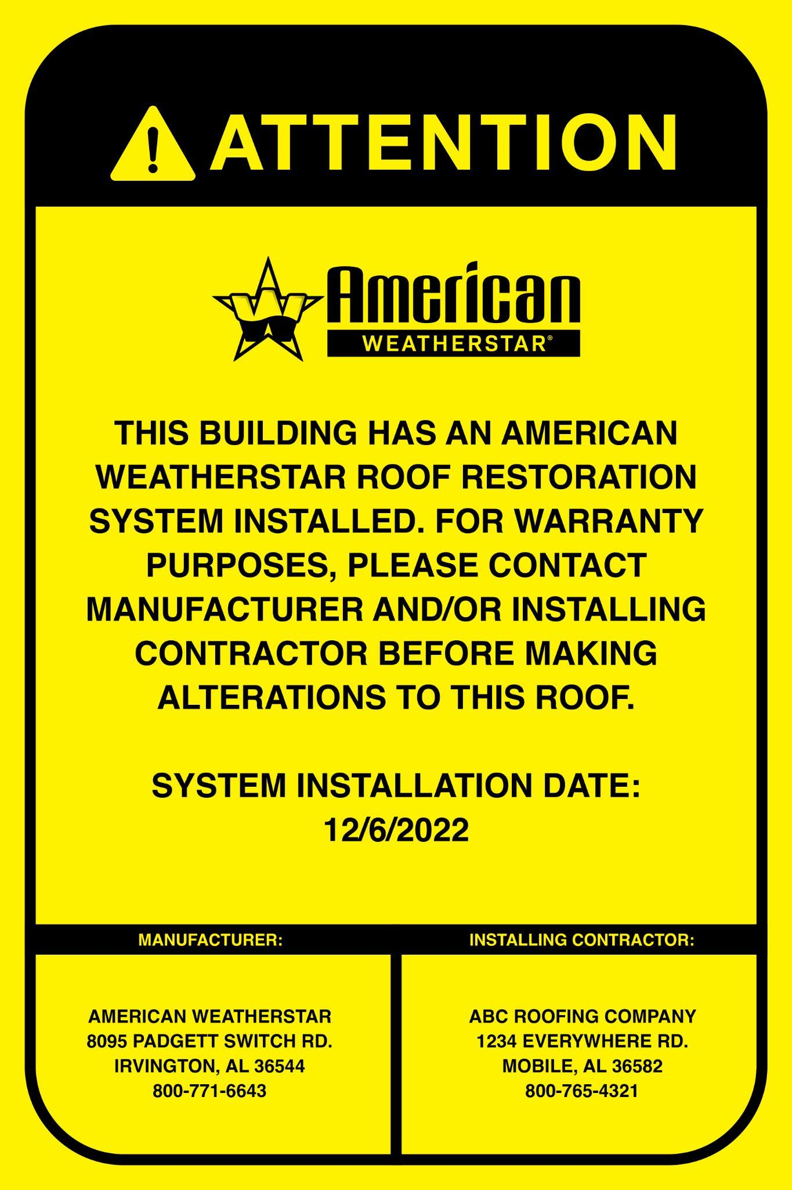
Sales &
Marketing
Tools
Rooftop Contact Sign
Quick Specs

Slide 23
Warranty Programs

Slide 24
Warranty Program
Length Options & Benefits
Material Warranty
5,10, 12, 15 & 20 years
NDL System Warranty
Standard: 5, 10, 12, 15 & 20 years
NDL System Elite Warranty
Standard: 20 years
Renewable
Transferrable
Extendable

Slide 25
Warranty Program
Requirements
REQUIREMENTS | MATERIAL ONLY | NDL SYSTEM | NDL SYSTEM ELITE
MUST BE AN APPROVED, PLATINUM, OR PLATINUM ELITE CONTRACTOR
COMPLETED APPLICATION
ROOF GRAPH & JOB PHOTOS
THIRD-PARTY INSPECTION
WARRANTY FEE
ANNUAL INSPECTION
✓
✓
✓
✓
✓
✓
✓
✓
✓
✓
✓
✓
✓
✓
✓

Slide 26
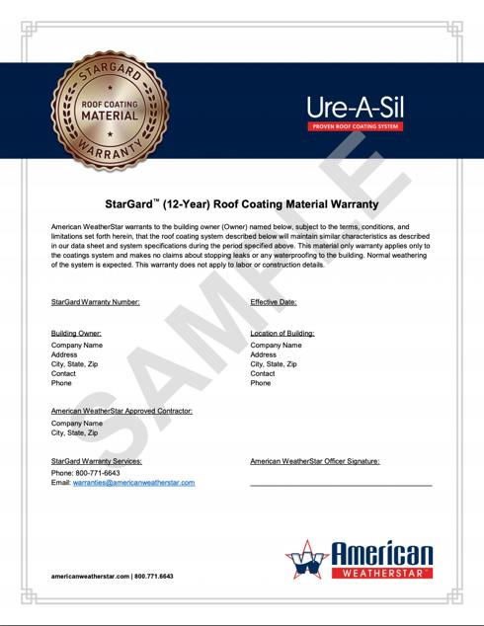

Warranty
Programs
Warranty Samples
Warranty Program

Slide 27
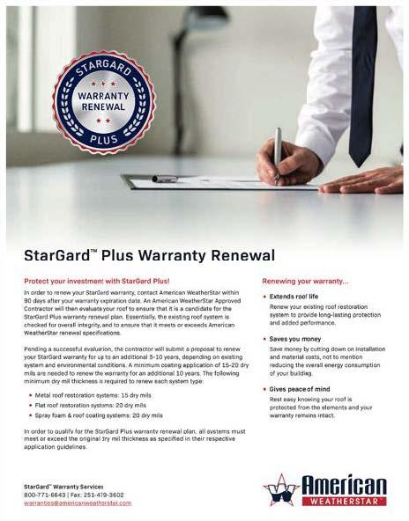
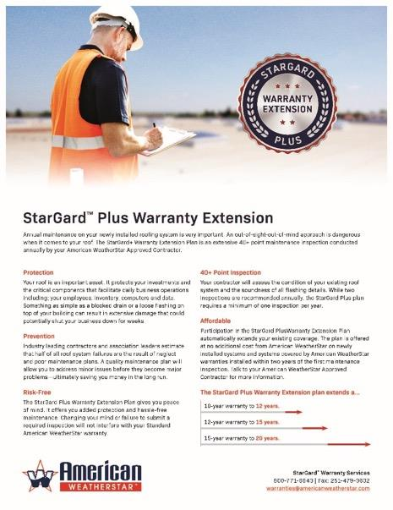
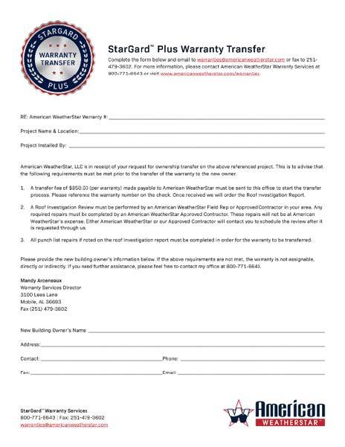
Warranty
Enhancement
Options
Stargard+

Slide 28

For more information, visit our website: www.americanweatherstar.com

