Slide 1
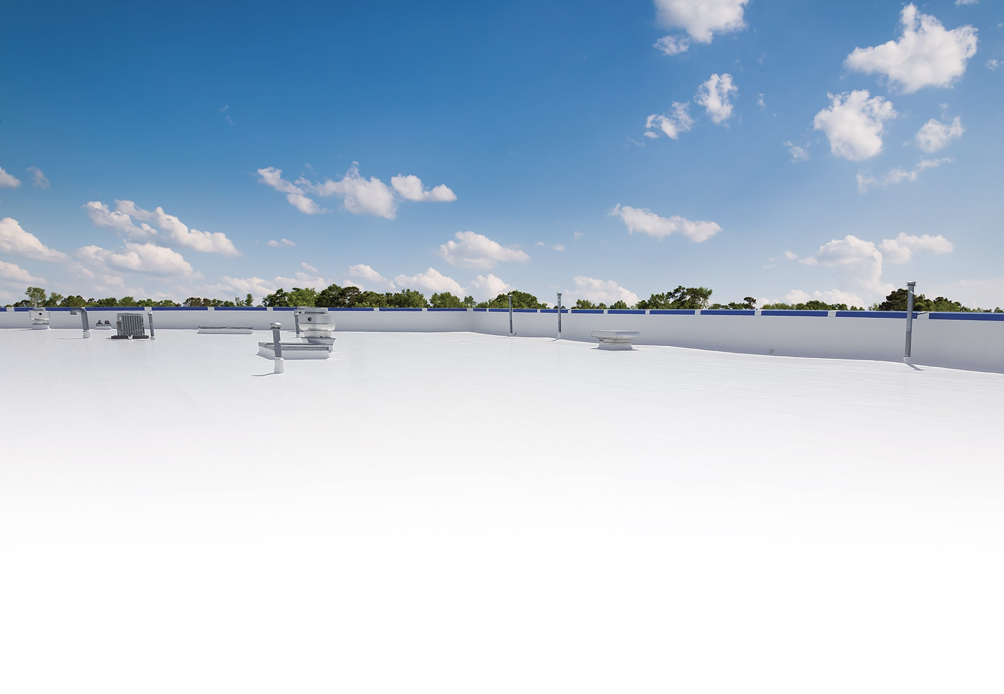

LUNCH & LEARN
Introduction to Roof Coatings

Slide 2

Presentation Outline
Industry Terms
Calculating Dry Film Thickness
Adhesion Test Instructions
Product Chemistry Overview

Slide 3
Industry Terms

Slide 4
Industry Terms
Viscosity
Spray-Grade
Brush-Grade
Butter-Grade
Flashing-Grade
Data Sheet Terminology
Solids by Volume
Elongation
Tensile Strength
Cure Time
Dry Time
Emissivity
Flash Point
Permeance
Reflectivity
Solids by Weight
VOCs
Water Absorption
Other Critical Terms
Mil
Wet Mil Thickness
Wet Mil Gauge
Dry Film Thickness (DFT)
Field Adhesion Test
Batch Retain
Detail Drawing
Fluid-Applied SYstem
Stretch Factor
Waste Factor

Slide 5
Calculating Dry Film

Slide 6
Calculating Dry Film Thickness (DFT)
W
x
V
=
D
1 gallon per 100 sq ft of any coating or primer = 16 wet mils
What’s left over after the liquid evaporates are the solids that make up the DFT.
Wet Mil Thickness
Volume by Solids
Dry Film Thickness

Slide 7
Adhesion Test Patch

Slide 8
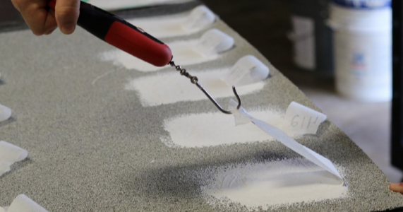
Adhesion Test Patch
Instructions

Slide 9
Product Chemistry Overview

Slide 10
Product Chemistry Overview
Benefits, Limitations, and Suitable Substrates
Asphalt Emulsion
Aluminum
Acrylic
Butyl
Silicone (Standard & High Solids)
Single Component Urethane (Aliphatic & Aromatic)
Primers & Accessories

Slide 11
Chemistry Overview – Asphalt Emulsions
Non-Fibered Emulsions
Fibered Emulsions
Benefits
Inexpensive
Water-Based, easy clean up
Fills in “alligatoring” and small cracks
Can be used with fabric to seal large areas
Limitations
Water-based, can freeze
Cold temperature applications
Suitable Surfaces
Modified Bitumen
Smooth BUR
Gravel BUR

Slide 12
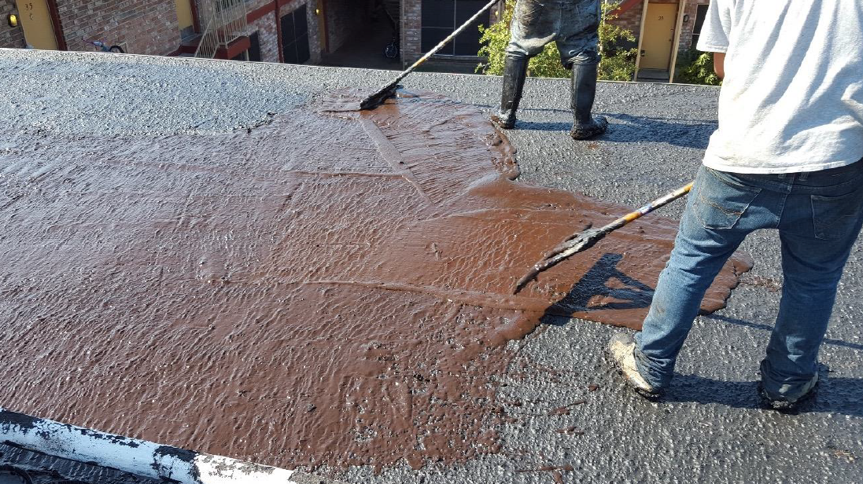
Asphalt Emulsions
Asphalt Emulsions

Slide 13
Chemistry Overview – Aluminum
Non-Fibered Aluminum
Fibered Aluminum
Benefits
Inexpensive
Gives contractor another option
Self-priming over light rust
Limitations
Not for waterproofing
Not as reflective as white
Less energy efficient than white
Limited life span
Suitable Surfaces
Modified Bitumen
Smooth BUR
Metal

Slide 14
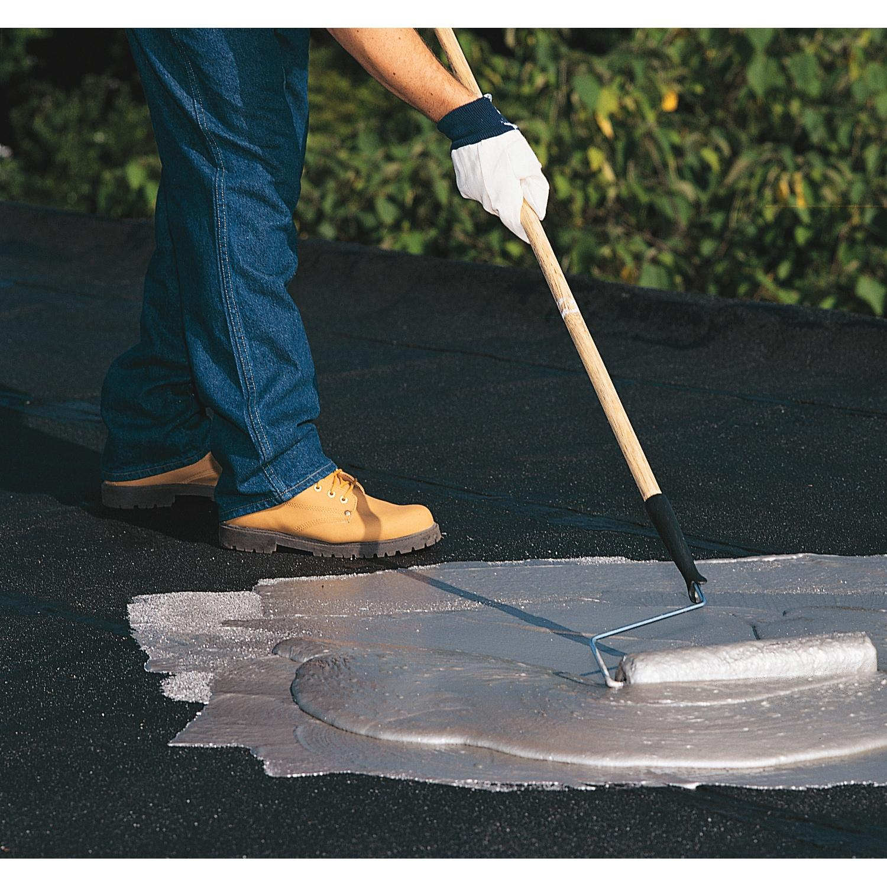
Aluminum

Slide 15

Chemistry Overview – Acrylic
Acrylic 211
High Tensile Acrylic 211
High-Build Acrylic 212
High-Gloss Acrylic 215
Acrylic Brush-Grade 220
Acrylic Butter-Grade 221
Acrylic Flashing-Grade 222
Acrylic Skylight Sealer 230
Benefits
Easy to Spray
Easy to Clean
Economical
Limitations
Ponding Water
Cold Temperature Applications
Suitable Surfaces
Metal
Modified Bitumen
Single-Ply
Smooth BUR
SPF

Slide 16
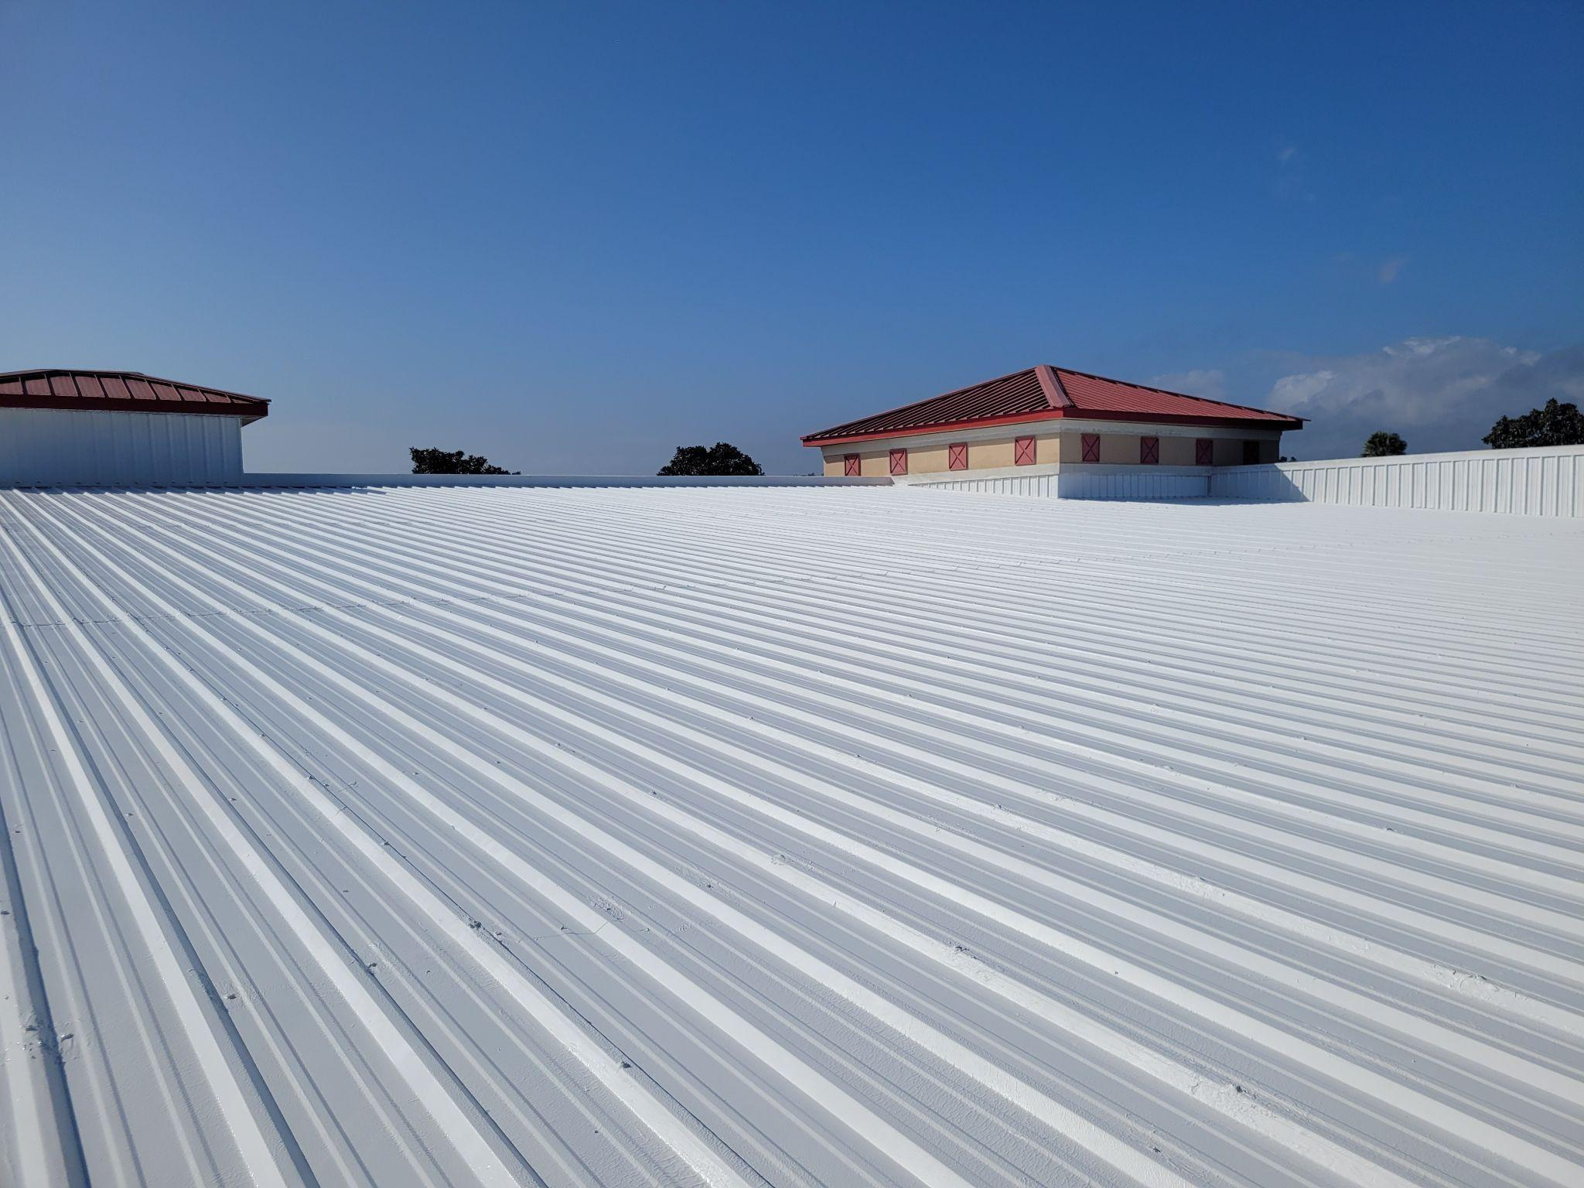
Acrylic 211

Slide 17
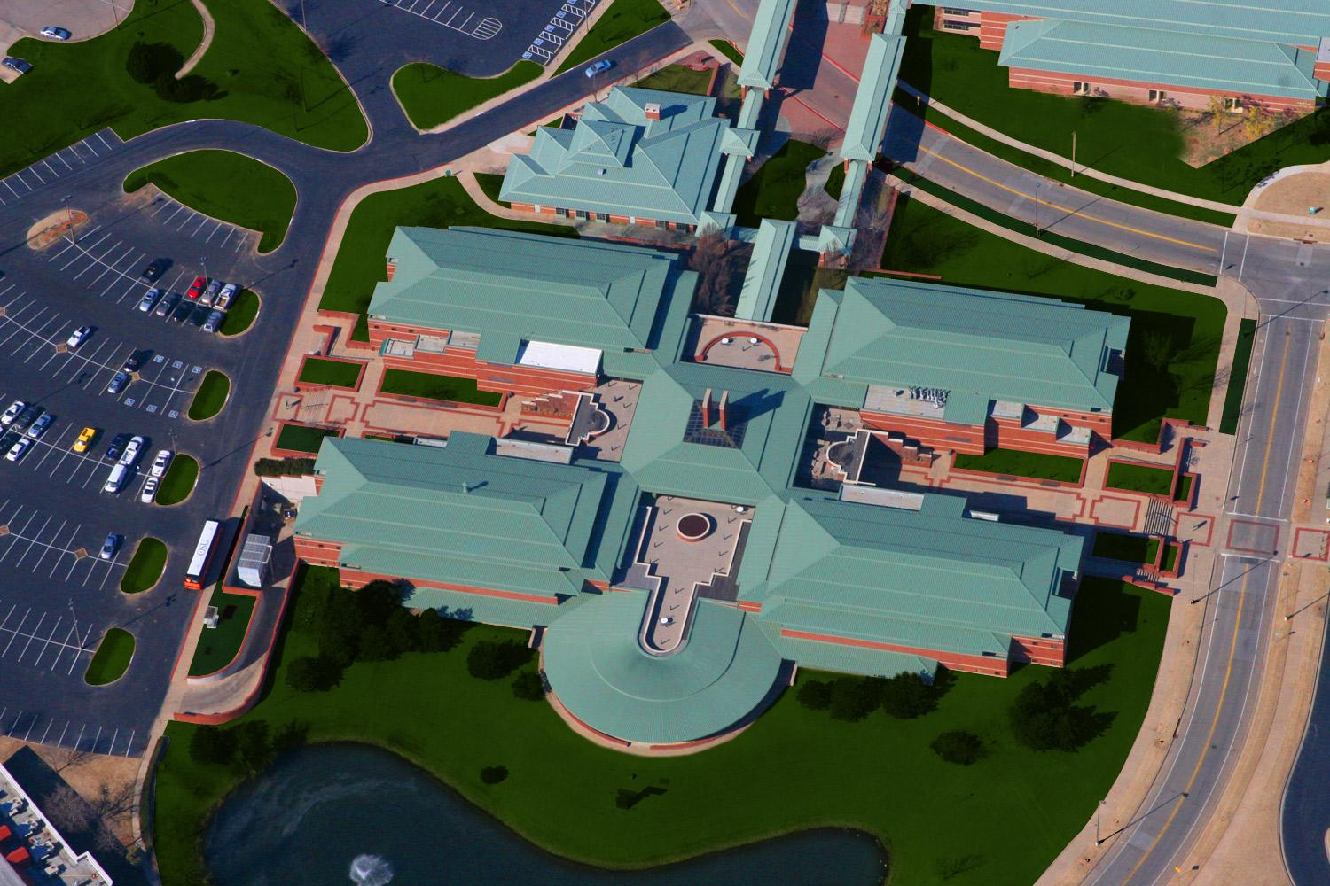
High Tensile Acrylic 211

Slide 18
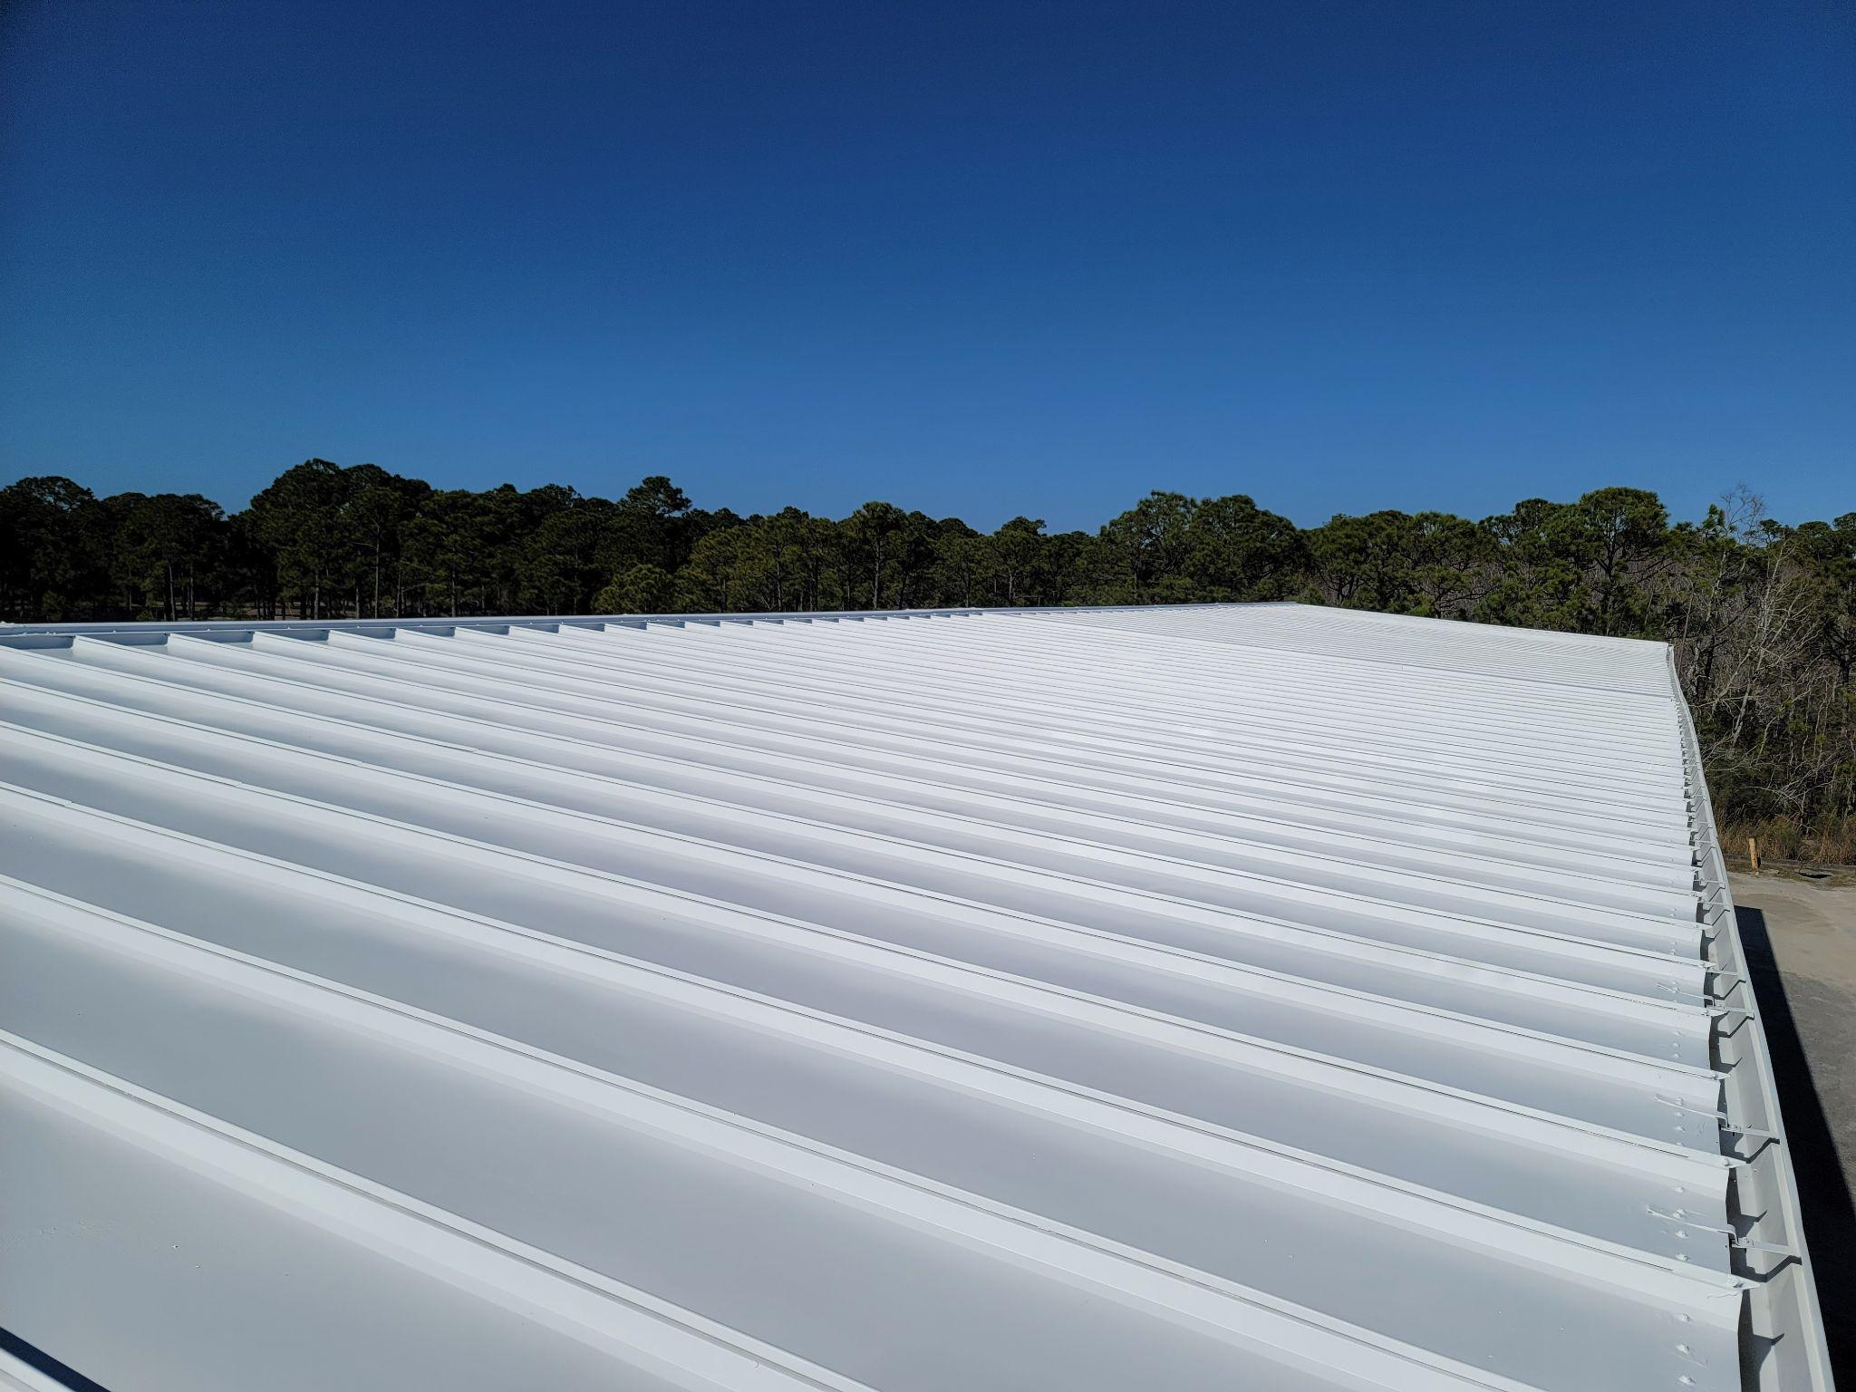
High-Build Acrylic 212

Slide 19
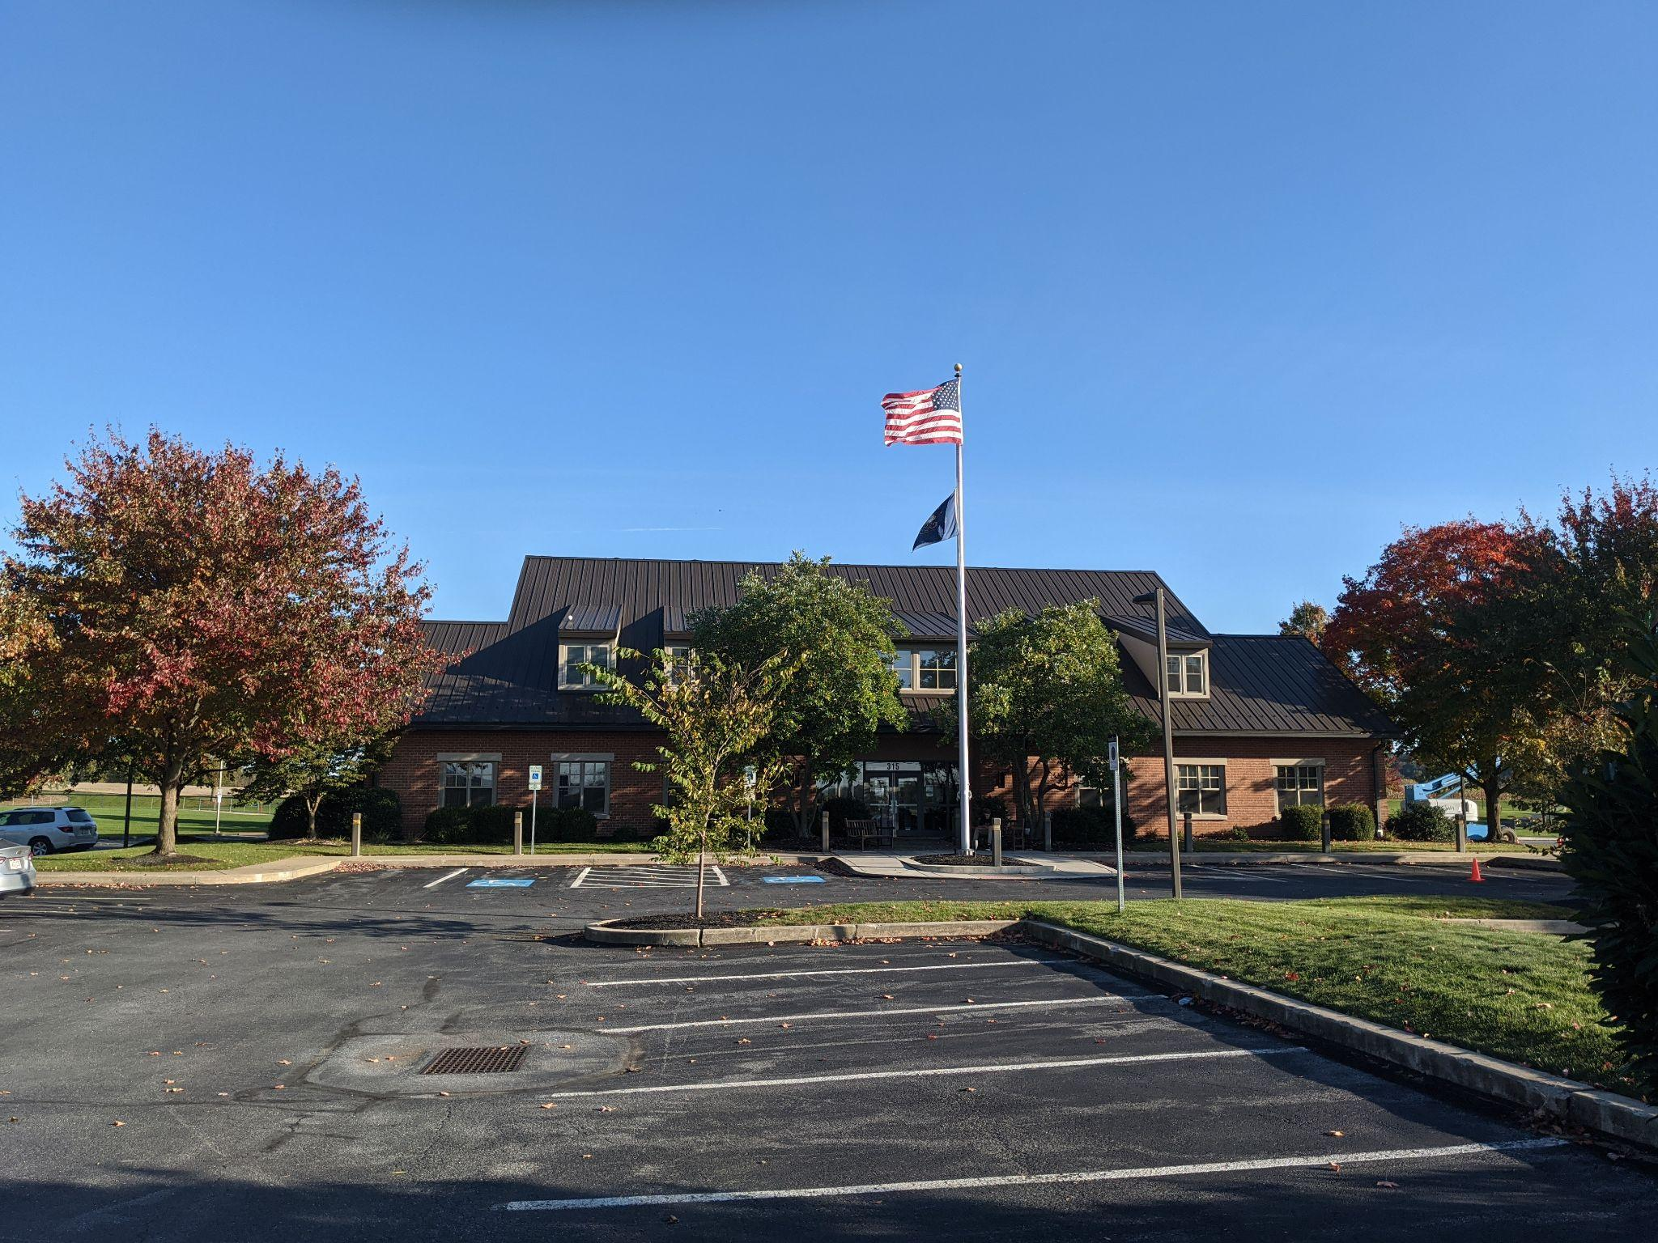
High-Gloss Acrylic 215

Slide 20
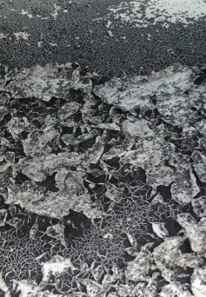
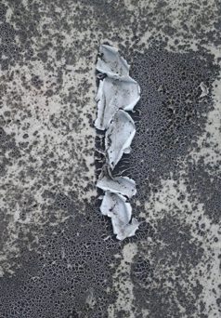
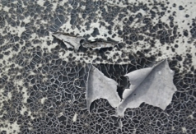
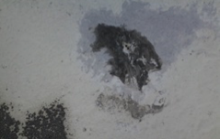
Potential
Acrylic Issues
Problems: This is what acrylic
coatings will look like if applied
in ponding water situations.

Slide 21
Chemistry Overview – Butyls
Butyl 310
Butyl Brush-Grade 320
Butyl Flashing-Grade 321
Benefits
Extremely high elongation
Fast drying
Great for repairs
Can be used as a vapor retardant over SPF
Very low perm rating
Limitations
Low solids content
Can be challenging to spray
Need acrylic top coat to stay bright white
Suitable Surfaces
Metal
Modified Bitumen
Single-Ply
Smooth BUR
SPF

Slide 22
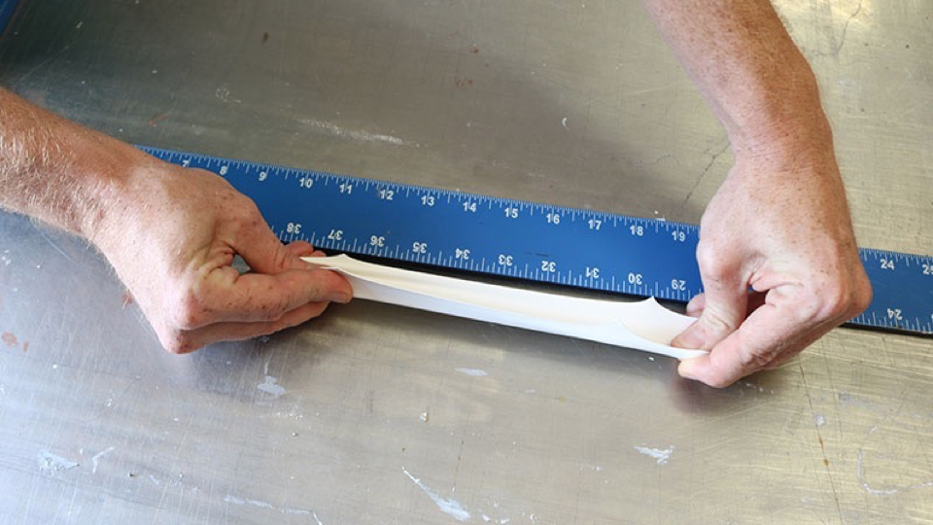
Butyl 310
“This is a super-important quote”
- From an expert

Slide 23

Chemistry Overview – Silicone
Silicone 410
High Solids Silicone 412
Silicone Walk Path 415
Silicone Brush-Grade 422
Benefits
The best UV stability
Wears much slower
Moisture cured
Fast drying
Cannot be washed off by rain
Able to withstand ponding water
Limitations
Easily attracts dirt
Can be challenging to spray
Very slippery when wet
Suitable Surfaces
Metal
Modified Bitumen
Single-Ply
Smooth BUR
SPF

Slide 24
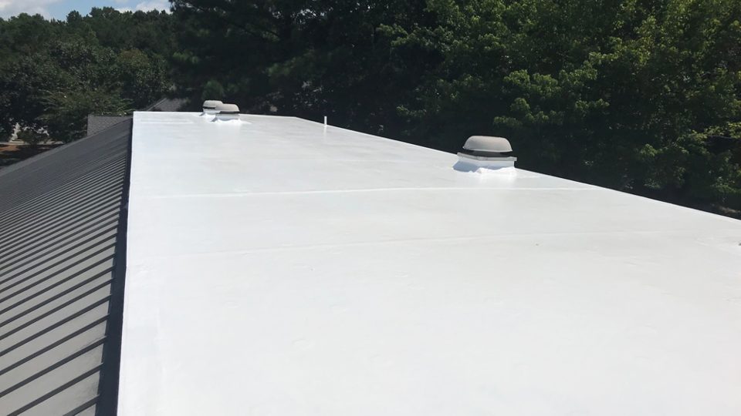
Silicone 410

Slide 25
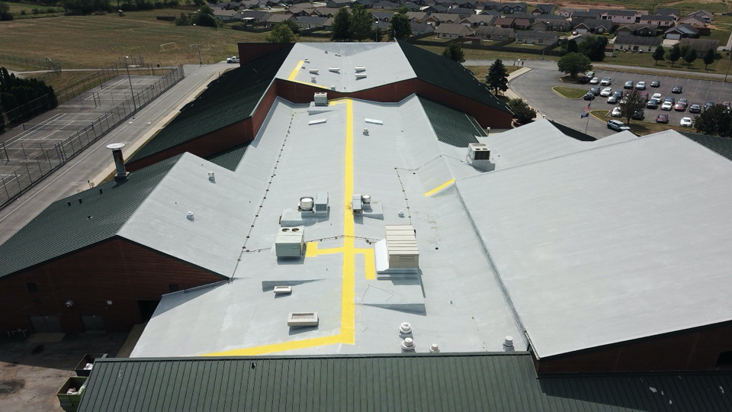
Silicone Walk Path 415

Slide 26

Chemistry Overview – Urethane
Aliphatic Urethane 510
Aromatic Urethane 520
Urethane Brush-Grade 522
Benefits
Extremely durable
Better adhesion qualities
Moisture cured
Fast drying
Cannot be washed off by rain
Able to withstand ponding water
Limitations
Can be challenging to spray
Xylene based – harsh on equipment
Always curing - even in the pail
Suitable Surfaces
Metal
Modified Bitumen
Single-Ply
Smooth BUR
SPF

Slide 27
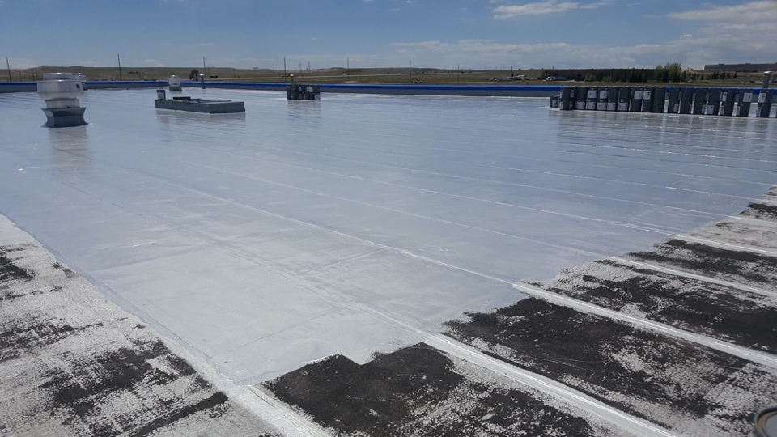
Aromatic Urethane 520

Slide 28
Chemistry Overview – Terminator 622
Terminator 622
Benefits
Applies & cures underwater
Better adhesion qualities
Adheres to silicone
Moisture cured
Fast drying
Cannot be wash away by rain
Able to withstand ponding water
Limitations
No spray-grade version
Suitable Surfaces
Metal
Modified Bitumen
Single-Ply
Smooth BUR
SPF
Concrete

Slide 29
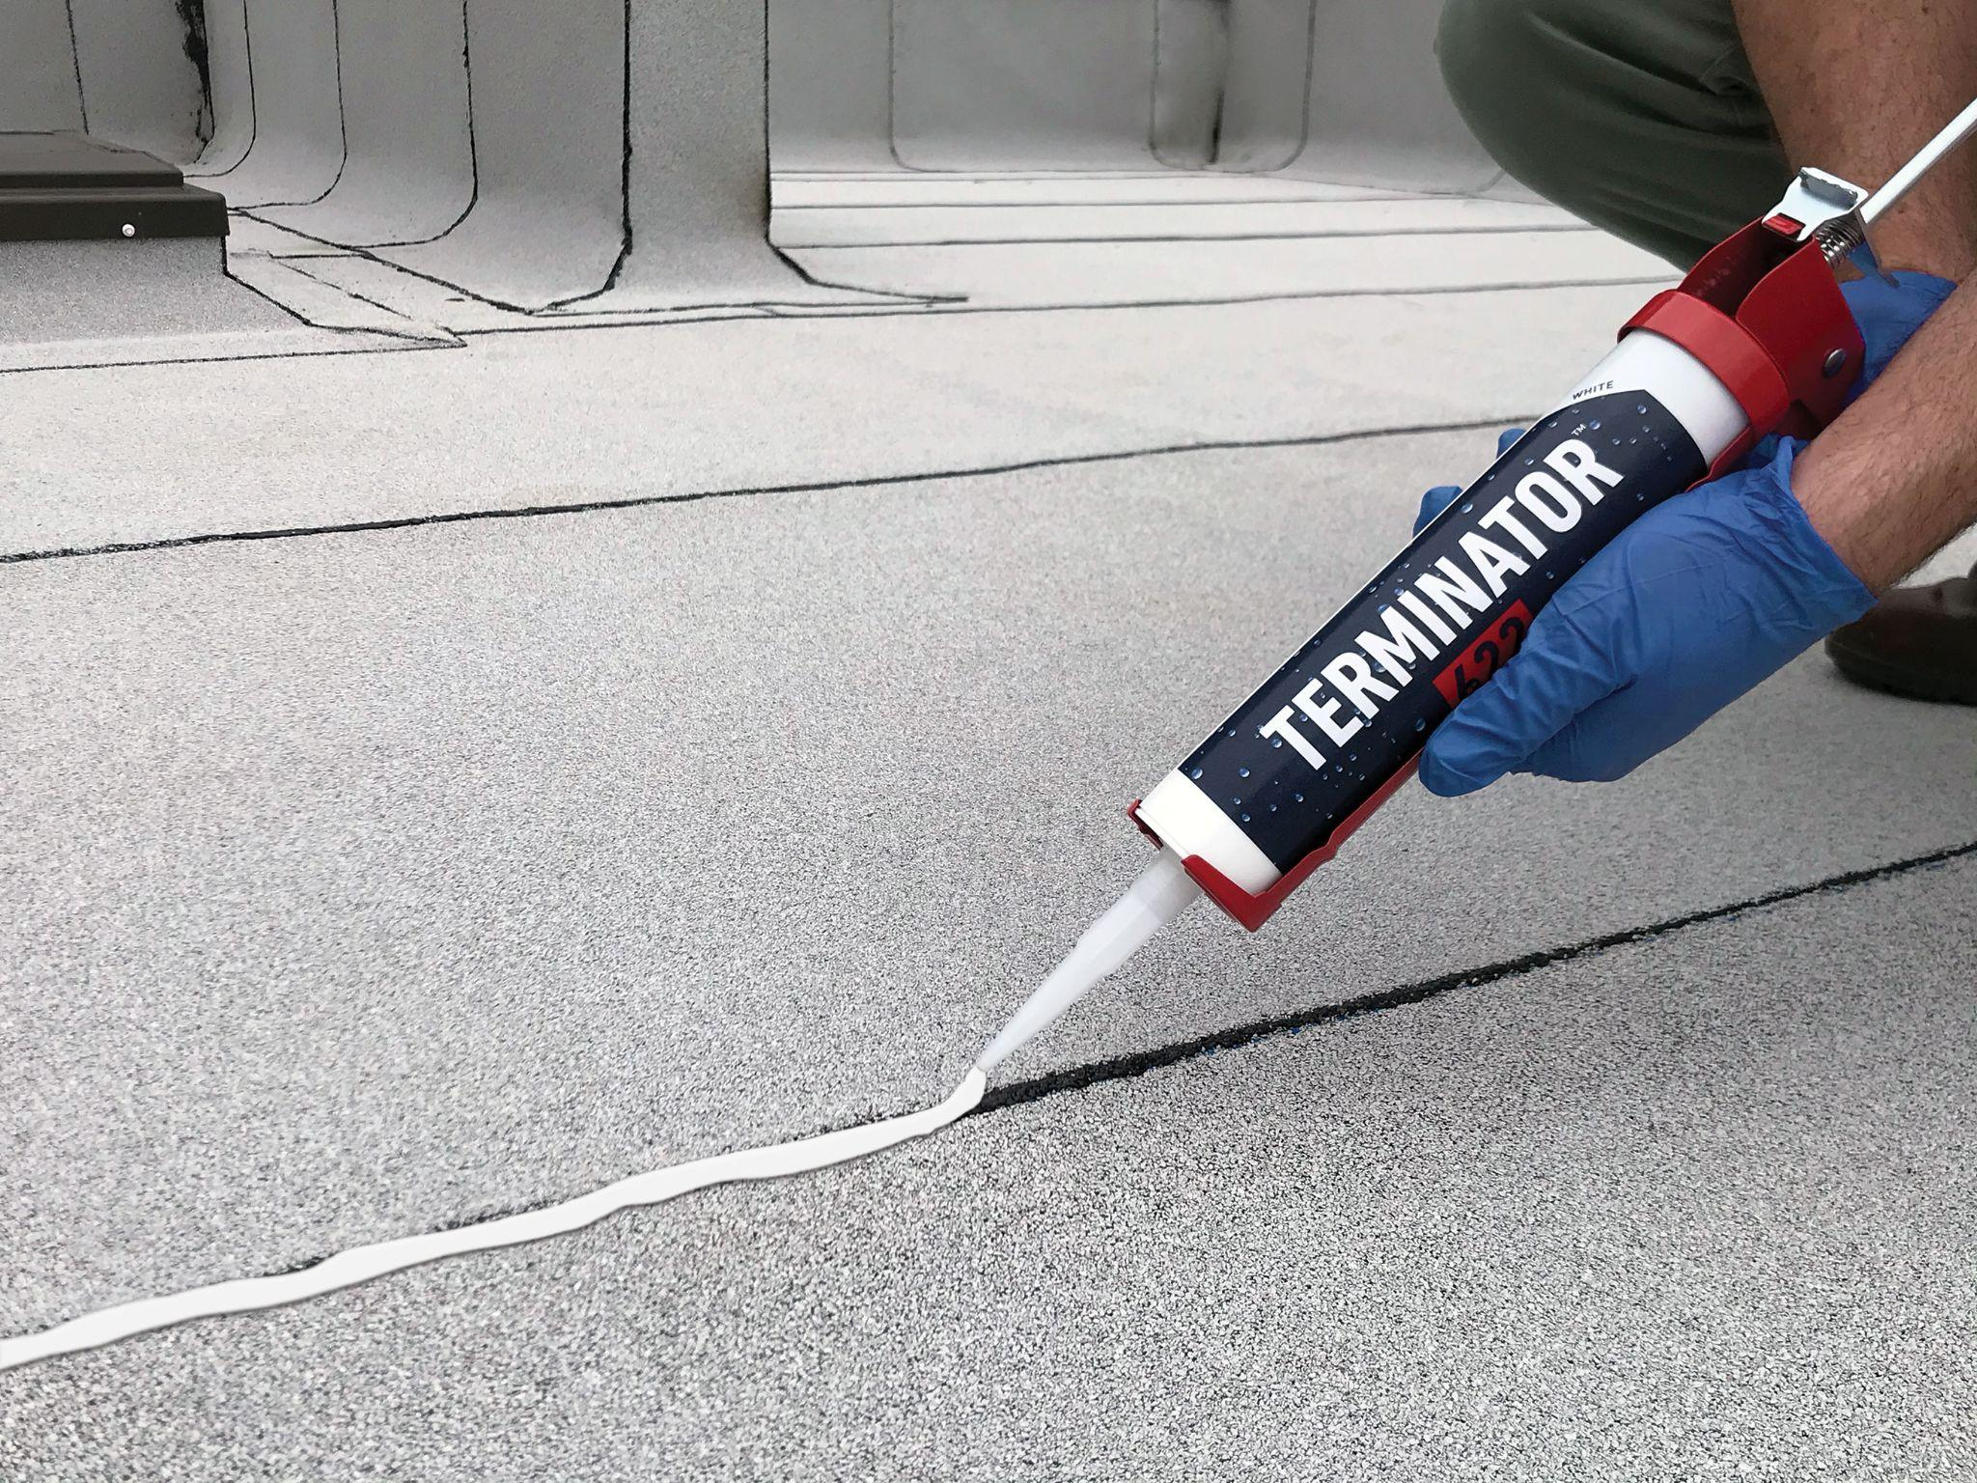
Terminator 622

Slide 30
Chemistry Overview – Primers & Cleaners
Acrylic Bonding Primer 905
Red Oxide Rust Prime 912
Color Prime 915
EcoCleaner 925
Fabric Bond 930
Acrylic Clear Prime 9000
Benefits
Cures and prevents rust
Promotes adhesion
Used to install fabric
Limitations
One product does not solve all priming issues
Suitable Surfaces
Metal
Modified Bitumen
Single-Ply
Smooth BUR
SPF
Concrete

Slide 31
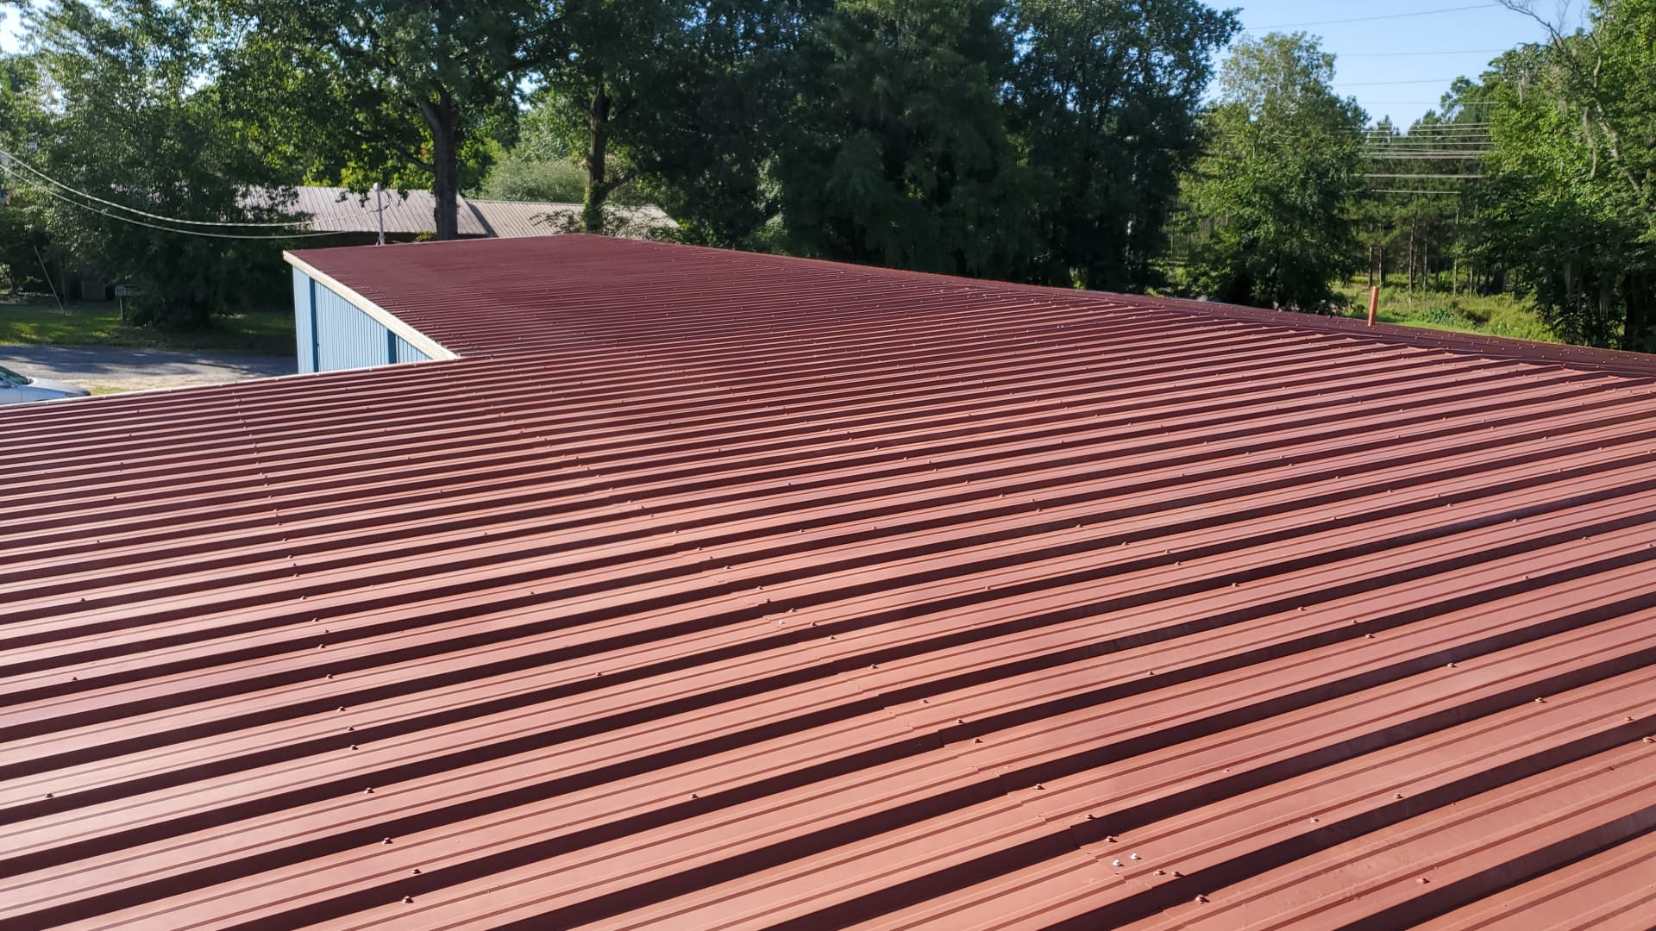
Red Oxide Rust Prime 912

Slide 32
Chemistry Overview – Wall Coatings
Acrylic Wall Coat 2000
High-Performance Elastomeric Wall Coat 2100
Benefits
Easy to spray
Easy to clean
Limitations
Cold temperature
Suitable Surfaces
Concrete
Cinder Block
Brick

Slide 33
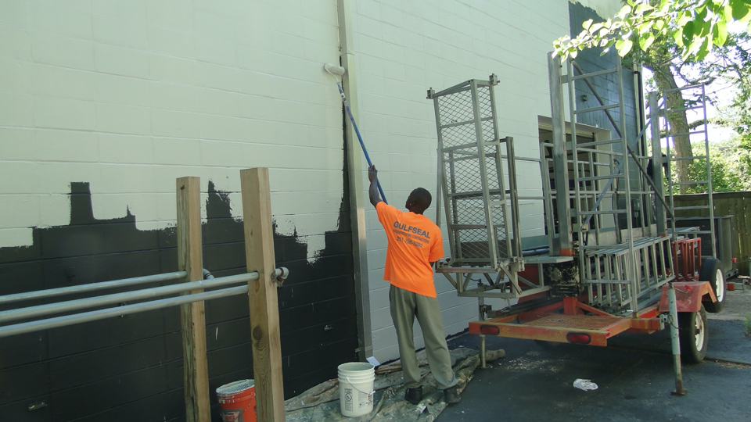
Acrylic Wall Coat 2000

Slide 34
Chemistry Overview – Accessories
Polyester Fabric
Seam Tape
3m Roofing Granules
Walk Path Granules 1100
Micro Fibers
Chip Brushes
Caulk Guns

Slide 35
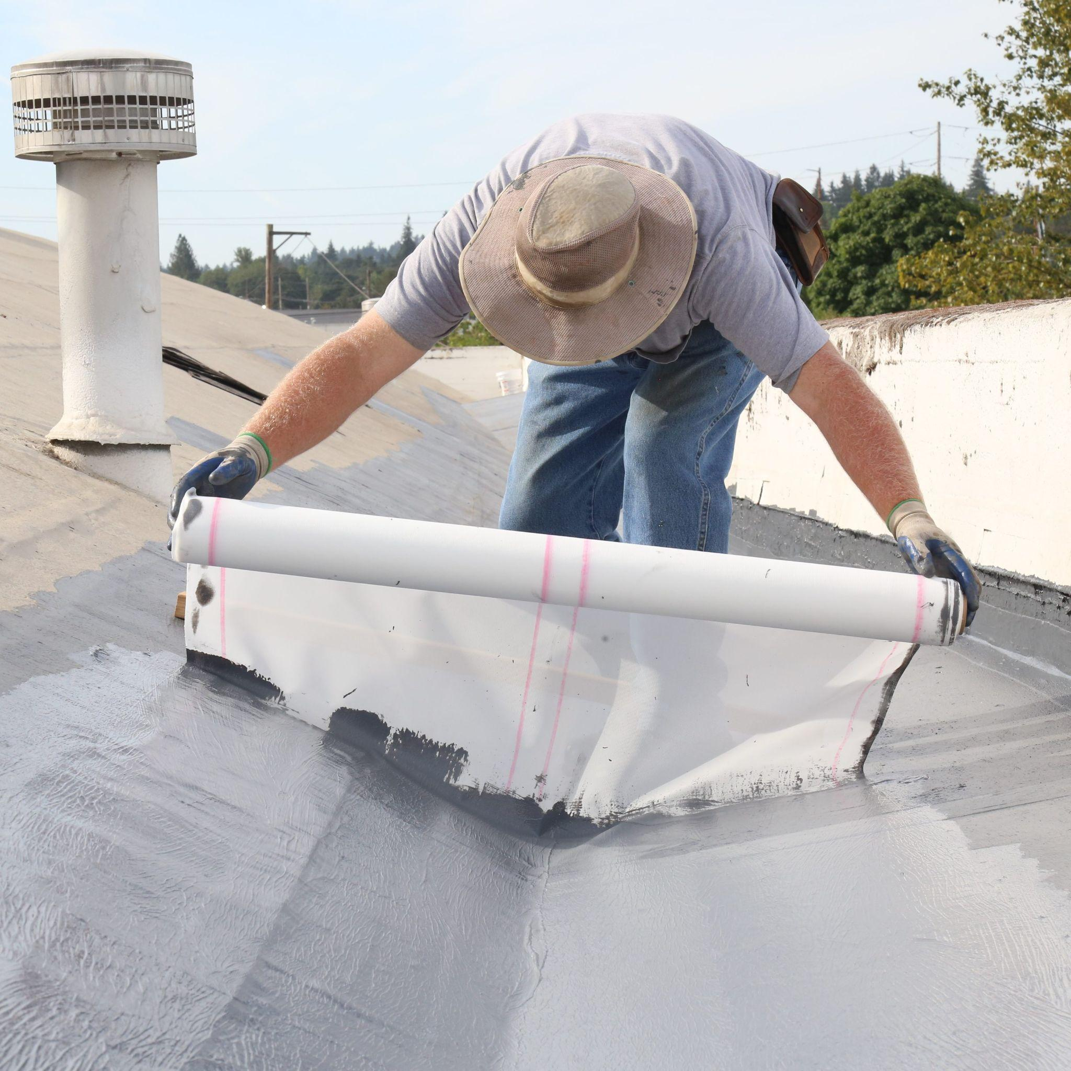
Polyester Fabric

Slide 36
Chemistry Overview – Cleaning Solvents
Rule 66 Mineral Spirits
Xylene

Slide 37
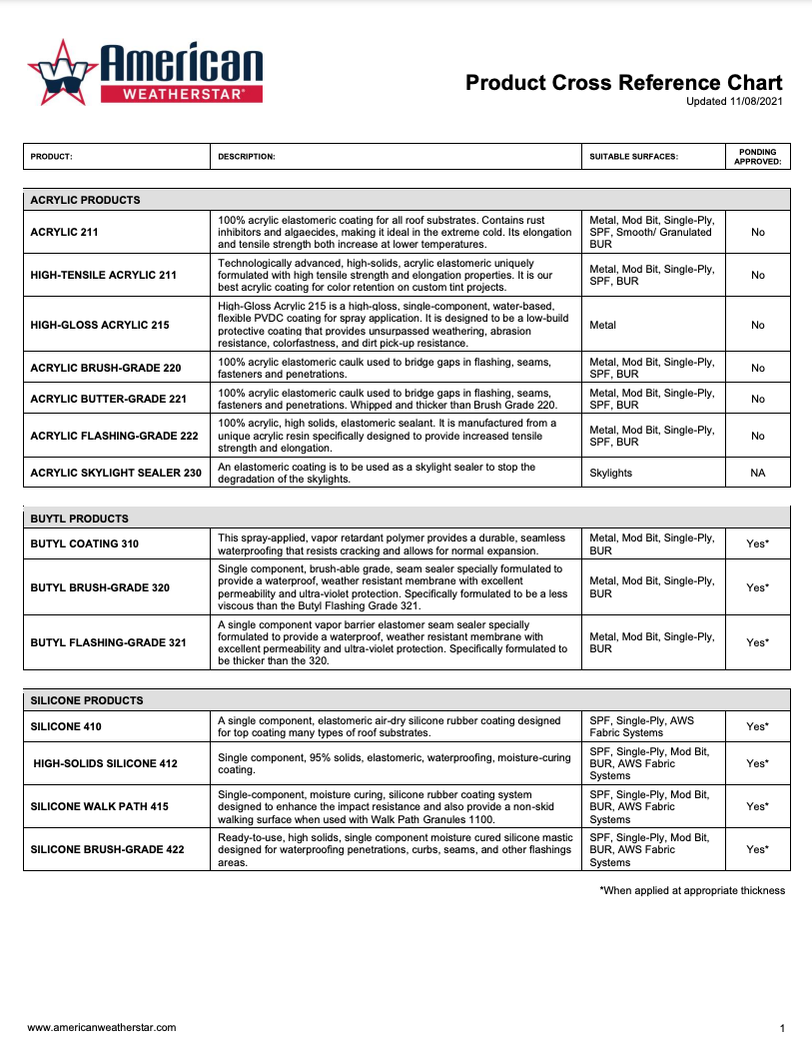
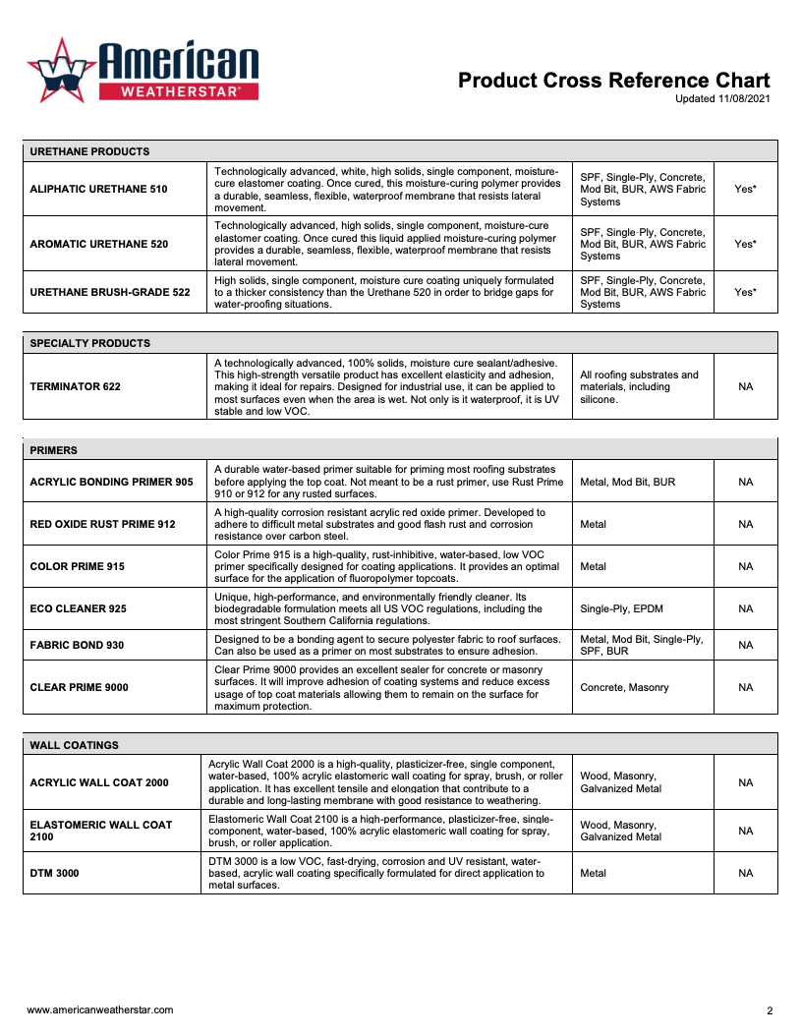
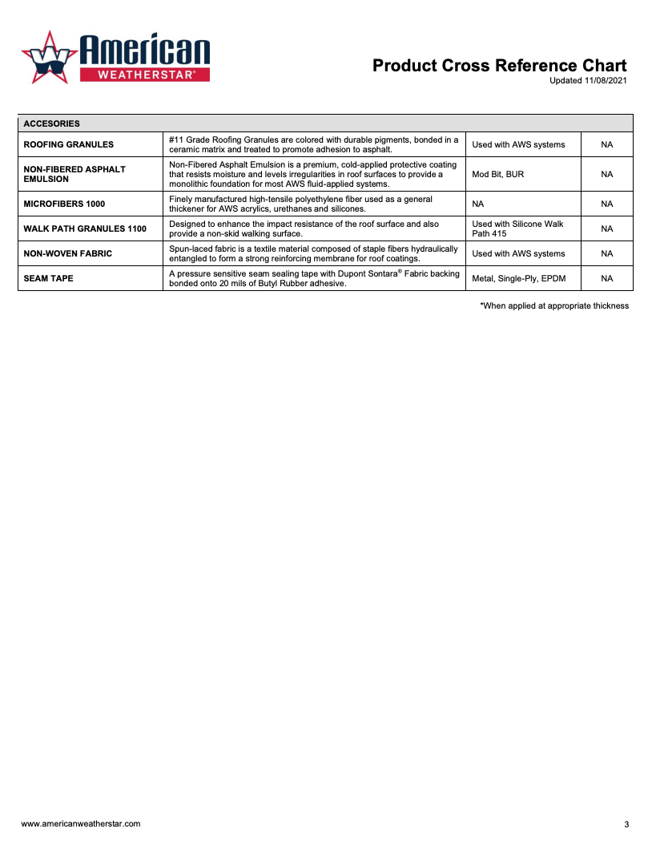
Product Cross
Reference Chart
Product Cross Ref Chart

Slide 38

For more information, visit our website: www.americanweatherstar.com

