Slide 1
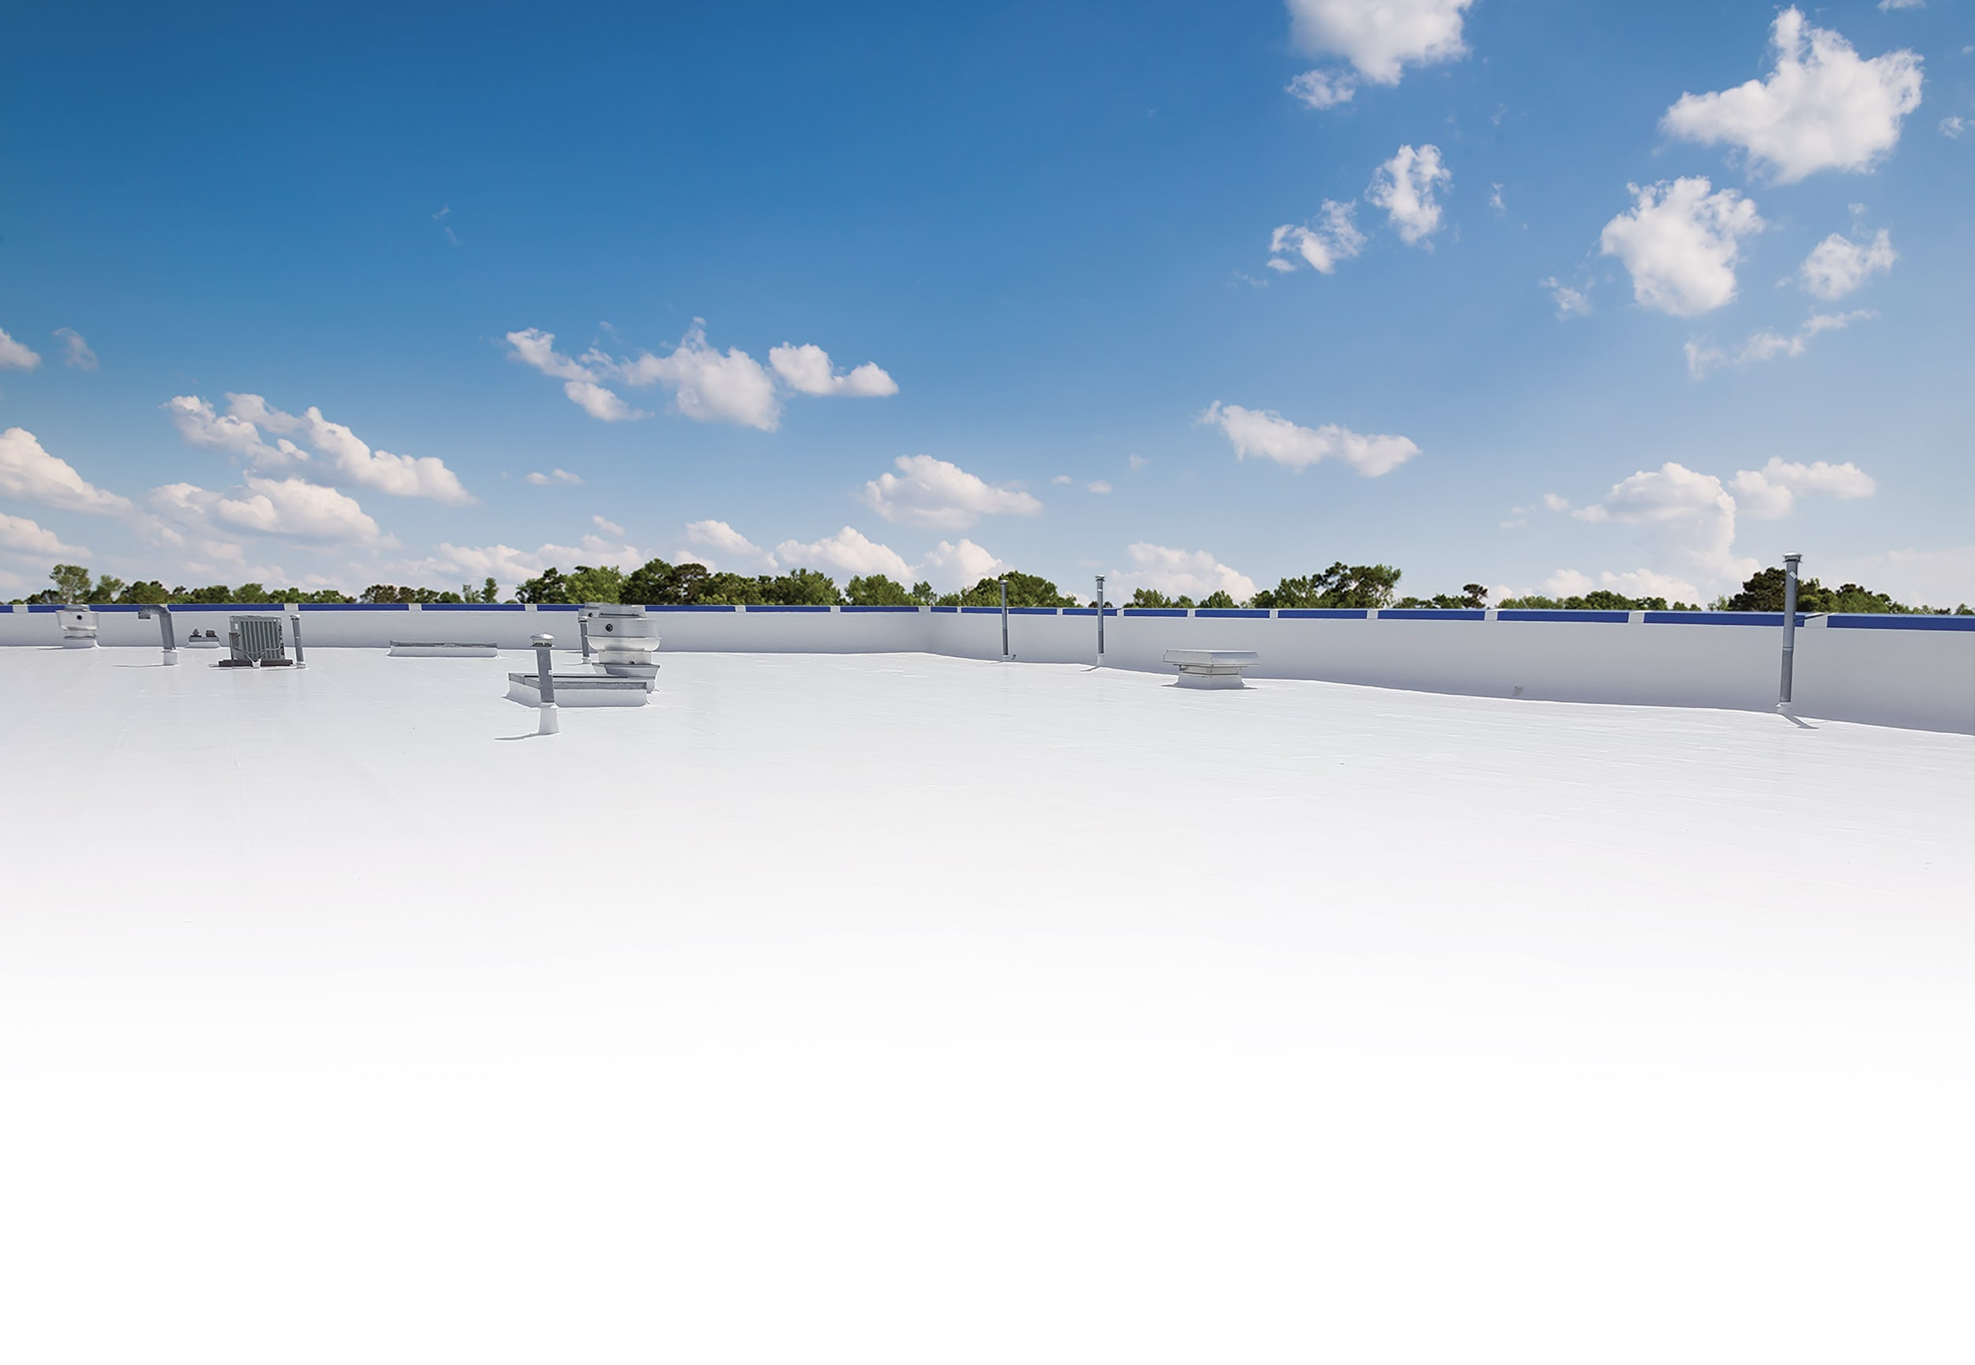
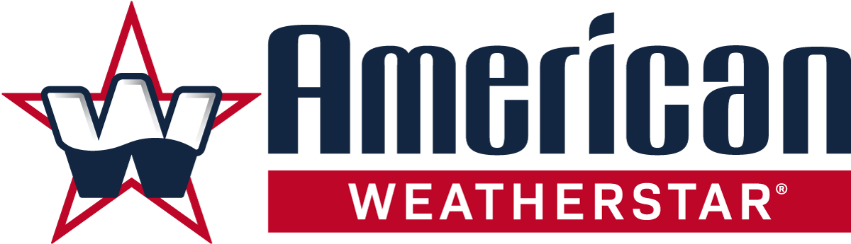
LUNCH & LEARN
Metal Roof Restoration

Slide 2

Presentation Outline
System Basics
Estimating Job Costs
Marketing Tools
Warranty Program

Slide 3
System Basics

Slide 4
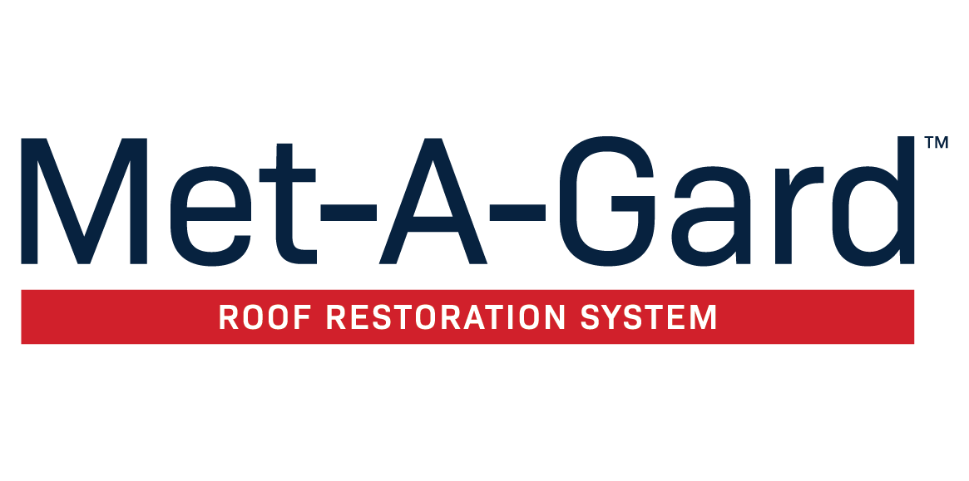
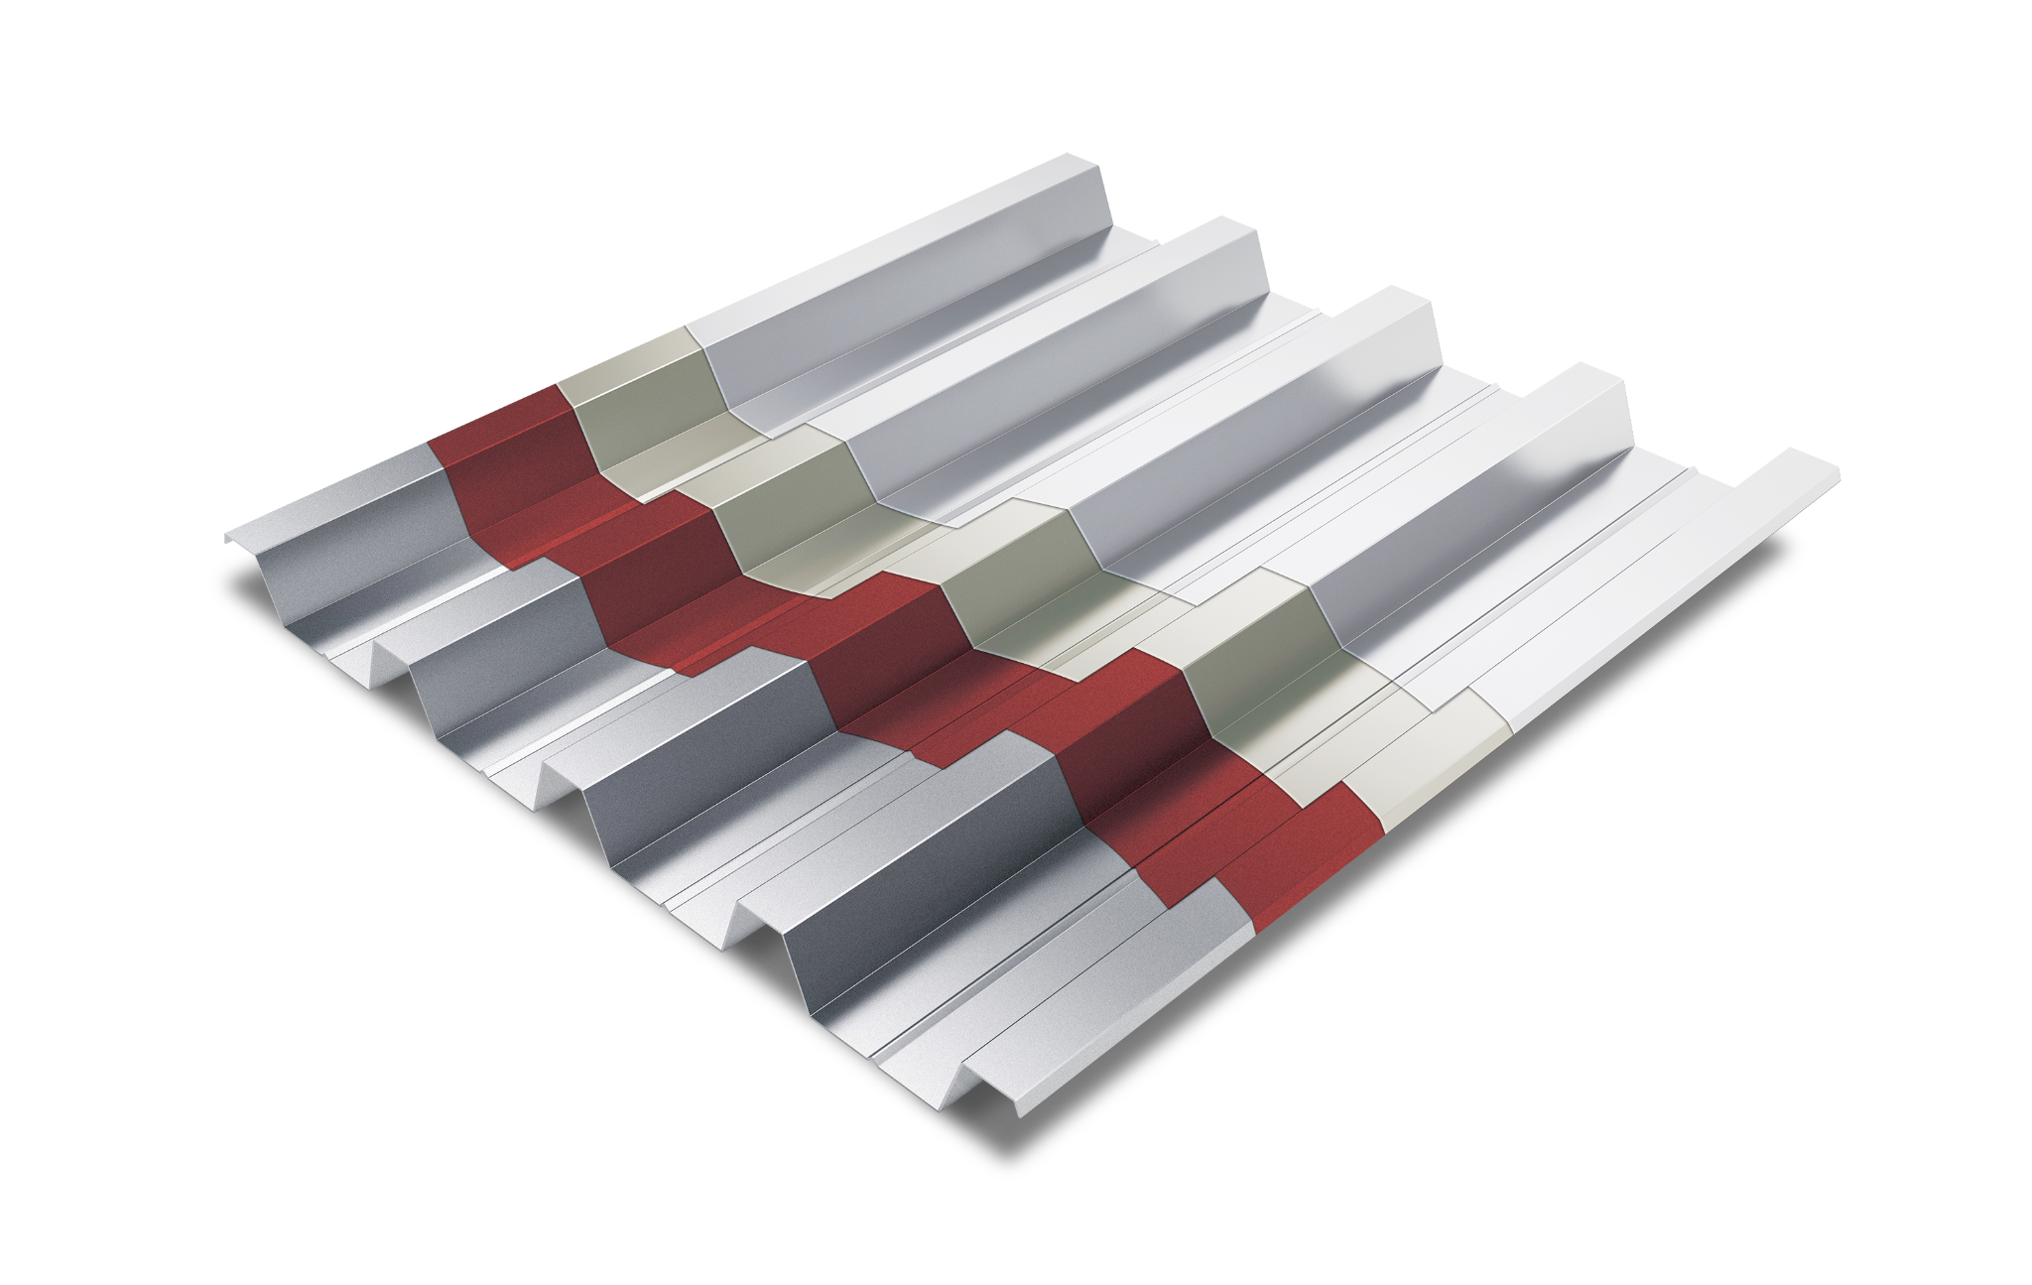
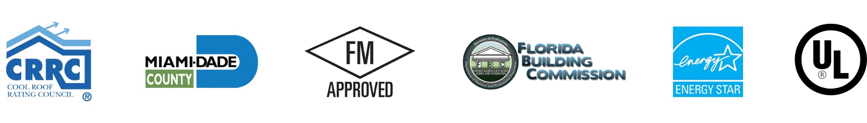
Suitable Substrates?
Metal
Which products compose this system?
Primers: Red Oxide Rust Prime 912
Waterproofing: Acrylic Brush-Grade 220
Base Coat: Acrylic 211
Top Coat: Acrylic 211
What are my equipment options?
Airless sprayer is best option for uniform mil thickness
Spreader is also an option with profile rollers
What type of warranties are available?
5 and 10 year
When is this system the best option?
Price Sensitive
Warm Weather
When is it not the best option?
Cooler Weather
Rainy Season
Existing Substrat
Top Coat
Acrylic 211
Base Coat
Acrylic 211
Primer (if needed)
Red Oxide Rust Prime 912
Metal Roof
Met-A-Gard Overview

Slide 5
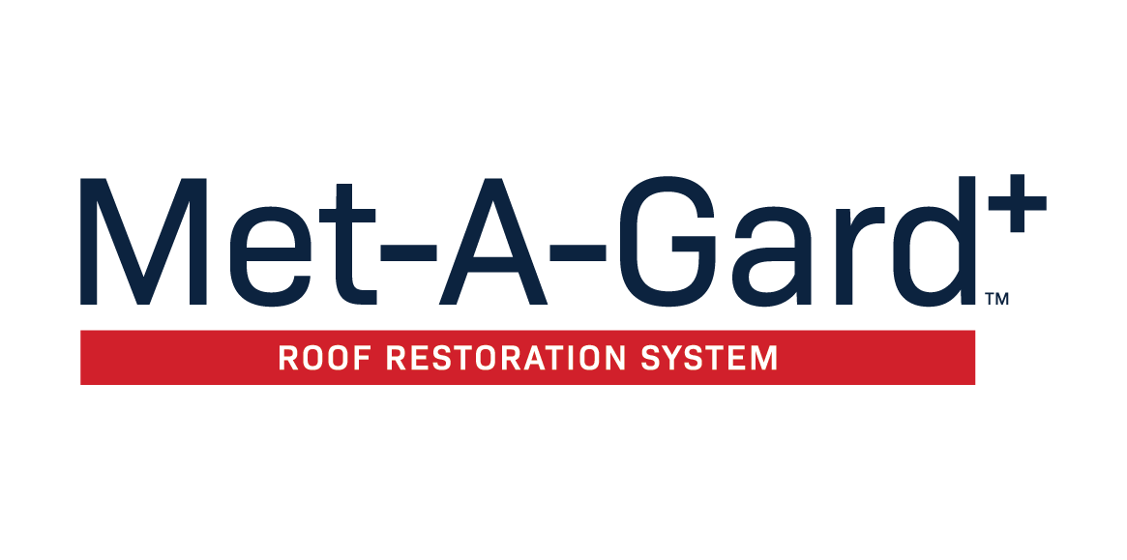
Suitable Substrates?
Metal
Which products compose this system?
Primers: Red Oxide Rust Prime 912
Waterproofing: Urethane Brush-Grade 522
Base Coat: HT Acrylic 211
Top Coat: HT Acrylic 211
What are my equipment options?
Airless sprayer is best option for uniform mil thickness
Spreader is also an option with profile rollers
What type of warranties are available?
12, 15, and 20 year
When is this system the best option?
Longer warranty required
Custom colors available
When is it not the best option?
Cooler Weather
Rainy Season
Existing Substrat
Top Coat
HT Acrylic 211
Base Coat
HT Acrylic 211
Primer (if needed)
Red Oxide Rust Prime 912
Metal Roof
Met-A-Gard+ Overview

Slide 6
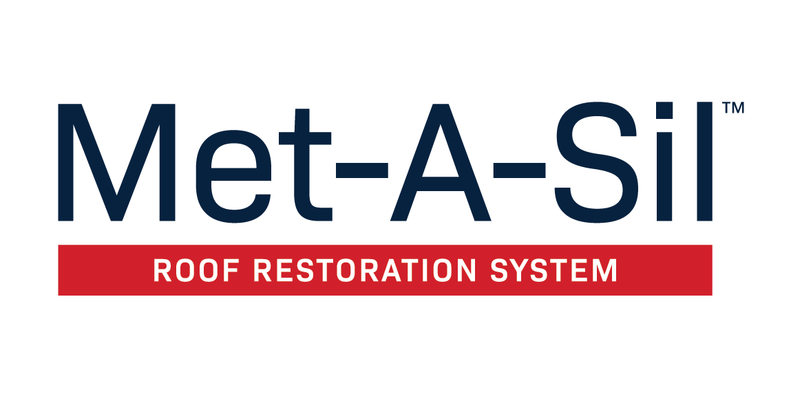
Suitable Substrates?
Metal
Which products compose this system?
Primers: Red Oxide Rust Prime 912
Waterproofing: Urethane Brush-Grade 522
Base Coat: Silicone 410 or 412
Top Coat: Silicone 410 or 412
What are my equipment options?
Graco 833 for 410 - 933 or air driven for 412
Spreader is also an option with Rooftop Equipment’s Profile Rollers
What type of warranties are available?
12, 15, and 20 year
When is this system the best option?
Longer warranty required
Pop-up storms expected
Cooler temps
When is it not the best option?
The most critical issue is if the contractor does not have proper equipment
More expensive than water-based systems
Existing Substrat
Top Coat
Silicone 410 or 412
Base Coat
Silicone 410 or 412
Primer (if needed)
Red Oxide Rust Prime 912
Metal Roof
Met-A-Gard+ Overview

Slide 7
Estimating Job Costs

Slide 8
Estimating Job Costs – Metal Roof Restoration
System/Chemistry being installed
Application Method
Time of Year/Weather Conditions
Prep required in advance of coating
Logistics (distance from contractors location)
Key Factors for Determining Job Timeline
Size of Project
Slope
Roof Substrate
Roof Access (Is a lift required?)
Staging Material
Roof Layout (Are there multiple sections?)

Slide 9
Estimating Job Costs
Met-A-Gard (10-Year System)
Roof Type ……………………………………………… Basic R-panel metal roof with moderate rust
Roof Size ……………………………………………………………………. 25,000 Square Feet (250’ x 100’)
Stretch Factor ……………………………………………………………………………………………………………… 15%
Waste Factor …………………………………………………………………………………………………………………. 5%
Total Area (including stretch & waste) …………………………………………. 30,000 Square Feet
(4) Horizontal Seams (including ridge cap) …..…………………………………… 250 Linear Feet
(12) Skylights …………………………………………………………………………………………………………… 3’ x 6’
(5) Pipe Vents .…………..………………………………………………………………………………….. 2’ Diameter
(2) HVAC Units …………………………………………………………………………………………….. 24’ Diameter

Slide 10
Met-A-Gard (10-Year System)
APPLICATION STEP | PRODUCT | COVERAGE RATE-REQUIRED DFT | QUANTITY REQUIRED | APPROX MATERIAL COST
PRESSURE WASH | EcoCleaner 925 | 150 square feet per gallon | 50 gallon (dilute 4:1) | $0.11 per sq ft
PRIMER | Red Oxide Rust Primer 912 | 200 square feet per gallon | 150 gallon | $0.22 per sq ft
WATERPROOFING | - | - | - | -
FASTENERS | Acrylic Brush-Grade 220 | 800 square feet per gallon | 40 gallons | $0.06 per sq ft
VERTICAL SEAMS | Acrylic Brush-Grade 220 | 200 linear feet per gallon | 50 gallons | $0.08 per sq ft
HORIZONTAL SEAMS | Acrylic Butter-Grade 221 | 75 linear feet per gallon | 20 gallons | $0.03 per sq ft
PENETRATIONS | Acrylic Butter-Grade 221 | 33 linear feet per gallon | 2 gallons | $0.01 per sq ft
PERIMETER OF SKYLIGHTS | Acrylic Butter-Grade 221 | 100 linear feet per gallon | 2 gallons | $0.01 per sq ft
CLEAR COAT ON SKYLIGHTS | Skylight Sealer 230 | 200 square feet per gallon (2 coats) | 5 gallons | $0.01 per sq ft
BASE COAT APPLICATION | Acrylic 211 | 1 gallon per square feet | 300 gallons | $0.32 per sq ft
TOP COAT APPLICATION | Acrylic 211 | 1 gallon per square feet | 300 gallons | $0.32 per sq ft
 |  |  |  | Total Cost: $1.14

Slide 11
Met-A-Gard (10-Year System)
(based on a 4 man experienced crew)
APPLICATION STEP | ESTIMATED TIME TO COMPLETE
PRESSURE WASHING | 1 days
PRIMER APPLICATION | 2 days
WATERPROOFING | 2 days
BASE COAT APPLICATION | 3 days
TOP COAT APPLICATION | 2 days
TOTAL TIME INVESTED | 9 working days

Slide 12
Marketing Tools

Slide 13
Marketing Tools - Overview
Website landing pages
Testimonials
System boards
Dry samples
System view videos
System brochures
Quick specs
Case studies
System branded warranties
StarGard+ program
Project Previews
Rooftop contact sign

Slide 14
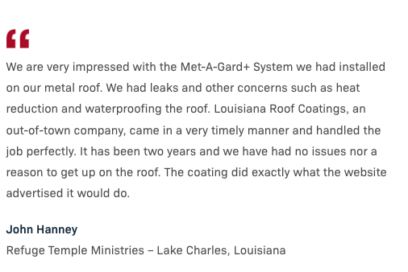
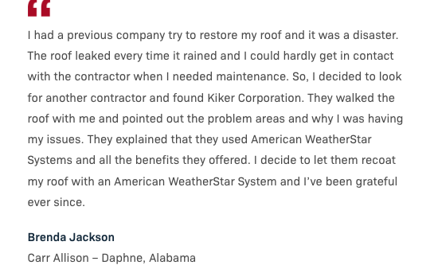
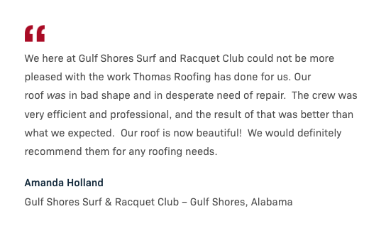
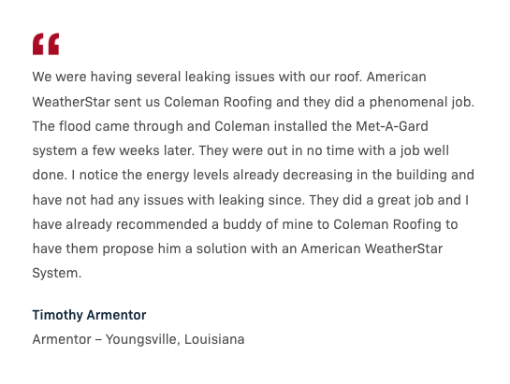
Sales &
Marketing
Tools
Testimonials
Testimonials

Slide 15
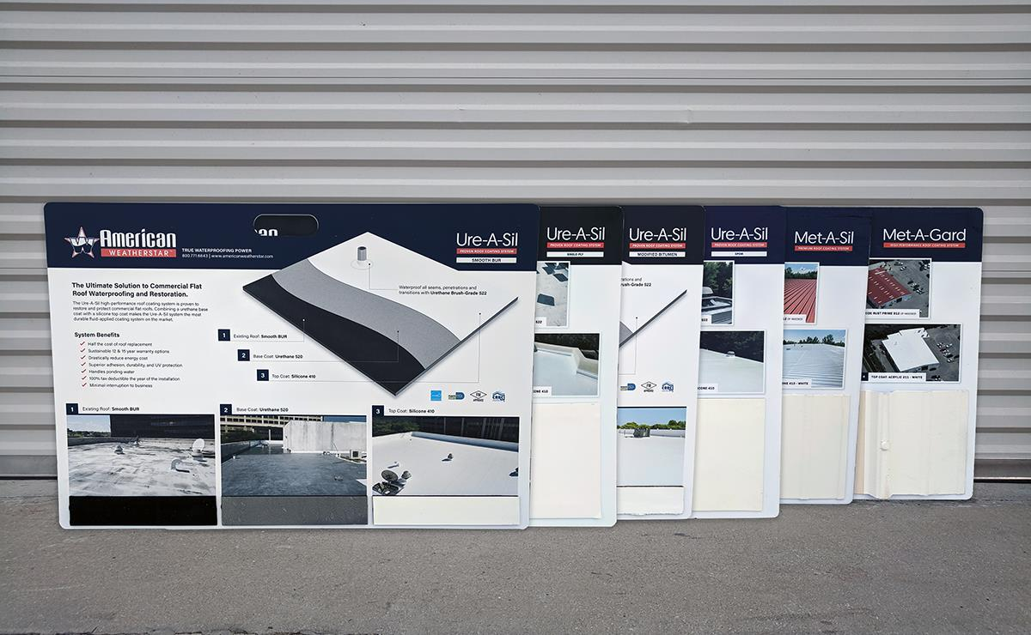
Sales &
Marketing
Tools
System Boards
System Boards

Slide 16
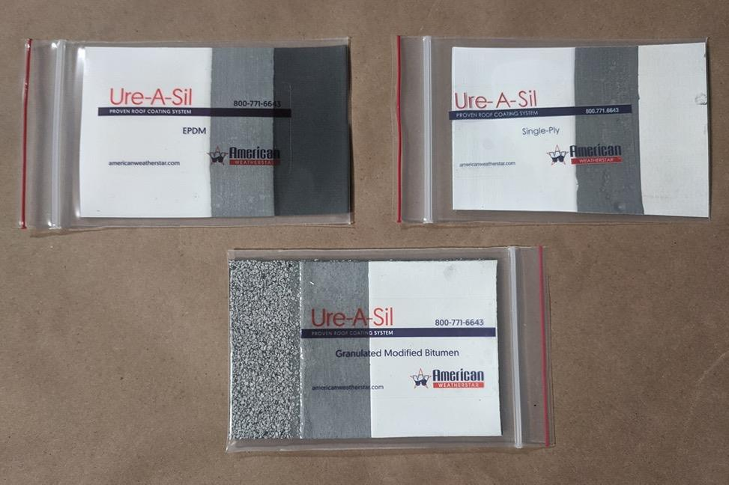
Sales &
Marketing
Tools
Dry Samples

Slide 17
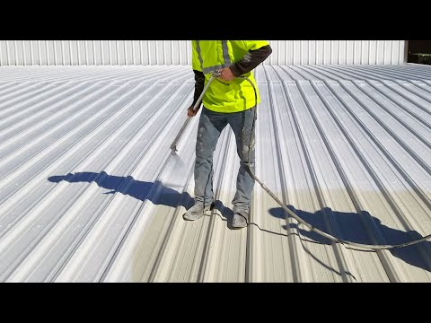
Sales &
Marketing
Tools
Informational Videos

Slide 18
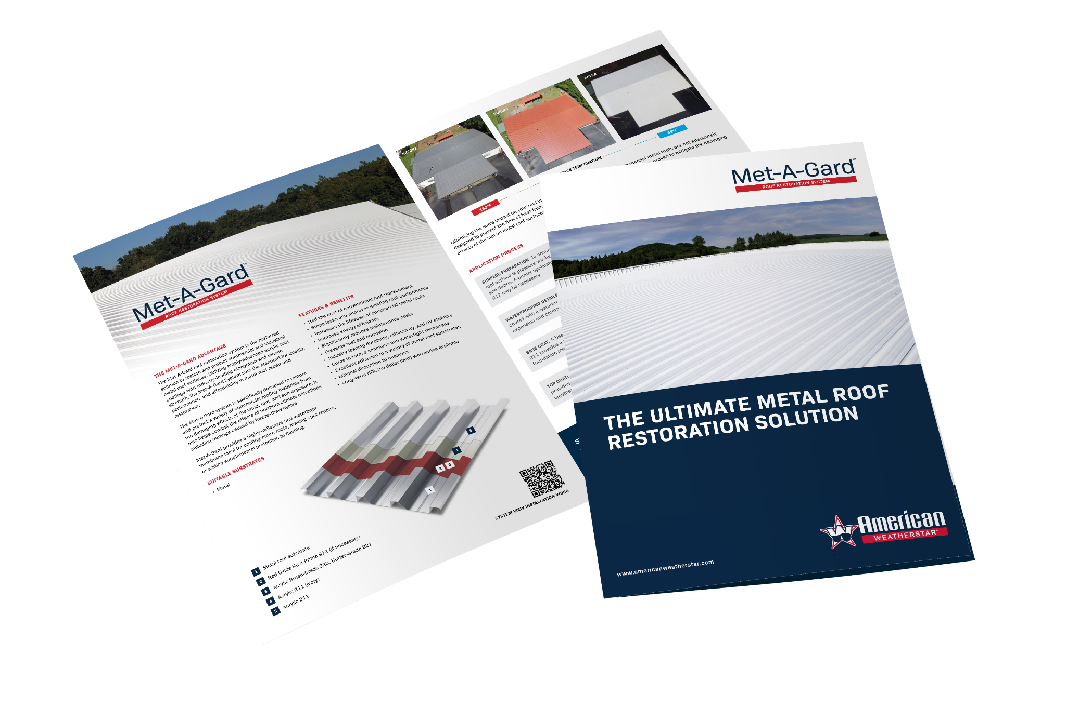
Sales &
Marketing
Tools
System Brochures
System Brochures

Slide 19
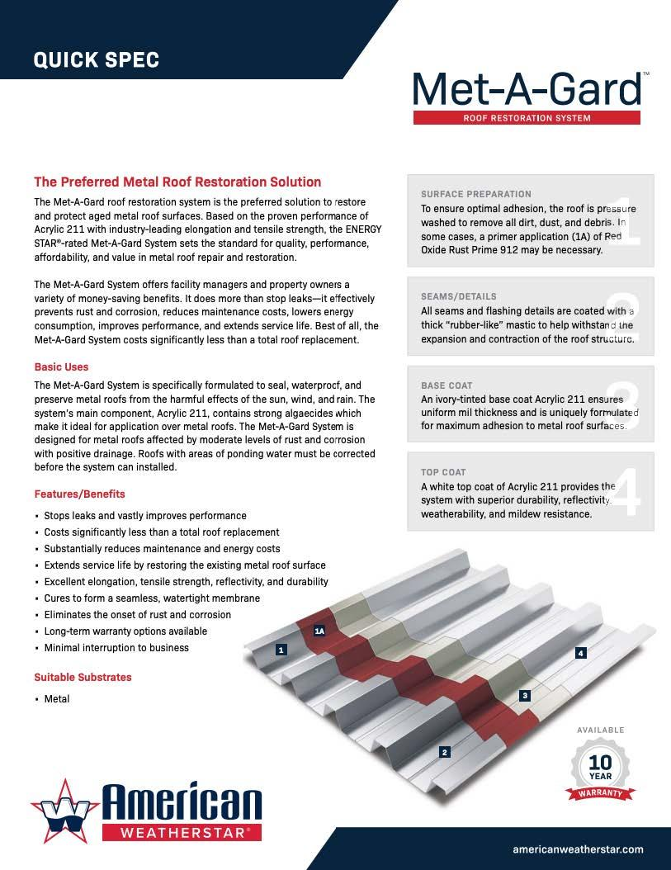
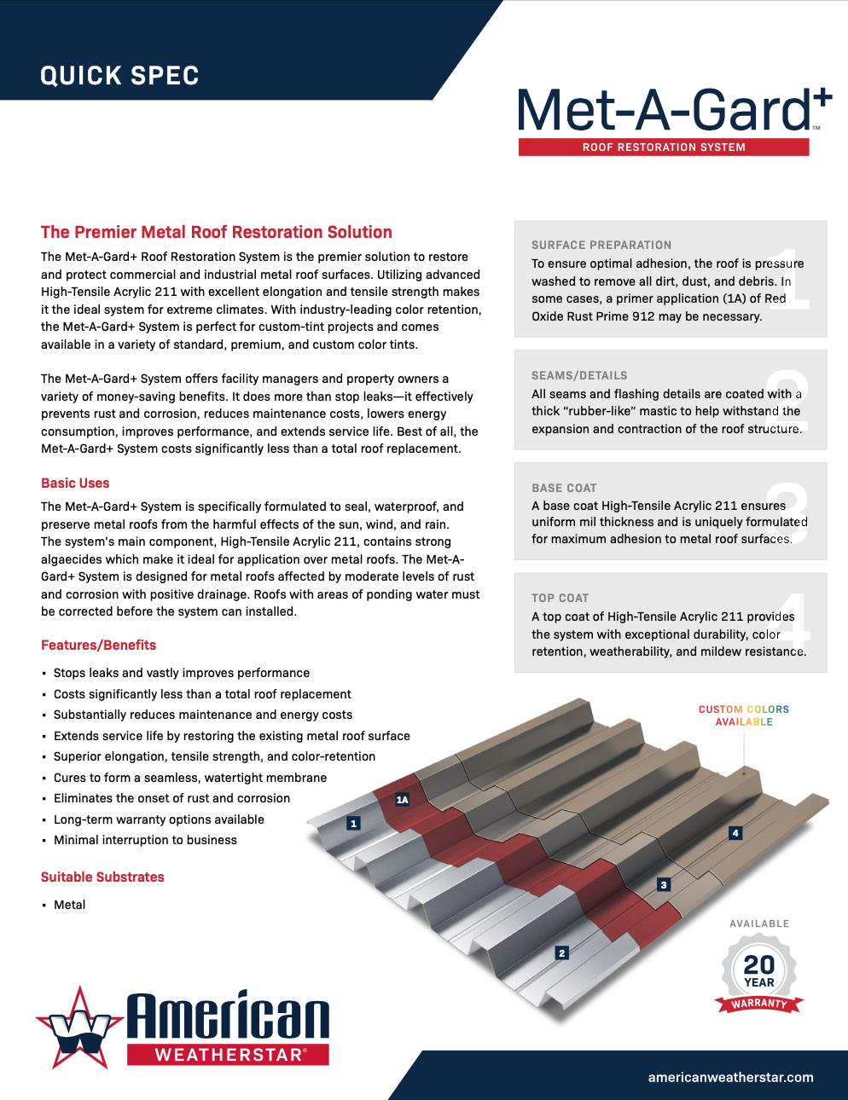
Sales &
Marketing
Tools
Quick Specs
Quick Specs

Slide 20
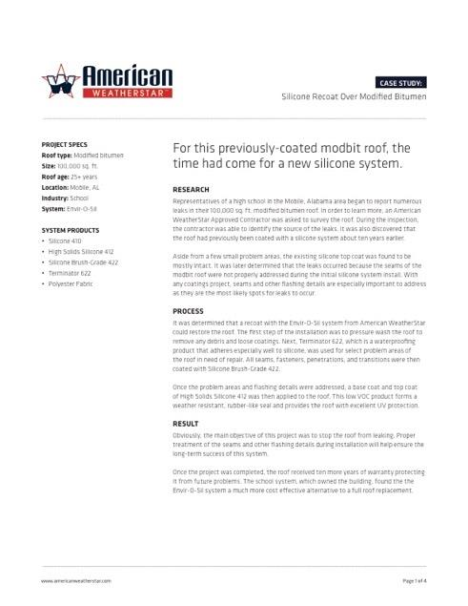
Sales &
Marketing
Tools
Case Studies
Case Studies

Slide 21
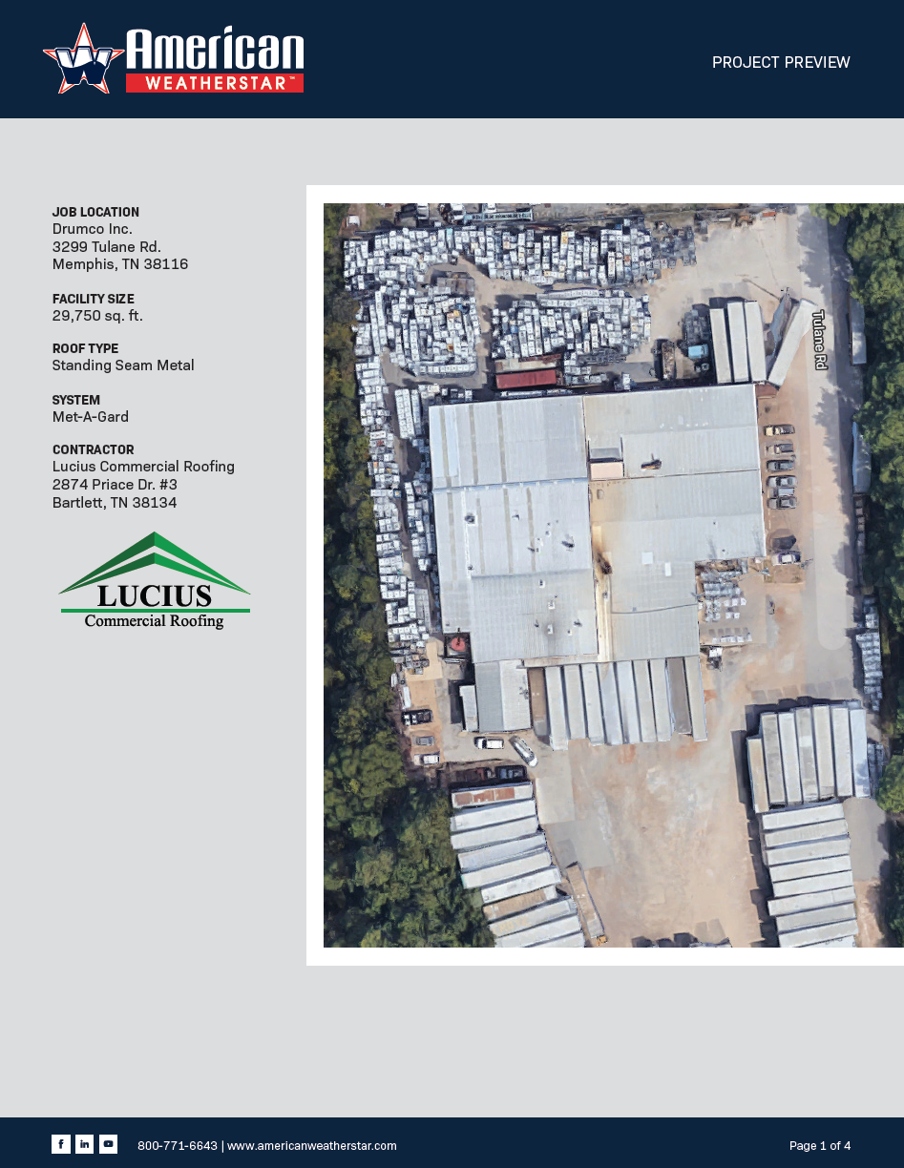
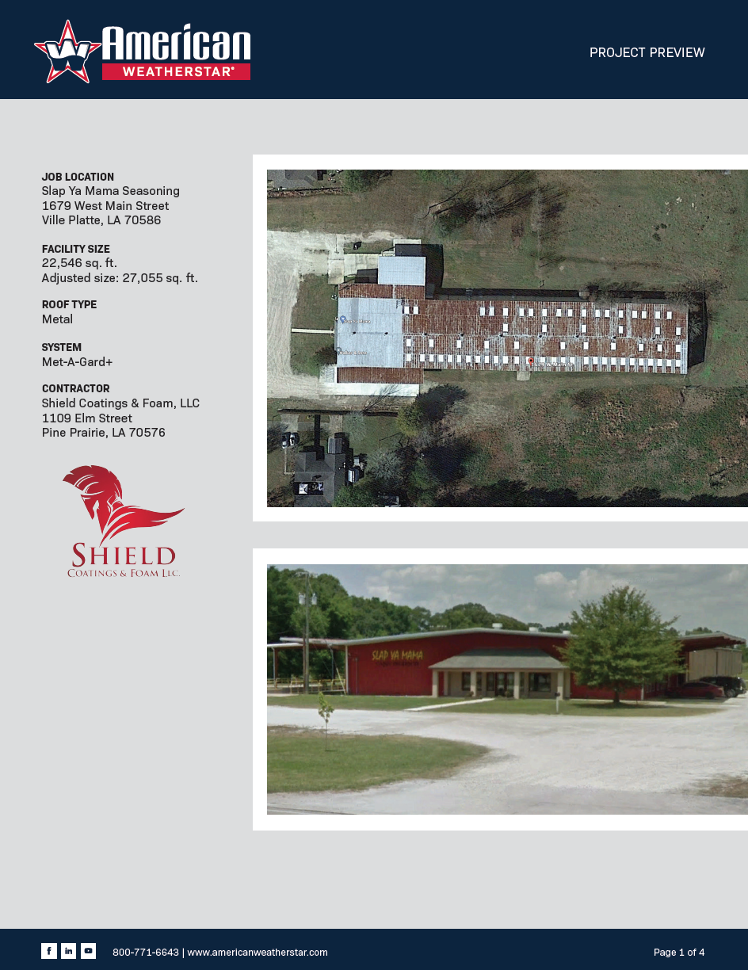
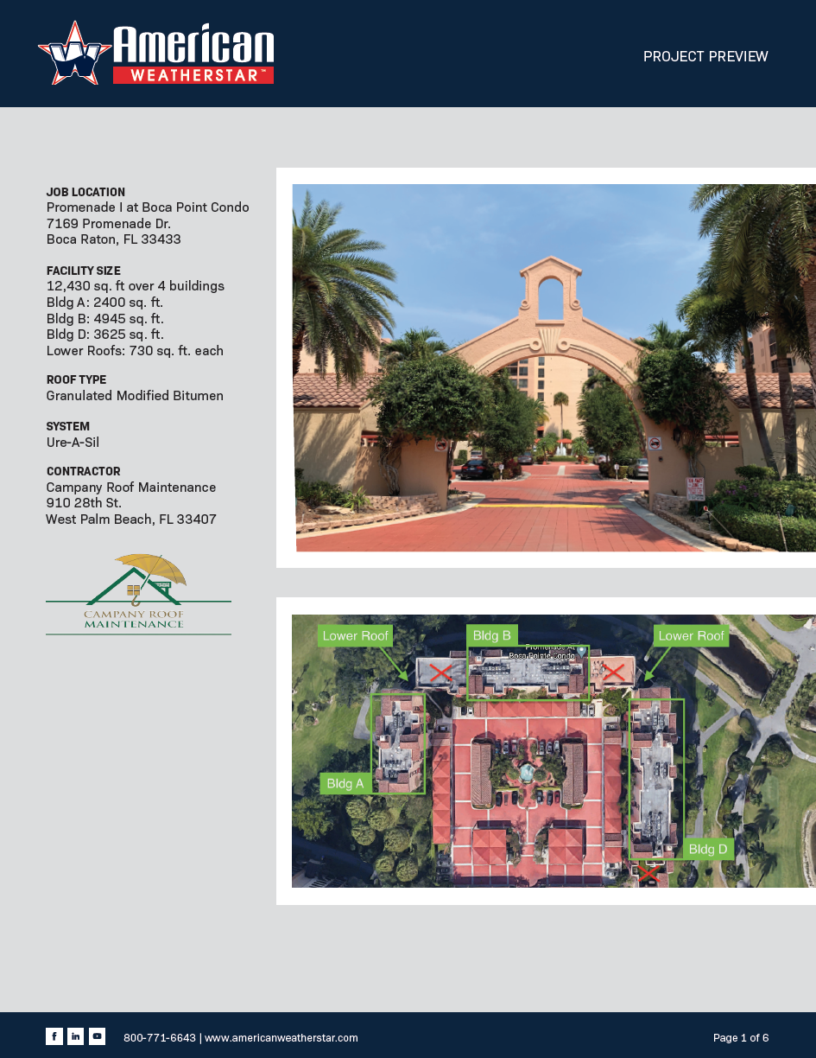
Sales &
Marketing
Tools
Project Previews
Project Previews

Slide 22
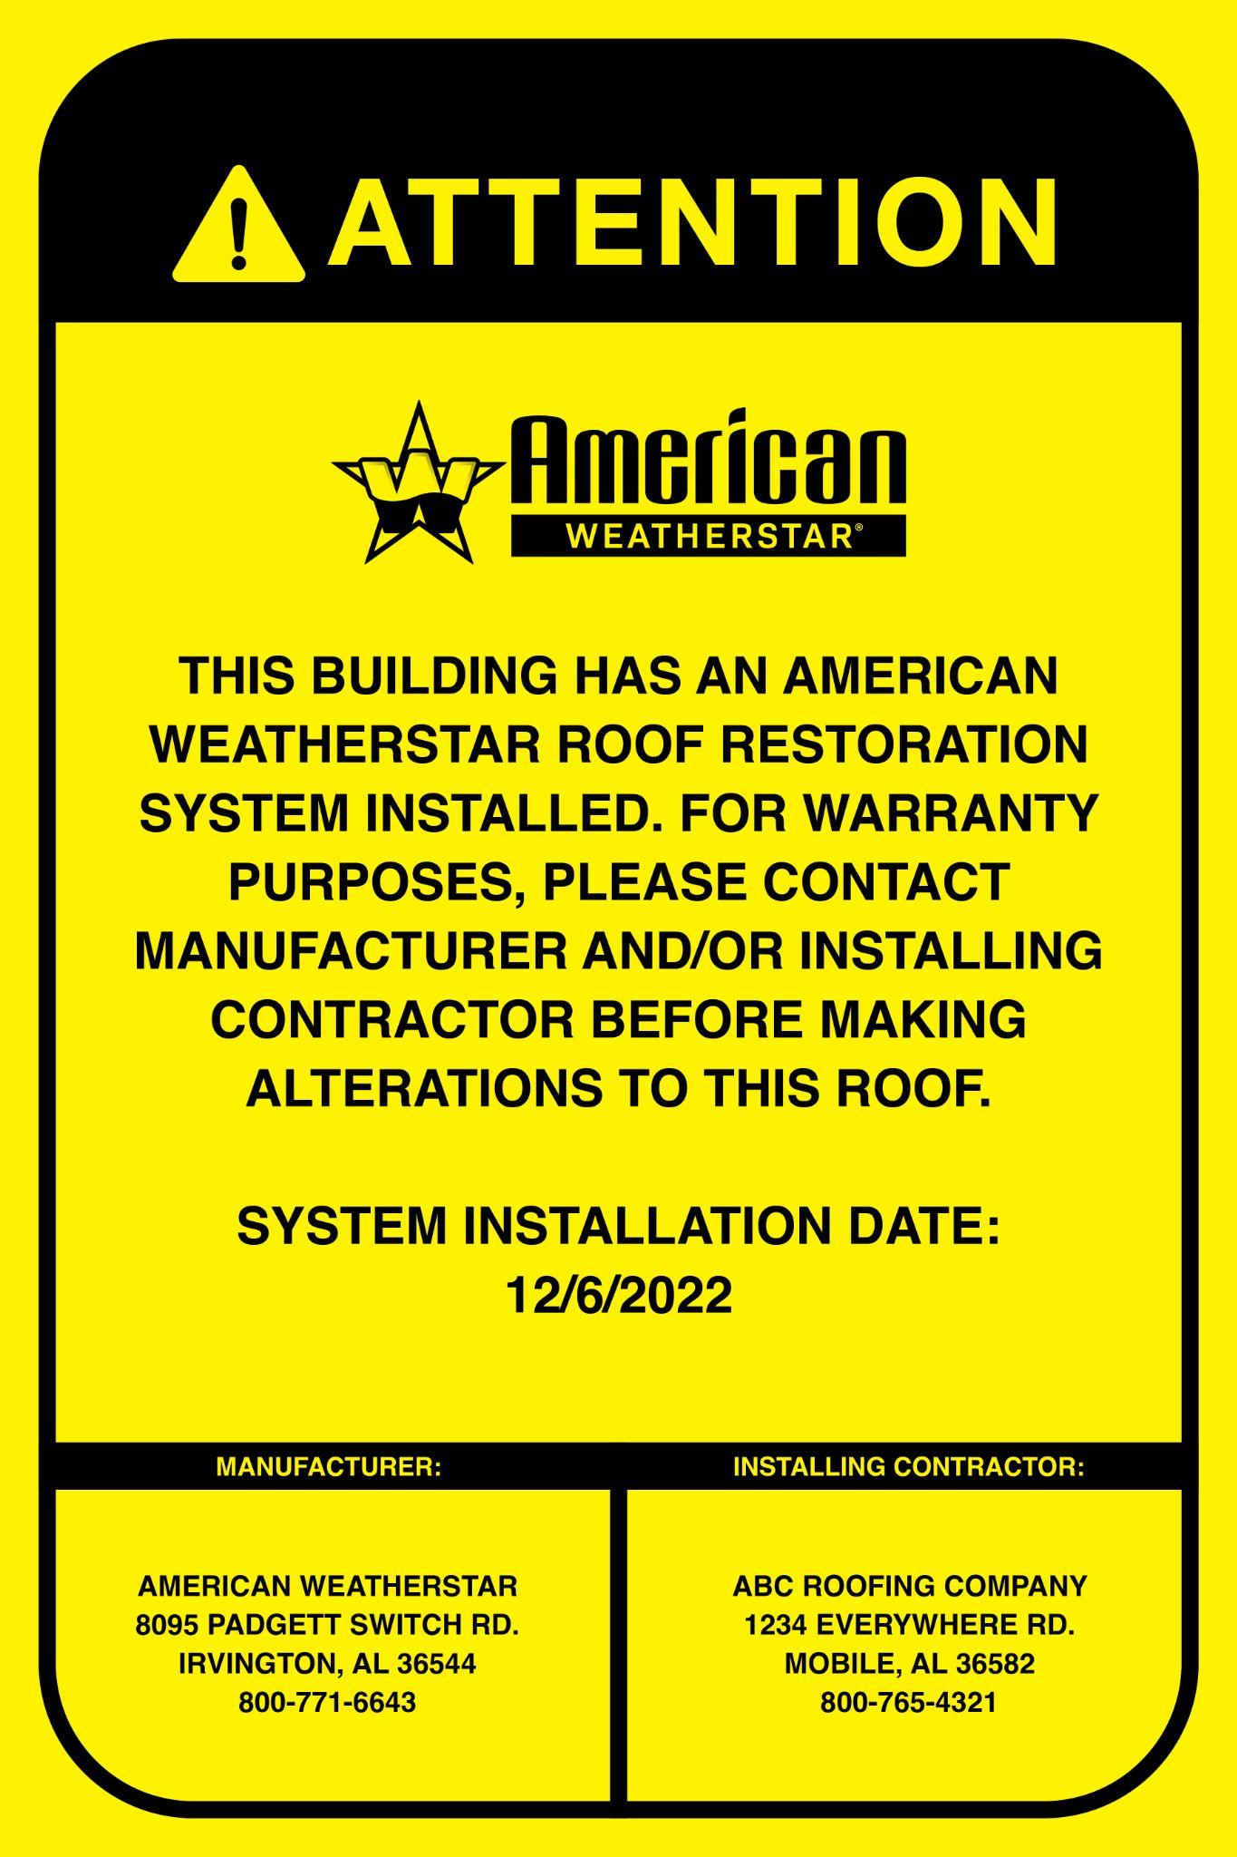
Sales &
Marketing
Tools
Rooftop Contact Sign
Quick Specs

Slide 23
Warranty Programs

Slide 24
Warranty Program
Length Options & Benefits
Material Warranty
5,10, 12, 15 & 20 years
NDL System Warranty
Standard: 5, 10, 12, 15 & 20 years
NDL System Elite Warranty
Standard: 20 years
Renewable
Transferrable
Extendable

Slide 25
Warranty Program
Requirements
REQUIREMENTS | MATERIAL ONLY | NDL SYSTEM | NDL SYSTEM ELITE
MUST BE AN APPROVED, PLATINUM, OR PLATINUM ELITE CONTRACTOR
COMPLETED APPLICATION
ROOF GRAPH & JOB PHOTOS
THIRD-PARTY INSPECTION
WARRANTY FEE
ANNUAL INSPECTION
✓
✓
✓
✓
✓
✓
✓
✓
✓
✓
✓
✓
✓
✓
✓

Slide 26
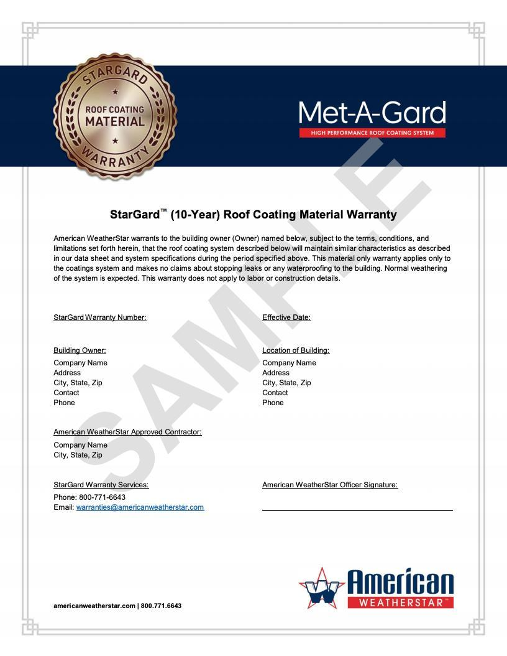

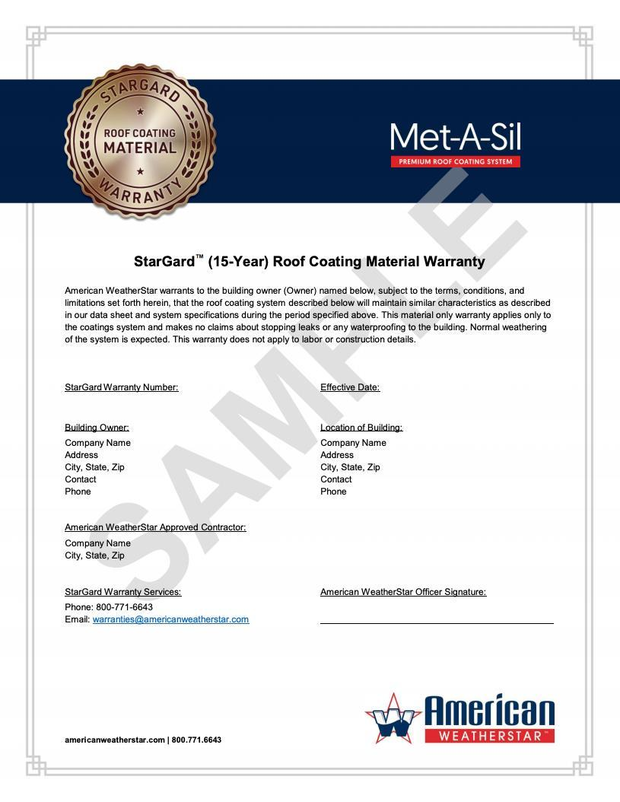
Warranty
Programs
Warranty Samples
Warranty Program

Slide 27
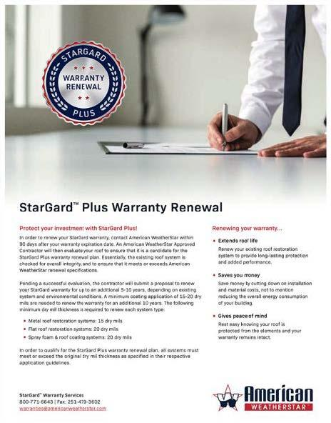
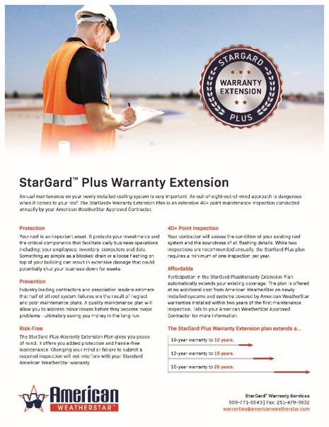
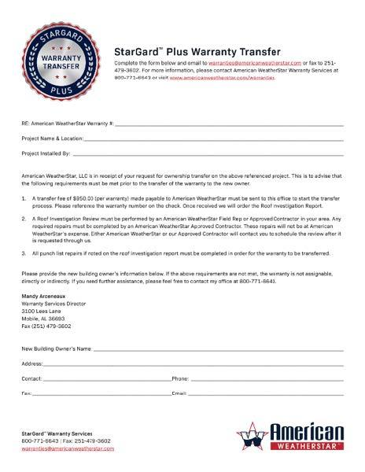
Warranty
Enhancement
Options
Stargard+

Slide 28

For more information, visit our website: www.americanweatherstar.com

