Slide 1


LUNCH & LEARN
Technical Services & Documents

Slide 2

Technical Services

Slide 3
Presentation Outline
Field Reps
3rd Party Consultants
Hail Expertise: Casualty Consulting Services
Inside Technical Services: Eric Long
  Application Guidelines
  Coverage Rates
  Details
  Samples
Tech App
Tech Talk Video Services
Roof Coatings 101

Slide 4
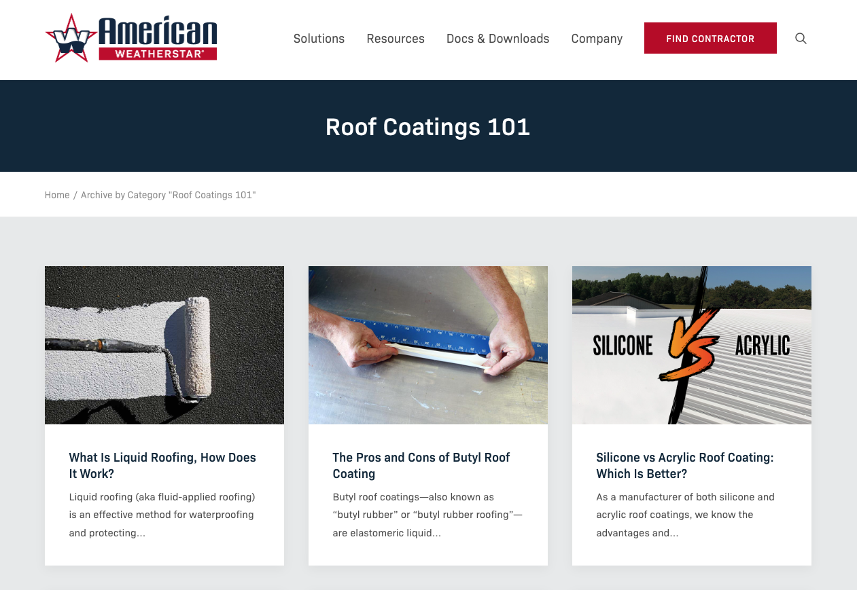
Roof Coatings 101
Roof Coatings 101

Slide 5
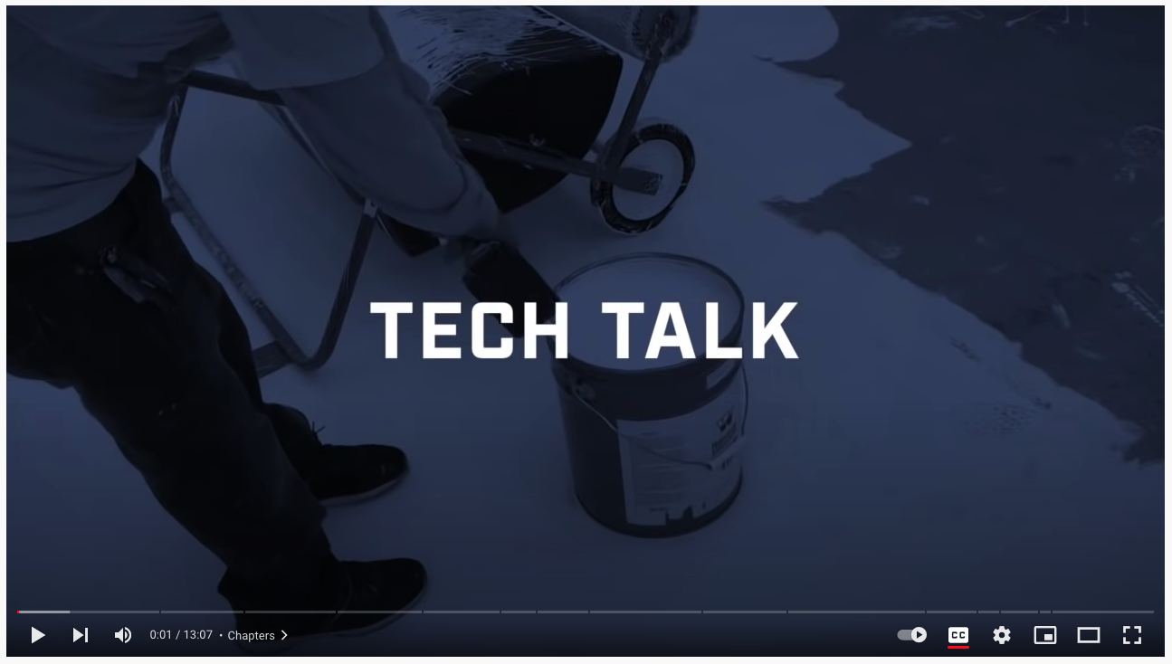
Tech Talk
Tech Talk

Slide 6
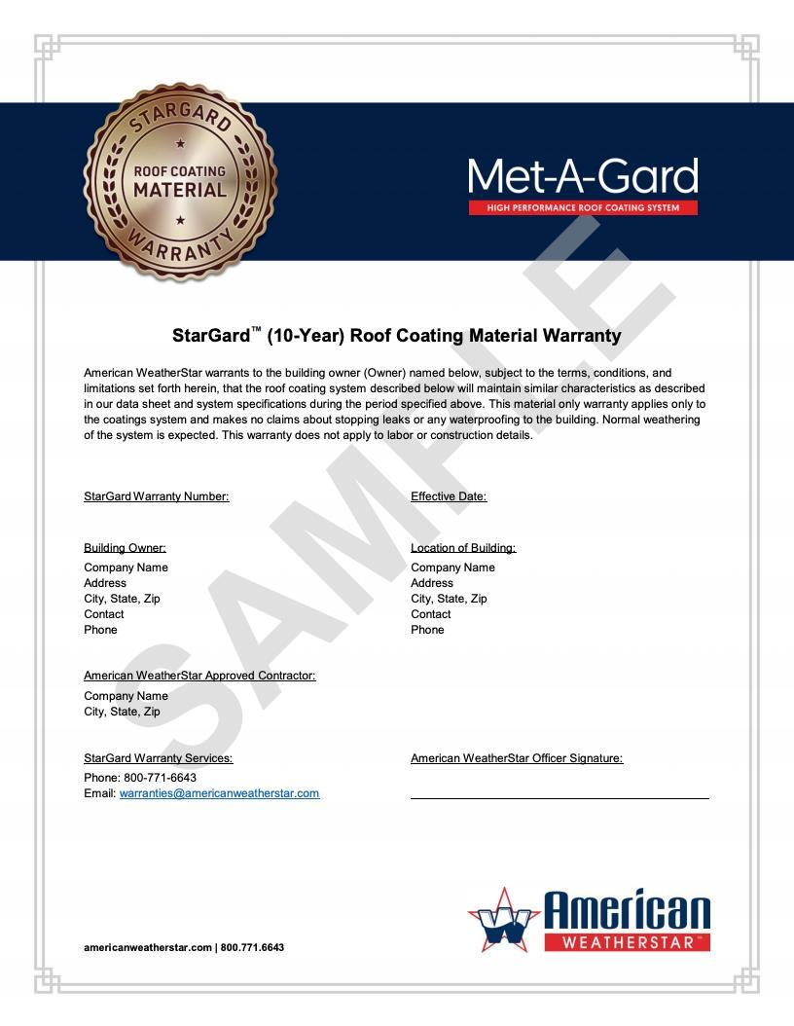
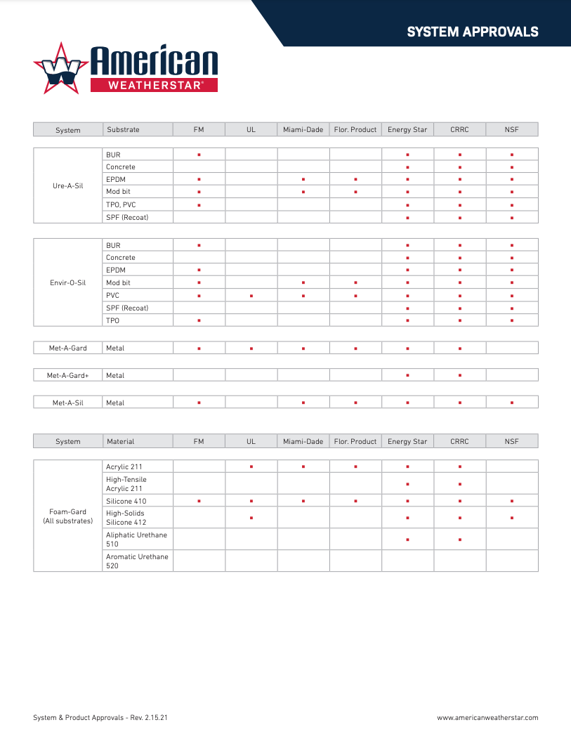
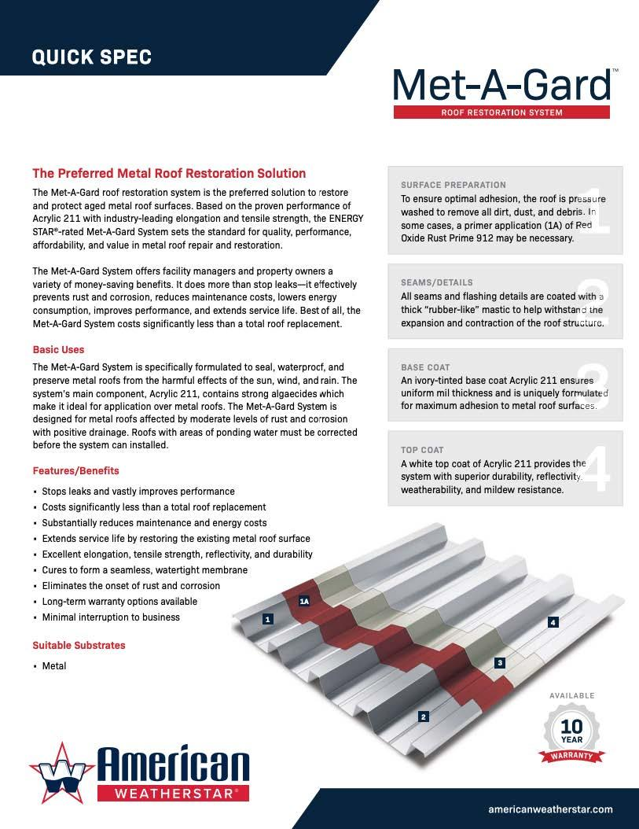
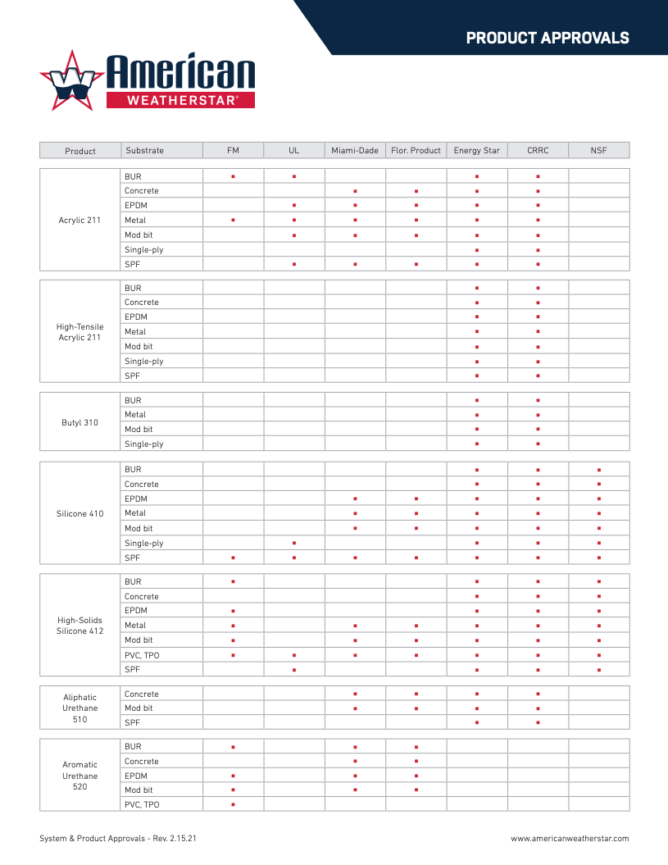
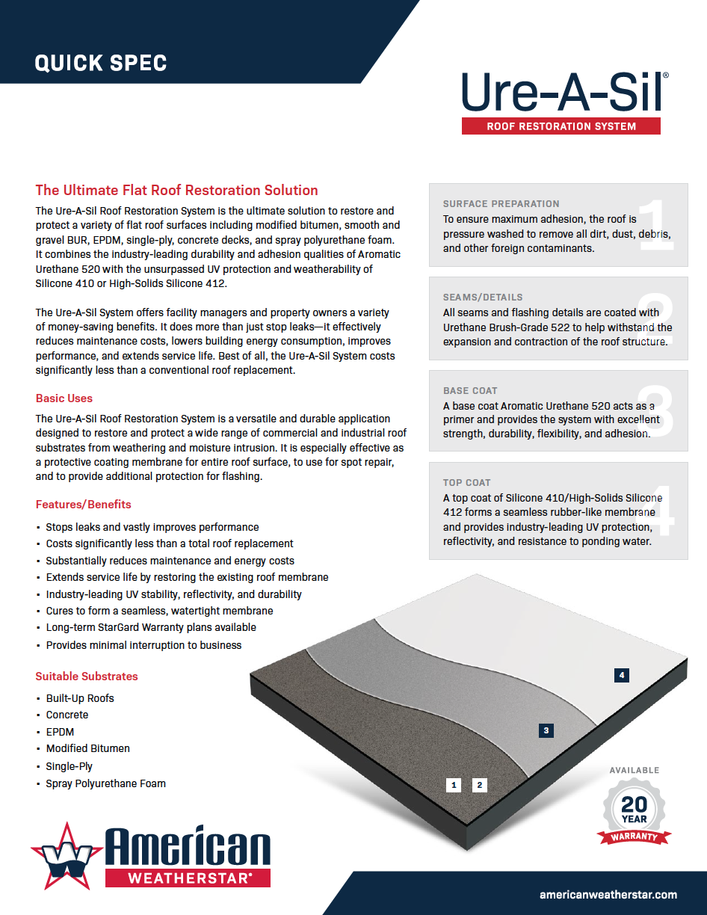

Documents & Catalog

Slide 7
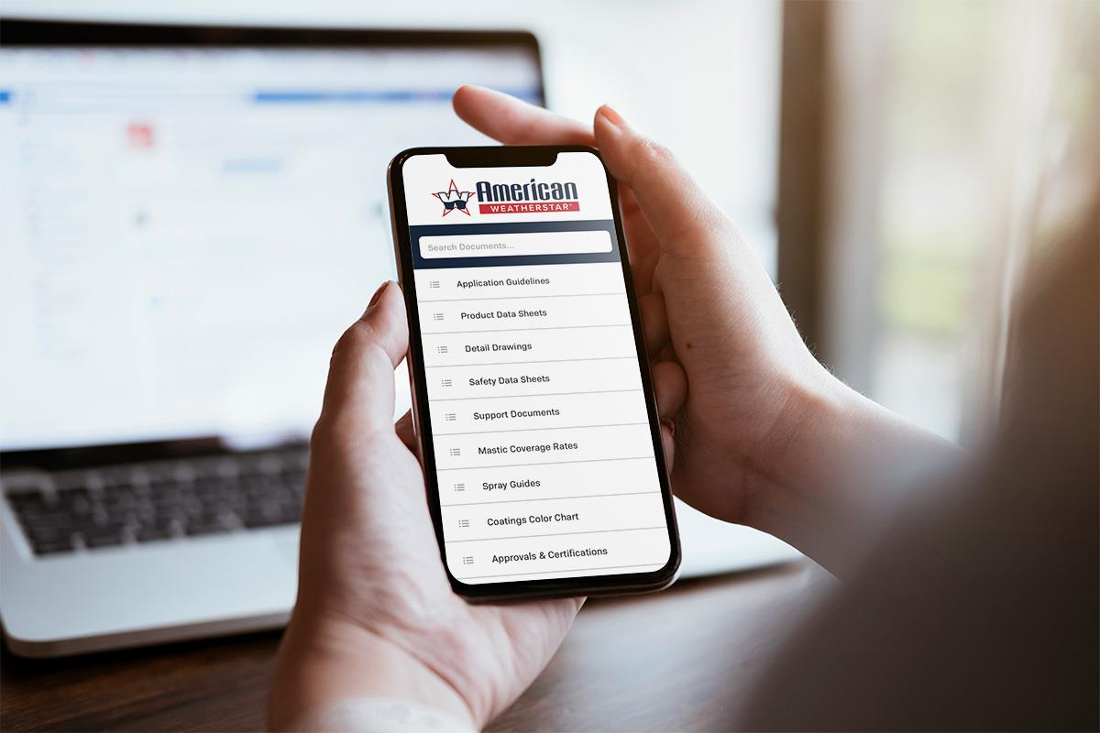
App

Slide 8
Technical Documents

Slide 9
Technical Documents
Product Data Sheets
Safety Data Sheets
Roof Surface Cross Reference
Application Guidelines
Metal Roof Stretch Factor Guide
Mastic Coverage Rates
Details
Spray Guides
Approvals

Slide 10
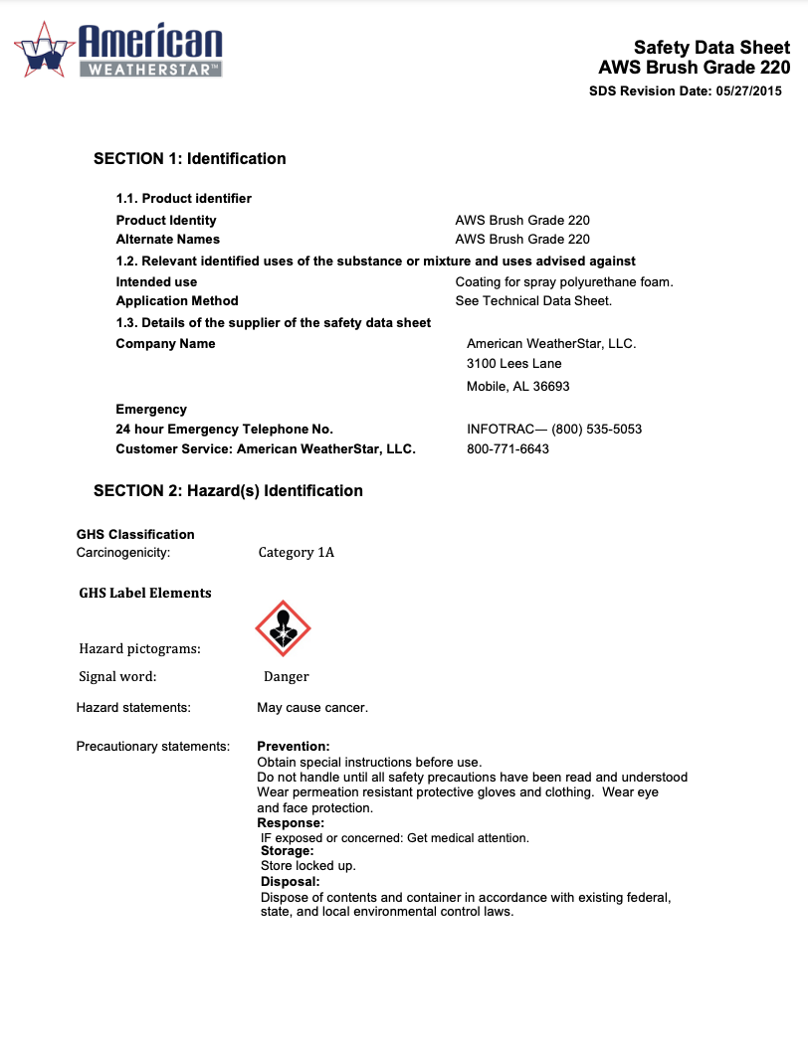
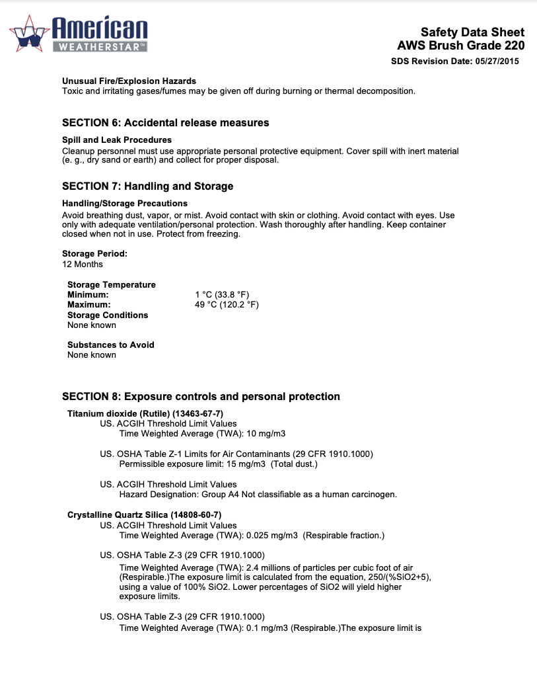
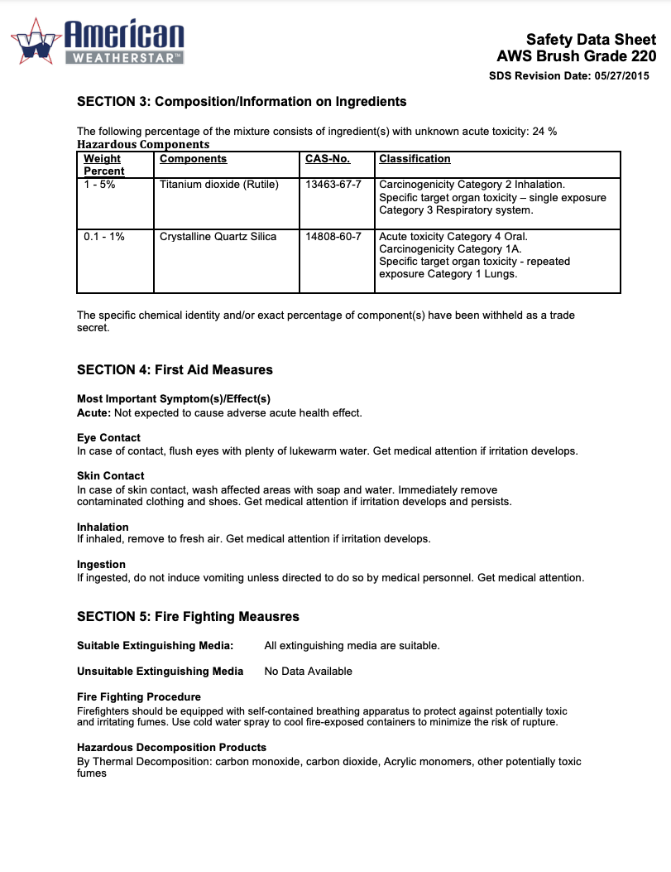
Technical
Documents
Safety Data Sheets
SDS

Slide 11
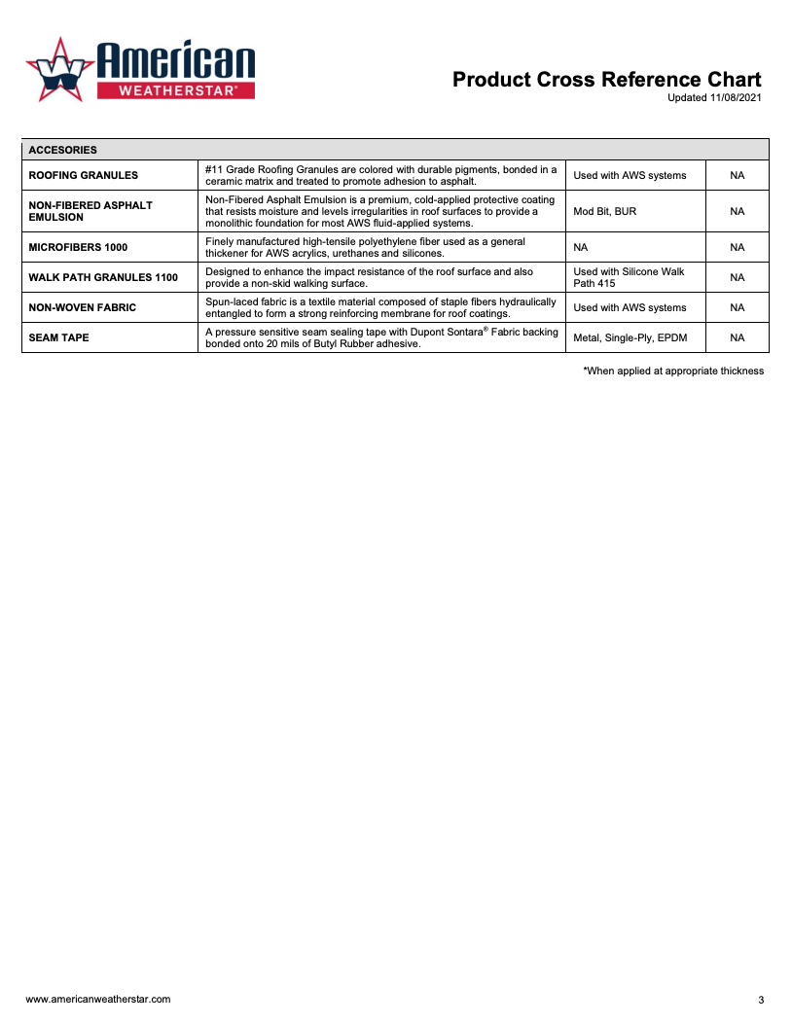
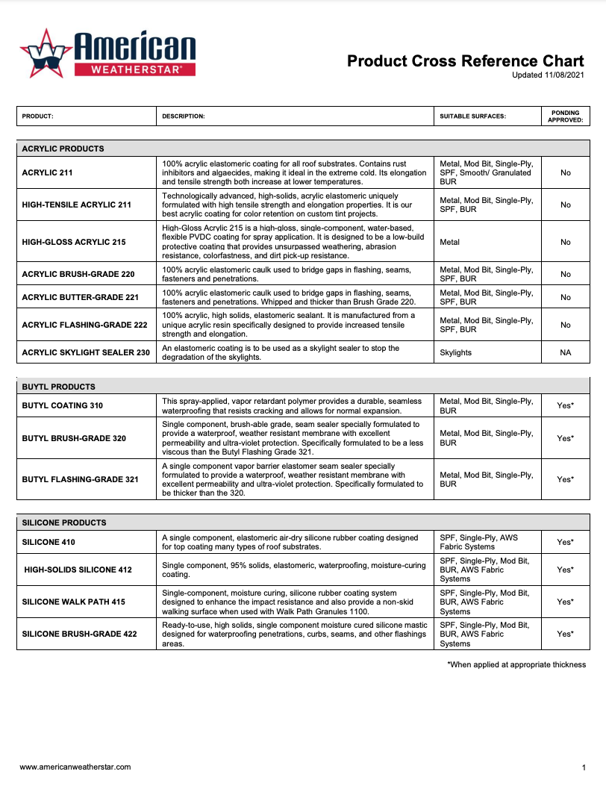
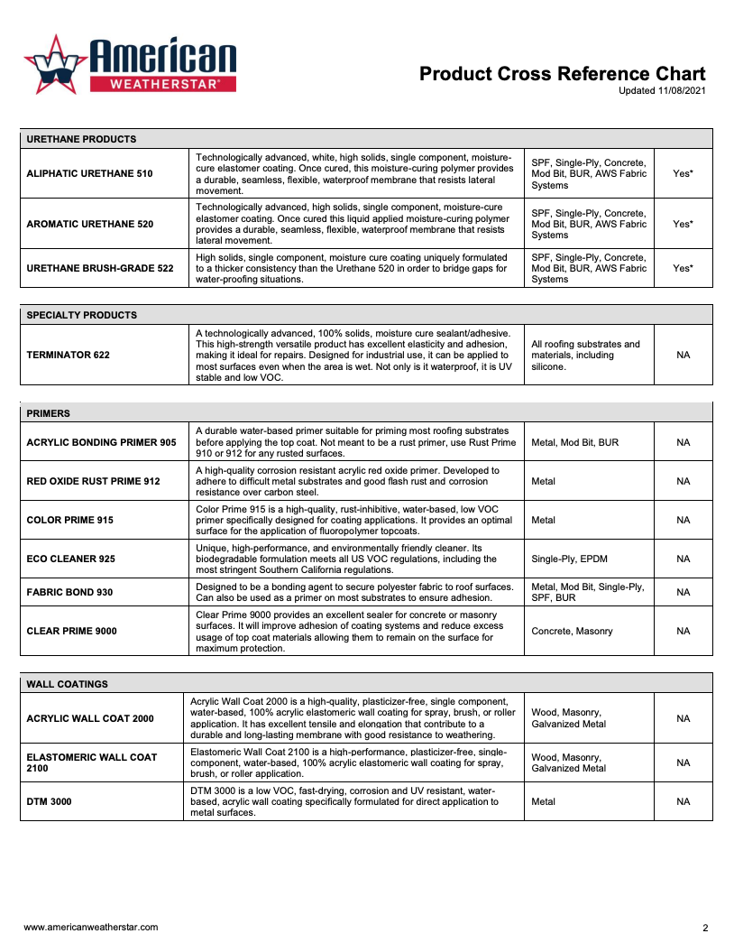
Technical
Documents
Cross Reference Sheets
Cross Reference Sheets

Slide 12
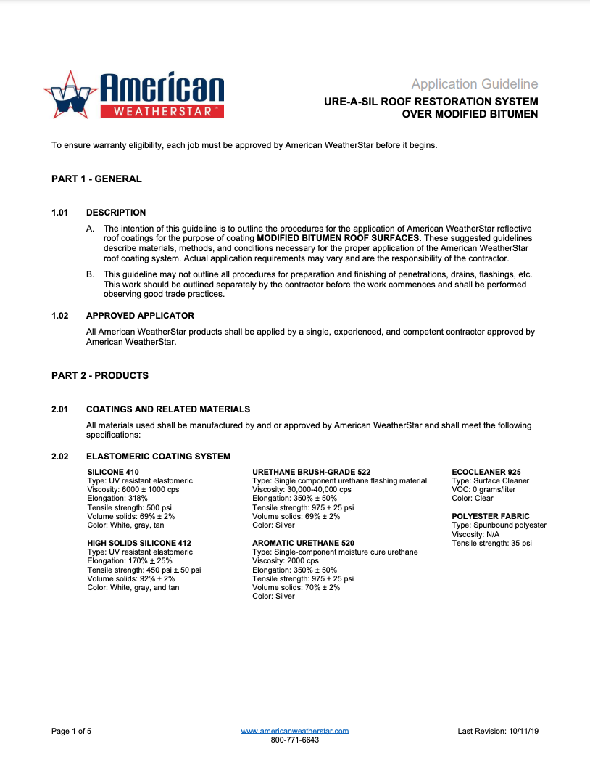
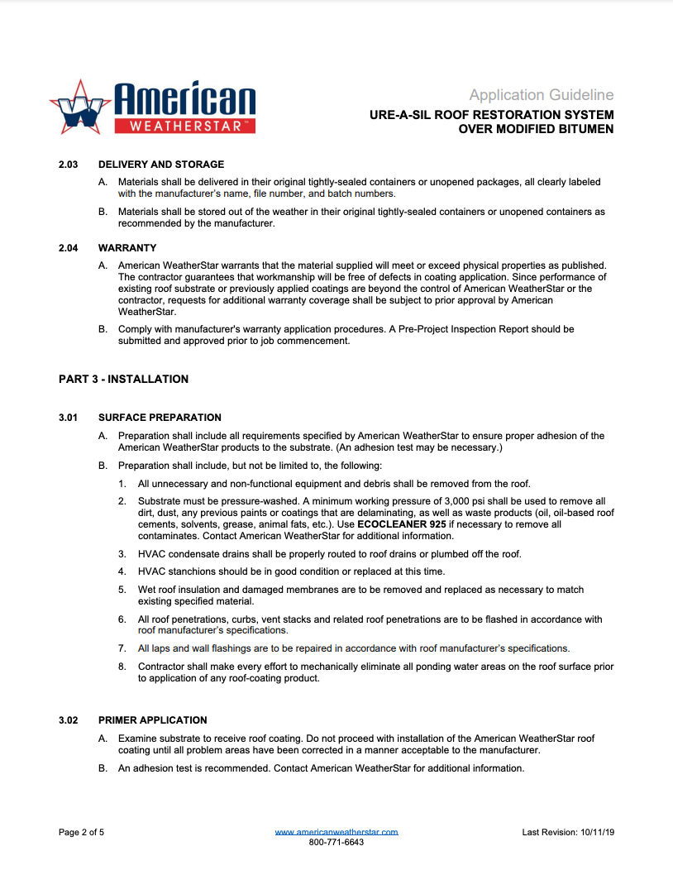
Technical
Documents
Application Guidelines
Application Guidelines

Slide 13
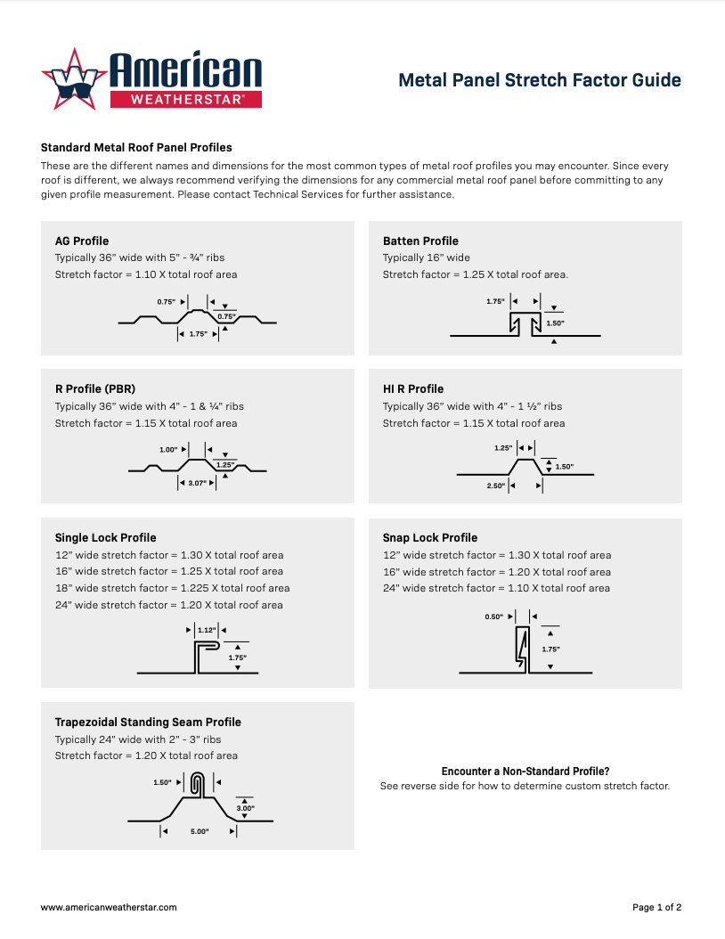
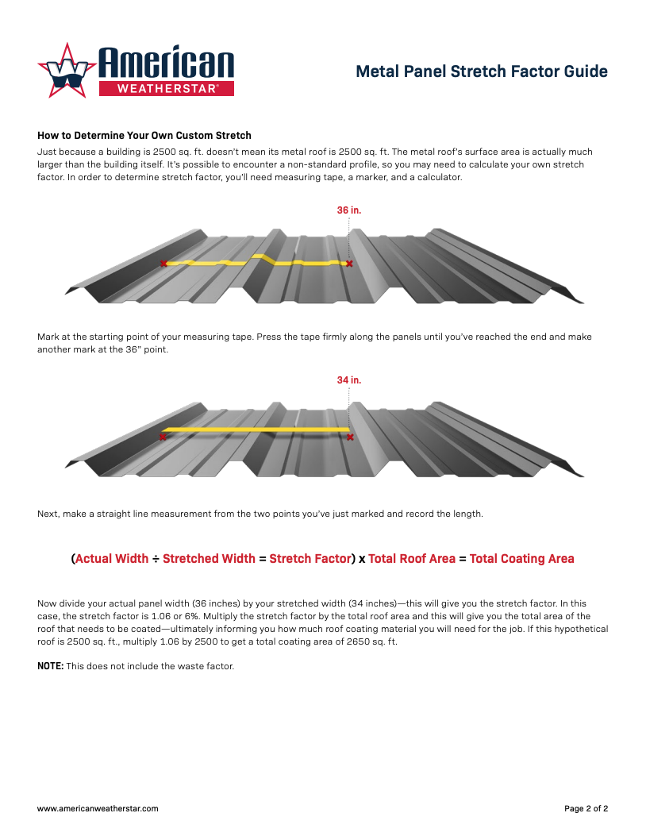
Technical
Documents
Metal Roof Estimating Guide
Metal Roof Estimating Guide

Slide 14
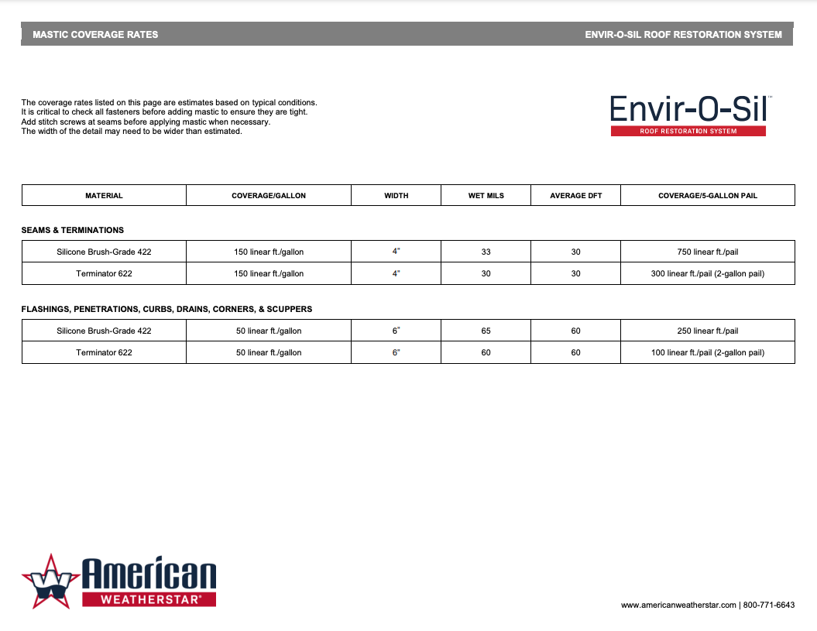
Technical
Documents
Mastic Coverage Rates
Mastic Coverage Rates

Slide 15
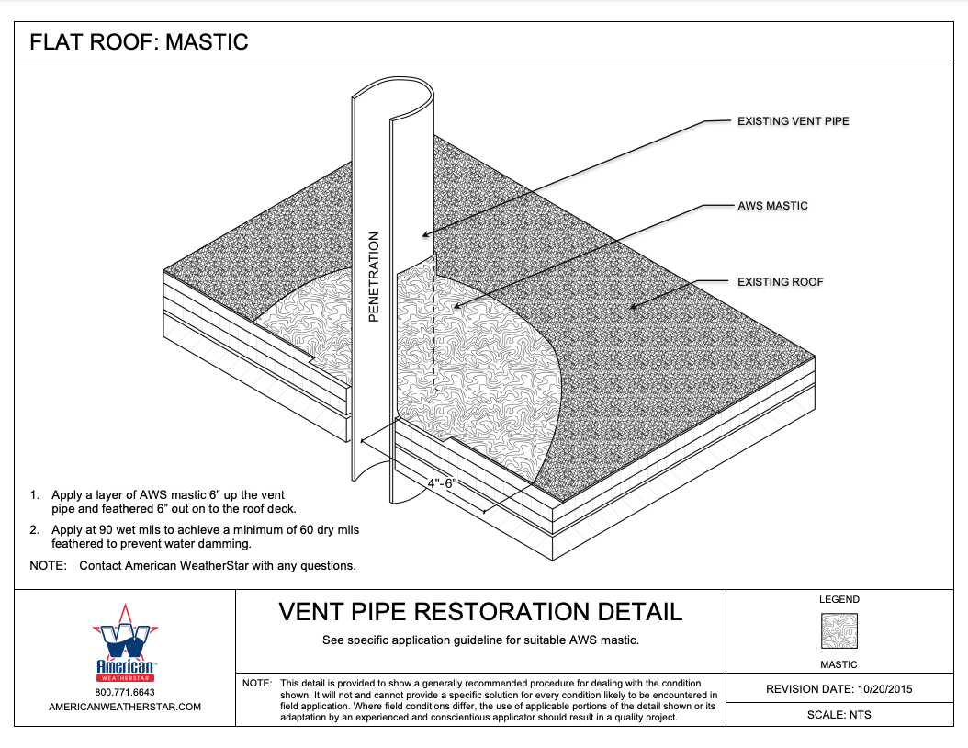
Technical
Documents
Detail Drawings
Detail Drawings

Slide 16
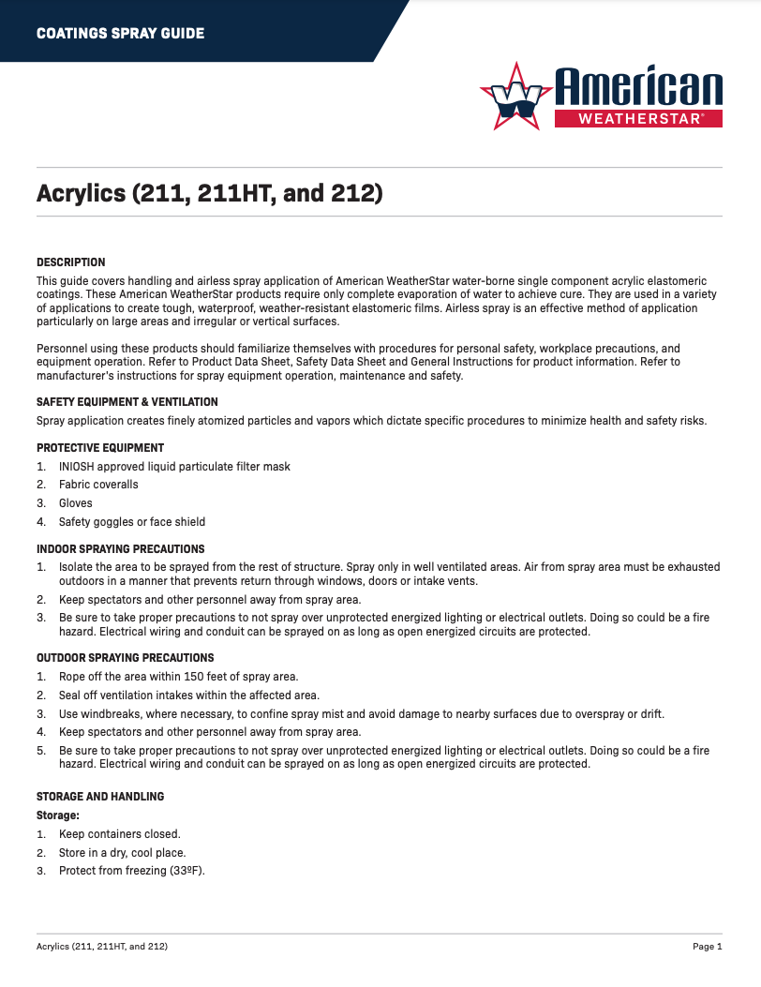
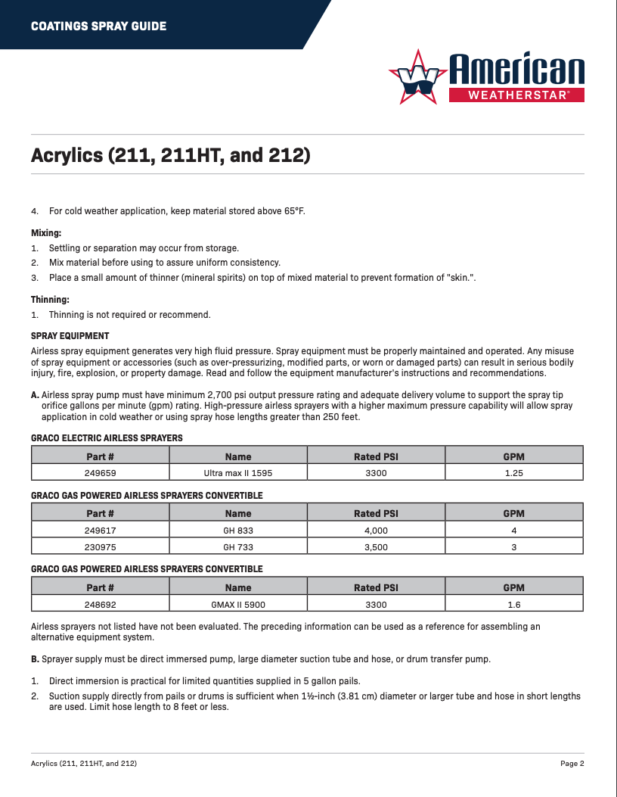
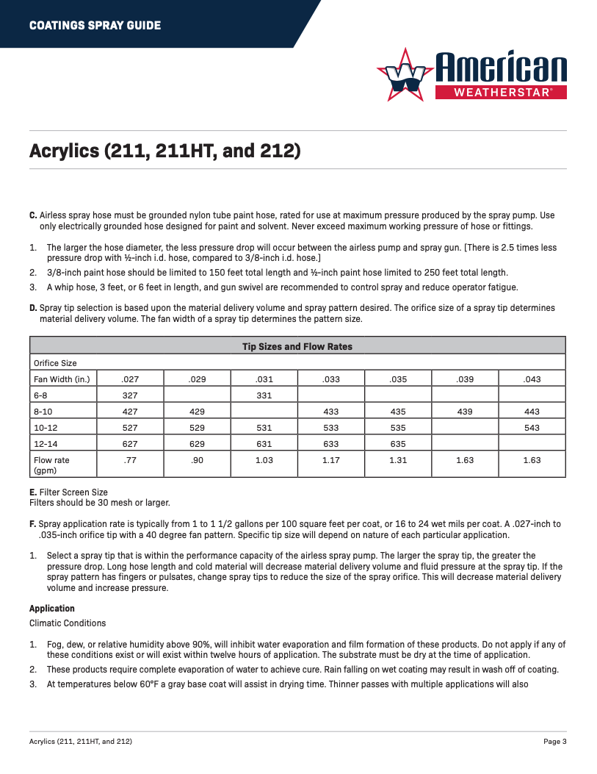
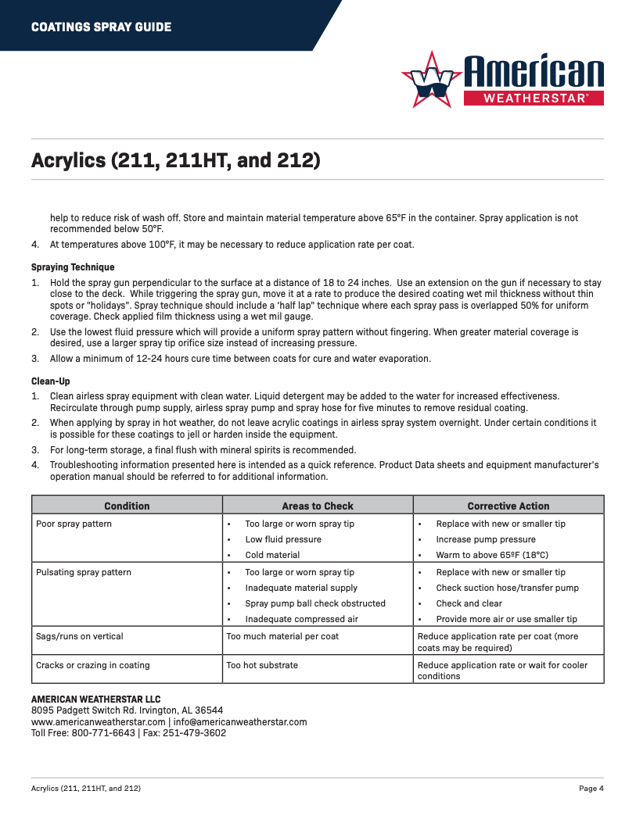
Technical
Documents
Coatings Spray Guide
Coating Spray Guides

Slide 17

Technical Documents
Approvals

Slide 18

For more information, visit our website: www.americanweatherstar.com

