Slide 1
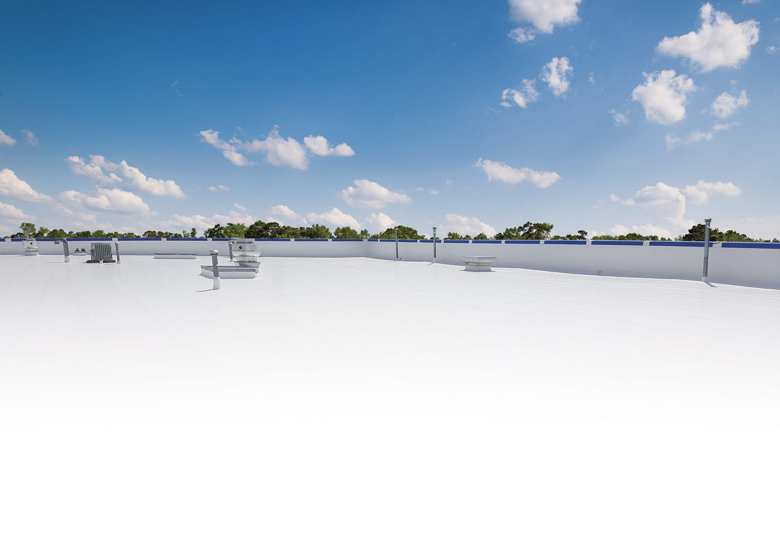

LUNCH & LEARN
Warranty Program

Slide 2

Presentation Outline
Program Overview
Material Warranty
NDL System Warranty
NDL System Elite Warranty
Requirements
StarGard Enhancements Overview
Extensions
Renewal plan
Transferability

Slide 3
Program Overview

Slide 4
Warranty Program
Length Options & Benefits
Material Warranty
5,10, 12, 15 & 20 years
NDL System Warranty
Standard: 5, 10, 12, 15 & 20 years
NDL System Elite Warranty
Standard: 20 years
Renewable
Transferrable
Extendable

Slide 5
Material Warranty

Slide 6
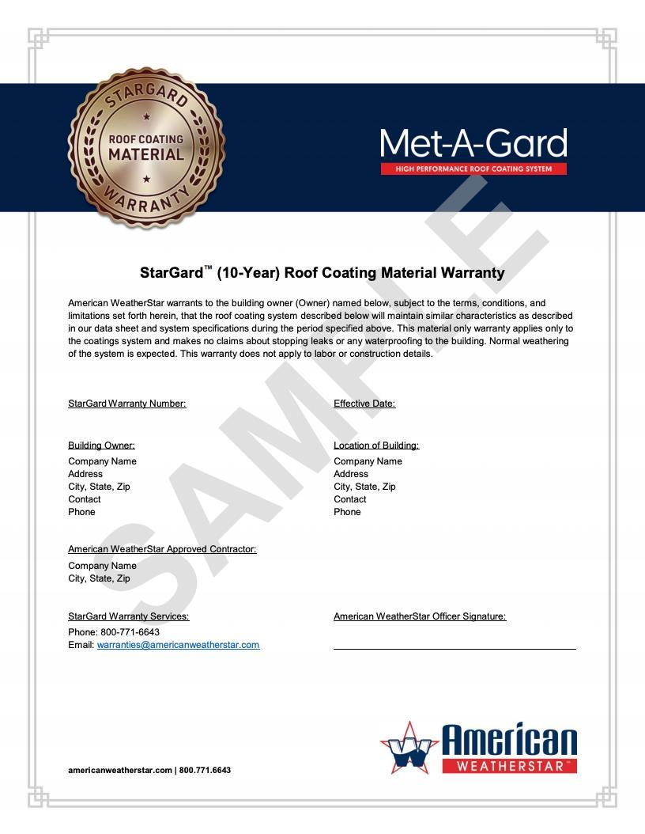
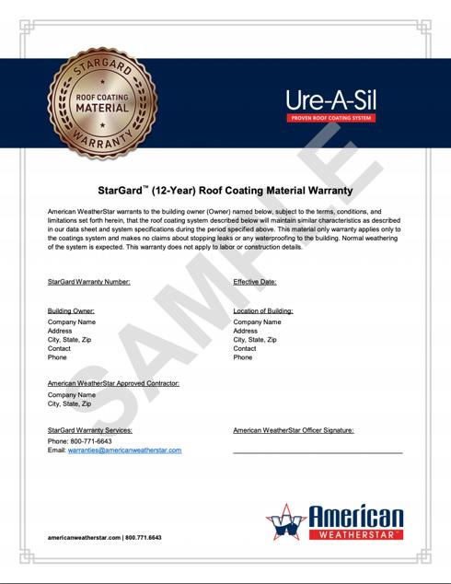
Material
Warranty
Warranty Program

Slide 7
NDL System Warranty

Slide 8
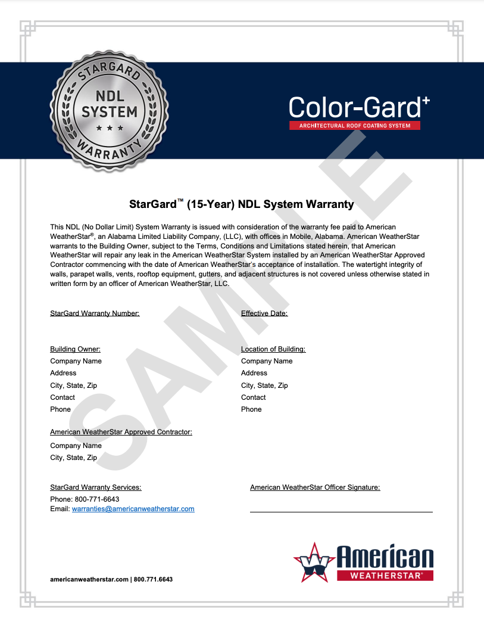
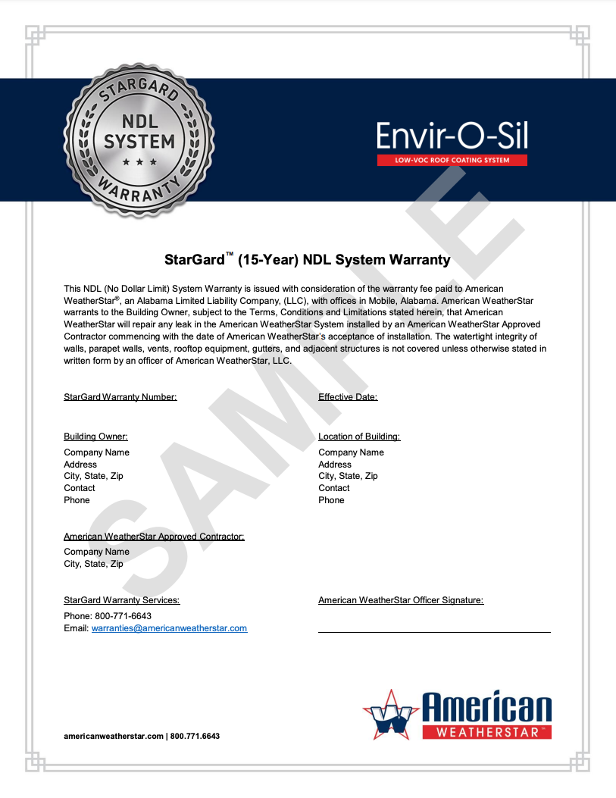
NDL
System
Warranty
NDL System Warranty

Slide 9
NDL System Elite Warranty

Slide 10
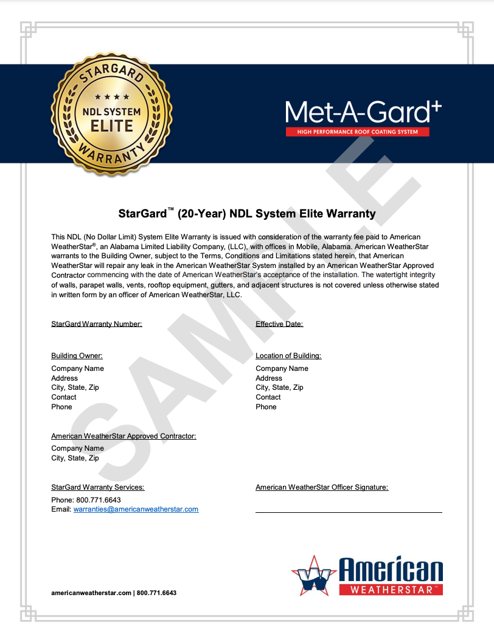
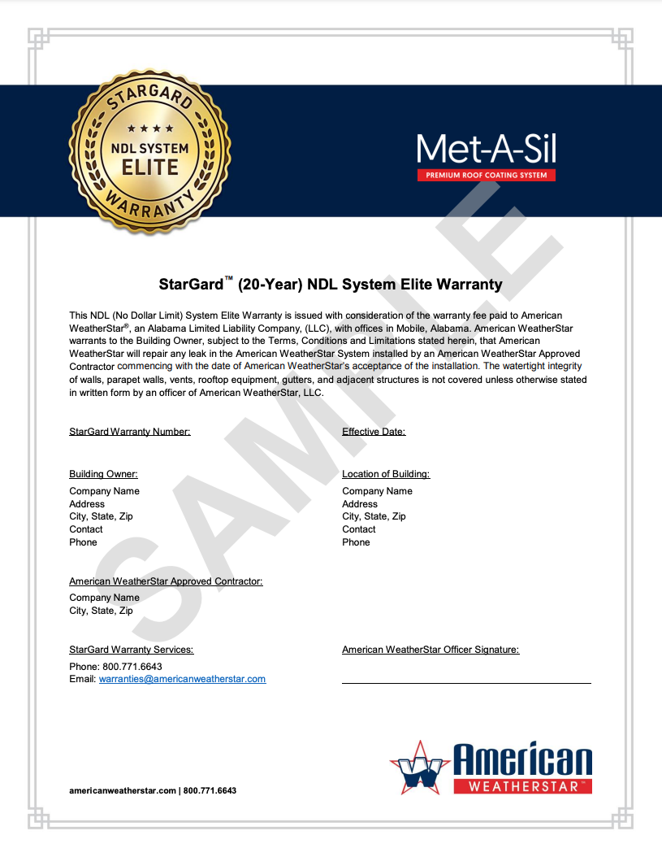
NDL System
Elite Warranty
NDL System Elite Warranty

Slide 11
Requirements

Slide 12
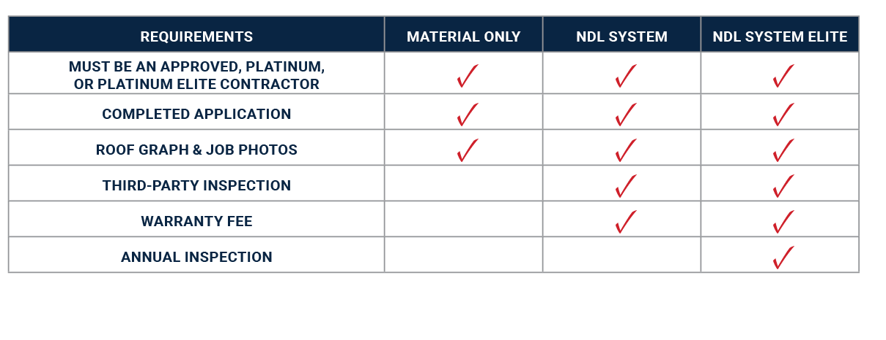
Warranty Program - Requirements

Slide 13
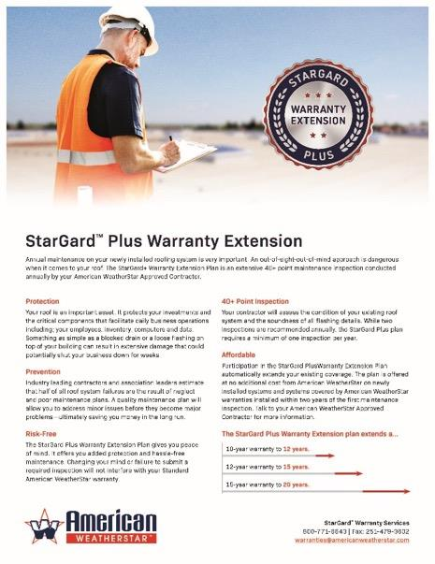
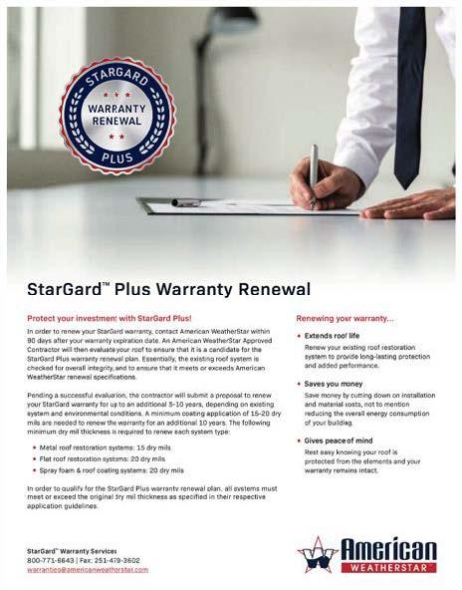
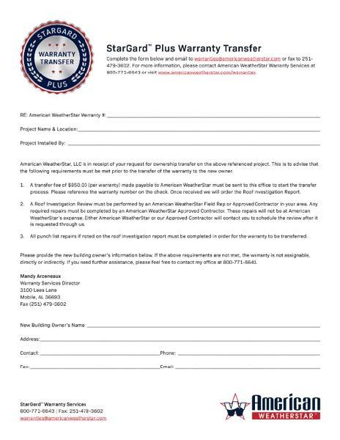
Warranty
Enhancement
Options
Stargard+

Slide 14
Stargard+
Warranty
Extension
Warranty Extension

Slide 15
Stargard+
Warranty
Renewal Plan
Warranty Renewal

Slide 16
Stargard+
Warranty
Transfer
Warranty Transfer

Slide 17

For more information, visit our website: www.americanweatherstar.com

